Slide 1
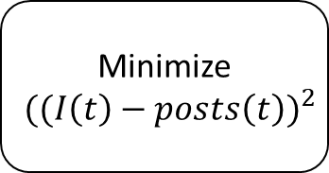
Search for relevant social media posts
Count the amount of social media posts over a given amount of time
Filter the data plot
Minimize
$${((I\left(t\right)−posts\left(t\right))}^{2}$$
Solve differential equations

Slide 2
E.OFF

Slide 3
Search for relevant social media posts
Estimate system parameters
Run simulation
Power demand exceeds threshold?
Yes/No

Slide 4







$${1−g}_{neighbors}−f_{neighbors}$$
Susceptible
$$g_{neighbors}$$
$$p_{forget}$$
$$f_{neighbors}$$
Recovered
Infected
$$p_{verify}$$
$$1−p_{forget}$$
$$1−p_{forget}−p_{verify}$$

Slide 5


$${1−g}_{neighbors}−f_{neighbors}$$
Susceptible
$$g_{neighbors}$$
$$f_{neighbors}$$
Recovered
Infected
$$p_{verify}$$
$$1$$
$$1−p_{verify}$$

Slide 6

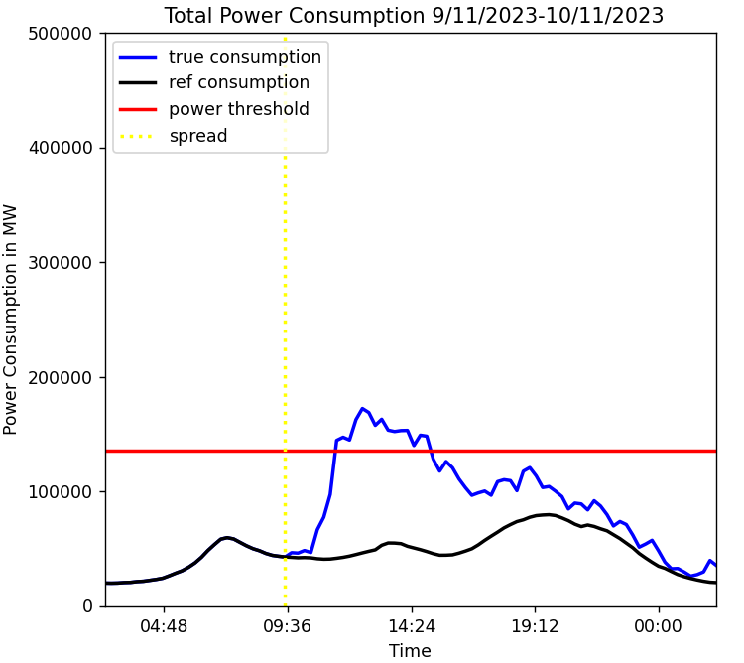
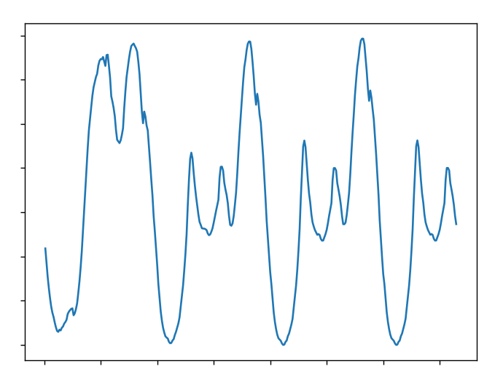

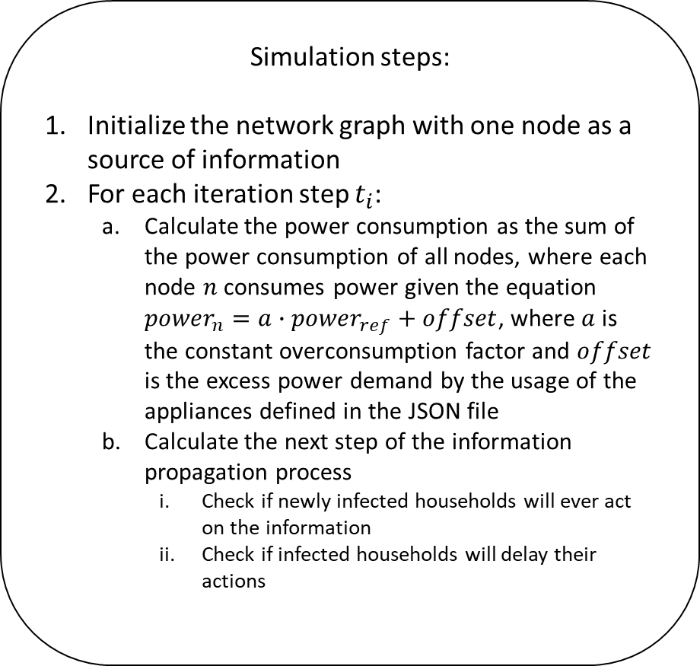
Simulation steps:
Initialize the network graph with one node as a source of information
For each iteration step $t_{i}$:
Calculate the power consumption as the sum of the power consumption of all nodes, where each node $n$ consumes power given the equation ${power}_{n}=a∙{power}_{ref}+offset$, where $a$ is the constant overconsumption factor and $offset$ is the excess power demand by the usage of the appliances defined in the JSON file
Calculate the next step of the information propagation process
Check if newly infected households will ever act on the information
Check if infected households will delay their actions
Input:
Output:
Social network graph
Reference power data
JSON file

