Slide 2
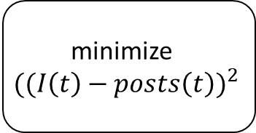
search for relevant social media posts
count the amount of social media posts over a given amount of time
filter the data plot
minimize
$${((I\left(t\right)−posts\left(t\right))}^{2}$$
solve differential equations

Slide 3
search for relevant social media posts
estimate system parameters
run simulation
Power demand exceeds threshold?
Yes/No

