Slide 1
Modelling and Analysis of Human Behavior Impacts on Energy Systems during Crisis Events
Master Thesis of Isabella N. Grieser

Slide 2
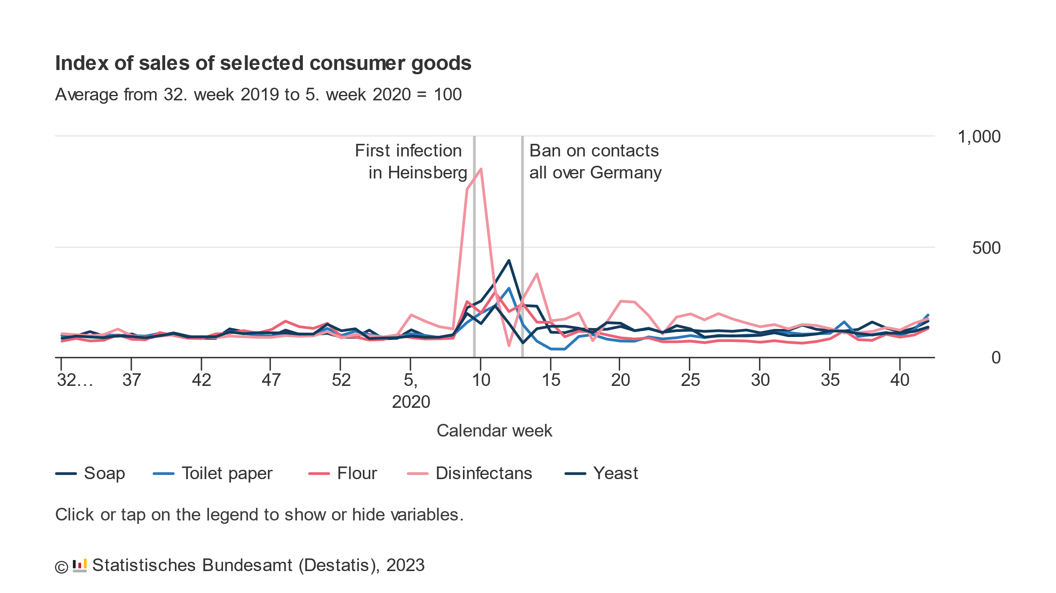
Panic Buying and Overconsumption became a very prominent topic during the COVID-19 Pandemic
Panic Buying: When consumers buy unusually large amounts of a product because of an unusual situation
During the COVID-19 Pandemic: People bought much greater number of disinfectants and soap in fear of the infectious disease. At the start of the lockdowns, the sales of toilet paper and yeast increased greatly

Slide 3
Panic Buying occured before the Pandemic, too
Other instances of panic buying behavior:
The Spanish Flu,1918: rush to buy quinine and other medications [5]
Cuban Missile Crisis, 1962: increased demand for canned foods [6]
Hurricane Irma, 2017: panic buying of fuel, bottled water and other essential goods [7]
Panic buying is an issue that already exists for a long time!
How would Panic Buying Behavior affect the Power Grid?

Slide 4
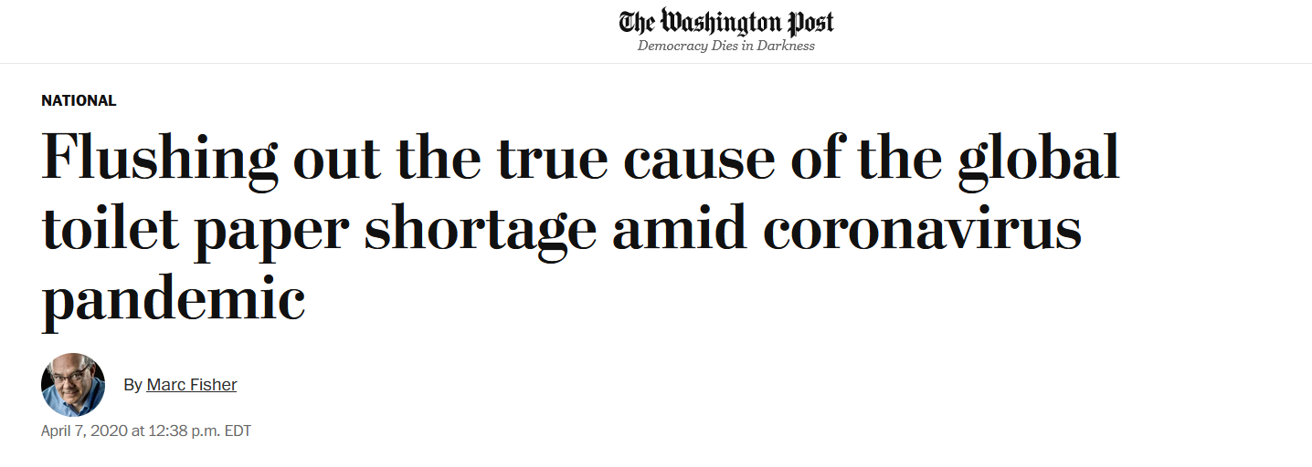
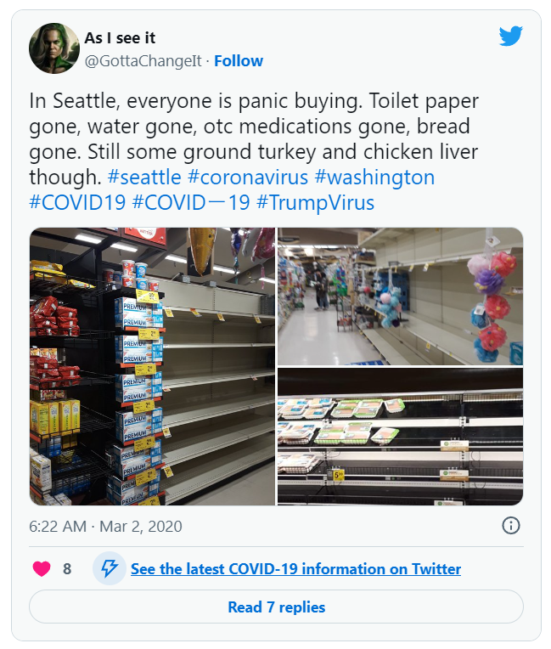
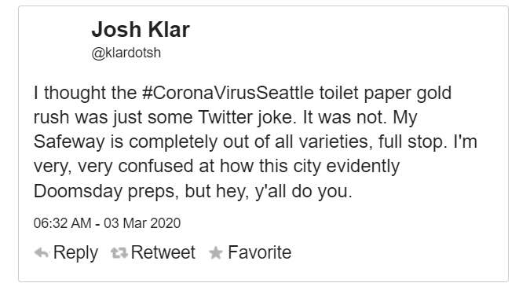
Consumption can be affected by Social Media
[2]
[1]
[2]

Slide 5
A few example Scenarios for changes in Consumption lead by Social Media affecting the Power Grid
Demand Response Scenario:
A false advertisement for reduced electricity price for a limited time spreads through social media
“Disconnect” Scenario:
Conspiracy theorists want to send a signal to the politicians by disconnecting all electrical appliances by a specified time
Terrorism Scenario:
A terror attack leads to people leaving the city in masses. But, in order to leave the city, they need to charge their electric vehicles first.
But: other scenarios could be imagined ….

Slide 6


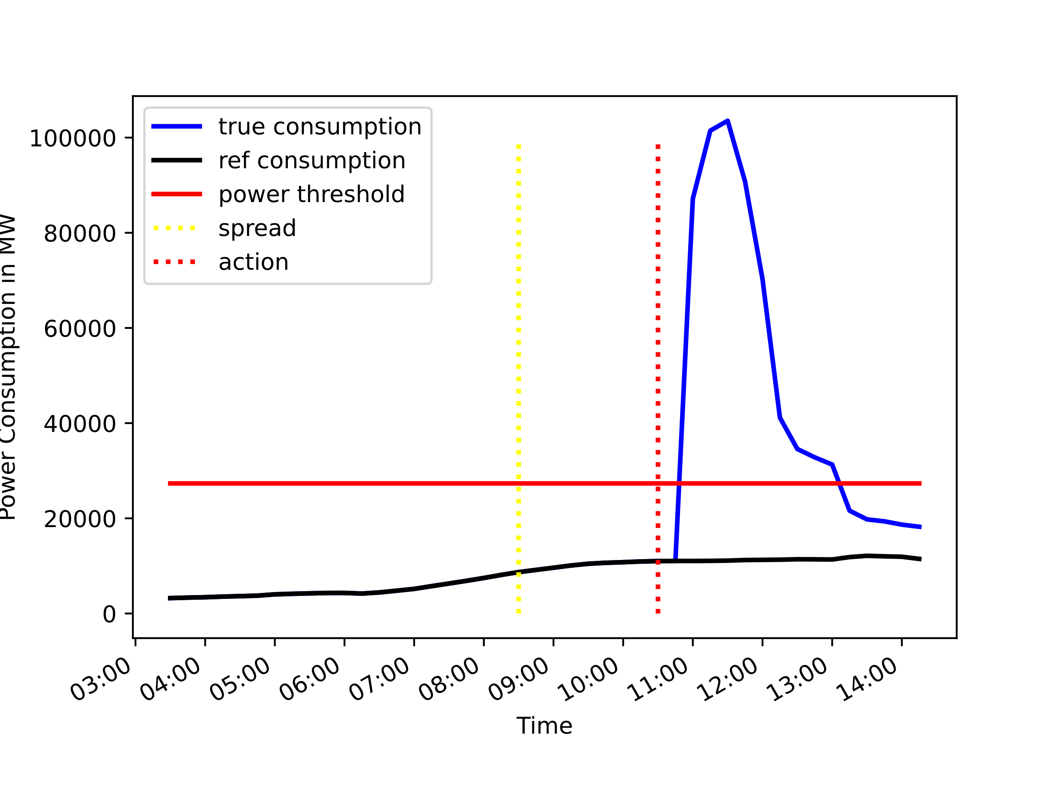
Idea: Analyze the Information Flow in Social Networks and check if it could affect the Power Grid
Create Social Media Graph
Model the Information Diffusion
Estimate the excess Power Demand

Slide 7

The Social Media Network Graph is modelled via Random Graph Algorithms
Social media networks possess different characteristics [4]:
Small world characteristic
Scale-free networks
Highly clustered
Graph Models that could be used to model social media networks:
Barabási–Albert model
Watts–Strogatz model

Slide 8
An epidemological Model is used to model the Information Propagation Process
The SIR model is used to model the information propagation process [5]:
Three states:
Susceptible (S)
Infected (I)
Recovered (R)
Neighbors are predominantly infected ➔ graph node becomes infected
Neighbors are predominantly recovered ➔ graph node recovers

Slide 9
Implementation of a Simulator to analyze the Effects on the Power Grid
Assumptions:
Each node in the social media graph signifies one (physical) household
The effect of the information may have a delayed response on the electrical grid
Simulation Steps :
Start with one source of information
For each iteration step
Calculate the power used in the network
Propagate the information in the graph
Power Calculation:
Each household may have electrical appliances and may activate them based on if they possess the specific appliances

Slide 10
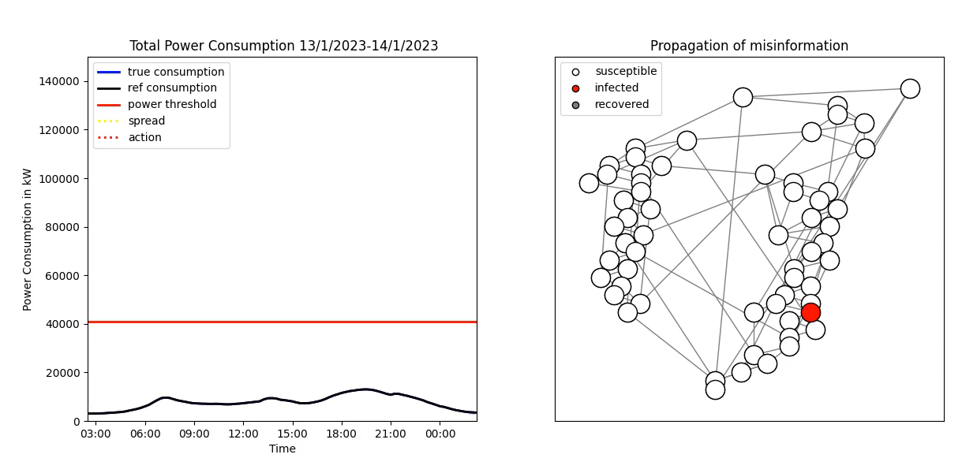
First Look into the Simulator
Notes:
TODO: legende graph

Slide 11
The Power Grid can be affected by Human Behavior
Non-behavior-based Variables
Historical Power Load
Weather
Behavior-based Variables
Social media
Traffic
Time
Satellite Images
…
…

Slide 12
Would it be possible to predict an increased Power Demand based on Real Variables?
Power demand correlates with variables based on human behavior
Use these variables as inputs to monitor and predict power demand surges
Social Media Data
Traffic Data
….

Slide 13
These Variables could be used to create a monitoring Platform for Panic Buying Behavior for the Power Grid
Social Media Data
Predict Model Parameters
Run Simulation
Power Demand critical?
Yes/No
….

Slide 14
Timeline for the Master Thesis
Literature Research
Definition of the Graph and Diffusion Model
Implementation of the Simulator
Implementation of the Parameter Estimators
Find usuable Test Data
Evaluate Method

Slide 15
Questions? Ideas?

Slide 16
Sources
[1] Fisher, Marc. “Flushing out the true cause of the global toilet paper shortage amid coronavirus pandemic" The Washington Post, https://www.washingtonpost.com/national/coronavirus-toilet-paper-shortage-panic/2020/04/07/1fd30e92-75b5-11ea-87da-77a8136c1a6d_story.html, 2020, accessed on 07/07/2023
[2] Stopera , Matt. “14 Tweets That Show What The Coronavirus Toilet Paper Shortage Looks Like In Seattle" Buzzfeed, https://www.buzzfeed.com/mjs538/tweets-that-show-what-the-coronavirus-toilet-paper, 2020, accessed on 07/07/2023
[3] Alan Mislove et al. “Measurement and analysis of online social networks”. In: Proceedings of the 7thACM SIGCOMM conference on Internet measurement. 2007, pp. 29–42.
[4] Marcella Tambuscio et al. “Fact-checking effect on viral hoaxes: A model of misinformation spreading social networks”. In: Proceedings of the 24th international conference on World Wide Web. 2015,pp. 977–982.
[5] Honigsbaum, Mark. "Regulating the 1918–19 pandemic: Flu, stoicism and the Northcliffe press." Medical history 57.2 (2013): 165-185.
[6] George, Alice L. Awaiting Armageddon: How Americans Faced the Cuban Missile Crisis. UNC Press Books, 2004.
[7] Alvarez, Lizette. “In Florida, Searching for Gas and Water, and Watching Irma." The New York Times, https://www.nytimes.com/2017/09/07/us/florida-irma-hurricane-supplies.html, 2017, accessed on 07/07/2023

