Slide 1
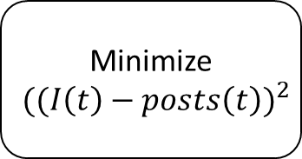
Search for relevant social media posts
Count the amount of social media posts over a given amount of time
Filter the data plot
Minimize
$${((I\left(t\right)−posts\left(t\right))}^{2}$$
Solve differential equations

Slide 2
Search for relevant social media posts
Estimate system parameters
Run simulation
Power demand exceeds threshold?
Yes/No

Slide 3







$${1−g}_{neighbors}−f_{neighbors}$$
Susceptible
$$g_{neighbors}$$
$$p_{forget}$$
$$f_{neighbors}$$
Recovered
Infected
$$p_{verify}$$
$$1−p_{forget}$$
$$1−p_{forget}−p_{verify}$$

Slide 4


$${1−g}_{neighbors}−f_{neighbors}$$
Susceptible
$$g_{neighbors}$$
$$f_{neighbors}$$
Recovered
Infected
$$p_{verify}$$
$$1$$
$$1−p_{verify}$$

Slide 5

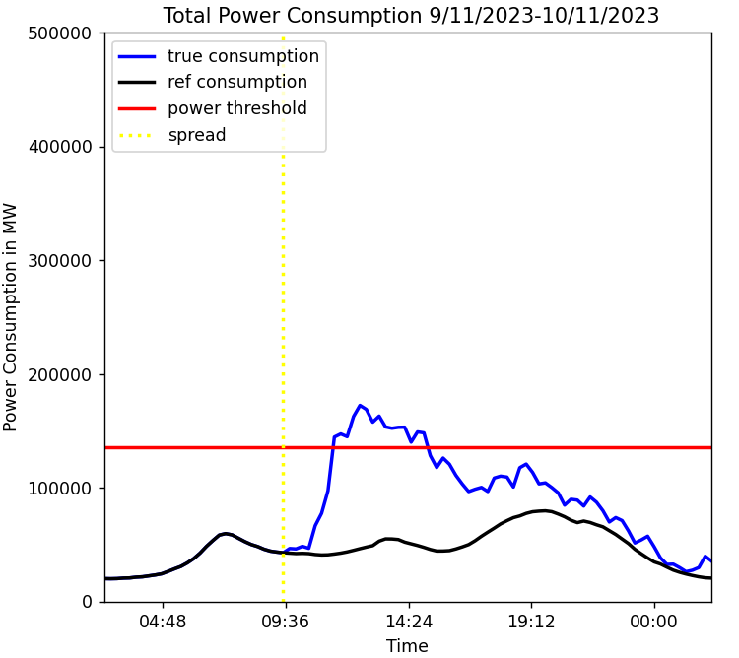
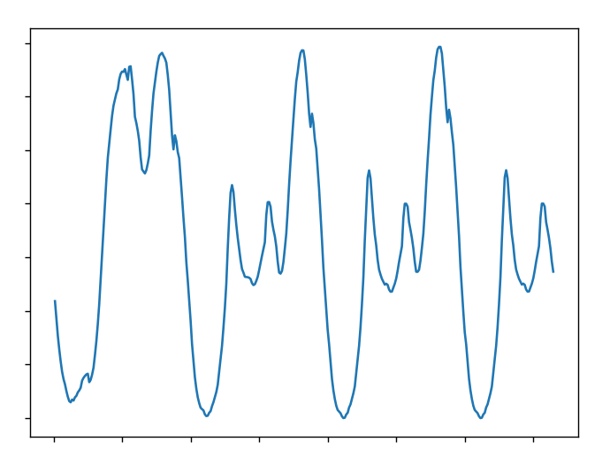

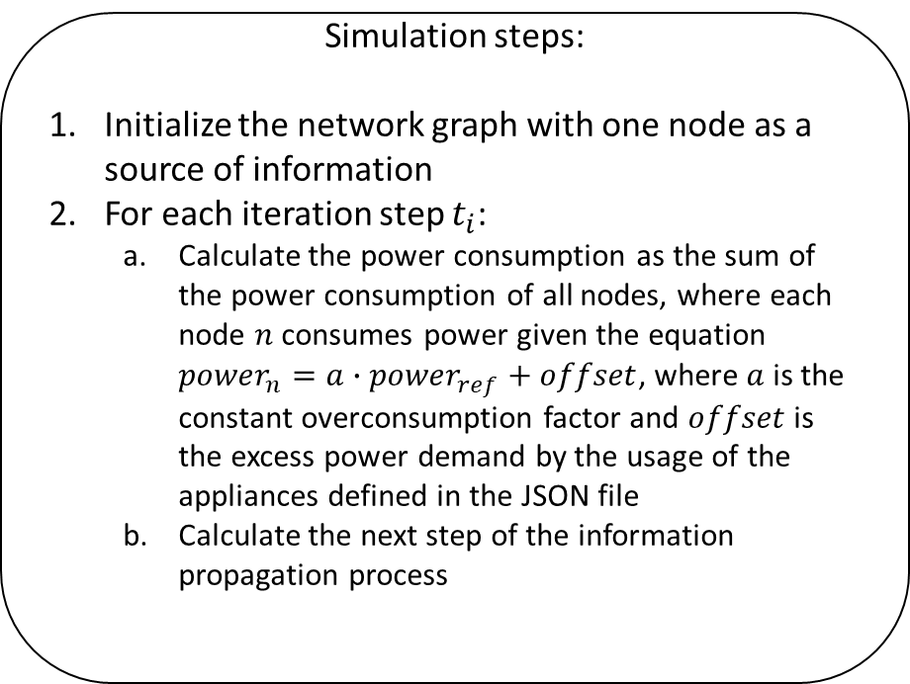
Input:
Simulation steps:
Initialize the network graph with one node as a source of information
For each iteration step $t_{i}$:
Calculate the power consumption as the sum of the power consumption of all nodes, where each node $n$ consumes power given the equation ${power}_{n}=a∙{power}_{ref}+offset$, where $a$ is the constant overconsumption factor and $offset$ is the excess power demand by the usage of the appliances defined in the JSON file
Calculate the next step of the information propagation process
Output:
Social network graph
Reference power data
JSON file

