Slide 1
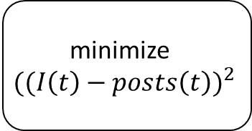
search for relevant social media posts
count the amount of social media posts over a given amount of time
filter the data plot
minimize
$${((I\left(t\right)−posts\left(t\right))}^{2}$$
solve differential equations

Slide 2
search for relevant social media posts
estimate system parameters
run simulation
Power demand exceeds threshold?
Yes/No

Slide 3







$${1−g}_{neighbors}−f_{neighbors}$$
Susceptible
$$g_{neighbors}$$
$$p_{forget}$$
$$f_{neighbors}$$
Recovered
Infected
$$p_{verify}$$
$$1−p_{forget}$$
$$1−p_{forget}−p_{verify}$$

Slide 4


$${1−g}_{neighbors}−f_{neighbors}$$
Susceptible
$$g_{neighbors}$$
$$f_{neighbors}$$
Recovered
Infected
$$p_{verify}$$
$$1$$
$$1−p_{verify}$$

