Slide 1
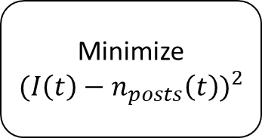
Search for relevant social media posts
Count the number of social media posts over a given amount of time
Smoothen data plot
Minimize
$${(I\left(t\right)−n_{posts}\left(t\right))}^{2}$$
Solve differential equations

Slide 2
E.OFF
E.OFF

Slide 3
Search for relevant social media posts
Estimate system parameters
Run simulation
Predict critical peak electricity demand trends

Slide 4







$${1−g}_{neighbors}−f_{neighbors}$$
Susceptible
$$g_{neighbors}$$
$$p_{forget}$$
$$f_{neighbors}$$
Recovered
Infected
$$p_{verify}$$
$$1−p_{forget}$$
$$1−p_{forget}−p_{verify}$$

Slide 5


$${1−g}_{neighbors}−f_{neighbors}$$
Susceptible
$$g_{neighbors}$$
$$f_{neighbors}$$
Recovered
Infected
$$p_{verify}$$
$$1$$
$$1−p_{verify}$$

Slide 6

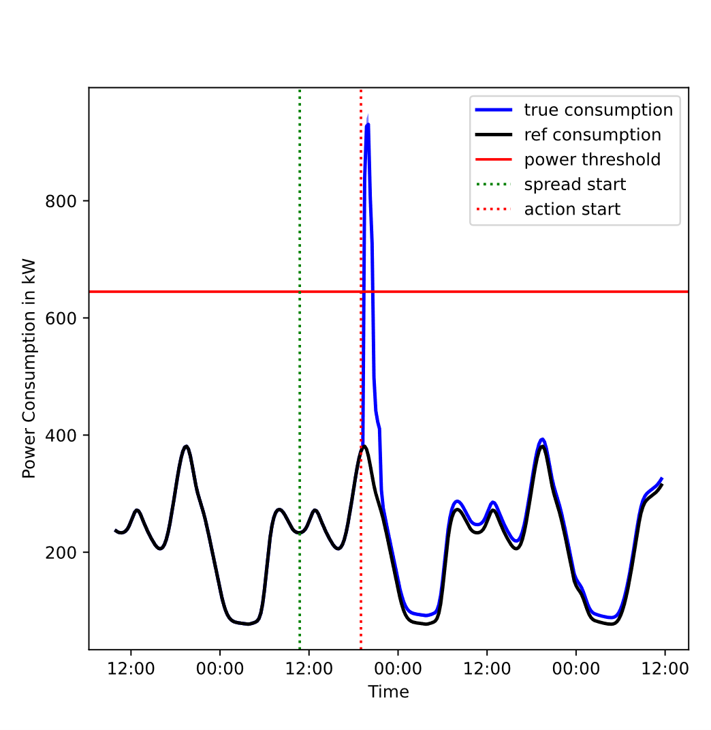
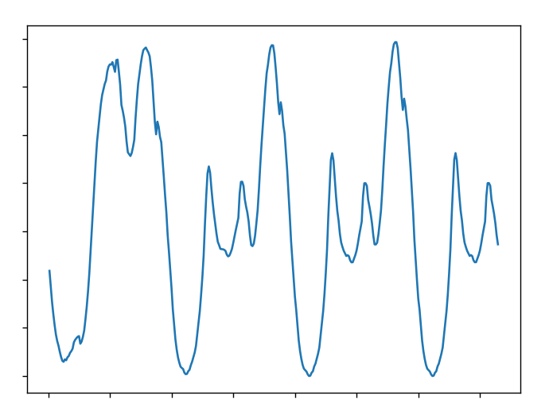

Input:
Output:
Social network graph
Initialize the network graph with one node as a source of information
Run the simulation algorithm
Reference power data
JSON file

Slide 7



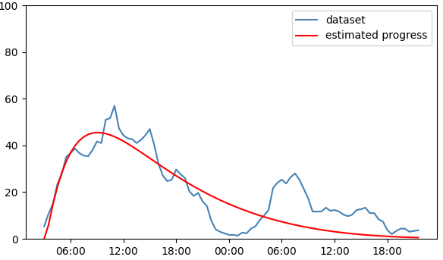
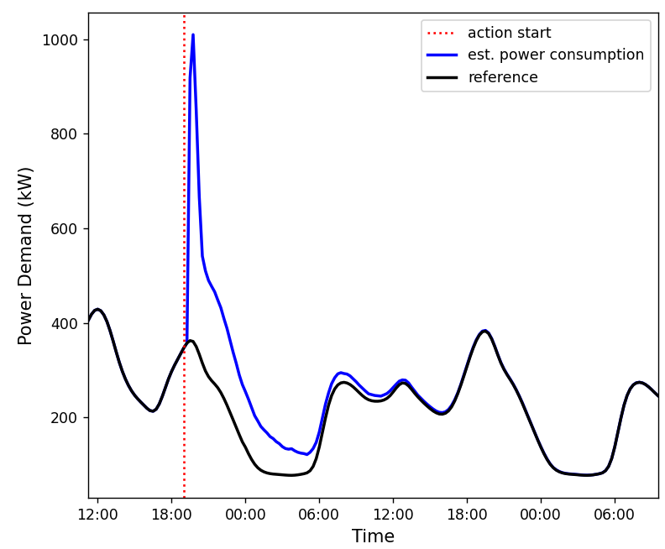
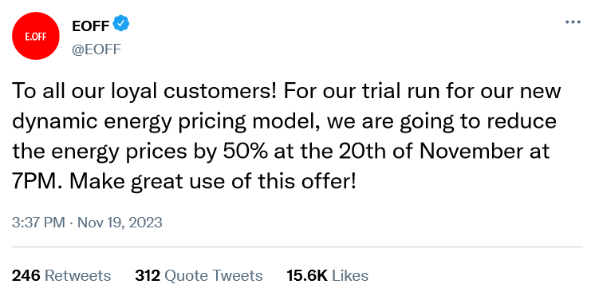

1. Collect Social Media Posts
2. Detect Social Media Events
3. Estimate Speed of Information Spread
4. Run Simulation
5. Assess Maximum Power Demand
…
…
…
…

