Slide 1
Extension of the Virtual Network Embedding formulation for Virtual Power Plants
Isabella Nunes Grieser

Slide 2
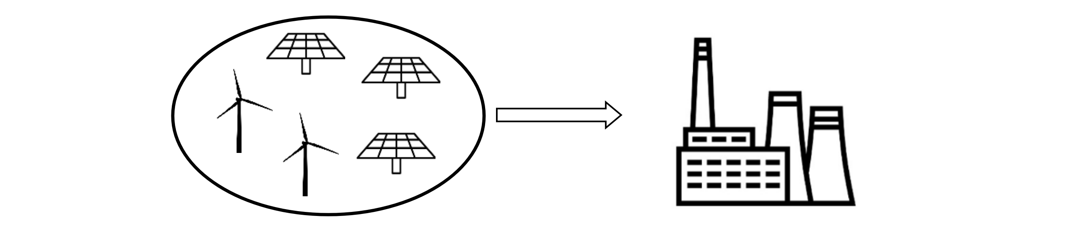
A Virtual Power Plant (VPP) is a distributed power plant
Virtual Power Plant: is made of multiple distributed energy resources (DERs) but can be seen as a regular power plant to an outside observer
A VPP contains:
Multiple DERs
A management office
A communication network between the management office and the DERs

Slide 3

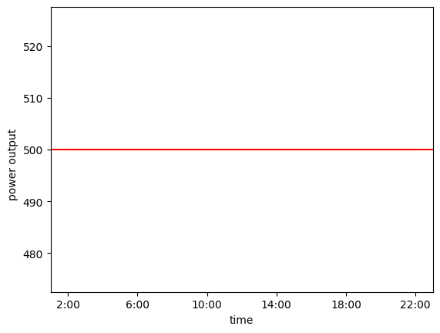
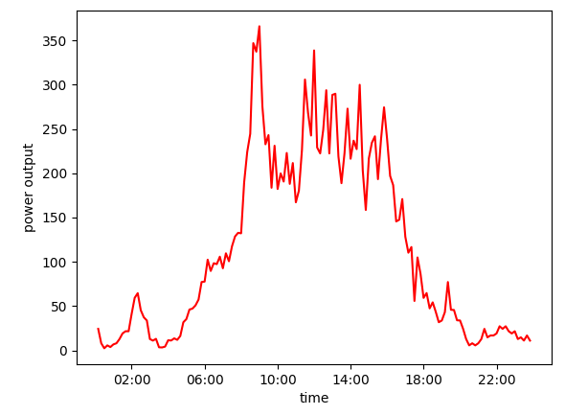


Generating a stable power output is a problem for renewable energy resources

Slide 4



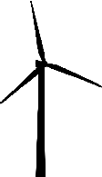

Idea: assign DERs to a VPP by virtual network embedding (VNE)
Problem: How to assign DERs to a VPP?
Answer: By using VNE algorithms
Mapping a virtual network (the VPP) onto a physical network
Find optimal embedding while considering the power output, the reliability and the DER activation cost

Slide 5

Mixed Integer Linear Programming (MILP) is used as basis for the VNE algorithm
The mapping algorithm was implemented using JuMP
JuMP is a Julia library for mathematical optimization problems (such as MILP)
Results are documented in a Jupyter Notebook

Slide 6
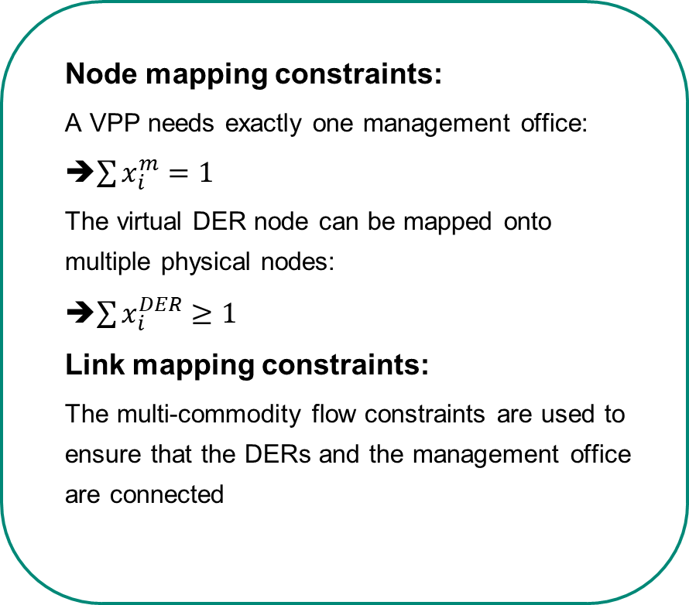
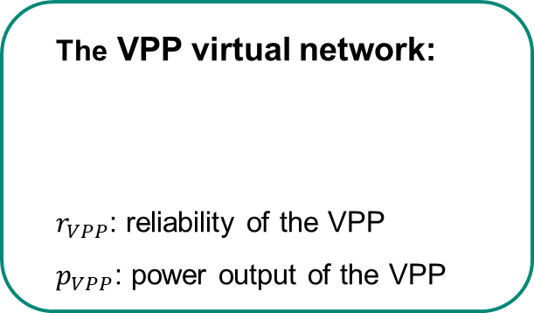
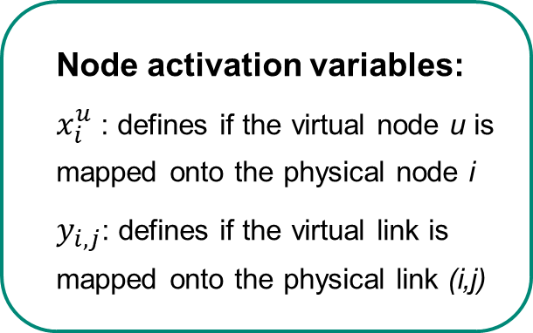
VPP virtual network model is mapped onto the physical network
The VPP virtual network:
$r_{VPP}$: reliability of the VPP
$p_{VPP}$: power output of the VPP
Node mapping constraints:
A VPP needs exactly one management office:
➔$\sum{x_{i}^{m}=1}$
The virtual DER node can be mapped onto multiple physical nodes:
➔$\sum{x_{i}^{DER}≥1}$
Link mapping constraints:
The multi-commodity flow constraints are used to ensure that the DERs and the management office are connected
Node activation variables:
$x_{i}^{u}$ : defines if the virtual node u is mapped onto the physical node i
$y_{i,j}$: defines if the virtual link is mapped onto the physical link (i,j)

Slide 7
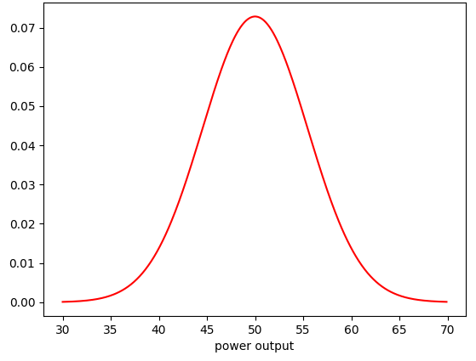






The VPP‘s reliability depends on two factors
Power output of the DERs
Communication link reliability
Power output: analyzed given pre-defined reliability levels (e.g $r_{levels}=[0.4 0.5 0.6]$)
$$P\left(x<50\right)=0.5$$
$$P\left(x<45\right)=0.4$$
$$P\left(x<55\right)=0.6$$
The power output scenarios are the cartesian product of the output levels of all individual DERs

Slide 8
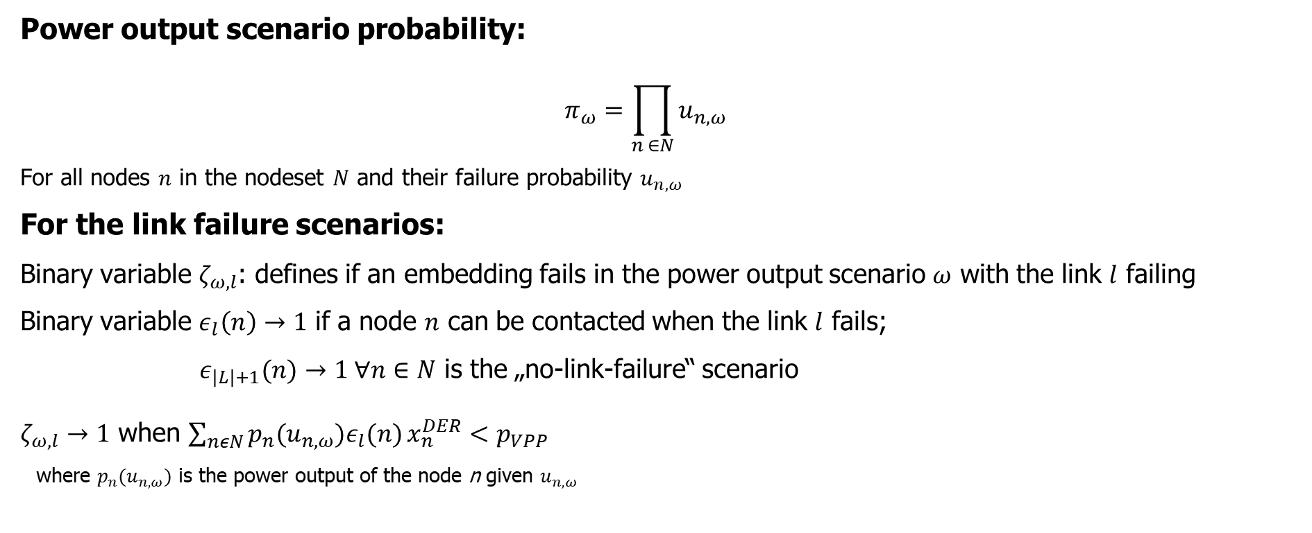
The reliability calculation constraints combine the power output of the DERs and the link reliability
Power output scenario probability:
$$π_{ω}=\prod_{n ∈N}{u_{n,ω}}$$
For all nodes $n$ in the nodeset $N$ and their failure probability $u_{n,ω}$
For the link failure scenarios:
Binary variable $ζ_{ω,l}$: defines if an embedding fails in the power output scenario $ω$ with the link $l$ failing
Binary variable $ε_{l}\left(n\right)→1$ if a node $n$ can be contacted when the link $l$ fails;
${ ε}_{\left|L\right|+1}(n)→1 ∀n∈N$ is the „no-link-failure“ scenario
$ζ_{ω,l}→1$ when $\sum_{nεN}{p_{n}(u_{n,ω})ε_{l}(n)}x_{n}^{DER}<p_{VPP}$
where $p_{n}(u_{n,ω})$ is the power output of the node n given $u_{n,ω}$

Slide 9
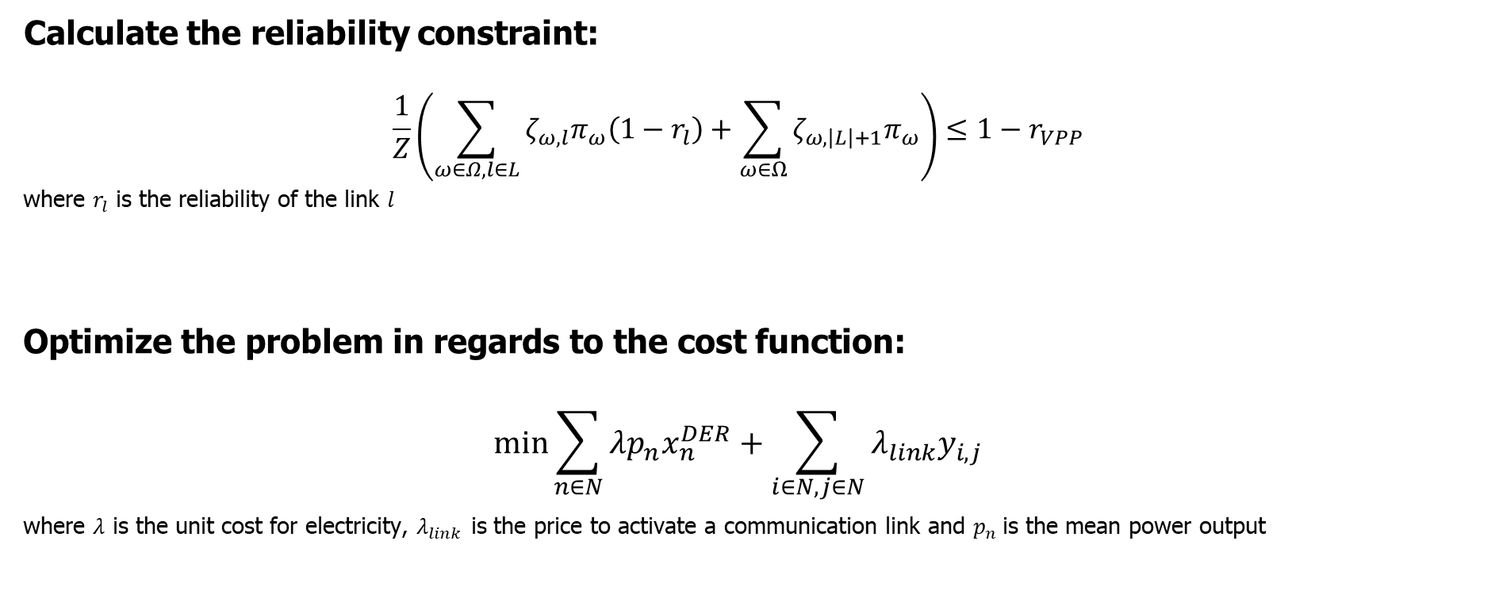
The reliability constraint ensures a reliable mapping for the lowest cost possible
Calculate the reliability constraint:
$$\frac{1}{Z}\left(\sum_{ω∈Ω,l∈L}{ζ_{ω,l}π_{ω}\left(1−r_{l}\right)}+\sum_{ω∈Ω}{ζ_{ω,\left|L\right|+1}π_{ω}}\right)≤1−r_{VPP}$$
where $r_{l}$ is the reliability of the link $l$
Optimize the problem in regards to the cost function:
$$min\sum_{n∈N}{λp_{n}x_{n}^{DER}}+\sum_{i∈N,j∈N}{λ_{link}y_{i,j}}$$
where $λ$ is the unit cost for electricity, $λ_{link}$ is the price to activate a communication link and $p_{n}$is the mean power output

Slide 10
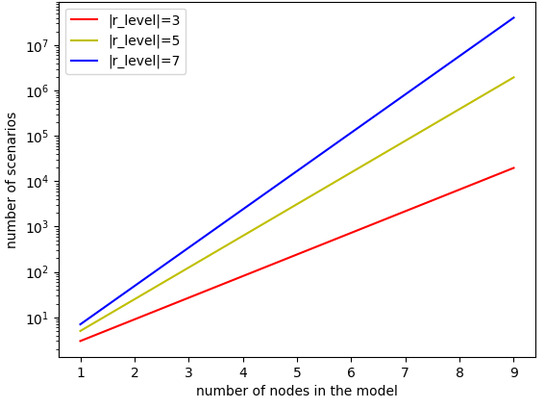

Scenario amounts increase exponentially with node size
Scenario amount: $\left|Ω\right|={{|r}_{levels}|}^{|N|}$

Slide 11
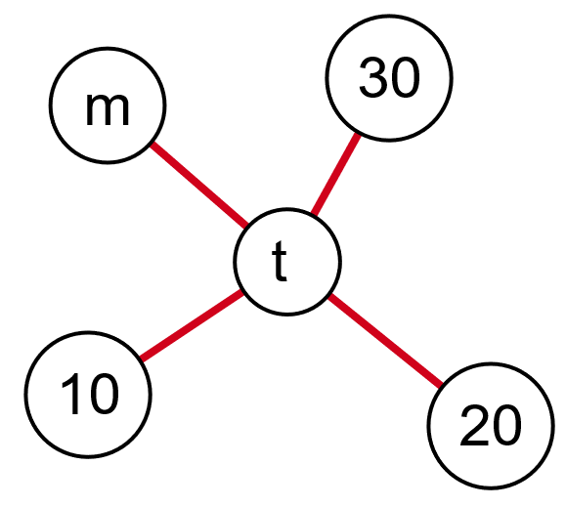
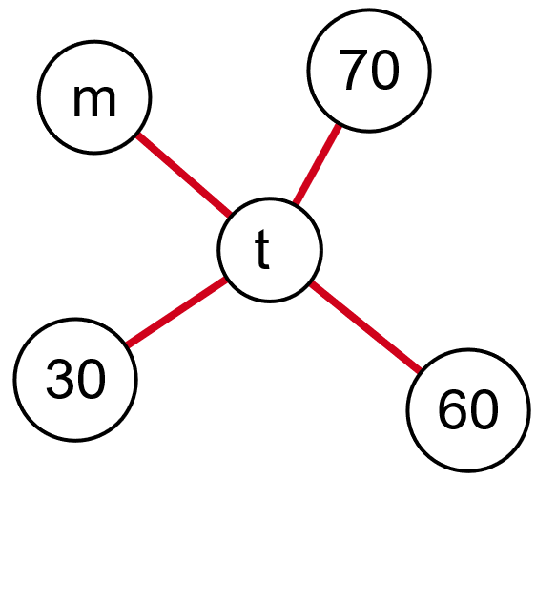




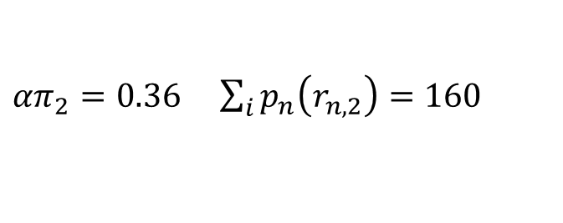
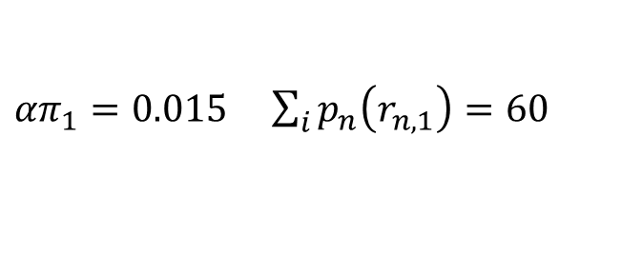



The power output scenarios are not independent of each other
VPP: $r_{VPP}=99\%$ $p_{VPP}=200$
Power output scenario 1:
Power output scenario 2:
$$u_{1,1} =0.5$$
$$u_{1,2} =0.8$$
$$u_{2,1}=0.1$$
$$u_{3,1} =0.3$$
$u_{2,2} =0.$5
$u_{3,2} =0.$9
${απ}_{1}=0.015$ $\sum_{i}{p_{n}\left(r_{n,1}\right)=60}$
${απ}_{2}=0.36$ $\sum_{i}{p_{n}\left(r_{n,2}\right)=160}$

Slide 12
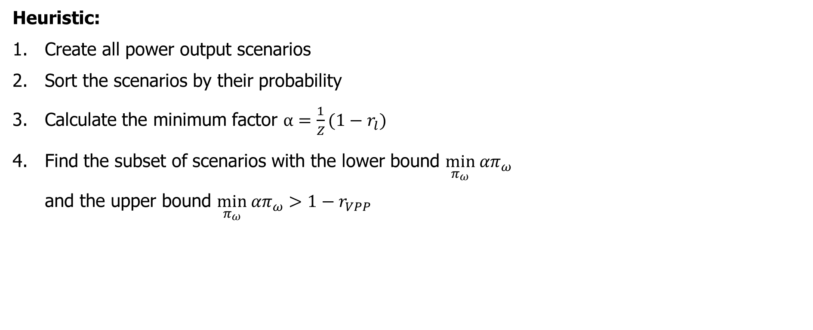
We can reduce the scenario constraint amount by ignoring high power output scenarios
Heuristic:
Create all power output scenarios
Sort the scenarios by their probability
Calculate the minimum factor $α=\frac{1}{Z}(1−r_{l})$
Find the subset of scenarios with the lower bound $\min_{π_{ω}} {απ}_{ω}$ and the upper bound $\min_{π_{ω}} {απ}_{ω}>1−r_{VPP}$

Slide 13
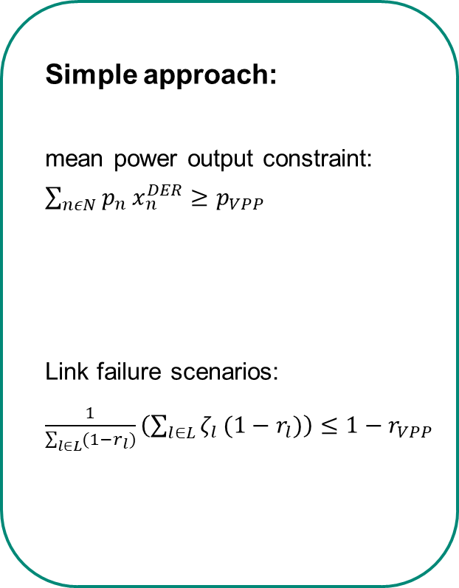
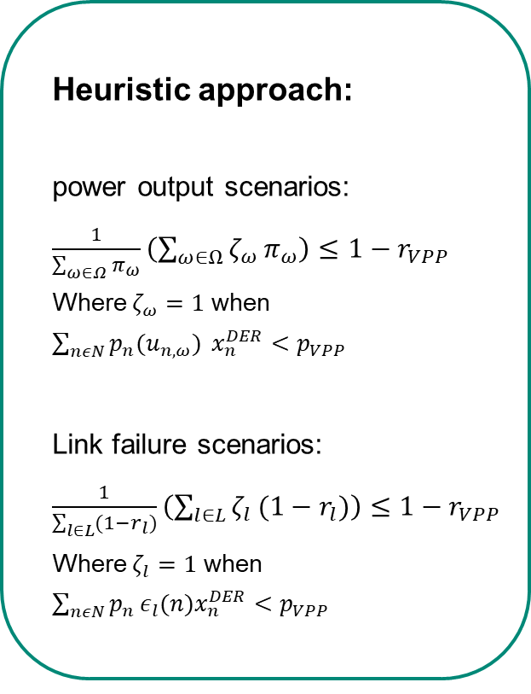
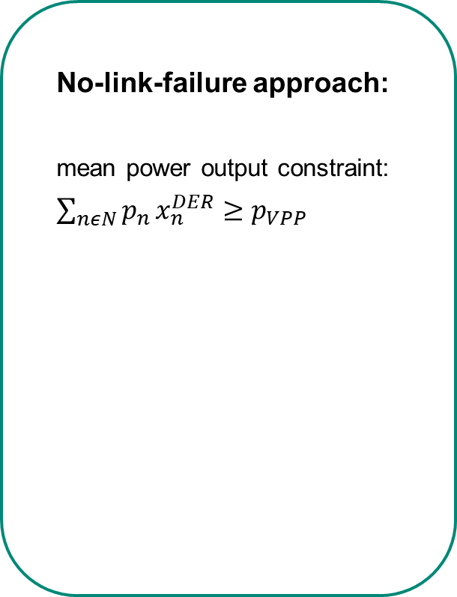
The exact approach was compared to three simpler approaches
Heuristic approach:
power output scenarios: $\frac{1}{\sum_{ω∈Ω}{π_{ω}}}\left(\sum_{ω∈Ω}{ζ_{ω }π_{ω}}\right)≤1−r_{VPP}$
Where $ζ_{ω}=1$ when $\sum_{nεN}{p_{n}(u_{n,ω}) }x_{n}^{DER}<p_{VPP}$
Link failure scenarios: $\frac{1}{\sum_{l∈L}{(1−r_{l})}}\left(\sum_{l∈L}{ζ_{l }{(1−r}_{l})}\right)≤1−r_{VPP}$
Where $ζ_{l}=1$ when $\sum_{nεN}{p_{n}}ε_{l}(n)x_{n}^{DER}<p_{VPP}$
Simple approach:
mean power output constraint: $\sum_{nεN}{p_{n}}x_{n}^{DER}≥p_{VPP}$
Link failure scenarios: $\frac{1}{\sum_{l∈L}{(1−r_{l})}}\left(\sum_{l∈L}{ζ_{l }(1−r_{l})}\right)≤1−r_{VPP}$
No-link-failure approach:
mean power output constraint: $\sum_{nεN}{p_{n}}x_{n}^{DER}≥p_{VPP}$

Slide 14
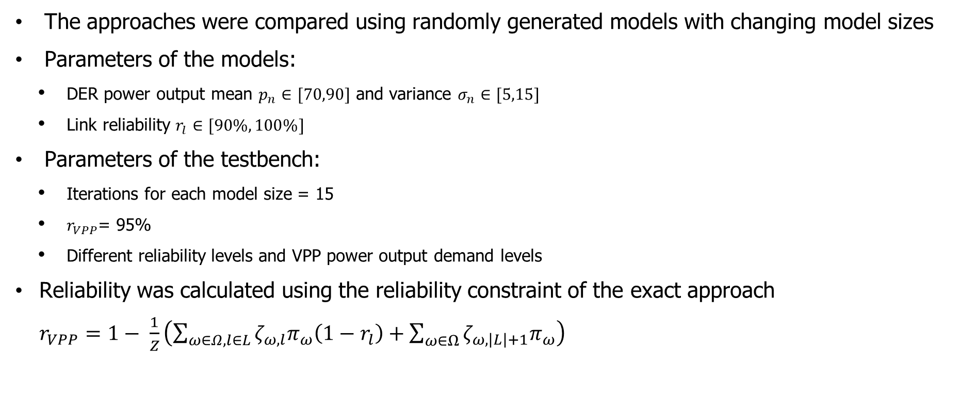
The evaluation results were calculated using a testbench
The approaches were compared using randomly generated models with changing model sizes
Parameters of the models:
DER power output mean $p_{n}∈[70,90]$ and variance $σ_{n}∈[5,15]$
Link reliability $r_{l}∈[90\%, 100\%]$
Parameters of the testbench:
Iterations for each model size = 15
$r_{VPP}$= 95%
Different reliability levels and VPP power output demand levels
Reliability was calculated using the reliability constraint of the exact approach $r_{VPP}=1− \frac{1}{Z}\left(\sum_{ω∈Ω,l∈L}{ζ_{ω,l}π_{ω}\left(1−r_{l}\right)}+\sum_{ω∈Ω}{ζ_{ω,\left|L\right|+1}π_{ω}}\right)$

Slide 15
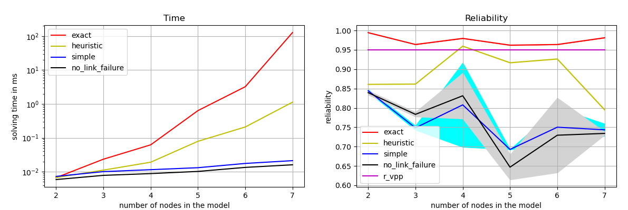
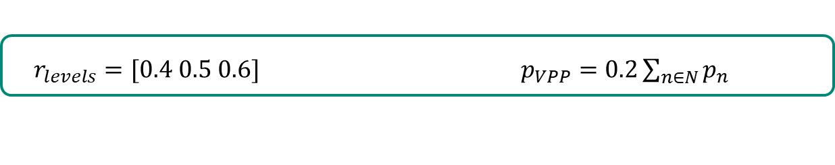
The exact approach computes more reliable results than the other approaches
$r_{levels}=[0.4 0.5 0.6]$ $p_{VPP}=0.2\sum_{n∈N}{p_{n}}$

Slide 16
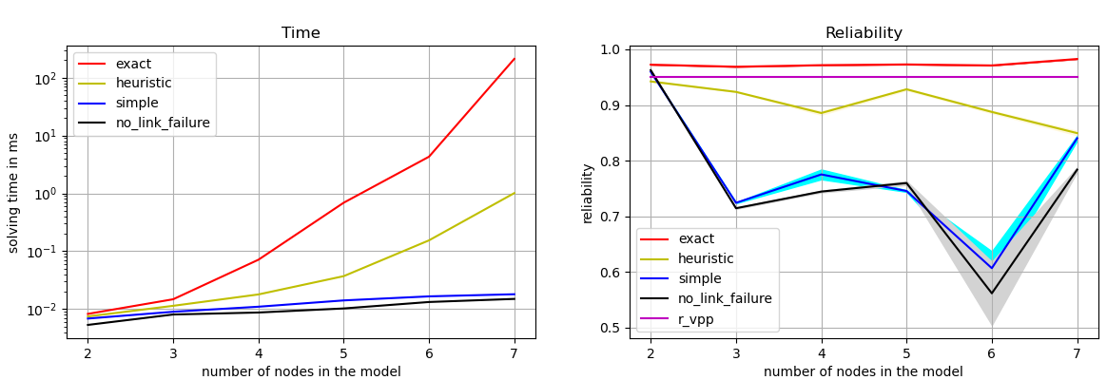
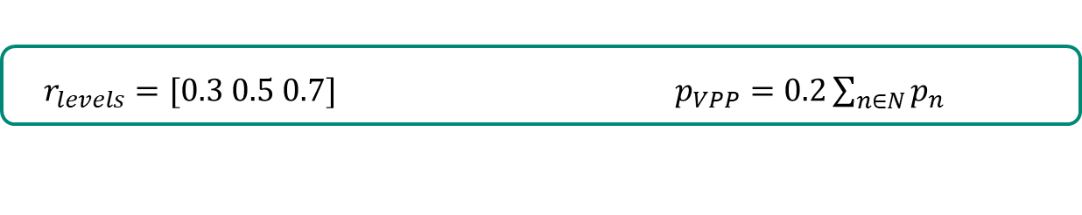
When the power output levels are more extreme the reliability of the simpler approaches are lower
$r_{levels}=[0.3 0.5 0.7]$ $p_{VPP}=0.2\sum_{n∈N}{p_{n}}$

Slide 17
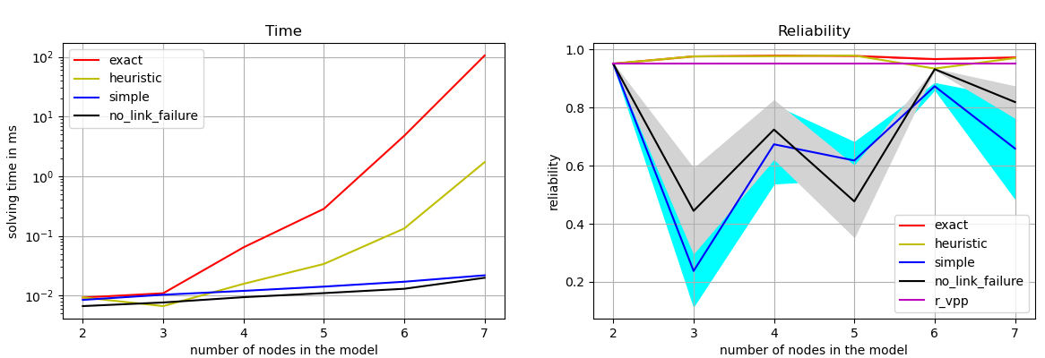
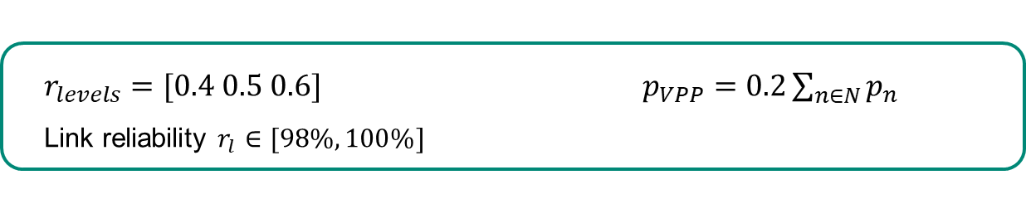
When the link reliability is high, then the heuristic approach is similar to the exact approach
$r_{levels}=[0.4 0.5 0.6]$ $p_{VPP}=0.2\sum_{n∈N}{p_{n}}$
Link reliability $r_{l}∈[98\%, 100\%]$

Slide 18

Thank you for your attention
Questions?

