Slide 1
Extension of the Virtual Network Embedding formulation for Virtual Power Plants

Slide 2

A Virtual Power Plant (VPP) is a distributed power plant
Virtual Power Plant: is made of multiple distributed energy resources (DERs) but can be seen from the outside as a regular power plant
A VPP contains:
A management office
Multiple DERs
A communication network between the management office and the DERs

Slide 3

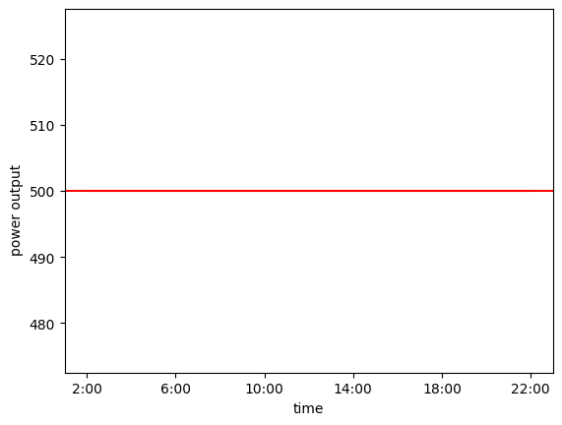
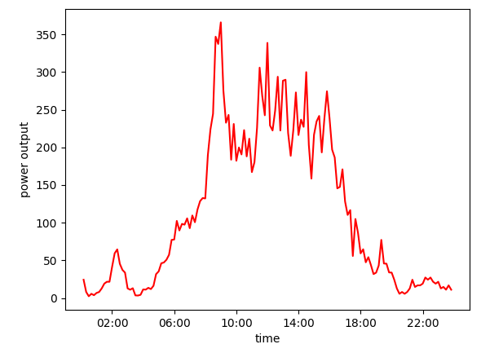


Generating a stable power output is a problem for renewable energy resources

Slide 4





Idea: assign DERs to a VPP by virtual network embedding (VNE)
Problem: How to assign DERs to a VPP?
Answer: By using VNE algorithms
Mapping a virtual network (the VPP) onto a physical network
Find optimal embedding while considering the power output reliability and the cost

Slide 5

Mixed Integer Linear Programming (MILP) is used as basis for the VNE algorithm
The mapping algorithm was implemented using JuMP
JuMP is a Julia library for mathematical optimization problems (such as MILP)
Results are documented in a Jupyter Notebook

Slide 6
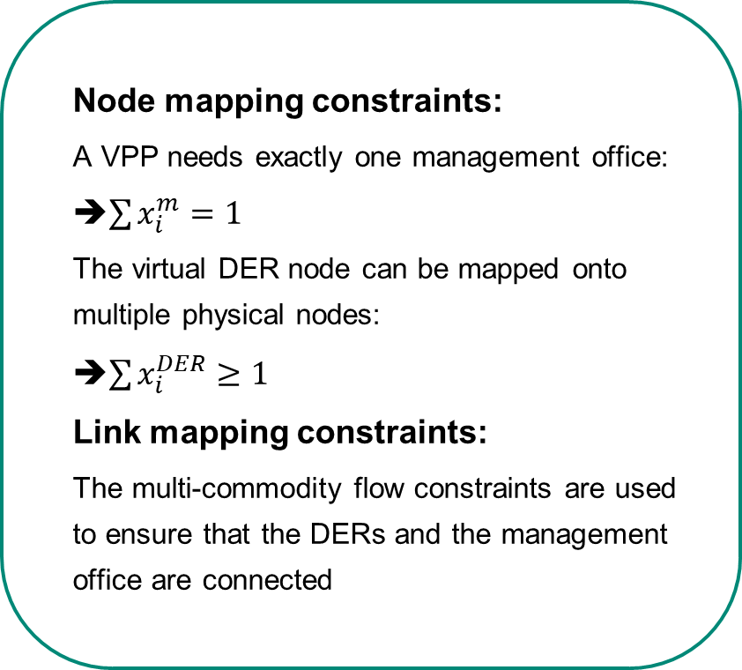
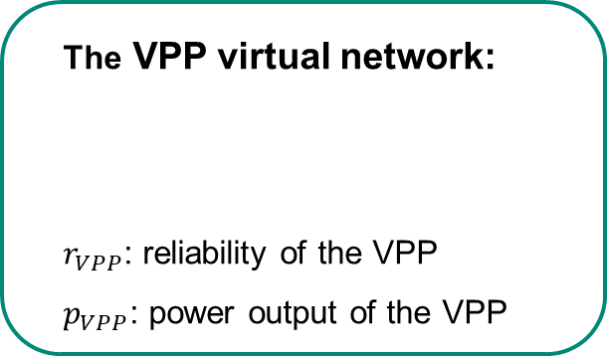
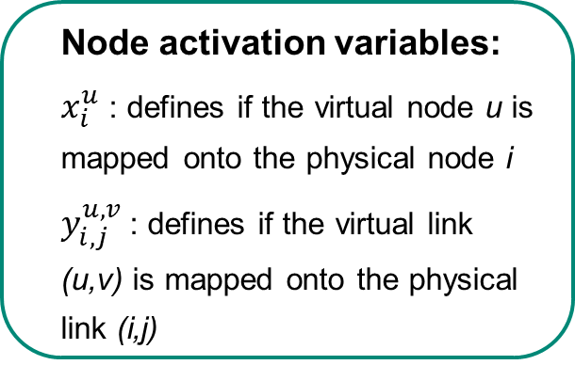
VPP virtual network model is mapped onto the physical network
The VPP virtual network:
$r_{VPP}$: reliability of the VPP
$p_{VPP}$: power output of the VPP
Node mapping constraints:
A VPP needs exactly one management office:
➔$\sum{x_{i}^{m}=1}$
The virtual DER node can be mapped onto multiple physical nodes:
➔$\sum{x_{i}^{DER}≥1}$
Link mapping constraints:
The multi-commodity flow constraints are used to ensure that the DERs and the management office are connected
Node activation variables:
$x_{i}^{u}$ : defines if the virtual node u is mapped onto the physical node i
$y_{i,j}^{u,v}$ : defines if the virtual link (u,v) is mapped onto the physical link (i,j)

Slide 7
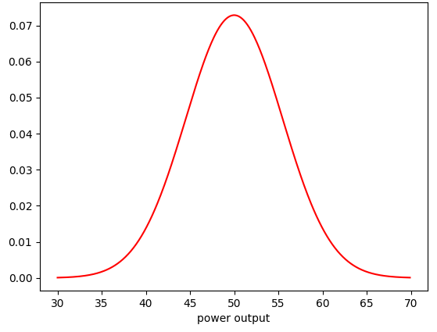






The VPP‘s reliability depends on two factors
Power output of the DERs
Communication link reliability
Power output: analyzed given pre-defined reliability levels (e.g $l=[0.4 0.5 0.7]$)
$$P\left(x<50\right)=0.5$$
$$P\left(x<45\right)=0.4$$
$$P\left(x<55\right)=0.6$$
The power output scenarios is the cartesian product of the output levels of all individual DERs

Slide 8
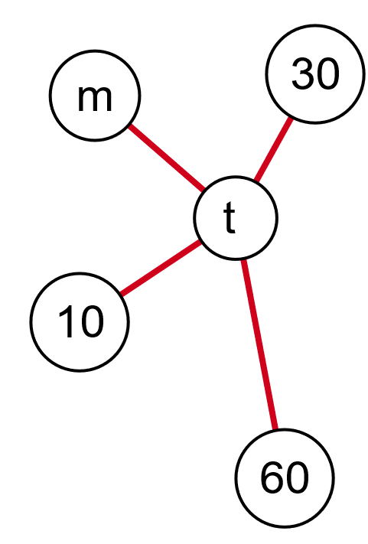


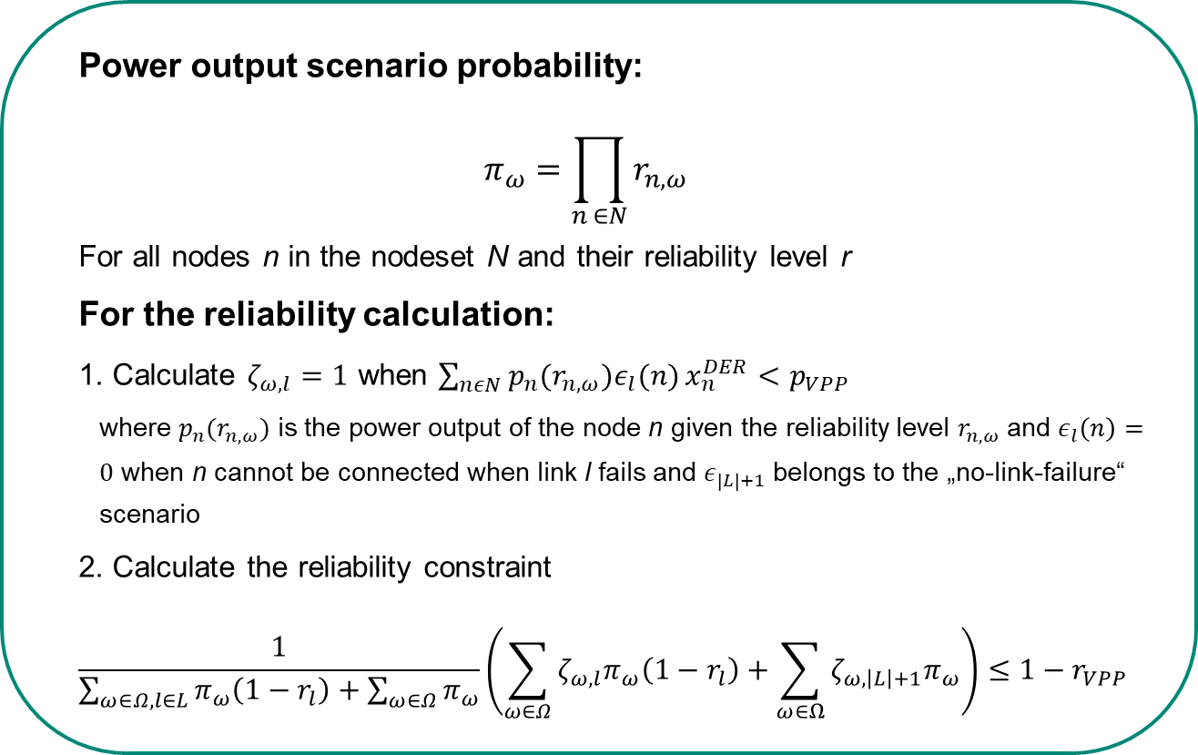

The reliability calculation constraints combine the power output of the DERs and the link reliability
power output scenario:
Power output scenario probability:
$$π_{ω}=\prod_{n ∈N}{r_{n,ω}}$$
For all nodes n in the nodeset N and their reliability level r
For the reliability calculation:
1. Calculate $ζ_{ω,l}=1$ when $\sum_{nεN}{p_{n}(r_{n,ω})ε_{l}(n)}x_{n}^{DER}<p_{VPP}$
where $p_{n}(r_{n,ω})$ is the power output of the node n given the reliability level $r_{n,ω}$ and $ε_{l}\left(n\right)=0$ when n cannot be connected when link l fails and $ε_{\left|L\right|+1}$ belongs to the „no-link-failure“ scenario
2. Calculate the reliability constraint
$$\frac{1}{\sum_{ω∈Ω,l∈L}{π_{ω}\left(1−r_{l}\right)+\sum_{ω∈Ω}{π_{ω}}}}\left(\sum_{ω∈Ω}{ζ_{ω,l}π_{ω}\left(1−r_{l}\right)}+\sum_{ω∈Ω}{ζ_{ω,\left|L\right|+1}π_{ω}}\right)≤1−r_{VPP}$$
$$P\left(x<30\right)=0.5$$
$$P\left(x<10\right)=0.1$$
$P\left(x<60\right)=0.$8

Slide 9

MILP optimizes the activation variables x and y based on the objective function
Objective function:
Minimization of the costs in dependency of the reliability constraints
$min\sum_{n∈N}{λp_{n}x_{n}^{DER}}+\sum_{i∈N,j∈N}{λ_{link}y_{i,j}}$

Slide 10
Number of scenario constraints can be reduced by ignoring irrelevant power output scenarios
power output scenario:
$$P\left(x<30\right)=0.5$$
$$P\left(x<10\right)=0.1$$
$P\left(x<60\right)=0.$8

