Slide 1
Introduction to Algorithms Dynamic Programming
CSE 680
Prof. Roger Crawfis

Slide 2
Fibonacci Numbers
Computing the n^{th} Fibonacci number recursively:
F(n) = F(n-1) + F(n-2)
F(0) = 0
F(1) = 1
Top-down approach
int Fib(int n)
{ if (n <= 1) return 1; else return Fib(n - 1) + Fib(n - 2); }
F(n)
F(n-1) + F(n-2)
F(n-2) + F(n-3) F(n-3) + F(n-4)

Slide 3
Fibonacci Numbers
What is the Recurrence relationship?
T(n) = T(n-1) + T(n-2) + 1
What is the solution to this?
Clearly it is O(2^{n}), but this is not tight.
A lower bound is Ω(2^{n/2}).
You should notice that T(n) grows very similarly to F(n), so in fact T(n) = Θ(F(n)).
Obviously not very good, but we know that there is a better way to solve it!

Slide 4
Fibonacci Numbers
Computing the n^{th} Fibonacci number using a bottom-up approach:
F(0) = 0
F(1) = 1
F(2) = 1+0 = 1
…
F(n-2) =
F(n-1) =
F(n) = F(n-1) + F(n-2)
Efficiency:
Time – O(n)
Space – O(n)

Slide 5
Fibonacci Numbers
The bottom-up approach is only Θ(n).
Why is the top-down so inefficient?
Recomputes many sub-problems.
How many times is F(n-5) computed?
F(n)
F(n-1) + F(n-2)
F(n-2) + F(n-3) F(n-3) + F(n-4)
… … …
n levels

Slide 6
Fibonacci Numbers
Fib(5) +
Fib(4) +
Fib(3) +
Fib(3) +
Fib(2) +
Fib(2) +
Fib(1)
Fib(2) +
Fib(1)
Fib(1)
Fib(0)
Fib(1)
Fib(0)
Fib(1)
Fib(0)

Slide 7
Dynamic Programming
Dynamic Programming is an algorithm design technique for optimization problems: often minimizing or maximizing.
Like divide and conquer, DP solves problems by combining solutions to sub-problems.
Unlike divide and conquer, sub-problems are not independent.
Sub-problems may share sub-sub-problems,

Slide 8
Dynamic Programming
The term Dynamic Programming comes from Control Theory, not computer science. Programming refers to the use of tables (arrays) to construct a solution.
In dynamic programming we usually reduce time by increasing the amount of space
We solve the problem by solving sub-problems of increasing size and saving each optimal solution in a table (usually).
The table is then used for finding the optimal solution to larger problems.
Time is saved since each sub-problem is solved only once.

Slide 9
Dynamic Programming
The best way to get a feel for this is through some more examples.
Matrix Chaining optimization
Longest Common Subsequence
0-1 Knapsack Problem
Transitive Closure of a direct graph

Slide 10
Matrix Chain-Products
Review: Matrix Multiplication.
C = A*B
A is d × e and B is e × f
O(d⋅e⋅f ) time
f
B
j
e
e
A
C
d
i
i,j
d
f

Slide 11
Matrix Chain-Products
Matrix Chain-Product:
Compute A=A₀*A₁*…*A_{n-1}
A_{i} is d_{i} × d_{i+1}
Problem: How to parenthesize?
Example
B is 3 × 100
C is 100 × 5
D is 5 × 5
(B*C)*D takes 1500 + 75 = 1575 ops
B*(C*D) takes 1500 + 2500 = 4000 ops

Slide 12
Enumeration Approach
Matrix Chain-Product Alg.:
Try all possible ways to parenthesize A=A₀*A₁*…*A_{n-1}
Calculate number of ops for each one
Pick the one that is best
Running time:
The number of parenthesizations is equal to the number of binary trees with n nodes
This is exponential!
It is called the Catalan number, and it is almost 4^{n}.
This is a terrible algorithm!

Slide 13
Greedy Approach
Idea #1: repeatedly select the product that uses the fewest operations.
Counter-example:
A is 101 × 11
B is 11 × 9
C is 9 × 100
D is 100 × 99
Greedy idea #1 gives A*((B*C)*D)), which takes 109989+9900+108900=228789 ops
(A*B)*(C*D) takes 9999+89991+89100=189090 ops
The greedy approach is not giving us the optimal value.

Slide 14
Dynamic Programming Approach
The optimal solution can be defined in terms of optimal sub-problems
There has to be a final multiplication (root of the expression tree) for the optimal solution.
Say, the final multiplication is at index k: (A₀*…*A_{k})*(A_{k+1}*…*A_{n-1}).
Let us consider all possible places for that final multiplication:
There are n-1 possible splits. Assume we know the minimum cost of computing the matrix product of each combination A₀…A_{i} and A_{i}…A_{n}. Let’s call these N_{0,i} and N_{i,n}.
Recall that A_{i} is a d_{i} × d_{i+1} dimensional matrix, and the final product will be a d₀ × d_{n}.

Slide 15
Dynamic Programming Approach
Define the following:
Then the optimal solution N_{0,n-1} is the sum of two optimal sub-problems, N_{0,k} and N_{k+1,n-1} plus the time for the last multiplication.

Slide 16
Dynamic Programming Approach
Define sub-problems:
Find the best parenthesization of an arbitrary set of consecutive products: A_{i}*A_{i+1}*…*A_{j}.
Let N_{i,j} denote the minimum number of operations done by this sub-problem.
Define N_{k,k} = 0 for all k.
The optimal solution for the whole problem is then N_{0,n-1}.

Slide 17
Dynamic Programming Approach
The characterizing equation for N_{i,j} is:
Note that sub-problems are not independent.
However, sub-problems of size m, are independent.
Also note that, for example N_{2,6} and N_{3,7}, both need solutions to N_{3,6}, N_{4,6}, N_{5,6}, and N_{6,6}. Solutions from the set of no matrix multiplies to four matrix multiplies.
This is an example of high sub-problem overlap, and clearly pre-computing these will significantly speed up the algorithm.

Slide 18
Recursive Approach
We could implement the calculation of these N_{i,j}’s using a straight-forward recursive implementation of the equation (aka not pre-compute them).
Algorithm RecursiveMatrixChain(S, i, j):
Input: sequence S of n matrices to be multiplied
Output: number of operations in an optimal parenthesization of S
if i=j
then return 0
for k ← i to j do
N_{i, j} ← min{N_{i,j}, RecursiveMatrixChain(S, i ,k) + RecursiveMatrixChain(S, k+1,j) + d_{i} d_{k+1} d_{j+1}}
return N_{i,j}

Slide 19
Subproblem Overlap
1..4
1..1
2..4
1..2
3..4
1..3
4..4
2..2
3..4
2..3
4..4
1..1
2..2
3..3
4..4
...
3..3
4..4
2..2
3..3

Slide 20
Dynamic Programming Algorithm
High sub-problem overlap, with independent sub-problems indicate that a dynamic programming approach may work.
Construct optimal sub-problems “bottom-up.” and remember them.
N_{i,i}’s are easy, so start with them
Then do problems of length 2,3,… sub-problems, and so on.
Running time: O(n³)
Algorithm matrixChain(S):
Input: sequence S of n matrices to be multiplied
Output: number of operations in an optimal parenthesization of S
for i ← 1 to n − 1 do
N_{i,i} ← 0
for b ← 1 to n − 1 do
{ b = j − i is the length of the problem }
for i ← 0 to n − b - 1 do
j ← i + b
N_{i,j} ← +∞
for k ← i to j − 1 do
N_{i,j} ← min{N_{i,j}, N_{i,k} + N_{k+1,j} + d_{i} d_{k+1} d_{j+1}}
return N_{0,n-1}

Slide 21
Algorithm Visualization
The bottom-up construction fills in the N array by diagonals
N_{i,j} gets values from previous entries in i-th row and j-th column
Filling in each entry in the N table takes O(n) time.
Total run time: O(n³)
Getting actual parenthesization can be done by remembering “k” for each N entry
answer
N
0
1
2
i
j
…
n-1
0
1
…
i
j
n-1

Slide 22
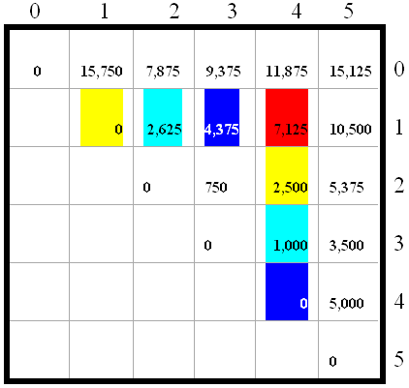
Algorithm Visualization
A₀: 30 X 35; A₁: 35 X15; A₂: 15X5;
A₃: 5X10; A₄: 10X20; A₅: 20 X 25

Slide 23
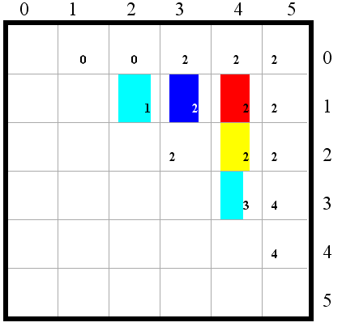
Algorithm Visualization
(A₀*(A₁*A₂))*((A₃*A₄)*A₅)

Slide 24
Matrix Chain-Products
Some final thoughts
We reduced replaced a O(2^{n}) algorithm with a Θ(n³) algorithm.
While the generic top-down recursive algorithm would have solved O(2^{n}) sub-problems, there are Θ(n²) sub-problems.
Implies a high overlap of sub-problems.
The sub-problems are independent:
Solution to A₀A₁…A_{k} is independent of the solution to A_{k+1}…A_{n}.

Slide 25
Matrix Chain-Products Summary
Determine the cost of each pair-wise multiplication, then the minimum cost of multiplying three consecutive matrices (2 possible choices), using the pre-computed costs for two matrices.
Repeat until we compute the minimum cost of all n matrices using the costs of the minimum n-1 matrix product costs.
n-1 possible choices.

