Slide 1
Pointers, Pointers, Pointers… CSE 333 Summer 2019
Please sit in the first six rows!
Instructor: Aaron Johnston
Teaching Assistants:
Yifan Bai Stuart Kol Daniel Lyu Kris Wong

Slide 2
About how long did Exercise 1 take?
0-1 Hours
1-2 Hours
2-3 Hours
3-4 Hours
4+ Hours
I prefer not to say

Slide 3




Administrivia
Exercise 2 out today and due Monday morning
Exercise grading
We will do our best to keep up
Things to watch for:
Input sanity check
No functional abstraction (single blob of code)
Formatting funnies (e.g. tabs instead of spaces)
Grades:
Correctness [0-3], Tools Check [0-2], Style [0-3]

Slide 4
Administrivia
Homework 0 due Monday
Logistics and infrastructure for projects
clint and valgrind are useful for exercises, too
Should have set up an SSH key and cloned GitLab repo by now
Do this ASAP so we have time to fix things if necessary
Homework 1 out later today, due in 2 weeks (Thu 7/11)
Linked list and hash table implementations in C
Get starter code using git pull in your course repo
Might have a merge if your local copy has unpushed changes
If git drops you into vim, :q to quit or :wq if you want to save changes
Notes:
One of CSE 333’s learning objectives: “substantial programming experience”

Slide 5

Administrivia
Documentation:
man pages, books
Reference websites: cplusplus.org, man7.org, gcc.gnu.org, etc.
Folklore:
Google-ing, Stack Overflow, that rando in the labs
Tradeoffs? Relative strengths & weaknesses?

Slide 6
Lecture Outline
Pointers & Pointer Arithmetic
Pointers as Parameters
Pointers and Arrays
Function Pointers

Slide 7


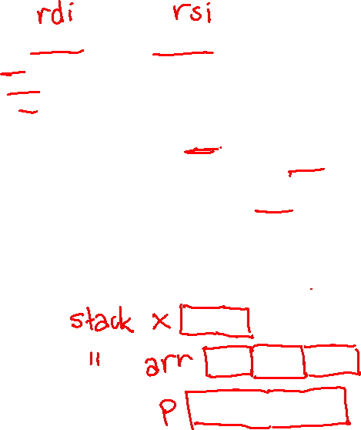
Box-and-Arrow Diagrams
boxarrow.c
int main(int argc, char** argv) {
int32_t x = 1;
int32_t arr[3] = {2, 3, 4};
int32_t* p = &arr[1];
printf("&x: %p; x: %d\n", &x, x);
printf("&arr[0]: %p; arr[0]: %d\n", &arr[0], arr[0]);
printf("&arr[2]: %p; arr[2]: %d\n", &arr[2], arr[2]);
printf("&p: %p; p: %p; *p: %d\n", &p, p, *p);
return 0;
}
address | name | value
Notes:
What are the variables here?
Where are arguments stored?
Attu demo: debugging symbols compile flag, using gdb, addresses exist as soon as stack frame created.

Slide 8
Box-and-Arrow Diagrams
boxarrow.c
int main(int argc, char** argv) {
int32_t x = 1;
int32_t arr[3] = {2, 3, 4};
int32_t* p = &arr[1];
printf("&x: %p; x: %d\n", &x, x);
printf("&arr[0]: %p; arr[0]: %d\n", &arr[0], arr[0]);
printf("&arr[2]: %p; arr[2]: %d\n", &arr[2], arr[2]);
printf("&p: %p; p: %p; *p: %d\n", &p, p, *p);
return 0;
}
address | name | value
&x | x | value
&arr[2] | arr[2] | value
&arr[1] | arr[1] | value
&arr[0] | arr[0] | value
&p | p | value
stack frame for main()
Notes:
These are local variables, so located on the Stack in some ordering.

Slide 9

Box-and-Arrow Diagrams
boxarrow.c
int main(int argc, char** argv) {
int32_t x = 1;
int32_t arr[3] = {2, 3, 4};
int32_t* p = &arr[1];
printf("&x: %p; x: %d\n", &x, x);
printf("&arr[0]: %p; arr[0]: %d\n", &arr[0], arr[0]);
printf("&arr[2]: %p; arr[2]: %d\n", &arr[2], arr[2]);
printf("&p: %p; p: %p; *p: %d\n", &p, p, *p);
return 0;
}
address | name | value
&x | x | 1
&arr[2] | arr[2] | 4
&arr[1] | arr[1] | 3
&arr[0] | arr[0] | 2
&p | p | &arr[1]
Notes:
Don’t forget about ASLR – address randomization!

Slide 10

Box-and-Arrow Diagrams
boxarrow.c
int main(int argc, char** argv) {
int32_t x = 1;
int32_t arr[3] = {2, 3, 4};
int32_t* p = &arr[1];
printf("&x: %p; x: %d\n", &x, x);
printf("&arr[0]: %p; arr[0]: %d\n", &arr[0], arr[0]);
printf("&arr[2]: %p; arr[2]: %d\n", &arr[2], arr[2]);
printf("&p: %p; p: %p; *p: %d\n", &p, p, *p);
return 0;
}
address | name | value
0x7fff…dc | x | 1
0x7fff…d8 | arr[2] | 4
0x7fff…d4 | arr[1] | 3
0x7fff…d0 | arr[0] | 2
0x7fff…c8 | p | 0x7fff…d4
Notes:
Don’t forget about ASLR – address randomization!

Slide 11
Pointer Arithmetic
Pointers are typed
Tells the compiler the size of the data you are pointing to
Exception: void* is a generic pointer (i.e. a placeholder)
Pointer arithmetic is scaled by sizeof(*p)
Works nicely for arrays
Does not work on void*, since void doesn’t have a size!
Valid pointer arithmetic:
Add/subtract an integer to/from a pointer
Subtract two pointers (within stack frame or malloc block)
Compare pointers (<, <=, ==, !=, >, >=), including NULL
Notes:
Everything else is illegal since it doesn’t make sense for addresses.

Slide 12

boxarrow2.c
int main(int argc, char** argv) {
int32_t arr[3] = {2, 3, 4};
int32_t* p = &arr[1];
int32_t** dp = &p; // pointer to a pointer
*(*dp) += 1;
p += 1;
*(*dp) += 1;
return 0;
}
At this point in the code, what values are stored in arr[]?
0x7fff…78 | arr[2] | 4
0x7fff…74 | arr[1] | 3
0x7fff…70 | arr[0] | 2
address | name | value
{2, 3, 4}
{3, 4, 5}
{2, 6, 4}
{2, 4, 5}
We’re lost…
0x7fff…68 | p | 0x7fff…74
0x7fff…60 | dp | 0x7fff…68
Notes:
Don’t forget about ASLR – address randomization!

Slide 13
Practice Solution
Note: arrow points to next instruction to be executed.
boxarrow2.c
int main(int argc, char** argv) {
int32_t arr[3] = {2, 3, 4};
int32_t* p = &arr[1];
int32_t** dp = &p; // pointer to a pointer
*(*dp) += 1;
p += 1;
*(*dp) += 1;
return 0;
}
0x7fff…78 | arr[2] | 4
0x7fff…74 | arr[1] | 3
0x7fff…70 | arr[0] | 2
4
address | name | value
0x7fff…68 | p | 0x7fff…74
0x7fff…60 | dp | 0x7fff…68
Notes:
Don’t forget about ASLR – address randomization!

Slide 14
Practice Solution
Note: arrow points to next instruction to be executed.
boxarrow2.c
int main(int argc, char** argv) {
int32_t arr[3] = {2, 3, 4};
int32_t* p = &arr[1];
int32_t** dp = &p; // pointer to a pointer
*(*dp) += 1;
p += 1;
*(*dp) += 1;
return 0;
}
0x7fff…78 | arr[2] | 4
0x7fff…74 | arr[1] | 4
0x7fff…70 | arr[0] | 2
address | name | value
0x7fff…68 | p | 0x7fff…74
0x7fff…60 | dp | 0x7fff…68
Notes:
Don’t forget about ASLR – address randomization!

Slide 15

Practice Solution
Note: arrow points to next instruction to be executed.
boxarrow2.c
int main(int argc, char** argv) {
int32_t arr[3] = {2, 3, 4};
int32_t* p = &arr[1];
int32_t** dp = &p; // pointer to a pointer
*(*dp) += 1;
p += 1;
*(*dp) += 1;
return 0;
}
0x7fff…78 | arr[2] | 4
0x7fff…74 | arr[1] | 4
0x7fff…70 | arr[0] | 2
address | name | value
0x7fff…68 | p | 0x7fff…78
0x7fff…60 | dp | 0x7fff…68
Notes:
Don’t forget about ASLR – address randomization!

Slide 16
Practice Solution
Note: arrow points to next instruction to be executed.
boxarrow2.c
int main(int argc, char** argv) {
int32_t arr[3] = {2, 3, 4};
int32_t* p = &arr[1];
int32_t** dp = &p; // pointer to a pointer
*(*dp) += 1;
p += 1;
*(*dp) += 1;
return 0;
}
5
0x7fff…78 | arr[2] | 4
0x7fff…74 | arr[1] | 4
0x7fff…70 | arr[0] | 2
address | name | value
0x7fff…68 | p | 0x7fff…78
0x7fff…60 | dp | 0x7fff…68
Notes:
Don’t forget about ASLR – address randomization!

Slide 17
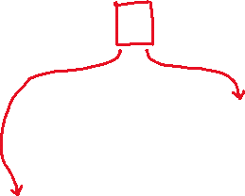
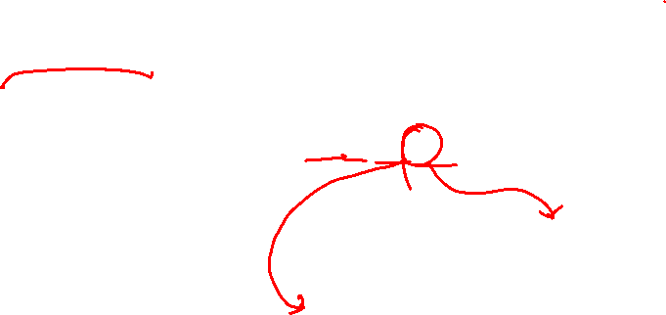
Endianness
Memory is byte-addressed, so endianness determines what ordering that multi-byte data gets read and stored in memory
Big-endian: Least significant byte has highest address
Little-endian: Least significant byte has lowest address
Example: 4-byte data 0xa1b2c3d4 at address 0x100
0x100
0x101
0x102
0x103
Big-Endian
a1
b2
c3
d4
0x100
0x101
0x102
0x103
Little-Endian
d4
c3
b2
a1

Slide 18
Pointer Arithmetic Example
Note: Arrow points to next instruction.
int main(int argc, char** argv) {
int arr[3] = {1, 2, 3};
int* int_ptr = &arr[0];
char* char_ptr = (char*) int_ptr;
int_ptr += 1;
int_ptr += 2; // uh oh
char_ptr += 1;
char_ptr += 2;
return 0;
}
Stack
(assume x86-64)
arr[2]
arr[1]
arr[0]
char_ptr
int_ptr
pointerarithmetic.c
+0 +1 +2 +3
Notes:
The provided code has printf statements after every pointer manipulation.
x86-64 is little-endian!

Slide 19
Pointer Arithmetic Example
Note: Arrow points to next instruction.
int main(int argc, char** argv) {
int arr[3] = {1, 2, 3};
int* int_ptr = &arr[0];
char* char_ptr = (char*) int_ptr;
int_ptr += 1;
int_ptr += 2; // uh oh
char_ptr += 1;
char_ptr += 2;
return 0;
}
Stack
(assume x86-64)
arr[2] | 03 | 00 | 00 | 00
arr[1] | 02 | 00 | 00 | 00
arr[0] | 01 | 00 | 00 | 00
char_ptr
int_ptr
pointerarithmetic.c
+0 +1 +2 +3
Notes:
The provided code has printf statements after every pointer manipulation.
x86-64 is little-endian!

Slide 20
Pointer Arithmetic Example
Note: Arrow points to next instruction.
int main(int argc, char** argv) {
int arr[3] = {1, 2, 3};
int* int_ptr = &arr[0];
char* char_ptr = (char*) int_ptr;
int_ptr += 1;
int_ptr += 2; // uh oh
char_ptr += 1;
char_ptr += 2;
return 0;
}
Stack
(assume x86-64)
arr[2] | 03 | 00 | 00 | 00
arr[1] | 02 | 00 | 00 | 00
arr[0] | 01 | 00 | 00 | 00
char_ptr
int_ptr
pointerarithmetic.c
+0 +1 +2 +3
Notes:
The provided code has printf statements after every pointer manipulation.
x86-64 is little-endian!

Slide 21
Pointer Arithmetic Example
Note: Arrow points to next instruction.
int main(int argc, char** argv) {
int arr[3] = {1, 2, 3};
int* int_ptr = &arr[0];
char* char_ptr = (char*) int_ptr;
int_ptr += 1;
int_ptr += 2; // uh oh
char_ptr += 1;
char_ptr += 2;
return 0;
}
Stack
(assume x86-64)
arr[2] | 03 | 00 | 00 | 00
arr[1] | 02 | 00 | 00 | 00
arr[0] | 01 | 00 | 00 | 00
char_ptr
int_ptr
pointerarithmetic.c
+0 +1 +2 +3
Notes:
The provided code has printf statements after every pointer manipulation.
x86-64 is little-endian!

Slide 22
Pointer Arithmetic Example
Note: Arrow points to next instruction.
int main(int argc, char** argv) {
int arr[3] = {1, 2, 3};
int* int_ptr = &arr[0];
char* char_ptr = (char*) int_ptr;
int_ptr += 1;
int_ptr += 2; // uh oh
char_ptr += 1;
char_ptr += 2;
return 0;
}
Stack
(assume x86-64)
arr[2] | 03 | 00 | 00 | 00
arr[1] | 02 | 00 | 00 | 00
arr[0] | 01 | 00 | 00 | 00
char_ptr
int_ptr
pointerarithmetic.c
int_ptr: 0x0x7ffffffde010
*int_ptr: 1
+0 +1 +2 +3
Notes:
The provided code has printf statements after every pointer manipulation.
x86-64 is little-endian!

Slide 23
Pointer Arithmetic Example
Note: Arrow points to next instruction.
int main(int argc, char** argv) {
int arr[3] = {1, 2, 3};
int* int_ptr = &arr[0];
char* char_ptr = (char*) int_ptr;
int_ptr += 1;
int_ptr += 2; // uh oh
char_ptr += 1;
char_ptr += 2;
return 0;
}
Stack
(assume x86-64)
arr[2] | 03 | 00 | 00 | 00
arr[1] | 02 | 00 | 00 | 00
arr[0] | 01 | 00 | 00 | 00
char_ptr
int_ptr
pointerarithmetic.c
int_ptr: 0x0x7ffffffde014
*int_ptr: 2
+0 +1 +2 +3
Notes:
The provided code has printf statements after every pointer manipulation.
x86-64 is little-endian!

Slide 24
Pointer Arithmetic Example
Note: Arrow points to next instruction.
int main(int argc, char** argv) {
int arr[3] = {1, 2, 3};
int* int_ptr = &arr[0];
char* char_ptr = (char*) int_ptr;
int_ptr += 1;
int_ptr += 2; // uh oh
char_ptr += 1;
char_ptr += 2;
return 0;
}
Stack
(assume x86-64)
arr[2] | 03 | 00 | 00 | 00
arr[1] | 02 | 00 | 00 | 00
arr[0] | 01 | 00 | 00 | 00
char_ptr
int_ptr
pointerarithmetic.c
int_ptr: 0x0x7ffffffde01C
*int_ptr: ???
+0 +1 +2 +3
Notes:
The provided code has printf statements after every pointer manipulation.
x86-64 is little-endian!

Slide 25
Pointer Arithmetic Example
Note: Arrow points to next instruction.
int main(int argc, char** argv) {
int arr[3] = {1, 2, 3};
int* int_ptr = &arr[0];
char* char_ptr = (char*) int_ptr;
int_ptr += 1;
int_ptr += 2; // uh oh
char_ptr += 1;
char_ptr += 2;
return 0;
}
Stack
(assume x86-64)
arr[2] | 03 | 00 | 00 | 00
arr[1] | 02 | 00 | 00 | 00
arr[0] | 01 | 00 | 00 | 00
char_ptr
int_ptr
pointerarithmetic.c
char_ptr: 0x0x7ffffffde010
*char_ptr: 1
+0 +1 +2 +3
Notes:
The provided code has printf statements after every pointer manipulation.
x86-64 is little-endian!

Slide 26
Pointer Arithmetic Example
Note: Arrow points to next instruction.
int main(int argc, char** argv) {
int arr[3] = {1, 2, 3};
int* int_ptr = &arr[0];
char* char_ptr = (char*) int_ptr;
int_ptr += 1;
int_ptr += 2; // uh oh
char_ptr += 1;
char_ptr += 2;
return 0;
}
Stack
(assume x86-64)
arr[2] | 03 | 00 | 00 | 00
arr[1] | 02 | 00 | 00 | 00
arr[0] | 01 | 00 | 00 | 00
char_ptr
int_ptr
pointerarithmetic.c
char_ptr: 0x0x7ffffffde011
*char_ptr: 0
+0 +1 +2 +3
Notes:
The provided code has printf statements after every pointer manipulation.
x86-64 is little-endian!

Slide 27
Pointer Arithmetic Example
Note: Arrow points to next instruction.
int main(int argc, char** argv) {
int arr[3] = {1, 2, 3};
int* int_ptr = &arr[0];
char* char_ptr = (char*) int_ptr;
int_ptr += 1;
int_ptr += 2; // uh oh
char_ptr += 1;
char_ptr += 2;
return 0;
}
Stack
(assume x86-64)
arr[2] | 03 | 00 | 00 | 00
arr[1] | 02 | 00 | 00 | 00
arr[0] | 01 | 00 | 00 | 00
char_ptr
int_ptr
pointerarithmetic.c
char_ptr: 0x0x7ffffffde013
*char_ptr: 0
+0 +1 +2 +3
Notes:
The provided code has printf statements after every pointer manipulation.
x86-64 is little-endian!

Slide 28
Lecture Outline
Pointers & Pointer Arithmetic
Pointers as Parameters
Pointers and Arrays
Function Pointers

Slide 29
C is Call-By-Value
C (and Java) pass arguments by value
Callee receives a local copy of the argument
Register or Stack
If the callee modifies a parameter, the caller’s copy isn’t modified
void swap(int a, int b) {
int tmp = a;
a = b;
b = tmp;
}
int main(int argc, char** argv) {
int a = 42, b = -7;
swap(a, b);
...

Slide 30
Broken Swap
Note: Arrow points to next instruction.
OS kernel [protected]
Stack
main
brokenswap.c
void swap(int a, int b) {
int tmp = a;
a = b;
b = tmp;
}
int main(int argc, char** argv) {
int a = 42, b = -7;
swap(a, b);
...
Heap
Read/Write Segment .data, .bss
Read-Only Segment .text, .rodata

Slide 31
Broken Swap
OS kernel [protected]
Stack
main
a
42
b
-7
brokenswap.c
void swap(int a, int b) {
int tmp = a;
a = b;
b = tmp;
}
int main(int argc, char** argv) {
int a = 42, b = -7;
swap(a, b);
...
Heap
Read/Write Segment .data, .bss
Read-Only Segment .text, .rodata

Slide 32
Broken Swap
OS kernel [protected]
Stack
main
a
42
b
-7
swap
a
42
b
-7
brokenswap.c
tmp
??
void swap(int a, int b) {
int tmp = a;
a = b;
b = tmp;
}
int main(int argc, char** argv) {
int a = 42, b = -7;
swap(a, b);
...
Heap
Read/Write Segment .data, .bss
Read-Only Segment .text, .rodata

Slide 33
Broken Swap
OS kernel [protected]
Stack
main
a
42
b
-7
swap
a
42
b
-7
brokenswap.c
tmp
42
void swap(int a, int b) {
int tmp = a;
a = b;
b = tmp;
}
int main(int argc, char** argv) {
int a = 42, b = -7;
swap(a, b);
...
Heap
Read/Write Segment .data, .bss
Read-Only Segment .text, .rodata

Slide 34
Broken Swap
OS kernel [protected]
Stack
main
a
42
b
-7
swap
a
-7
b
-7
brokenswap.c
tmp
42
void swap(int a, int b) {
int tmp = a;
a = b;
b = tmp;
}
int main(int argc, char** argv) {
int a = 42, b = -7;
swap(a, b);
...
Heap
Read/Write Segment .data, .bss
Read-Only Segment .text, .rodata

Slide 35
Broken Swap
OS kernel [protected]
Stack
main
a
42
b
-7
swap
a
-7
b
42
brokenswap.c
tmp
42
void swap(int a, int b) {
int tmp = a;
a = b;
b = tmp;
}
int main(int argc, char** argv) {
int a = 42, b = -7;
swap(a, b);
...
Heap
Read/Write Segment .data, .bss
Read-Only Segment .text, .rodata

Slide 36
Broken Swap
OS kernel [protected]
Stack
main
a
42
b
-7
brokenswap.c
void swap(int a, int b) {
int tmp = a;
a = b;
b = tmp;
}
int main(int argc, char** argv) {
int a = 42, b = -7;
swap(a, b);
...
Heap
Read/Write Segment .data, .bss
Read-Only Segment .text, .rodata

Slide 37
Faking Call-By-Reference in C
Can use pointers to approximate call-by-reference
Callee still receives a copy of the pointer (i.e. call-by-value), but it can modify something in the caller’s scope by dereferencing the pointer parameter
void swap(int a, int b) {
int tmp = a;
a = b;
b = tmp;
}
int main(int argc, char** argv) {
int a = 42, b = -7;
swap(a, b);
...
void swap(int* a, int* b) {
int tmp = *a;
*a = *b;
*b = tmp;
}
int main(int argc, char** argv) {
int a = 42, b = -7;
swap(&a, &b);
...

Slide 38
Fixed Swap
Note: Arrow points to next instruction.
OS kernel [protected]
Stack
main
a
42
b
-7
swap.c
void swap(int* a, int* b) {
int tmp = *a;
*a = *b;
*b = tmp;
}
int main(int argc, char** argv) {
int a = 42, b = -7;
swap(&a, &b);
...
Heap
Read/Write Segment .data, .bss
Read-Only Segment .text, .rodata

Slide 39
Fixed Swap
OS kernel [protected]
Stack
main
a
42
b
-7
swap
a
b
swap.c
tmp
??
void swap(int* a, int* b) {
int tmp = *a;
*a = *b;
*b = tmp;
}
int main(int argc, char** argv) {
int a = 42, b = -7;
swap(&a, &b);
...
Heap
Read/Write Segment .data, .bss
Read-Only Segment .text, .rodata

Slide 40
Fixed Swap
OS kernel [protected]
Stack
main
a
42
b
-7
swap
a
b
swap.c
tmp
42
void swap(int* a, int* b) {
int tmp = *a;
*a = *b;
*b = tmp;
}
int main(int argc, char** argv) {
int a = 42, b = -7;
swap(&a, &b);
...
Heap
Read/Write Segment .data, .bss
Read-Only Segment .text, .rodata

Slide 41
Fixed Swap
OS kernel [protected]
Stack
main
a
-7
b
-7
swap
a
b
swap.c
tmp
42
void swap(int* a, int* b) {
int tmp = *a;
*a = *b;
*b = tmp;
}
int main(int argc, char** argv) {
int a = 42, b = -7;
swap(&a, &b);
...
Heap
Read/Write Segment .data, .bss
Read-Only Segment .text, .rodata

Slide 42
Fixed Swap
OS kernel [protected]
Stack
main
a
-7
b
42
swap
a
b
swap.c
tmp
42
void swap(int* a, int* b) {
int tmp = *a;
*a = *b;
*b = tmp;
}
int main(int argc, char** argv) {
int a = 42, b = -7;
swap(&a, &b);
...
Heap
Read/Write Segment .data, .bss
Read-Only Segment .text, .rodata

Slide 43


Fixed Swap
OS kernel [protected]
Stack
main
a
-7
b
42
swap.c
void swap(int* a, int* b) {
int tmp = *a;
*a = *b;
*b = tmp;
}
int main(int argc, char** argv) {
int a = 42, b = -7;
swap(&a, &b);
...
Heap
Read/Write Segment .data, .bss
Read-Only Segment .text, .rodata

Slide 44
Lecture Outline
Pointers & Pointer Arithmetic
Pointers as Parameters
Pointers and Arrays
Function Pointers

Slide 45
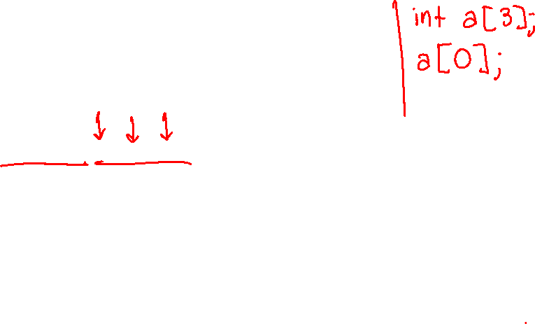
Pointers and Arrays
A pointer can point to an array element
You can use array indexing notation on pointers
ptr[i] is *(ptr+i) with pointer arithmetic – reference the data i elements forward from ptr
An array name’s value is the beginning address of the array
Like a pointer to the first element of array, but can’t change
int a[] = {10, 20, 30, 40, 50};
int32_t* p1 = &a[3]; // refers to a's 4th element
int32_t* p2 = &a[0]; // refers to a's 1st element
int32_t* p3 = a; // refers to a's 1st element
*p1 = 100;
*p2 = 200;
p1[1] = 300;
p2[1] = 400;
p3[2] = 500; // final: 200, 400, 500, 100, 300

Slide 46


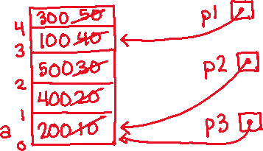
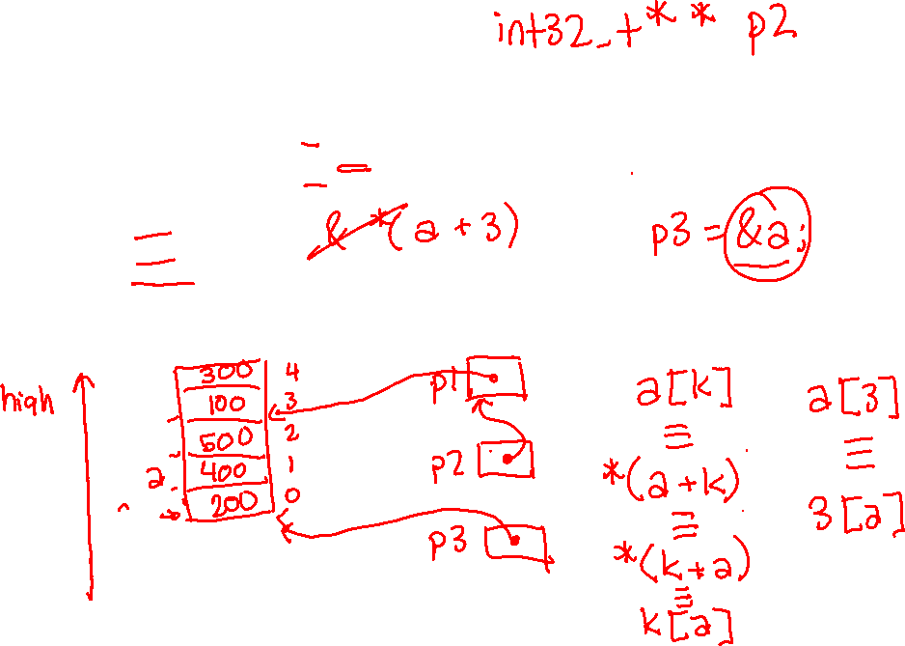
Pointers and Arrays
int a[] = {10, 20, 30, 40, 50};
int32_t* p1 = &a[3]; // refers to a's 4th element
int32_t* p2 = &a[0]; // refers to a's 1st element
int32_t* p3 = a; // refers to a's 1st element
*p1 = 100;
*p2 = 200;
p1[1] = 300;
p2[1] = 400;
p3[2] = 500; // final: 200, 400, 500, 100, 300

Slide 47
Array Parameters
Array parameters are actually passed as pointers to the first array element
The [] syntax for parameter types is just for convenience
OK to use whichever best helps the reader
This code:
Equivalent to:
void f(int a[]);
int main( ... ) {
int a[5];
...
f(a);
return 0;
}
void f(int a[]) {
void f(int* a);
int main( ... ) {
int a[5];
...
f(&a[0]);
return 0;
}
void f(int* a) {

Slide 48
Lecture Outline
Pointers & Pointer Arithmetic
Pointers as Parameters
Pointers and Arrays
Function Pointers

Slide 49
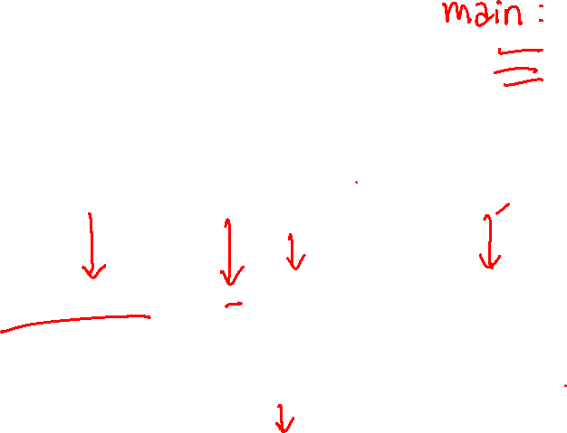
Function Pointers
Based on what you know about assembly, what is a function name, really?
Can use pointers that store addresses of functions!
Generic format:
Looks like a function prototype with extra * in front of name
Why are parentheses around (* name) needed?
Using the function:
Calls the pointed-to function with the given arguments and return the return value
returnType (* name)(type1, …, typeN)
(*name)(arg1, …, argN)
Notes:
Comit & and * when using a function name as an argument or calling a function via a pointer

Slide 50
Function Pointer Example
map() performs operation on each element of an array
#define LEN 4
int negate(int num) {return -num;}
int square(int num) {return num*num;}
// perform operation pointed to on each array element
void map(int a[], int len, int (* op)(int n)) {
for (int i = 0; i < len; i++) {
a[i] = (*op)(a[i]); // dereference function pointer
}
}
int main(int argc, char** argv) {
int arr[LEN] = {-1, 0, 1, 2};
int (* op)(int n); // function pointer called 'op'
op = square; // function name returns addr (like array)
map(arr, LEN, op);
...
funcptr parameter
funcptr dereference
funcptr definition
funcptr assignment
map.c

Slide 51
Extra Exercise #1
Use a box-and-arrow diagram for the following program and explain what it prints out:
#include <stdio.h>
int foo(int* bar, int** baz) {
*bar = 5;
*(bar+1) = 6;
*baz = bar + 2;
return *((*baz)+1);
}
int main(int argc, char** argv) {
int arr[4] = {1, 2, 3, 4};
int* ptr;
arr[0] = foo(&arr[0], &ptr);
printf("%d %d %d %d %d\n",
arr[0], arr[1], arr[2], arr[3], *ptr);
return 0;
}

Slide 52
Extra Exercise #2
Write a program that determines and prints out whether the computer it is running on is little-endian or big-endian.
Hint: pointerarithmetic.c from today’s lecture or show_bytes.c from 351

Slide 53
Extra Exercise #3
Write a function that:
Arguments: [1] an array of ints and [2] an array length
Malloc’s an int* array of the same element length
Initializes each element of the newly-allocated array to point to the corresponding element of the passed-in array
Returns a pointer to the newly-allocated array

Slide 54
Extra Exercise #4
Write a function that:
Accepts a function pointer and an integer as arguments
Invokes the pointed-to function with the integer as its argument

