Slide 1
Data Structures and Modules CSE 333 Summer 2019
Instructor: Aaron Johnston
Teaching Assistants:
Yifan Bai Stuart Kol Daniel Lyu Kris Wong

Slide 2
About how long did Exercise 3 take?
0-1 Hours
1-2 Hours
2-3 Hours
3-4 Hours
4+ Hours
I prefer not to say

Slide 3
Administrivia
This Thursday (7/4) is Independence Day
Sections and Office Hours will be cancelled
Exercise 4: Practice with good style, debugging (Friday), and C modules (Today)
Released today, due Monday (7/8)
Significantly longer and harder than previous exercises!
Homework 1 due in a week
Advice: be sure to read headers carefully while implementing
Advice: use git add/commit/push often to save your work

Slide 4
Lecture Outline
Implementing Data Structures in C
Multi-file C Programs
C Preprocessor Intro

Slide 5


Simple Linked List in C
Each node in a linear, singly-linked list contains:
Some element as its payload
A pointer to the next node in the linked list
This pointer is NULL (or some other indicator) in the last node in the list
Element Z
Element Y
Element X
$$∅$$
head

Slide 6


Linked List Node
Let’s represent a linked list node with a struct
For now, assume each element is an int32_t
typedef struct node_st {
int32_t element;
struct node_st* next;
} Node;
int main(int argc, char** argv) {
Node n1, n2;
n1.element = 1;
n1.next = &n2;
n2.element = 2;
n2.next = NULL;
return EXIT_SUCCESS;
}
element
next
n1
1
element
next
n2
2
$$∅$$
manual_list.c

Slide 7


Push Onto List
Arrow points to next instruction.
typedef struct node_st {
int32_t element;
struct node_st* next;
} Node;
Node* Push(Node* head, int32_t e) {
Node* n = (Node*) malloc(sizeof(Node));
assert(n != NULL); // crashes if false
n->element = e;
n->next = head;
return n;
}
int main(int argc, char** argv) {
Node* list = NULL;
list = Push(list, 1);
list = Push(list, 2);
return EXIT_SUCCESS;
}
(main) list
$$∅$$
push_list.c

Slide 8

Push Onto List
Arrow points to next instruction.
typedef struct node_st {
int32_t element;
struct node_st* next;
} Node;
Node* Push(Node* head, int32_t e) {
Node* n = (Node*) malloc(sizeof(Node));
assert(n != NULL); // crashes if false
n->element = e;
n->next = head;
return n;
}
int main(int argc, char** argv) {
Node* list = NULL;
list = Push(list, 1);
list = Push(list, 2);
return EXIT_SUCCESS;
}
(main) list
$$∅$$
(Push) head
$$∅$$
(Push) e
1
(Push) n
element
next
push_list.c

Slide 9

Push Onto List
Arrow points to next instruction.
typedef struct node_st {
int32_t element;
struct node_st* next;
} Node;
Node* Push(Node* head, int32_t e) {
Node* n = (Node*) malloc(sizeof(Node));
assert(n != NULL); // crashes if false
n->element = e;
n->next = head;
return n;
}
int main(int argc, char** argv) {
Node* list = NULL;
list = Push(list, 1);
list = Push(list, 2);
return EXIT_SUCCESS;
}
(main) list
$$∅$$
(Push) head
$$∅$$
(Push) e
1
(Push) n
element
next
push_list.c

Slide 10
Push Onto List
Arrow points to next instruction.
typedef struct node_st {
int32_t element;
struct node_st* next;
} Node;
Node* Push(Node* head, int32_t e) {
Node* n = (Node*) malloc(sizeof(Node));
assert(n != NULL); // crashes if false
n->element = e;
n->next = head;
return n;
}
int main(int argc, char** argv) {
Node* list = NULL;
list = Push(list, 1);
list = Push(list, 2);
return EXIT_SUCCESS;
}
(main) list
$$∅$$
(Push) head
$$∅$$
(Push) e
1
(Push) n
element
next
push_list.c

Slide 11
Push Onto List
Arrow points to next instruction.
typedef struct node_st {
int32_t element;
struct node_st* next;
} Node;
Node* Push(Node* head, int32_t e) {
Node* n = (Node*) malloc(sizeof(Node));
assert(n != NULL); // crashes if false
n->element = e;
n->next = head;
return n;
}
int main(int argc, char** argv) {
Node* list = NULL;
list = Push(list, 1);
list = Push(list, 2);
return EXIT_SUCCESS;
}
(main) list
$$∅$$
(Push) head
$$∅$$
(Push) e
1
(Push) n
element
next
1
push_list.c

Slide 12
Push Onto List
Arrow points to next instruction.
typedef struct node_st {
int32_t element;
struct node_st* next;
} Node;
Node* Push(Node* head, int32_t e) {
Node* n = (Node*) malloc(sizeof(Node));
assert(n != NULL); // crashes if false
n->element = e;
n->next = head;
return n;
}
int main(int argc, char** argv) {
Node* list = NULL;
list = Push(list, 1);
list = Push(list, 2);
return EXIT_SUCCESS;
}
(main) list
$$∅$$
(Push) head
$$∅$$
(Push) e
1
(Push) n
element
next
1
$$∅$$
push_list.c

Slide 13
Push Onto List
Arrow points to next instruction.
typedef struct node_st {
int32_t element;
struct node_st* next;
} Node;
Node* Push(Node* head, int32_t e) {
Node* n = (Node*) malloc(sizeof(Node));
assert(n != NULL); // crashes if false
n->element = e;
n->next = head;
return n;
}
int main(int argc, char** argv) {
Node* list = NULL;
list = Push(list, 1);
list = Push(list, 2);
return EXIT_SUCCESS;
}
(main) list
(Push) head
(Push) e
1
(Push) n
element
next
1
$$∅$$
push_list.c

Slide 14
Push Onto List
Arrow points to next instruction.
typedef struct node_st {
int32_t element;
struct node_st* next;
} Node;
Node* Push(Node* head, int32_t e) {
Node* n = (Node*) malloc(sizeof(Node));
assert(n != NULL); // crashes if false
n->element = e;
n->next = head;
return n;
}
int main(int argc, char** argv) {
Node* list = NULL;
list = Push(list, 1);
list = Push(list, 2);
return EXIT_SUCCESS;
}
(main) list
(Push) head
(Push) e
2
(Push) n
element
next
1
$$∅$$
element
next
push_list.c

Slide 15
Push Onto List
Arrow points to next instruction.
typedef struct node_st {
int32_t element;
struct node_st* next;
} Node;
Node* Push(Node* head, int32_t e) {
Node* n = (Node*) malloc(sizeof(Node));
assert(n != NULL); // crashes if false
n->element = e;
n->next = head;
return n;
}
int main(int argc, char** argv) {
Node* list = NULL;
list = Push(list, 1);
list = Push(list, 2);
return EXIT_SUCCESS;
}
(main) list
(Push) head
(Push) e
2
(Push) n
element
next
1
$$∅$$
element
next
push_list.c

Slide 16
Push Onto List
Arrow points to next instruction.
typedef struct node_st {
int32_t element;
struct node_st* next;
} Node;
Node* Push(Node* head, int32_t e) {
Node* n = (Node*) malloc(sizeof(Node));
assert(n != NULL); // crashes if false
n->element = e;
n->next = head;
return n;
}
int main(int argc, char** argv) {
Node* list = NULL;
list = Push(list, 1);
list = Push(list, 2);
return EXIT_SUCCESS;
}
(main) list
(Push) head
(Push) e
2
(Push) n
element
next
1
$$∅$$
element
next
push_list.c

Slide 17
Push Onto List
Arrow points to next instruction.
typedef struct node_st {
int32_t element;
struct node_st* next;
} Node;
Node* Push(Node* head, int32_t e) {
Node* n = (Node*) malloc(sizeof(Node));
assert(n != NULL); // crashes if false
n->element = e;
n->next = head;
return n;
}
int main(int argc, char** argv) {
Node* list = NULL;
list = Push(list, 1);
list = Push(list, 2);
return EXIT_SUCCESS;
}
(main) list
(Push) head
(Push) e
2
(Push) n
element
next
1
$$∅$$
element
next
2
push_list.c

Slide 18
Push Onto List
Arrow points to next instruction.
typedef struct node_st {
int32_t element;
struct node_st* next;
} Node;
Node* Push(Node* head, int32_t e) {
Node* n = (Node*) malloc(sizeof(Node));
assert(n != NULL); // crashes if false
n->element = e;
n->next = head;
return n;
}
int main(int argc, char** argv) {
Node* list = NULL;
list = Push(list, 1);
list = Push(list, 2);
return EXIT_SUCCESS;
}
(main) list
(Push) head
(Push) e
2
(Push) n
element
next
1
$$∅$$
element
next
2
push_list.c

Slide 19
Push Onto List
Arrow points to next instruction.
typedef struct node_st {
int32_t element;
struct node_st* next;
} Node;
Node* Push(Node* head, int32_t e) {
Node* n = (Node*) malloc(sizeof(Node));
assert(n != NULL); // crashes if false
n->element = e;
n->next = head;
return n;
}
int main(int argc, char** argv) {
Node* list = NULL;
list = Push(list, 1);
list = Push(list, 2);
return EXIT_SUCCESS;
}
(main) list
(Push) head
(Push) e
2
(Push) n
element
next
1
$$∅$$
element
next
2
push_list.c

Slide 20
Push Onto List
Arrow points to next instruction.
typedef struct node_st {
int32_t element;
struct node_st* next;
} Node;
Node* Push(Node* head, int32_t e) {
Node* n = (Node*) malloc(sizeof(Node));
assert(n != NULL); // crashes if false
n->element = e;
n->next = head;
return n;
}
int main(int argc, char** argv) {
Node* list = NULL;
list = Push(list, 1);
list = Push(list, 2);
return EXIT_SUCCESS;
}
A (benign) memory leak!
Try running with Valgrind:
bash$ gcc –Wall -g –o push_list push_list.c
bash$ valgrind --leak-check=full ./push_list
element
next
1
$$∅$$
element
next
2
push_list.c

Slide 21


A Generic Linked List
Let’s generalize the linked list element type
Let customer decide type (instead of always int32_t)
Idea: let them use a generic pointer (i.e. a void*)
typedef struct node_st {
void* element;
struct node_st* next;
} Node;
Node* Push(Node* head, void* e) {
Node* n = (Node*) malloc(sizeof(Node));
assert(n != NULL); // crashes if false
n->element = e;
n->next = head;
return n;
}
element
next
element
next
$$∅$$

Slide 22

Using a Generic Linked List
Type casting needed to deal with void* (raw address)
Before pushing, should convert to void*
Must convert back to data type when accessing
typedef struct node_st {
void* element;
struct node_st* next;
} Node;
Node* Push(Node* head, void* e); // assume last slide’s code
int main(int argc, char** argv) {
char* hello = "Hi there!";
char* goodbye = "Bye bye.";
Node* list = NULL;
list = Push(list, (void*) hello);
list = Push(list, (void*) goodbye);
printf("payload: '%s'\n", (char*) ((list->next)->element) );
return EXIT_SUCCESS;
}
manual_list_void.c

Slide 23
Linked List Code for Memory Diagram
Node* Push(Node* head, void* e) {
Node* n = malloc(sizeof(Node));
assert(n != NULL);
n->element = e;
n->next = head;
return n;
}
manual_list_void.c
typedef struct node_st {
void* element;
struct node_st* next;
} Node;
Node* Push(Node* head, void* e);
int main(int argc, char** argv) {
char* hello = "Hi there!";
char* goodbye = "Bye bye.";
Node* list = NULL;
list = Push(list, (void*) hello);
list = Push(list, (void*) goodbye);
return EXIT_SUCCESS;
}

Slide 24
Resulting Memory Diagram

Slide 25
Resulting Memory Diagram
(main) list
(main) goodbye
(main) hello
element
B
y
e
b
y
e
.
\0
next
element
H
i
t
h
e
r
e
!
\0
next
$$∅$$

Slide 26
Lecture Outline
Implementing Data Structures in C
Multi-file C Programs
C Preprocessor Intro

Slide 27
Multi-File C Programs
Let’s create a linked list module
A module is a self-contained piece of an overall program
Has externally visible functions that customers can invoke
Has externally visible typedefs, and perhaps global variables, that customers can use
May have internal functions, typedefs, or global variables that customers should not look at
The module’s interface is its set of public functions, typedefs, and global variables

Slide 28

Modularity
The degree to which components of a system can be separated and recombined
“Loose coupling” and “separation of concerns”
Modules can be developed independently
Modules can be re-used in different projects
main program
linked list
hash
table

Slide 29
C Header Files
Header: a C file whose only purpose is to be #include’d
Generally has a filename .h extension
Holds the variables, types, and function prototype declarations that make up the interface to a module
Main Idea:
Every name.c is intended to be a module that has a name.h
name.h declares the interface to that module
Other modules can use name by #include-ing name.h
They should assume as little as possible about the implementation in name.c

Slide 30



C Module Conventions
Most C projects adhere to the following rules:
.h files only contain declarations, never definitions
.c files never contain prototype declarations for functions that are intended to be exported through the module interface
Those function prototype declarations belong in the .h file
NEVER #include a .c file – only #include .h files
#include all of headers you reference, even if another header (accidentally or not) includes some of them
Any .c file with an associated .h file should be able to be compiled into a .o file
The .c file should #include the .h file; the compiler will check definitions and declarations for consistency

Slide 31

#include and the C Preprocessor
The C preprocessor (cpp) transforms your source code before the compiler runs
Input is a C file (text) and output is still a C file (text)
Processes the directives it finds in your code (#directive)
e.g. #include "ll.h“ is replaced by the post-processed content of ll.h
e.g. #define PI 3.1415 defines a symbol and replaces later occurrences
Several others that we’ll see soon…
Run on your behalf by gcc during compilation
#include "ll.h"
#define PI 3.1415
Notes:
“ “ – look in local directory first, then in library directory if it can’t be found
< > -- look directly in library directory

Slide 32
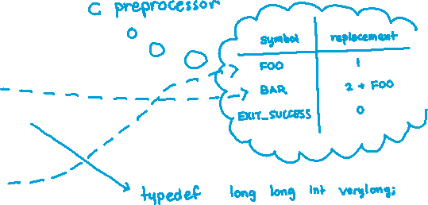

C Preprocessor Example
What do you think the preprocessor output will be?
#define BAR 2 + FOO
typedef long long int verylong;
cpp_example.h
#define FOO 1
#include "cpp_example.h"
int main(int argc, char** argv) {
int x = FOO; // a comment
int y = BAR;
verylong z = FOO + BAR;
return EXIT_SUCCESS;
}
cpp_example.c

Slide 33
C Preprocessor Example
We can manually run the preprocessor:
cpp is the preprocessor (can also use gcc -E)
“-P” option suppresses some extra debugging annotations
#define BAR 2 + FOO
typedef long long int verylong;
bash$ cpp –P cpp_example.c out.c
cpp_example.h
bash$ cpp –P cpp_example.c out.c
bash$ cat out.c
typedef long long int verylong;
int main(int argc, char **argv) {
int x = 1;
int y = 2 + 1;
verylong z = 1 + 2 + 1;
return 0;
}
#define FOO 1
#include "cpp_example.h"
int main(int argc, char** argv) {
int x = FOO; // a comment
int y = BAR;
verylong z = FOO + BAR;
return EXIT_SUCCESS;
}
cpp_example.c
Notes:
https://en.wikipedia.org/wiki/C_preprocessor#Order_of_expansion

Slide 34
Program Using a Linked List
#include <stdlib.h>
#include <assert.h>
#include "ll.h"
Node* Push(Node* head,
void* element) {
... // implementation here
}
#include "ll.h"
int main(int argc, char** argv) {
Node* list = NULL;
char* hi = "hello";
char* bye = "goodbye";
list = Push(list, (void*)hi);
list = Push(list, (void*)bye);
...
return 0;
}
ll.c
typedef struct node_st {
void* element;
struct node_st* next;
} Node;
Node* Push(Node* head,
void* element);
example_ll_customer.c
ll.h

Slide 35
Compiling the Program
Four parts:
1) Compile example_ll_customer.c into an object file
2) Compile ll.c into an object file
3) Link both object files into an executable
4) Test, Debug, Rinse, Repeat
bash$ gcc –Wall -g –c –o example_ll_customer.o example_ll_customer.c
bash$ gcc –Wall –g –c –o ll.o ll.c
bash$ gcc -g –o example_ll_customer ll.o example_ll_customer.o
bash$ ./example_ll_customer
Payload: 'yo!'
Payload: 'goodbye'
Payload: 'hello'
bash$ valgrind –leak-check=full ./example_ll_customer
... etc ...

Slide 36
Where Do the Comments Go?
If a function is declared in a header file (.h) and defined in a C file (.c):
The header needs full documentation because it is the public specification
No need to copy/paste the comment into the C file
Don’t want two copies that can get out of sync
Recommended to leave “specified in <filename>.h” comment in C file code to help the reader

Slide 37
Where Do the Comments Go?
If a function has a prototype and implementation in same C file:
One school of thought: Full comment on the prototype at the top of the file, no comment (or “declared above”) on code
333 project code is like this
Another school: Prototype is for the compiler and doesn’t need comment; put the comments with the code to keep them together
Not used in 333

Slide 38
Extra Exercise #1
Extend the linked list program we covered in class:
Add a function that returns the number of elements in a list
Implement a program that builds a list of lists
i.e. it builds a linked list where each element is a (different) linked list
Bonus: design and implement a “Pop” function
Removes an element from the head of the list
Make sure your linked list code, and customers’ code that uses it, contains no memory leaks

Slide 39
Extra Exercise #2
Implement and test a binary search tree
https://en.wikipedia.org/wiki/Binary_search_tree
Don’t worry about making it balanced
Implement key insert() and lookup() functions
Bonus: implement a key delete() function
Implement it as a C module
bst.c, bst.h
Implement test_bst.c
Contains main() and tests out your BST

Slide 40
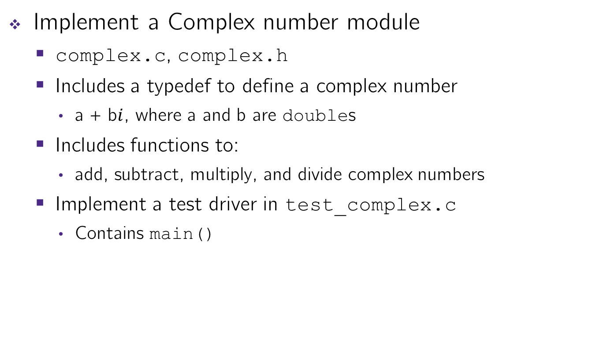
Extra Exercise #3
Implement a Complex number module
complex.c, complex.h
Includes a typedef to define a complex number
a + b$i$, where a and b are doubles
Includes functions to:
add, subtract, multiply, and divide complex numbers
Implement a test driver in test_complex.c
Contains main()

