Slide 1
C Wrap-Up, File I/O CSE 333 Summer 2019
Instructor: Aaron Johnston
Teaching Assistants:
Yifan Bai Stuart Kol Daniel Lyu Kris Wong

Slide 2
About how long did Exercise 4 take?
0-3 Hours
3-4 Hours
4-5 Hours
5-6 Hours
6+ Hours
I prefer not to say

Slide 3
Administrivia
Exercise 5 out today, due Wednesday morning
No exercise due Friday! Exercise 6 will be released on Thursday and due the following Monday (7/15)
Homework 0 grades will be posted this afternoon
Run git pull to see feedback
Homework 1 due Thursday (7/11) at 11:59 pm
Submit via GitLab (i.e. commit/push changes, then push tag)

Slide 4
Lecture Outline
Visibility of Symbols
extern, static
File I/O with the C standard library

Slide 5
Namespace Problem
If we define a global variable named “counter” in one C file, is it visible in a different C file in the same program?
Yes, if you use external linkage
The name “counter” refers to the same variable in both files
The variable is defined in one file and declared in the other(s)
When the program is linked, the symbol resolves to one location
No, if you use internal linkage
The name “counter” refers to a different variable in each file
The variable must be defined in each file
When the program is linked, the symbols resolve to two locations

Slide 6
External Linkage
extern makes a declaration of something externally-visible
For variables, tells the compiler not to allocate space for it
#include <stdio.h>
// A global variable, defined and
// initialized here in foo.c.
// It has external linkage by
// default.
int counter = 1;
int main(int argc, char** argv) {
printf("%d\n", counter);
bar();
printf("%d\n", counter);
return 0;
}
#include <stdio.h>
// "counter" is defined and
// initialized in foo.c.
// Here, we declare it, and
// specify external linkage
// by using the extern specifier.
extern int counter;
void bar() {
counter++;
printf("(b): counter = %d\n",
counter);
}
foo.c
bar.c

Slide 7
Internal Linkage
static (in the global context) restricts a definition to visibility within that file
#include <stdio.h>
// A global variable, defined and
// initialized here in foo.c.
// We force internal linkage by
// using the static specifier.
static int counter = 1;
int main(int argc, char** argv) {
printf("%d\n", counter);
bar();
printf("%d\n", counter);
return 0;
}
#include <stdio.h>
// A global variable, defined and
// initialized here in bar.c.
// We force internal linkage by
// using the static specifier.
static int counter = 100;
void bar() {
counter++;
printf("(b): counter = %d\n",
counter);
}
foo.c
bar.c

Slide 8


Function Visibility
// By using the static specifier, we are indicating
// that foo() should have internal linkage. Other
// .c files cannot see or invoke foo().
static int foo(int x) {
return x*3 + 1;
}
// Bar is "extern" by default. Thus, other .c files
// could declare our bar() and invoke it.
int bar(int x) {
return 2*foo(x);
}
bar.c
#include <stdio.h>
extern int bar(int x); // "extern" is default, usually omit
int main(int argc, char** argv) {
printf("%d\n", bar(5));
return 0;
}
main.c
Notes:
Q: Can you put a static function in a .h file?
- No! As you saw on exercise 4

Slide 9






Linkage Issues
Every global (variables and functions) is extern by default
Unless you add the static specifier, if some other module uses the same name, you’ll end up with a collision!
Best case: compiler (or linker) error
Worst case: stomp all over each other
It’s good practice to:
Use static to “defend” your globals
Hide your private stuff!
Place external declarations in a module’s header file
Header is the public specification

Slide 10
Static Confusion…
C has a different use for the word “static”: to create a persistent local variable
The storage for that variable is allocated when the program loads, in either the .data or .bss segment
Retains its value across multiple function invocations
void foo() {
static int count = 1;
printf("foo has been called %d times\n", count++);
}
void bar() {
int count = 1;
printf("bar has been called %d times\n", count++);
}
int main(int argc, char** argv) {
foo(); foo(); bar(); bar(); return 0;
}
static_extent.c

Slide 11
Additional C Topics
Teach yourself!
man pages are your friend!
String library functions in the C standard library
#include <string.h>
strlen(), strcpy(), strdup(), strcat(), strcmp(), strchr(), strstr(), …
#include <stdlib.h> or #include <stdio.h>
atoi(), atof(), sprint(), sscanf()
How to declare, define, and use a function that accepts a variable-number of arguments (varargs)
unions and what they are good for
enums and what they are good for
Pre- and post-increment/decrement
Harder: the meaning of the “volatile” storage class

Slide 12
Lecture Outline
Visibility of Symbols
extern, static
File I/O with the C standard library

Slide 13
Remember This Picture?
A brief
diversion...
C application
C++ application
Java application
C standard library (glibc)
C++ STL/boost/ standard library
JRE
OS / app interface
(system calls)
CPU memory storage network GPU clock audio radio peripherals
operating system
HW/SW interface
(x86 + devices)
hardware
Notes:
OS is CSE 451

Slide 14

File I/O
We’ll start by using C’s standard library
These functions are part of glibc on Linux
They are implemented using Linux system calls
C’s stdio defines the notion of a stream
A way of reading or writing a sequence of characters to and from a device
Can be either text or binary; Linux does not distinguish
Is buffered by default; libc reads ahead of your program
Three streams provided by default: stdin, stdout, stderr
You can open additional streams to read and write to files
C streams are manipulated with a FILE* pointer, which is defined in stdio.h
Notes:
stdin – for reading user input from the keyboard
stdout – for printing non-error output to the console
stderr – for printing error output to the console
Can redirect the default streams using the freopen() function.

Slide 15
C Stream Functions
Some stream functions (complete list in stdio.h):
FILE* fopen(filename, mode);
Opens a stream to the specified file in specified file access mode
int fclose(stream);
Closes the specified stream (and file)
int fprintf(stream, format, ...);
Writes a formatted C string
printf(...); is equivalent to fprintf(stdout, ...);
int fscanf(stream, format, ...);
Reads data and stores data matching the format string
FILE* fopen(filename, mode);
int fclose(stream);
int fprintf(stream, format, ...);
int fscanf(stream, format, ...);
Notes:
Open http://www.cplusplus.com/reference/cstdio/ to demo how to look up reference information.
FILE* stream
char* filename, format, mode;

Slide 16


C Stream Functions
Some stream functions (complete list in stdio.h):
FILE* fopen(filename, mode);
Opens a stream to the specified file in specified file access mode
int fclose(stream);
Closes the specified stream (and file)
int fprintf(stream, format, ...);
Writes an array of count elements of size bytes from ptr to stream
int fscanf(stream, format, ...);
Reads an array of count elements of size bytes from stream to ptr
FILE* fopen(filename, mode);
int fclose(stream);
size_t fwrite(ptr, size, count, stream);
size_t fread(ptr, size, count, stream);
Notes:
FILE* stream
char* filename, format, mode;

Slide 17
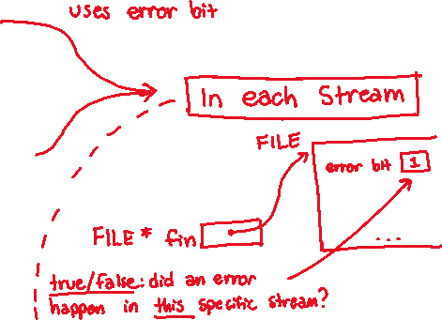
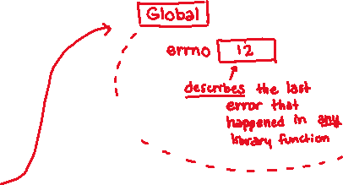
Error Checking/Handling
Some error functions (complete list in stdio.h):
void perror(message);
Prints message followed by error message related to errno to stderr
int ferror(stream);
Checks if the error indicator associated with the specified stream is set, returning 1 if so
void clearerr(stream);
Resets error and eof indicators for the specified stream
void perror(message);
int ferror(stream);
int clearerr(stream);
Notes:
errno -- global value
may be set by any standard library call

Slide 18
Which of the following lines could be inserted to correctly indicate an error?
int res = fwrite(ptr, 1, count, stream);
if (res < count) {
fclose(stream);
return EXIT_FAILURE;
}
...
A.
perror(“fwrite failed”);
B.
perror(“fwrite failed”);
C.
ferror(stream);
D.
perror(“fwrite failed”);
E. We’re lost…
Notes:
FILE* stream
char* filename, format, mode;
Correct Answer: B
A: Wrong because we don’t know if there was a failure yet, and perror doesn’t check, it’s for reporting
B: OK – report as immediately as you can!
C: Wrong because it is checking for an error, but we already know there was an issue – we need to report now
D: Wrong because errno might have been changed after another library call

Slide 19
C Streams Example
cp_example.c
#include <stdio.h>
#include <stdlib.h>
#include <errno.h>
#define READBUFSIZE 128
int main(int argc, char** argv) {
FILE *fin, *fout;
char readbuf[READBUFSIZE];
size_t readlen;
if (argc != 3) {
fprintf(stderr, "usage: ./cp_example infile outfile\n");
return EXIT_FAILURE; // defined in stdlib.h
}
// Open the input file
fin = fopen(argv[1], "rb"); // "rb" -> read, binary mode
if (fin == NULL) {
perror("fopen for read failed");
return EXIT_FAILURE;
}
...

Slide 20
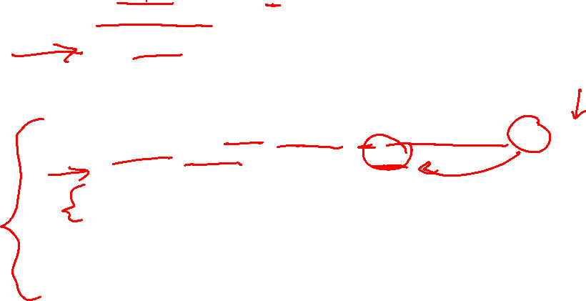
C Streams Example
cp_example.c
int main(int argc, char** argv) {
... // previous slide’s code
// Open the output file
fout = fopen(argv[2], "wb"); // "wb" -> write, binary mode
if (fout == NULL) {
perror("fopen for write failed");
fclose(fin);
return EXIT_FAILURE;
}
// Read from the file, write to fout
while ((readlen = fread(readbuf, 1, READBUFSIZE, fin)) > 0) {
if (fwrite(readbuf, 1, readlen, fout) < readlen) {
perror("fwrite failed");
fclose(fin);
fclose(fout);
return EXIT_FAILURE;
}
}
... // next slide’s code
}
Notes:
size_t fread ( void * ptr, size_t size, size_t count, FILE * stream );

Slide 21
C Streams Example
cp_example.c
int main(int argc, char** argv) {
... // two slides ago’s code
... // previous slide’s code
// Test to see if we encountered an error while reading
if (ferror(fin)) {
perror("fread failed");
fclose(fout);
return EXIT_FAILURE;
}
fclose(fin);
fclose(fout);
return EXIT_SUCCESS;
}
Notes:
DEMO:
- Usage msg: $ ./cp_example.c
- Behavior: $ ./cp_example.c cp_example.c temp.c
- Read fail (doesn’t exist): $ ./cp_example.c foo bar
- Read fail (permissions): $ chmod 200 temp.c $ ./cp_example temp.c temp2.c
- Write fail (doesn’t exist): $ chmod 400 temp.c $ ./cp_example cp_example.c temp.c

Slide 22
Extra Exercise #1
Write a program that:
Uses argc/argv to receive the name of a text file
Reads the contents of the file a line at a time
Parses each line, converting text into a uint32_t
Builds an array of the parsed uint32_t’s
Sorts the array
Prints the sorted array to stdout
Hint: use man to read about getline, sscanf, realloc, and qsort
bash$ cat in.txt
1213
3231
000005
52
bash$ ./extra1 in.txt
5
52
1213
3231
bash$

Slide 23
Extra Exercise #2
Write a program that:
Loops forever; in each loop:
Prompt the user to input a filename
Reads a filename from stdin
Opens and reads the file
Prints its contents to stdout in the format shown:
Hints:
Use man to read about fgets
Or, if you’re more courageous, try man 3 readline to learn about libreadline.a and Google to learn how to link to it
00000000 50 4b 03 04 14 00 00 00 00 00 9c 45 26 3c f1 d5
00000010 68 95 25 1b 00 00 25 1b 00 00 0d 00 00 00 43 53
00000020 45 6c 6f 67 6f 2d 31 2e 70 6e 67 89 50 4e 47 0d
00000030 0a 1a 0a 00 00 00 0d 49 48 44 52 00 00 00 91 00
00000040 00 00 91 08 06 00 00 00 c3 d8 5a 23 00 00 00 09
00000050 70 48 59 73 00 00 0b 13 00 00 0b 13 01 00 9a 9c
00000060 18 00 00 0a 4f 69 43 43 50 50 68 6f 74 6f 73 68
00000070 6f 70 20 49 43 43 20 70 72 6f 66 69 6c 65 00 00
00000080 78 da 9d 53 67 54 53 e9 16 3d f7 de f4 42 4b 88
00000090 80 94 4b 6f 52 15 08 20 52 42 8b 80 14 91 26 2a
000000a0 21 09 10 4a 88 21 a1 d9 15 51 c1 11 45 45 04 1b
... etc ...

