Slide 1
POSIX I/O, System Calls CSE 333 Summer 2019
Instructor: Aaron Johnston
Teaching Assistants:
Yifan Bai Stuart Kol Daniel Lyu Kris Wong

Slide 2
About how long did Exercise 5 take?
0-1 Hours
1-2 Hours
2-3 Hours
3-4 Hours
4+ Hours
I prefer not to say

Slide 3

Administrivia
Homework 1 due tomorrow (7/11) at 11:59pm
Watch that hashtable.c doesn’t violate the modularity of ll.h
Watch for pointer to local (stack) variables
Keep track of types – draw memory diagrams!
Use a debugger (e.g. gdb) if you’re getting segfaults
Please leave “STEP #” markers for graders!
Remember to tag hw1-final (we’ll figure out late days)
Extra Credit: if you add unit tests, put them in a new file and adjust the coverage Makefile
Homework 2 released Friday (7/12)
Exercise 6 posted tomorrow, due Monday (7/15)

Slide 4
Lecture Outline
C Stream Buffering
POSIX Lower-Level I/O
System Calls

Slide 5

Buffering
By default, stdio uses buffering for streams:
Data written by fwrite() is copied into a buffer allocated by stdio inside your process’ address space
As some point, the buffer will be “drained” into the destination:
When you explicitly call fflush() on the stream
When the buffer size is exceeded (often 1024 or 4096 bytes)
For stdout to console, when a newline is written (“line buffered”) or when some other function tries to read from the console
When you call fclose() on the stream
When your process exits gracefully (exit() or return from main())

Slide 6

Buffering Issues
What happens if…
Your computer loses power before the buffer is flushed?
Your program assumes data is written to a file and signals another program to read it?
Performance implications:
Data is copied into the stdio buffer
Consumes CPU cycles and memory bandwidth
Can potentially slow down high-performance applications, like a web server or database (“zero-copy”)
Groups small writes into a larger write
Fewer disk accesses
Notes:
https://en.wikipedia.org/wiki/Zero-copy

Slide 7
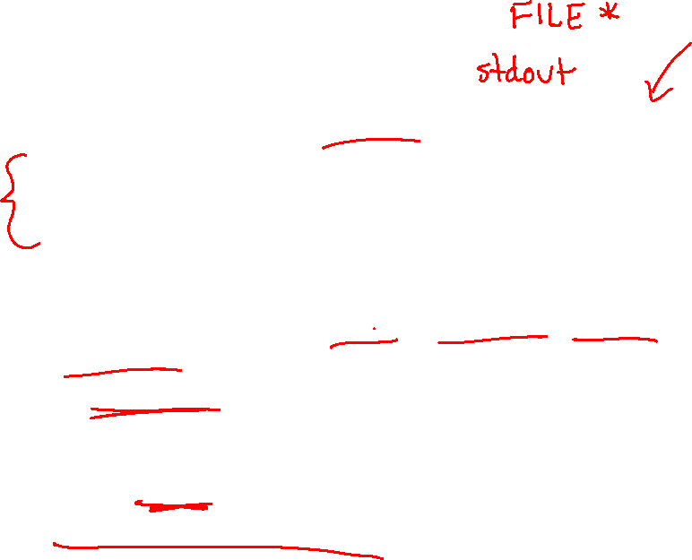
Buffering Issue Solutions
Turn off buffering with setbuf(stream, NULL)
Unfortunately, this may also cause performance problems
e.g. if your program does many small fwrite()s, each one will now trigger a system call into the Linux kernel
Use a different set of system calls
POSIX (OS layer) provides open(), read(), write(), close(), etc.
No buffering is done at the user level
But… what about the layers below?
The OS caches disk reads and writes in the FS buffer cache
Disk controllers have caches too!

Slide 8
Lecture Outline
C Stream Buffering
POSIX Lower-Level I/O
System Calls

Slide 9
C Standard Library File I/O
So far you’ve used the C standard library to access files
Use a provided FILE* stream abstraction
fopen(), fread(), fwrite(), fclose(), fseek()
These are convenient and portable
They are buffered
They are implemented using lower-level OS calls

Slide 10

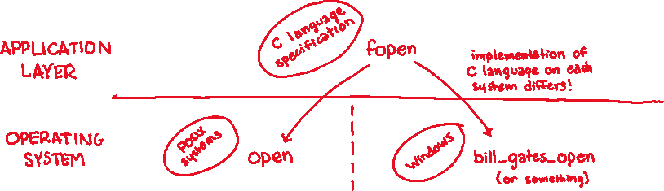
Lower-Level File Access
Most UNIX-en support a common set of lower-level file access APIs: POSIX – Portable Operating System Interface
open(), read(), write(), close(), lseek()
Similar in spirit to their f*() counterparts from C std lib
Lower-level and unbuffered compared to their counterparts
Also less convenient
You will have to use these to read file system directories and for network I/O, so we might as well learn them now
Notes:
POSIX – Portable Operating System Interface

Slide 11


open()/close()
To open a file:
Pass in the filename and access mode
Similar to fopen()
Get back a “file descriptor”
Similar to FILE* from fopen(), but is just an int
Defaults: 0 is stdin, 1 is stdout, 2 is stderr
#include <fcntl.h> // for open()
#include <unistd.h> // for close()
...
int fd = open("foo.txt", O_RDONLY);
if (fd == -1) {
perror("open failed");
exit(EXIT_FAILURE);
}
...
close(fd);
Notes:
fopen() returns a pointer in user addr space, which can then be passed around.
open() just returns int because it can't return pointer in OS space.

Slide 12
Reading from a File
Returns the number of bytes read
Might be fewer bytes than you requested (!!!)
Returns 0 if you’re already at the end-of-file
Returns -1 on error (and sets errno)
There are some surprising error modes (check errno)
EBADF: bad file descriptor
EFAULT: output buffer is not a valid address
EINTR: read was interrupted, please try again (ARGH!!!! 😤😠)
And many others…
ssize_t read(int fd, void* buf, size_t count);

Slide 13
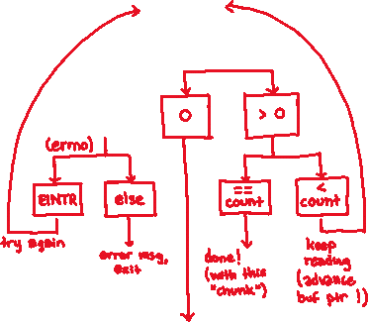
Reading from a File
Returns the number of bytes read
Might be fewer bytes than you requested (!!!)
Returns 0 if you’re already at the end-of-file
Returns -1 on error (and sets errno)
There are some surprising error modes (check errno)
EBADF: bad file descriptor
EFAULT: output buffer is not a valid address
EINTR: read was interrupted, please try again (ARGH!!!! 😤😠)
And many others…
ssize_t read(int fd, void* buf, size_t count);
read
(return value)
-1

Slide 14





One way to read() $n$ bytes
Which is the correct completion of the blank below?
char* buf = ...; // buffer of size n
int bytes_left = n;
int result; // result of read()
while (bytes_left > 0) {
result = read(fd, ______, bytes_left);
if (result == -1) {
if (errno != EINTR) {
// a real error happened,
// so return an error result
}
// EINTR happened,
// so do nothing and try again
continue;
}
bytes_left -= result;
}
A. buf
B. buf + bytes_left
C. buf + bytes_left - n
D. buf + n - bytes_left
E. We’re lost…
Notes:
Correct answer: D (we want the buffer, then the start of the portion left to write. That will be bytes_left away from the end of our total content, so n – bytes_left)

Slide 15



One method to read() $n$ bytes
int fd = open(filename, O_RDONLY);
char* buf = ...; // buffer of appropriate size
int bytes_left = n;
int result;
while (bytes_left > 0) {
result = read(fd, buf + (n - bytes_left), bytes_left);
if (result == -1) {
if (errno != EINTR) {
// a real error happened, so return an error result
}
// EINTR happened, so do nothing and try again
continue;
} else if (result == 0) {
// EOF reached, so stop reading
break;
}
bytes_left -= result;
}
close(fd);
readN.c

Slide 16


Other Low-Level Functions
Read man pages to learn about:
write() – write data
#include <unistd.h>
fsync() – flush data to the underlying device
#include <unistd.h>
opendir(), readdir(), closedir() – deal with directory listings
Make sure you read the section 3 version (e.g. man 3 opendir)
#include <dirent.h>
A useful shortcut sheet (from CMU): http://www.cs.cmu.edu/~guna/15-123S11/Lectures/Lecture24.pdf

Slide 17


C Standard Library vs. POSIX
 | C Standard Library File I/O | POSIX I/O
Functions
Buffering
Implemented
Portability
Notes:
FUNCTIONS: fopen, fwrite | open, write
BUFFERING: buffered | unbuffered
IMPLEMENTED: C standard library | operating system
PORTABILITY: works anywhere with C | only works on POSIX systems

Slide 18
Lecture Outline
C Stream Buffering
POSIX Lower-Level I/O
System Calls

Slide 19

What’s an OS?
Software that:
Directly interacts with the hardware
OS is trusted to do so; user-level programs are not
OS must be ported to new hardware; user-level programs are portable
Manages (allocates, schedules, protects) hardware resources
Decides which programs can access which files, memory locations, pixels on the screen, etc. and when
Abstracts away messy hardware devices
Provides high-level, convenient, portable abstractions (e.g. files, disk blocks)

Slide 20

OS: Abstraction Provider
The OS is the “layer below”
A module that your program can call (with system calls)
Provides a powerful OS API – POSIX, Windows, etc.
a process running your program
File System
open(), read(), write(), close(), …
Network Stack
connect(), listen(), read(), write(), ...
Virtual Memory
brk(), shm_open(), …
Process Management
fork(), wait(), nice(), …
OS API
file system | network stack | virtual memory | process mgmt. | … etc …
OS
Notes:
API – Application Programming Interface
nice() – a UNIX kernel call that sets the priority of a process

Slide 21

OS: Protection System
OS isolates process from each other
But permits controlled sharing between them
Through shared name spaces (e.g. file names)
OS isolates itself from processes
Must prevent processes from accessing the hardware directly
OS is allowed to access the hardware
User-level processes run with the CPU (processor) in unprivileged mode
The OS runs with the CPU in privileged mode
User-level processes invoke system calls to safely enter the OS
Process A (untrusted)
Process B (untrusted)
Process C (untrusted)
Process D (trusted)
OS
(trusted)
HW (trusted)
Notes:
FS = File System
Trusted mode is enforced in hardware by hardware bit (part of status bits – only accessible by things with privilege).
The OS is very paranoid!

Slide 22
System Call Trace
Process A (untrusted)
Process B (untrusted)
Process C (untrusted)
Process D (trusted)
A CPU (thread of execution) is running user-level code in Process A; the CPU is set to unprivileged mode.
OS
(trusted)
HW (trusted)
Notes:
Let’s trace what happens on a system call…

Slide 23
System Call Trace
Process A (untrusted)
Process B (untrusted)
Process C (untrusted)
Process D (trusted)
Code in Process A invokes a system call; the hardware then sets the CPU to privileged mode and traps into the OS, which invokes the appropriate system call handler.
system call
OS
(trusted)
HW (trusted)

Slide 24
System Call Trace
Process A (untrusted)
Process B (untrusted)
Process C (untrusted)
Process D (trusted)
Because the CPU executing the thread that’s in the OS is in privileged mode, it is able to use privileged instructions that interact directly with hardware devices like disks.
OS
(trusted)
HW (trusted)

Slide 25
System Call Trace
Process A (untrusted)
Process B (untrusted)
Process C (untrusted)
Process D (trusted)
Once the OS has finished servicing the system call, which might involve long waits as it interacts with HW, it:
(1) Sets the CPU back to unprivileged mode and
(2) Returns out of the system call back to the user-level code in Process A.
system call return
OS
(trusted)
HW (trusted)

Slide 26
System Call Trace
Process A (untrusted)
Process B (untrusted)
Process C (untrusted)
Process D (trusted)
The process continues executing whatever code is next after the system call invocation.
OS
(trusted)
HW (trusted)
Useful reference: CSPP § 8.1–8.3 (the 351 book)

