Slide 1
System Calls (end), Build Tools CSE 333 Summer 2019
Instructor: Aaron Johnston
Teaching Assistants:
Yifan Bai Stuart Kol Daniel Lyu Kris Wong

Slide 2
Administrivia
Exercise 6 posted yesterday, due Monday
Read a directory and open/copy text files found there
Copy exactly and only the bytes in the file(s). No extra output please!
Good warm-up for…
Homework 2 due in two weeks (7/25)
File system crawler, indexer, and search engine
Spec + starter files will be pushed out today

Slide 3


Review: C Standard Library vs. POSIX
 | C Standard Library File I/O | POSIX I/O
Functions | fwrite, fopen, … | write, open, …
Buffering | Yes | No
Implemented in | C Standard Library | OS
Portability | More | Less
Notes:
BUFFERING: because it automatically keeps reading, delayed
PORTABILITY: because it is present anywhere C exists, uses POSIX under the hood on POSIX systems, uses something else on other systems

Slide 4
Lecture Outline
System Calls (end)
Makefile Basics

Slide 5
Details on x86/Linux
Your program
A more accurate picture:
Consider a typical Linux process
Its thread of execution can be in one of several places:
In your program’s code
In glibc, a shared library containing the C standard library, POSIX, support, and more
In the Linux architecture-independent code
In Linux x86-64 code
glibc
C standard
library
POSIX
Linux system calls
architecture-independent code
architecture-dependent code
Linux kernel

Slide 6

Details on x86/Linux
Your program
Some routines your program invokes may be entirely handled by glibc without involving the kernel
e.g. strcmp() from stdio.h
There is some initial overhead when invoking functions in dynamically linked libraries (during loading)
But after symbols are resolved, invoking glibc routines is basically as fast as a function call within your program itself!
glibc
C standard
library
POSIX
architecture-independent code
architecture-dependent code
Linux kernel
Notes:
(1)

Slide 7



Details on x86/Linux
Your program
Some routines may be handled by glibc, but they in turn invoke Linux system calls
e.g. POSIX wrappers around Linux syscalls
POSIX readdir() invokes the underlying Linux readdir()
e.g. C stdio functions that read and write from files
fopen(), fclose(), fprintf() invoke underlying Linux open(), close(), write(), etc.
glibc
C standard
library
POSIX
architecture-independent code
architecture-dependent code
Linux kernel
Notes:
(2) POSIX is directly talking to OS, not doing any real work for you (unlike the C std lib wrapper functions).

Slide 8



Details on x86/Linux
Your program
Your program can choose to directly invoke Linux system calls as well
Nothing is forcing you to link with glibc and use it
But relying on directly-invoked Linux system calls may make your program less portable across UNIX varieties
glibc
C standard
library
POSIX
architecture-independent code
architecture-dependent code
Linux kernel
Notes:
(3) If you really want to talk to the OS directly, you can write it in assembly!

Slide 9
Details on x86/Linux
Your program
Let’s walk through how a Linux system call actually works
We’ll assume 32-bit x86 using the modern SYSENTER / SYSEXIT x86 instructions
x86-64 code is similar, though details always change over time, so take this as an example – not a debugging guide
glibc
C standard
library
POSIX
architecture-independent code
architecture-dependent code
Linux kernel
Notes:
Changed over time, but more important to have a mental model -- OS course for details

Slide 10
Details on x86/Linux
0xFFFFFFFF
Your program
Remember our process address space picture?
Let’s add some details:
linux-gate.so
Linux kernel
kernel stack
glibc
C standard
library
POSIX
Stack
Shared Libraries
architecture-independent code
architecture-dependent code
Heap (malloc/free)
Read/Write Segment .data, .bss
Read-Only Segment .text, .rodata
Linux kernel
CPU
0x00000000

Slide 11


Details on x86/Linux
0xFFFFFFFF
Your program
Process is executing your program code
linux-gate.so
Linux kernel
kernel stack
glibc
C standard
library
POSIX
Stack
SP
Shared Libraries
architecture-independent code
architecture-dependent code
Heap (malloc/free)
Read/Write Segment .data, .bss
IP
Read-Only Segment .text, .rodata
Linux kernel
CPU
unpriv
0x00000000

Slide 12
Details on x86/Linux
0xFFFFFFFF
Your program
Process calls into a glibc function
e.g. fopen()
We’ll ignore the messy details of loading/linking shared libraries
linux-gate.so
Linux kernel
kernel stack
glibc
C standard
library
POSIX
Stack
SP
IP
Shared Libraries
architecture-independent code
architecture-dependent code
Heap (malloc/free)
Read/Write Segment .data, .bss
Read-Only Segment .text, .rodata
Linux kernel
CPU
unpriv
0x00000000

Slide 13

Details on x86/Linux
0xFFFFFFFF
Your program
IP
linux-gate.so
glibc begins the process of invoking a Linux system call
glibc’s fopen() likely invokes Linux’s open() system call
Puts the system call # and arguments into registers
Uses the call x86 instruction to call into the routine __kernel_vsyscall located in linux-gate.so
Linux kernel
kernel stack
glibc
C standard
library
POSIX
Stack
SP
Shared Libraries
architecture-independent code
architecture-dependent code
Heap (malloc/free)
Read/Write Segment .data, .bss
Read-Only Segment .text, .rodata
Linux kernel
CPU
unpriv
0x00000000
Notes:
linux-gate.so is a magic function to bridge C and ASM calling conventions (details not important).

Slide 14


Details on x86/Linux
0xFFFFFFFF
Your program
IP
linux-gate.so
linux-gate.so is a vdso
A virtual dynamically-linked shared object
Is a kernel-provided shared library that is plunked into a process’ address space
Provides the intricate machine code needed to trigger a system call
Linux kernel
kernel stack
glibc
C standard
library
POSIX
Stack
SP
Shared Libraries
architecture-independent code
architecture-dependent code
Heap (malloc/free)
Read/Write Segment .data, .bss
Read-Only Segment .text, .rodata
Linux kernel
CPU
unpriv
0x00000000
Notes:
linux-gate.so is a magic function to bridge C and ASM calling conventions (details not important).

Slide 15

Details on x86/Linux
0xFFFFFFFF
Your program
linux-gate.so eventually invokes the SYSENTER x86 instruction
SYSENTER is x86’s “fast system call” instruction
Causes the CPU to raise its privilege level
Traps into the Linux kernel by changing the SP, IP to a previously-determined location
Changes some segmentation-related registers (see CSE451)
linux-gate.so
SP
Linux kernel
kernel stack
IP
glibc
C standard
library
POSIX
Stack
Shared Libraries
architecture-independent code
architecture-dependent code
Heap (malloc/free)
Read/Write Segment .data, .bss
Read-Only Segment .text, .rodata
Linux kernel
CPU
priv
0x00000000
Notes:
Important that SP moved, too!
SYSENTER is an interrupt and SYSEXIT is a return from an interrupt.

Slide 16
Details on x86/Linux
0xFFFFFFFF
Your program
The kernel begins executing code at the SYSENTER entry point
Is in the architecture-dependent part of Linux
It’s job is to:
Look up the system call number in a system call dispatch table
Call into the address stored in that table entry; this is Linux’s system call handler
For open(), the handler is named sys_open, and is system call #5
linux-gate.so
SP
Linux kernel
kernel stack
IP
glibc
C standard
library
POSIX
Stack
Shared Libraries
architecture-independent code
architecture-dependent code
Heap (malloc/free)
Read/Write Segment .data, .bss
Read-Only Segment .text, .rodata
Linux kernel
CPU
priv
0x00000000

Slide 17

Details on x86/Linux
0xFFFFFFFF
Your program
The system call handler executes
What it does is system-call specific
It may take a long time to execute, especially if it has to interact with hardware
Linux may choose to context switch the CPU to a different runnable process
linux-gate.so
SP
Linux kernel
kernel stack
IP
glibc
C standard
library
POSIX
Stack
Shared Libraries
architecture-independent code
architecture-dependent code
Heap (malloc/free)
Read/Write Segment .data, .bss
Read-Only Segment .text, .rodata
Linux kernel
CPU
priv
0x00000000

Slide 18
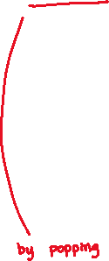
Details on x86/Linux
0xFFFFFFFF
Your program
Eventually, the system call handler finishes
Returns back to the system call entry point
Places the system call’s return value in the appropriate register
Calls SYSEXIT to return to the user-level code
linux-gate.so
SP
Linux kernel
kernel stack
IP
glibc
C standard
library
POSIX
Stack
Shared Libraries
architecture-independent code
architecture-dependent code
Heap (malloc/free)
Read/Write Segment .data, .bss
Read-Only Segment .text, .rodata
Linux kernel
CPU
priv
0x00000000

Slide 19

Details on x86/Linux
0xFFFFFFFF
Your program
SYSEXIT transitions the processor back to user-mode code
Restores the IP, SP to user-land values
Sets the CPU back to unprivileged mode
Changes some segmentation-related registers (see CSE451)
Returns the processor back to glibc
linux-gate.so
Linux kernel
kernel stack
glibc
C standard
library
POSIX
Stack
SP
IP
Shared Libraries
architecture-independent code
architecture-dependent code
Heap (malloc/free)
Read/Write Segment .data, .bss
Read-Only Segment .text, .rodata
Linux kernel
CPU
unpriv
0x00000000

Slide 20
Details on x86/Linux
0xFFFFFFFF
Your program
glibc continues to execute
Might execute more system calls
Eventually returns back to your program code
linux-gate.so
Linux kernel
kernel stack
glibc
C standard
library
POSIX
Stack
SP
Shared Libraries
architecture-independent code
architecture-dependent code
Heap (malloc/free)
Read/Write Segment .data, .bss
IP
Read-Only Segment .text, .rodata
Linux kernel
CPU
unpriv
0x00000000

Slide 21
strace
A useful Linux utility that shows the sequence of system calls that a process makes:
bash$ strace ls 2>&1 | less
execve("/usr/bin/ls", ["ls"], [/* 41 vars */]) = 0
brk(NULL) = 0x15aa000
mmap(NULL, 4096, PROT_READ|PROT_WRITE, MAP_PRIVATE|MAP_ANONYMOUS, -1, 0) = 0x7f03bb741000
access("/etc/ld.so.preload", R_OK) = -1 ENOENT (No such file or directory)
open("/etc/ld.so.cache", O_RDONLY|O_CLOEXEC) = 3
fstat(3, {st_mode=S_IFREG|0644, st_size=126570, ...}) = 0
mmap(NULL, 126570, PROT_READ, MAP_PRIVATE, 3, 0) = 0x7f03bb722000
close(3) = 0
open("/lib64/libselinux.so.1", O_RDONLY|O_CLOEXEC) = 3
read(3, "\177ELF\2\1\1\0\0\0\0\0\0\0\0\0\3\0>\0\1\0\0\0\300j\0\0\0\0\0\0"..., 832) = 832
fstat(3, {st_mode=S_IFREG|0755, st_size=155744, ...}) = 0
mmap(NULL, 2255216, PROT_READ|PROT_EXEC, MAP_PRIVATE|MAP_DENYWRITE, 3, 0) = 0x7f03bb2fa000
mprotect(0x7f03bb31e000, 2093056, PROT_NONE) = 0
mmap(0x7f03bb51d000, 8192, PROT_READ|PROT_WRITE, MAP_PRIVATE|MAP_FIXED|MAP_DENYWRITE, 3, 0x23000) = 0x7f03bb51d000
... etc ...

Slide 22
If You’re Curious
Download the Linux kernel source code
Available from http://www.kernel.org/
man, section 2: Linux system calls
man 2 intro
man 2 syscalls
man, section 3: glibc/libc library functions
man 3 intro
The book: The Linux Programming Interface by Michael Kerrisk (keeper of the Linux man pages)
Notes:
man 1 – user commands
man 2 – Linux system calls
man 3 – library functions

Slide 23
Lecture Outline
System Calls (end)
Makefile Basics

Slide 24
make
make is a classic program for controlling what gets (re)compiled and how
Many other such programs exist (e.g. ant, maven, IDE “projects”)
make has tons of fancy features, but only two basic ideas:
Scripts for executing commands
Dependencies for avoiding unnecessary work

Slide 25
Building Software
Programmers spend a lot of time “building”
Creating programs from source code
Both programs that they write and other people write
Programmers like to automate repetitive tasks
Repetitive: gcc -Wall -g -std=c11 -o widget foo.c bar.c baz.c
Retype this every time: 😭
Use up-arrow or history: 😐 (still retype after logout)
Have an alias or bash script: 🙂
Have a Makefile: 😊 (you’re ahead of us)

Slide 26

“Real” Build Process
On larger projects, you don’t want one big set of commands to recompile:
If gcc didn’t combine steps for you, you’d need to preprocess, compile, and link on your own
If source files have multiple outputs (e.g. javadoc), you’d have to type out the source file name(s) multiple times
You don’t want to have to document the build logic when you distribute source code
One small change -> recompile everything
A bash script can handle 1-3 (use a variable for filenames for 2), but 4 is trickier

Slide 27
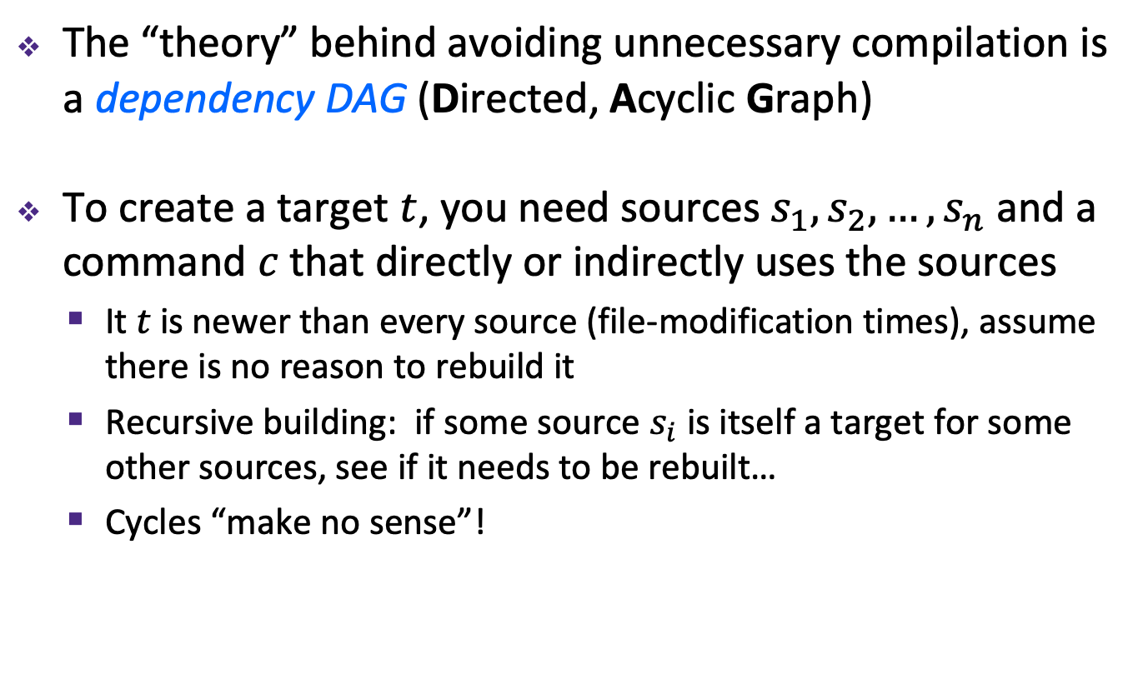
Recompilation Management
The “theory” behind avoiding unnecessary compilation is a dependency DAG (Directed, Acyclic Graph)
To create a target $t$, you need sources $s_{1}, s_{2}, …, s_{n}$ and a command $c$ that directly or indirectly uses the sources
It $t$ is newer than every source (file-modification times), assume there is no reason to rebuild it
Recursive building: if some source $s_{i}$ is itself a target for some other sources, see if it needs to be rebuilt…
Cycles “make no sense”!

Slide 28

Theory Applied to C
Compiling a .c creates a .o – the .o depends on the .c and all included files (.h, recursively/transitively)
foo.h
foo.c
bar.c
Source files
Statically-linked libraries
libZ.a
foo.o
bar.o
Object files
bar
Executable

Slide 29
Theory Applied to C
Compiling a .c creates a .o – the .o depends on the .c and all included files (.h, recursively/transitively)
An archive (library, .a) depends on included .o files
foo.h
foo.c
bar.c
Source files
Statically-linked libraries
libZ.a
foo.o
bar.o
Object files
bar
Executable

Slide 30
Theory Applied to C
Compiling a .c creates a .o – the .o depends on the .c and all included files (.h, recursively/transitively)
An archive (library, .a) depends on included .o files
Creating an executable (“linking”) depends on .o files and archives
Archives linked by -L<path> -l<name> (e.g. -L. -lfoo to get libfoo.a from current directory)
foo.h
foo.c
bar.c
Source files
Statically-linked libraries
libZ.a
foo.o
bar.o
Object files
bar
Executable

Slide 31


Theory Applied to C
If one .c file changes, just need to recreate one .o file, maybe a library, and re-link
If a .h file changes, may need to rebuild more
Many more possibilities!
foo.h
foo.c
bar.c
Source files
Statically-linked libraries
libZ.a
foo.o
bar.o
Object files
bar
Executable

Slide 32
make Basics
A makefile contains a bunch of triples:
Colon after target is required
Command lines must start with a TAB, NOT SPACES
Multiple commands for same target are executed in order
Can split commands over multiple lines by ending lines with ‘\’
Example:
target: sources
command
$←$ Tab $→$
foo.o: foo.c foo.h bar.h
gcc -Wall -o foo.o -c foo.c

Slide 33

Using make
Defaults:
If no -f specified, use a file named Makefile
If no target specified, will use the first one in the file
Will interpret commands in your default shell
Set SHELL variable in makefile to ensure
Target execution:
Check each source in the source list:
If the source is a target in the Makefile, then process it recursively
If some source does not exist, then error
If any source is newer than the target (or target does not exist), run command (presumably to update the target)
bash$ make -f <makefileName> target
Notes:
Configure needs to figure things out like “where is the compiler?”.

Slide 34

make Variables
You can define variables in a makefile:
All values are strings of text, no “types”
Variable names are case-sensitive and can’t contain ‘:’, ‘#’, ‘=’, or whitespace
Example:
Advantages:
Easy to change things (especially in multiple commands)
Can also specify on the command line: (e.g. make foo.o CC=clang CFLAGS=-g)
CC = gcc
CFLAGS = -Wall -std=c11
foo.o: foo.c foo.h bar.h
$(CC) $(CFLAGS) -o foo.o -c foo.c

Slide 35

More Variables
It’s common to use variables to hold lists of filenames:
clean is a convention
Remove generated files to “start over” from just the source
It’s “funny” because the target doesn’t exist and there are no sources, but it works because:
The target doesn’t exist, so it must be “remade” by running the command
These “phony” targets have several uses, such as “all”…
OBJFILES = foo.o bar.o baz.o
widget: $(OBJFILES)
gcc -o widget $(OBJFILES)
clean:
rm $(OBJFILES) widget *~

Slide 36
“all” Example
all: prog B.class someLib.a
# notice no commands this time
prog: foo.o bar.o main.o
gcc –o prog foo.o bar.o main.o
B.class: B.java
javac B.java
someLib.a: foo.o baz.o
ar r foo.o baz.o
foo.o: foo.c foo.h header1.h header2.h
gcc -c -Wall foo.c
# similar targets for bar.o, main.o, baz.o, etc...

Slide 37
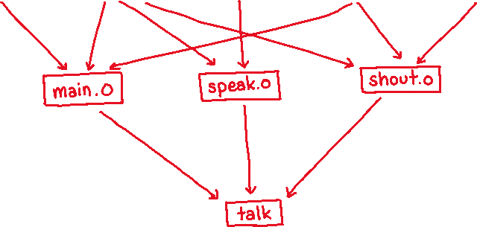
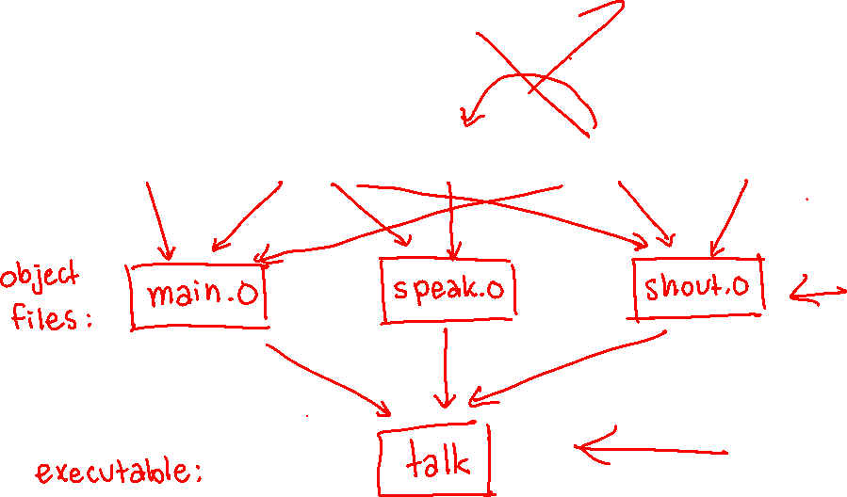


Writing a Makefile Example
“talk” program
main.c
speak.h
speak.c
shout.h
shout.c

Slide 38
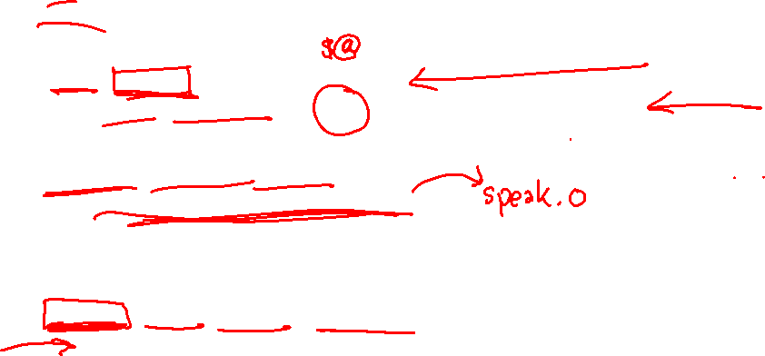
Writing a Makefile Example
CC = gcc
CFLAGS = -Wall -g -std=c11
# default target
talk: main.o speak.o shout.o
$(CC) $(CFLAGS) -o talk main.o speak.o shout.o
# individual source files
speak.o: speak.c speak.h
$(CC) $(CFLAGS) -c speak.c
shout.o: shout.c shout.h speak.h
$(CC) $(CFLAGS) -c shout.c
main.o: main.c speak.h shout.h
$(CC) $(CFLAGS) -c main.c
# phony target - delete built files (including OS X debug files)
clean:
rm -rf talk *.o *~ talk.dSYM

Slide 39

Revenge of the Funny Characters
Special variables:
$@ for target name
$^ for all sources
$< for left-most source
Lots more! – see the documentation
Examples:
# CC and CFLAGS defined above
widget: foo.o bar.o
$(CC) $(CFLAGS) -o $@ $^
foo.o: foo.c foo.h bar.h
$(CC) $(CFLAGS) -c $<

Slide 40
And more…
There are a lot of “built-in” rules – see documentation
There are “suffix” rules and “pattern” rules
Example:
Remember that you can put any shell command – even whole scripts!
You can repeat target names to add more dependencies
Often this stuff is more useful for reading makefiles than writing your own (until some day…)
%.class: %.java
javac $< # we need the $< here

