Slide 1
C++ References, const, & Classes CSE 333 Summer 2019
Instructor: Aaron Johnston
Teaching Assistants:
Yifan Bai Stuart Kol Daniel Lyu Kris Wong

Slide 2
About how long did Exercise 7 take?
0-1 Hours
1-2 Hours
2-3 Hours
3-4 Hours
4+ Hours
I prefer not to say

Slide 3
Administrivia
Exercise 7 extended to 2:00pm
Exercise 8 out today, due Friday (7/19)
Midterm Exam in lecture on Monday, July 29
Details, topics list, practice exams available on course website
Will test up to, but not including, C++ templates and STL
We provide reference sheet, you can bring one double-sided note sheet
Reminder: We have a strict academic misconduct policy
Collaboration: discussing course concepts, reasoning about how to approach an exercise, describing your debugging process
Copying: misrepresenting work as your own, using someone else’s code to directly inform your own

Slide 4
Lecture Outline
C++ References
const in C++
C++ Classes Intro

Slide 5
Pointers Reminder
Note: Arrow points to next instruction.
A pointer is a variable containing an address
Modifying the pointer doesn’t modify what it points to, but you can access/modify what it points to by dereferencing
These work the same in C and C++
int main(int argc, char** argv) {
int x = 5, y = 10;
int* z = &x;
*z += 1;
x += 1;
z = &y;
*z += 1;
return EXIT_SUCCESS;
}
x | 5
y | 10
z
pointer.cc

Slide 6
Pointers Reminder
Note: Arrow points to next instruction.
A pointer is a variable containing an address
Modifying the pointer doesn’t modify what it points to, but you can access/modify what it points to by dereferencing
These work the same in C and C++
int main(int argc, char** argv) {
int x = 5, y = 10;
int* z = &x;
*z += 1;
x += 1;
z = &y;
*z += 1;
return EXIT_SUCCESS;
}
x | 5
y | 10
z | 0x7fff…a4
pointer.cc

Slide 7
Pointers Reminder
Note: Arrow points to next instruction.
A pointer is a variable containing an address
Modifying the pointer doesn’t modify what it points to, but you can access/modify what it points to by dereferencing
These work the same in C and C++
int main(int argc, char** argv) {
int x = 5, y = 10;
int* z = &x;
*z += 1; // sets x to 6
x += 1;
z = &y;
*z += 1;
return EXIT_SUCCESS;
}
x | 6
y | 10
z | 0x7fff…a4
pointer.cc

Slide 8
Pointers Reminder
Note: Arrow points to next instruction.
A pointer is a variable containing an address
Modifying the pointer doesn’t modify what it points to, but you can access/modify what it points to by dereferencing
These work the same in C and C++
int main(int argc, char** argv) {
int x = 5, y = 10;
int* z = &x;
*z += 1; // sets x to 6
x += 1; // sets x (and *z) to 7
z = &y;
*z += 1;
return EXIT_SUCCESS;
}
x | 7
y | 10
z | 0x7fff…a4
pointer.cc

Slide 9
Pointers Reminder
Note: Arrow points to next instruction.
A pointer is a variable containing an address
Modifying the pointer doesn’t modify what it points to, but you can access/modify what it points to by dereferencing
These work the same in C and C++
int main(int argc, char** argv) {
int x = 5, y = 10;
int* z = &x;
*z += 1; // sets x to 6
x += 1; // sets x (and *z) to 7
z = &y; // sets z to the address of y
*z += 1;
return EXIT_SUCCESS;
}
x | 7
y | 10
z | 0x7fff…a0
pointer.cc

Slide 10
Pointers Reminder
Note: Arrow points to next instruction.
A pointer is a variable containing an address
Modifying the pointer doesn’t modify what it points to, but you can access/modify what it points to by dereferencing
These work the same in C and C++
int main(int argc, char** argv) {
int x = 5, y = 10;
int* z = &x;
*z += 1; // sets x to 6
x += 1; // sets x (and *z) to 7
z = &y; // sets z to the address of y
*z += 1; // sets y (and *z) to 11
return EXIT_SUCCESS;
}
x | 7
y | 11
z | 0x7fff…a0
pointer.cc

Slide 11
References
Note: Arrow points to next instruction.
A reference is an alias for another variable
Alias: another name that is bound to the aliased variable
Mutating a reference is mutating the aliased variable
Introduced in C++ as part of the language
int main(int argc, char** argv) {
int x = 5, y = 10;
int& z = x;
z += 1;
x += 1;
z = y;
z += 1;
return EXIT_SUCCESS;
}
x | 5
y | 10
reference.cc
Notes:
analogy: superhero identities

Slide 12
References
Note: Arrow points to next instruction.
A reference is an alias for another variable
Alias: another name that is bound to the aliased variable
Mutating a reference is mutating the aliased variable
Introduced in C++ as part of the language
int main(int argc, char** argv) {
int x = 5, y = 10;
int& z = x; // binds the name "z" to x
z += 1;
x += 1;
z = y;
z += 1;
return EXIT_SUCCESS;
}
x, z | 5
y | 10
reference.cc

Slide 13
References
Note: Arrow points to next instruction.
A reference is an alias for another variable
Alias: another name that is bound to the aliased variable
Mutating a reference is mutating the aliased variable
Introduced in C++ as part of the language
int main(int argc, char** argv) {
int x = 5, y = 10;
int& z = x; // binds the name "z" to x
z += 1; // sets z (and x) to 6
x += 1;
z = y;
z += 1;
return EXIT_SUCCESS;
}
x, z | 6
y | 10
reference.cc

Slide 14
References
Note: Arrow points to next instruction.
A reference is an alias for another variable
Alias: another name that is bound to the aliased variable
Mutating a reference is mutating the aliased variable
Introduced in C++ as part of the language
int main(int argc, char** argv) {
int x = 5, y = 10;
int& z = x; // binds the name "z" to x
z += 1; // sets z (and x) to 6
x += 1; // sets x (and z) to 7
z = y;
z += 1;
return EXIT_SUCCESS;
}
x, z | 7
y | 10
reference.cc

Slide 15
References
Note: Arrow points to next instruction.
A reference is an alias for another variable
Alias: another name that is bound to the aliased variable
Mutating a reference is mutating the aliased variable
Introduced in C++ as part of the language
int main(int argc, char** argv) {
int x = 5, y = 10;
int& z = x; // binds the name "z" to x
z += 1; // sets z (and x) to 6
x += 1; // sets x (and z) to 7
z = y; // sets z (and x) to the value of y
z += 1;
return EXIT_SUCCESS;
}
x, z | 10
y | 10
reference.cc

Slide 16
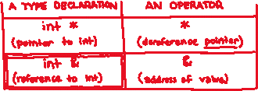
References
Note: Arrow points to next instruction.
A reference is an alias for another variable
Alias: another name that is bound to the aliased variable
Mutating a reference is mutating the aliased variable
Introduced in C++ as part of the language
int main(int argc, char** argv) {
int x = 5, y = 10;
int& z = x; // binds the name "z" to x
z += 1; // sets z (and x) to 6
x += 1; // sets x (and z) to 7
z = y; // sets z (and x) to the value of y
z += 1; // sets z (and x) to 11
return EXIT_SUCCESS;
}
x, z | 11
y | 10
reference.cc

Slide 17
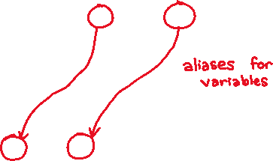
Pass-By-Reference
Note: Arrow points to next instruction.
C++ allows you to use real pass-by-reference
Client passes in an argument with normal syntax
Function uses reference parameters with normal syntax
Modifying a reference parameter modifies the caller’s argument!
void swap(int& x, int& y) {
int tmp = x;
x = y;
y = tmp;
}
int main(int argc, char** argv) {
int a = 5, b = 10;
swap(a, b);
cout << "a: " << a << "; b: " << b << endl;
return EXIT_SUCCESS;
}
(main) a | 5
(main) b | 10
passbyreference.cc

Slide 18
Pass-By-Reference
Note: Arrow points to next instruction.
C++ allows you to use real pass-by-reference
Client passes in an argument with normal syntax
Function uses reference parameters with normal syntax
Modifying a reference parameter modifies the caller’s argument!
void swap(int& x, int& y) {
int tmp = x;
x = y;
y = tmp;
}
int main(int argc, char** argv) {
int a = 5, b = 10;
swap(a, b);
cout << "a: " << a << "; b: " << b << endl;
return EXIT_SUCCESS;
}
(main) a (swap) x | 5
(main) b (swap) y | 10
(swap) tmp
passbyreference.cc

Slide 19
Pass-By-Reference
Note: Arrow points to next instruction.
C++ allows you to use real pass-by-reference
Client passes in an argument with normal syntax
Function uses reference parameters with normal syntax
Modifying a reference parameter modifies the caller’s argument!
void swap(int& x, int& y) {
int tmp = x;
x = y;
y = tmp;
}
int main(int argc, char** argv) {
int a = 5, b = 10;
swap(a, b);
cout << "a: " << a << "; b: " << b << endl;
return EXIT_SUCCESS;
}
(main) a (swap) x | 5
(main) b (swap) y | 10
(swap) tmp | 5
passbyreference.cc

Slide 20
Pass-By-Reference
Note: Arrow points to next instruction.
C++ allows you to use real pass-by-reference
Client passes in an argument with normal syntax
Function uses reference parameters with normal syntax
Modifying a reference parameter modifies the caller’s argument!
void swap(int& x, int& y) {
int tmp = x;
x = y;
y = tmp;
}
int main(int argc, char** argv) {
int a = 5, b = 10;
swap(a, b);
cout << "a: " << a << "; b: " << b << endl;
return EXIT_SUCCESS;
}
(main) a (swap) x | 10
(main) b (swap) y | 10
(swap) tmp | 5
passbyreference.cc

Slide 21
Pass-By-Reference
Note: Arrow points to next instruction.
C++ allows you to use real pass-by-reference
Client passes in an argument with normal syntax
Function uses reference parameters with normal syntax
Modifying a reference parameter modifies the caller’s argument!
void swap(int& x, int& y) {
int tmp = x;
x = y;
y = tmp;
}
int main(int argc, char** argv) {
int a = 5, b = 10;
swap(a, b);
cout << "a: " << a << "; b: " << b << endl;
return EXIT_SUCCESS;
}
(main) a (swap) x | 10
(main) b (swap) y | 5
(swap) tmp | 5
passbyreference.cc

Slide 22
Pass-By-Reference
Note: Arrow points to next instruction.
C++ allows you to use real pass-by-reference
Client passes in an argument with normal syntax
Function uses reference parameters with normal syntax
Modifying a reference parameter modifies the caller’s argument!
void swap(int& x, int& y) {
int tmp = x;
x = y;
y = tmp;
}
int main(int argc, char** argv) {
int a = 5, b = 10;
swap(a, b);
cout << "a: " << a << "; b: " << b << endl;
return EXIT_SUCCESS;
}
(main) a | 10
(main) b | 5
passbyreference.cc

Slide 23
Lecture Outline
C++ References
const in C++
C++ Classes Intro

Slide 24


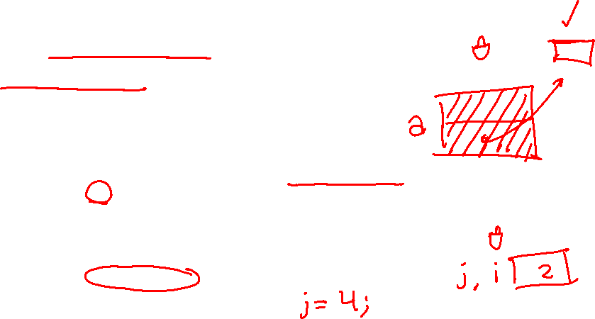
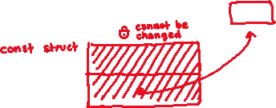
const
const: this cannot be changed/mutated
Used much more in C++ than in C
Signal of intent to compiler; meaningless at hardware level
Results in compile-time errors
void BrokenPrintSquare(const int& i) {
i = i*i; // compiler error here!
std::cout << i << std::endl;
}
int main(int argc, char** argv) {
int j = 2;
BrokenPrintSquare(j);
return EXIT_SUCCESS;
}
brokenpassbyrefconst.cc
Notes:
const introduced to get rid of #define with constants (const correctness) plus other uses later (const member functions)

Slide 25



const and Pointers
Pointers can change data in two different contexts:
You can change the value of the pointer
You can change the thing the pointer points to (via dereference)
const can be used to prevent either/both of these behaviors!
const next to pointer name means you can’t change the value of the pointer
const next to data type pointed to means you can’t use this pointer to change the thing being pointed to
Tip: read variable declaration from right-to-left, divide at *

Slide 26

const and Pointers
The syntax with pointers is confusing:
int main(int argc, char** argv) {
int x = 5; // int
const int y = 6; // (const int)
y++;
const int *z = &y; // pointer to a (const int)
*z += 1;
z++;
int *const w = &x; // (const pointer) to a (variable int)
*w += 1;
w++;
const int *const v = &x; // (const pointer) to a (const int)
*v += 1;
v++;
return EXIT_SUCCESS;
}
constmadness.cc

Slide 27
const and Pointers
The syntax with pointers is confusing:
int main(int argc, char** argv) {
int x = 5; // int
const int y = 6; // (const int)
y++; // compiler error
const int *z = &y; // pointer to a (const int)
*z += 1; // compiler error
z++; // ok
int *const w = &x; // (const pointer) to a (variable int)
*w += 1; // ok
w++; // compiler error
const int *const v = &x; // (const pointer) to a (const int)
*v += 1; // compiler error
v++; // compiler error
return EXIT_SUCCESS;
}
constmadness.cc

Slide 28

const Parameters
A const parameter cannot be mutated inside the function
Therefore it does not matter if the argument can be mutated or not
A non-const parameter may be mutated inside the function
It would be BAD if you passed it a const variable
void foo(const int* y) {
std::cout << *y << std::endl;
}
void bar(int* y) {
std::cout << *y << std::endl;
}
int main(int argc, char** argv) {
const int a = 10;
int b = 20;
foo(&a); // OK
foo(&b); // OK
bar(&a); // not OK – error
bar(&b); // OK
return EXIT_SUCCESS;
}

Slide 29
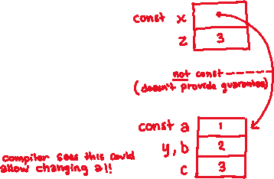


What will happen when we try to compile and run?
poll.cc
void foo(int* const x,
int& y, int z) {
*x += 1;
y *= 2;
z -= 3;
}
int main(int argc, char** argv) {
const int a = 1;
int b = 2, c = 3;
foo(&a, b, c);
std::cout << "(" << a << ", " << b
<< ", " << c << ")" << std::endl;
return EXIT_SUCCESS;
}
A. Output “(2, 4, 0)"
B. Output “(2, 4, 3)"
C. Compiler error about arguments to foo (in main)
D. Compiler error about body of foo
E. We’re lost…
Notes:
Answer: C -- Compiler error about arguments to foo (in main)

Slide 30
When to Use References?
Notes:
const ref for reading, pointers for writing

Slide 31
When to Use References?
A stylistic choice, not mandated by the C++ language
Google C++ style guide suggests:
Input parameters:
Either use values (for primitive types like int or small structs/objects)
Or use const references (for complex struct/object instances)
Output parameters:
Use const pointers
Unchangeable pointers referencing changeable data
List input parameters first, then output parameters last
void CylinderVolume(const Circle& face, int height,
int* const volume) {
*volume = face.area * height;
}
styleguide.cc
Notes:
const ref for reading, pointers for writing

Slide 32
Lecture Outline
C++ References
const in C++
C++ Classes Intro

Slide 33

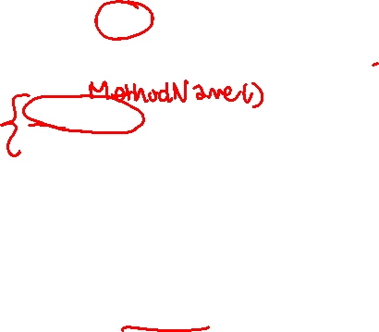
Classes
Class definition syntax (in a .h file):
Members can be functions (methods) or data (variables)
Class member function definition syntax (in a .cc file):
(1) define within the class definition or (2) declare within the class definition and then define elsewhere
class Name {
public:
// public member definitions & declarations go here
private:
// private member definitions & declarations go here
}; // class Name
retType Name::MethodName(type1 param1, …, typeN paramN) {
// body statements
}
Notes:
instead of individually tagging members, public group (on top!), private group later

Slide 34

Class Organization
It’s a little more complex than in C when modularizing with struct definition:
Class definition is part of interface and should go in .h file
Private members still must be included in definition (!)
Usually put member function definitions into companion .cc file with implementation details
Common exception: setter and getter methods
These files can also include non-member functions that use the class
Unlike Java, you can name files anything you want
Typically Name.cc and Name.h for class Name
Notes:
if public declaration - why include private things? compiler needs to know how much space to allocate

Slide 35



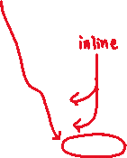
Class Definition (.h file)
Point.h
#ifndef _POINT_H_
#define _POINT_H_
class Point {
public:
Point(const int x, const int y); // constructor
int get_x() const { return x_; } // inline member function
int get_y() const { return y_; } // inline member function
double Distance(const Point& p) const; // member function
void SetLocation(const int x, const int y); // member function
private:
int x_; // data member
int y_; // data member
}; // class Point
#endif // _POINT_H_
Notes:
const after member function names: guaranteed not to change _this_

Slide 36
Class Member Definitions (.cc file)
Point.cc
#include <cmath>
#include "Point.h"
Point::Point(const int x, const int y) {
x_ = x;
this->y_ = y; // "this->" is optional unless name conflicts
}
double Point::Distance(const Point& p) const {
// We can access p’s x_ and y_ variables either through the
// get_x(), get_y() accessor functions or the x_, y_ private
// member variables directly, since we’re in a member
// function of the same class.
double distance = (x_ - p.get_x()) * (x_ - p.get_x());
distance += (y_ - p.y_) * (y_ - p.y_);
return sqrt(distance);
}
void Point::SetLocation(const int x, const int y) {
x_ = x;
y_ = y;
}

Slide 37
Class Usage (.cc file)
usepoint.cc
#include <iostream>
#include "Point.h"
using namespace std;
int main(int argc, char** argv) {
Point p1(1, 2); // allocate a new Point on the Stack
Point p2(4, 6); // allocate a new Point on the Stack
cout << "p1 is: (" << p1.get_x() << ", ";
cout << p1.get_y() << ")" << endl;
cout << "p2 is: (" << p2.get_x() << ", ";
cout << p2.get_y() << ")" << endl;
cout << "dist : " << p1.Distance(p2) << endl;
return 0;
}

Slide 38
Extra Exercise #1
Write a C++ program that:
Has a class representing a 3-dimensional point
Has the following methods:
Return the inner product of two 3D points
Return the distance between two 3D points
Accessors and mutators for the x, y, and z coordinates

Slide 39
Extra Exercise #2
Write a C++ program that:
Has a class representing a 3-dimensional box
Use your Extra Exercise #1 class to store the coordinates of the vertices that define the box
Assume the box has right-angles only and its faces are parallel to the axes, so you only need 2 vertices to define it
Has the following methods:
Test if one box is inside another box
Return the volume of a box
Handles <<, =, and a copy constructor
Uses const in all the right places

