Slide 1
C++ Constructor Insanity CSE 333 Summer 2019
Instructor: Aaron Johnston
Teaching Assistants:
Yifan Bai Stuart Kol Daniel Lyu Kris Wong

Slide 2
About how long did Exercise 8 take?
0-1 Hours
1-2 Hours
2-3 Hours
3-4 Hours
4+ Hours
I prefer not to say

Slide 3
Administrivia
Exercise 9 released today, due Monday
Write a substantive class in C++ (but no dynamic allocation – yet)
Homework 2 due next Thursday (7/25)
File system crawler, indexer, and search engine
Note: libhw1.a (yours or ours) and the .h files from hw1 need to be in right directory (~yourgit/hw1/)
Note: use Ctrl-D to exit searchshell, test on directory of small self-made files

Slide 4
Lecture Outline
C++ Classes Review
Constructors
Copy Constructors
Assignment
Destructors

Slide 5



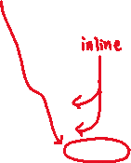
Class Definition (.h file)
Point.h
#ifndef _POINT_H_
#define _POINT_H_
class Point {
public:
Point(const int x, const int y); // constructor
int get_x() const { return x_; } // inline member function
int get_y() const { return y_; } // inline member function
double Distance(const Point& p) const; // member function
void SetLocation(const int x, const int y); // member function
private:
int x_; // data member
int y_; // data member
}; // class Point
#endif // _POINT_H_
Notes:
const after member function names: guaranteed not to change _this_

Slide 6
Class Member Definitions (.cc file)
Point.cc
#include <cmath>
#include "Point.h"
Point::Point(const int x, const int y) {
x_ = x;
this->y_ = y; // "this->" is optional unless name conflicts
}
double Point::Distance(const Point& p) const {
// We can access p’s x_ and y_ variables either through the
// get_x(), get_y() accessor functions or the x_, y_ private
// member variables directly, since we’re in a member
// function of the same class.
double distance = (x_ - p.get_x()) * (x_ - p.get_x());
distance += (y_ - p.y_) * (y_ - p.y_);
return sqrt(distance);
}
void Point::SetLocation(const int x, const int y) {
x_ = x;
y_ = y;
}

Slide 7
Class Usage (.cc file)
usepoint.cc
#include <iostream>
#include "Point.h"
using namespace std;
int main(int argc, char** argv) {
Point p1(1, 2); // allocate a new Point on the Stack
Point p2(4, 6); // allocate a new Point on the Stack
cout << "p1 is: (" << p1.get_x() << ", ";
cout << p1.get_y() << ")" << endl;
cout << "p2 is: (" << p2.get_x() << ", ";
cout << p2.get_y() << ")" << endl;
cout << "dist : " << p1.Distance(p2) << endl;
return 0;
}

Slide 8
struct vs. class
In C, a struct can only contain data fields
No methods and all fields are always accessible
In C++, struct and class are (nearly) the same!
Both can have methods and member visibility (public/private/protected, friend)
Minor difference: members are default public in a struct and default private in a class
Common style convention:
Use struct for simple bundles of data
Use class for abstractions with data + functions

Slide 9
Lecture Outline
C++ Classes Review
Constructors
Copy Constructors
Assignment
Destructors

Slide 10












Slide 11



Constructors
A constructor (ctor) initializes a newly-instantiated object
A class can have multiple constructors that differ in parameters
Which one is invoked depends on how the object is instantiated
Written with the class name as the method name:
C++ will automatically create a synthesized default constructor if you have no user-defined constructors
Takes no arguments and calls the default ctor on all non-“plain old data” (non-POD) member variables
Synthesized default ctor will fail if you have non-initialized const or reference data members
Point(const int x, const int y);

Slide 12
Synthesized Default Constructor
class SimplePoint {
public:
// no constructors declared!
int get_x() const { return x_; } // inline member function
int get_y() const { return y_; } // inline member function
double Distance(const SimplePoint& p) const;
void SetLocation(const int x, const int y);
private:
int x_; // data member
int y_; // data member
}; // class SimplePoint
SimplePoint.h
#include "SimplePoint.h"
... // definitions for Distance() and SetLocation()
int main(int argc, char** argv) {
SimplePoint x; // invokes synthesized default constructor
return EXIT_SUCCESS;
}
SimplePoint.cc
Notes:
const after member function names: guaranteed not to change _this_

Slide 13
Synthesized Default Constructor
If you define any constructors, C++ assumes you have defined all the ones you intend to be available and will not add any others
#include "SimplePoint.h"
// defining a constructor with two arguments
SimplePoint::SimplePoint(const int x, const int y) {
x_ = x;
y_ = y;
}
void foo() {
SimplePoint x; // compiler error: if you define any
// ctors, C++ will NOT synthesize a
// default constructor for you.
SimplePoint y(1, 2); // works: invokes the 2-int-arguments
// constructor
}

Slide 14


Multiple Constructors (overloading)
#include "SimplePoint.h"
// default constructor
SimplePoint::SimplePoint() {
x_ = 0;
y_ = 0;
}
// constructor with two arguments
SimplePoint::SimplePoint(const int x, const int y) {
x_ = x;
y_ = y;
}
void foo() {
SimplePoint x; // invokes the default constructor
SimplePoint a[3]; // invokes the default ctor 3 times
SimplePoint y(1, 2); // invokes the 2-int-arguments ctor
}

Slide 15
Initialization Lists
C++ lets you optionally declare an initialization list as part of a constructor definition
Initializes fields according to parameters in the list
The following two are (nearly) identical:
Point::Point(const int x, const int y) {
x_ = x;
y_ = y;
std::cout << ”Point: (" << x_ << "," << y_<< ")" << std::endl;
}
// constructor with an initialization list
Point::Point(const int x, const int y) : x_(x), y_(y) {
std::cout << "Point: (" << x_ << ",” << y_<< ")" << std::endl;
}

Slide 16


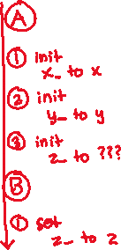
Initialization vs. Construction
Data members in initializer list are initialized in the order they are defined in the class, not by the initialization list ordering (!)
Data members that don’t appear in the initialization list are default initialized/constructed before body is executed
Initialization preferred to assignment to avoid extra steps
Real constructors should never mix the two styles
class Point3D {
public:
// constructor with 3 int arguments
Point3D(const int x, const int y, const int z) : y_(y), x_(x) {
z_ = z;
}
private:
int x_, y_, z_; // data members
}; // class Point3D
First, initialization list is applied.
Next, constructor body is executed.

Slide 17
Lecture Outline
C++ Classes Review
Constructors
Copy Constructors
Assignment
Destructors

Slide 18

Copy Constructors
C++ has the notion of a copy constructor (cctor)
Used to create a new object as a copy of an existing object
Point::Point(const int x, const int y) : x_(x), y_(y) { }
// copy constructor
Point::Point(const Point& copyme) {
x_ = copyme.x_;
y_ = copyme.y_;
}
void foo() {
Point x(1, 2); // invokes the 2-int-arguments constructor
Point y(x); // invokes the copy constructor
// could also be written as "Point y = x;"
}
Initializer lists can also be used in copy constructors (preferred)

Slide 19

Synthesized Copy Constructor
If you don’t define your own copy constructor, C++ will synthesize one for you
It will do a shallow copy of all of the fields (i.e. member variables) of your class
Sometimes the right thing; sometimes the wrong thing
#include "SimplePoint.h"
... // definitions for Distance() and SetLocation()
int main(int argc, char** argv) {
SimplePoint x;
SimplePoint y(x); // invokes synthesized copy constructor
...
return EXIT_SUCCESS;
}

Slide 20
When Do Copies Happen?
The copy constructor is invoked if:
You initialize an object from another object of the same type:
You pass a non-reference object as a value parameter to a function:
You return a non-reference object value from a function:
Point x; // default ctor
Point y(x); // copy ctor
Point z = y; // copy ctor
void foo(Point x) { ... }
Point y; // default ctor
foo(y); // copy ctor
Point foo() {
Point y; // default ctor
return y; // copy ctor
}

Slide 21
Compiler Optimization
The compiler sometimes uses a “return by value optimization” or “move semantics” to eliminate unnecessary copies
Sometimes you might not see a constructor get invoked when you might expect it
Point foo() {
Point y; // default ctor
return y; // copy ctor? optimized?
}
Point x(1, 2); // two-ints-argument ctor
Point y = x; // copy ctor
Point z = foo(); // copy ctor? optimized?

Slide 22
Lecture Outline
C++ Classes Review
Constructors
Copy Constructors
Assignment
Destructors

Slide 23
Assignment != Construction
“=” is the assignment operator
Assigns values to an existing, already constructed object
Point w; // default ctor
Point x(1, 2); // two-ints-argument ctor
Point y(x); // copy ctor
Point z = w; // copy ctor
y = x; // assignment operator

Slide 24

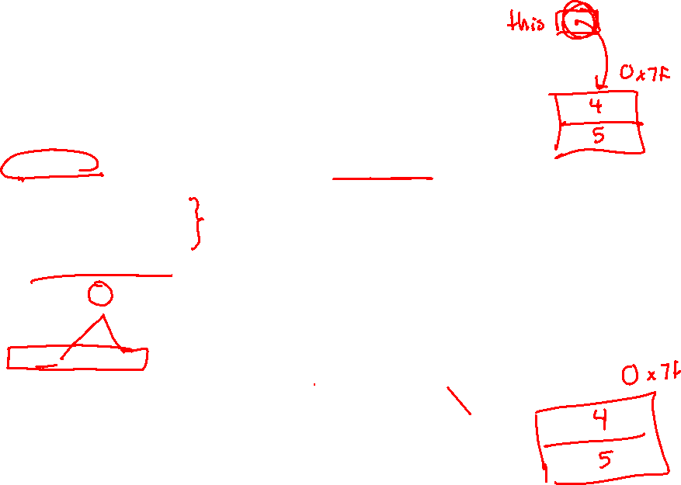
Overloading the “=” Operator
You can choose to define the “=” operator
But there are some rules you should follow:
Point& Point::operator=(const Point& rhs) {
if (this != &rhs) { // (1) always check against this
x_ = rhs.x_;
y_ = rhs.y_;
}
return *this; // (2) always return *this from op=
}
Point a; // default constructor
a = b = c; // works because = return *this
a = (b = c); // equiv. to above (= is right-associative)
(a = b) = c; // "works" because = returns a non-const

Slide 25
Synthesized Assignment Operator
If you don’t define the assignment operator, C++ will synthesize one for you
It will do a shallow copy of all of the fields (i.e. member variables) of your class
Sometimes the right thing; sometimes the wrong thing
#include "SimplePoint.h"
... // definitions for Distance() and SetLocation()
int main(int argc, char** argv) {
SimplePoint x;
SimplePoint y(x);
y = x; // invokes synthesized assignment operator
return EXIT_SUCCESS;
}

Slide 26
Lecture Outline
C++ Classes Review
Constructors
Copy Constructors
Assignment
Destructors

Slide 27
Destructors
C++ has the notion of a destructor (dtor)
Invoked automatically when a class instance is deleted, goes out of scope, etc. (even via exceptions or other causes!)
Place to put your cleanup code – free any dynamic storage or other resources owned by the object
Standard C++ idiom for managing dynamic resources
Slogan: “Resource Acquisition Is Initialization” (RAII)
Point::~Point() { // destructor
// do any cleanup needed when a Point object goes away
// (nothing to do here since we have no dynamic resources)
}

Slide 28
Extra Exercise #1
Modify your Point3D class from Lec 10 Extra #1
Disable the copy constructor and assignment operator
Attempt to use copy & assignment in code and see what error the compiler generates
Write a CopyFrom() member function and try using it instead
(See details about CopyFrom() in next lecture)

Slide 29
Extra Exercise #2
Write a C++ class that:
Is given the name of a file as a constructor argument
Has a GetNextWord() method that returns the next whitespace- or newline-separated word from the file as a copy of a string object, or an empty string once you hit EOF
Has a destructor that cleans up anything that needs cleaning up

