Slide 1
C++ Class Details, Heap CSE 333 Summer 2019
Instructor: Aaron Johnston
Teaching Assistants:
Yifan Bai Stuart Kol Daniel Lyu Kris Wong

Slide 2
About how long did Exercise 9 take?
0-1 Hours
1-2 Hours
2-3 Hours
3-4 Hours
4+ Hours
I prefer not to say

Slide 3
Administrivia
Exercise 10 released today, due Wednesday
Improve Vector: dynamically allocated memory, practice with more friend functions
As with exercise 9, refer to Complex.h/Complex.cc
Homework 2 due this Thursday (7/25)
Midterm next Monday (7/29)
Review session this Sunday (7/28), 4:30 – 6:30pm in ECE 037

Slide 4
Lecture Outline
Class Details
Filling in some additional details
Using the Heap in C++
new / delete / delete[]

Slide 5





Review: Constructor Insanity
Monkey(), Monkey(int x)
Constructor (ctor)
Monkey(const Monkey& copyme)
Copy Constructor (cctor)
Monkey& operator=(const Monkey& rhs)
Assignment Operator (op=)
~Monkey()
Destructor (dtor)

Slide 6
Destructors
C++ has the notion of a destructor (dtor)
Invoked automatically when a class instance is deleted, goes out of scope, etc. (even via exceptions or other causes!)
Place to put your cleanup code – free any dynamic storage or other resources owned by the object
Standard C++ idiom for managing dynamic resources
Slogan: “Resource Acquisition Is Initialization” (RAII)
Point::~Point() { // destructor
// do any cleanup needed when a Point object goes away
// (nothing to do here since we have no dynamic resources)
}

Slide 7

How many times does the destructor get invoked?
Assume Point with everything defined (ctor, cctor, =, dtor)
Assume no compiler optimizations
A. 1
B. 2
C. 3
D. 4
E. We’re lost…
test.cc
Point PrintTheta(Point& pt) {
Point origin(0, 0);
double theta = atan2(pt.get_y(), pt.get_x());
cout << "theta = " << theta << " rad" << endl;
return pt;
}
int main(int argc, char** argv) {
Point pt(3, 4);
PrintTheta(pt);
return 0;
}
Notes:
Correct Answer: 3
PrintRad: origin falls out of scope
main: PrintRad returns a temp Point, ignored
main: pt falls out of scope
#include <iostream>
#include <cmath>

Slide 8
Rule of Three
If you define any of:
Destructor
Copy Constructor
Assignment (operator=)
Then you should normally define all three
Can explicitly ask for default synthesized versions (C++11):
class Point {
public:
Point() = default; // the default ctor
~Point() = default; // the default dtor
Point(const Point& copyme) = default; // the default cctor
Point& operator=(const Point& rhs) = default; // the default "="
...

Slide 9
Dealing with the Insanity
C++ style guide tip:
When applicable, disable the copy constructor and assignment operator by declaring as private and not defining them (pre-C++11)
Point.h
class Point {
public:
Point(const int x, const int y) : x_(x), y_(y) { } // ctor
...
private:
Point(const Point& copyme); // disable cctor (no def.)
Point& operator=(const Point& rhs); // disable "=" (no def.)
...
}; // class Point
Point w; // compiler error (no default constructor)
Point x(1, 2); // OK!
Point y = w; // compiler error (no copy constructor)
y = x; // compiler error (no assignment operator)
Notes:
Need to be private in order to induce compile-time error in customer code.
Otherwise, you will get a linking error later on.

Slide 10
Disabling in C++11
C++11 add new syntax to do this directly
This is the better choice in C++11 code
Point_2011.h
class Point {
public:
Point(const int x, const int y) : x_(x), y_(y) { } // ctor
...
Point(const Point& copyme) = delete; // declare cctor and "=" as
Point& operator=(const Point& rhs) = delete; // as deleted (C++11)
private:
...
}; // class Point
Point w; // compiler error (no default constructor)
Point x(1, 2); // OK!
Point y = w; // compiler error (no copy constructor)
y = x; // compiler error (no assignment operator)

Slide 11
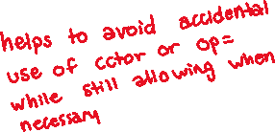
CopyFrom
C++11 style guide tip:
If you disable them, then you instead may want an explicit “CopyFrom” function that can be used when occasionally needed
Point.h
class Point {
public:
Point(const int x, const int y) : x_(x), y_(y) { } // ctor
void CopyFrom(const Point& copy_from_me);
...
Point(Point& copyme) = delete; // disable cctor
Point& operator=(Point& rhs) = delete; // disable "="
private:
...
}; // class Point
sanepoint.cc
Point x(1, 2); // OK
Point y(3, 4); // OK
x.CopyFrom(y); // OK
Notes:
Allows for explicit copying without inadvertent execution of the copy constructor (especially during function calls and returns).

Slide 12
Access Control
Access modifiers for members:
public: accessible to all parts of the program
private: accessible to the member functions of the class
Private to class, not object instances
protected: accessible to member functions of the class and any derived classes (subclasses – more to come, later)
Reminders:
Access modifiers apply to all members that follow until another access modifier is reached
If no access modifier is specified, struct members default to public and class members default to private

Slide 13
Nonmember Functions
“Nonmember functions” are just normal functions that happen to use some class
Called like a regular function instead of as a member of a class object instance
This gets a little weird when we talk about operators…
These do not have access to the class’ private members
Useful nonmember functions often included as part of interface to a class
Declaration goes in header file, but outside of class definition

Slide 14
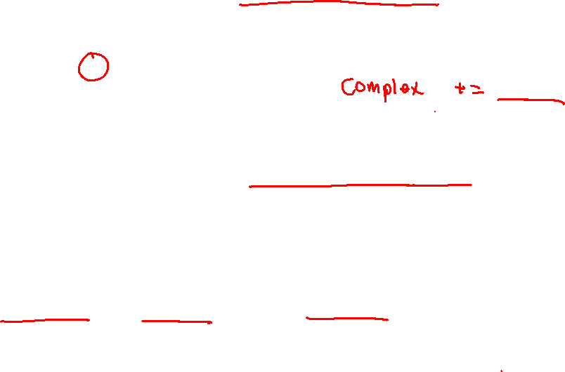
Review: Operator Overloading
Can overload operators using member functions
Restriction: left-hand side argument must be a class you are implementing
Can overload operators using nonmember functions
No restriction on arguments (can specify any two)
Particularly important when the left-hand side will be a class you do not have control over, like ostream or istream.
But no access to private data members
Complex &operator+=(const Complex &a) {
...
}
Complex operator+(const Complex &a, const Complex &b) {
...
}

Slide 15
friend Nonmember Functions
A class can give a nonmember function (or class) access to its non-public members by declaring it as a friend within its definition
Not a class member, but has access privileges as if it were
friend functions are usually unnecessary if your class includes appropriate “getter” public functions
Complex.h
class Complex {
...
friend std::istream& operator>>(std::istream& in, Complex& a);
...
}; // class Complex
std::istream& operator>>(std::istream& in, Complex& a) {
...
}
Complex.cc

Slide 16
Namespaces
Each namespace is a separate scope
Useful for avoiding symbol collisions!
Namespace definition:
namespace name { // declarations go here }
Creates a new namespace name if it did not exist, otherwise adds to the existing namespace (!)
This means that components (e.g. classes, functions) of a namespace can be defined in multiple source files
namespace name { // declarations go here }

Slide 17
Classes vs. Namespaces
They seems somewhat similar, but classes are not namespaces:
There are no instances/objects of a namespace; a namespace is just a group of logically-related things (classes, functions, etc.)
To access a member of a namespace, you must use the fully qualified name (i.e. nsp_name::member)
Unless you are using that namespace
You only used the fully qualified name of a class member when you are defining it outside of the scope of the class definition

Slide 18
Lecture Outline
Class Details
Filling in some additional details
Using the Heap in C++
new / delete / delete[]

Slide 19
C++11 nullptr
C and C++ have long used NULL as a pointer value that references nothing
C++11 introduced a new literal for this: nullptr
New reserved word
Interchangeable with NULL for all practical purposes, but it has type T* for any/every T, and is not an integer value
Avoids funny edge cases (see C++ references for details)
Still can convert to/from integer 0 for tests, assignment, etc.
Advice: prefer nullptr in C++11 code
Though NULL will also be around for a long, long time
Notes:
NULL: becomes 0, hard to tell if int or pointer value Name: horrifying reason

Slide 20

new/delete
To allocate on the heap using C++, you use the new keyword instead of malloc() from stdlib.h
You can use new to allocate an object (e.g. new Point)
You can use new to allocate a primitive type (e.g. new int)
To deallocate a heap-allocated object or primitive, use the delete keyword instead of free() from stdlib.h
Don’t mix and match!
Never free() something allocated with new
Never delete something allocated with malloc()
Careful if you’re using a legacy C code library or module in C++

Slide 21

new/delete Example
int* AllocateInt(int x) {
int* heapy_int = new int;
*heapy_int = x;
return heapy_int;
}
Point* AllocatePoint(int x, int y) {
Point* heapy_pt = new Point(x,y);
return heapy_pt;
}
heappoint.cc
#include "Point.h"
using namespace std;
... // definitions of AllocateInt() and AllocatePoint()
int main() {
Point* x = AllocatePoint(1, 2);
int* y = AllocateInt(3);
cout << "x's x_ coord: " << x->get_x() << endl;
cout << "y: " << y << ", *y: " << *y << endl;
delete x;
delete y;
return EXIT_SUCCESS;
}

Slide 22

Dynamically Allocated Arrays
To dynamically allocate an array:
Default initialize:
To dynamically deallocate an array:
Use delete[] name;
It is incorrect to use “delete name;” on an array
The compiler probably won’t catch this, though (!) because it can’t always tell if name* was allocated with new type[size]; or new type;
Especially inside a function where a pointer parameter could point to a single item or an array and there’s no way to tell which!
Result of wrong delete is undefined behavior
type* name = new type[size];
delete[] name;
Notes:
DRAW: array with arrow pointing into middle

Slide 23
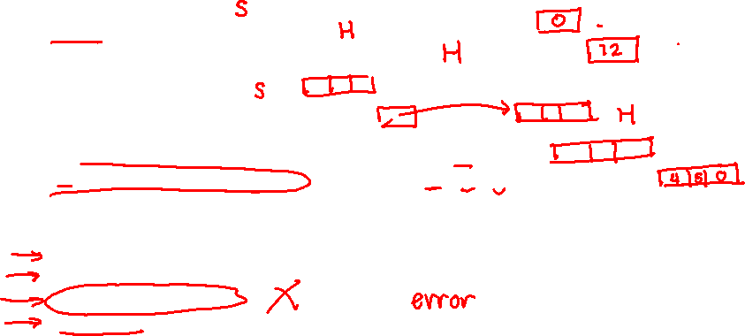
Arrays Example (primitive)
arrays.cc
#include "Point.h"
int main() {
int stack_int;
int* heap_int = new int;
int* heap_int_init = new int(12);
int stack_arr[3];
int* heap_arr = new int[3];
int* heap_arr_init_val = new int[3]();
int* heap_arr_init_lst = new int[3]{4, 5}; // C++11
...
delete heap_int; //
delete heap_int_init; //
delete heap_arr; //
delete[] heap_arr_init_val; //
return EXIT_SUCCESS;
}
Notes:
ERRORS:
- 3rd (delete heap_arr;) // should be delete[] heap_arr;
- Memory leak of heap_arr_init_lst
DEMO: run $ valgrind --leak-check=full ./arrays
- highlight “Mismatched free() / delete / delete []”

Slide 24
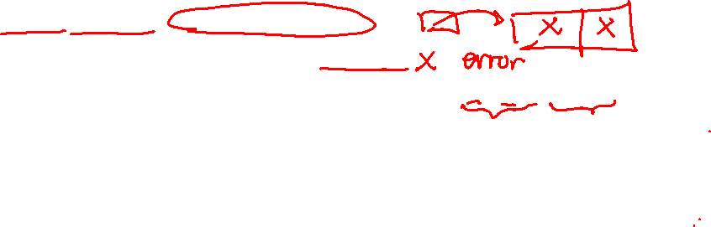
Arrays Example (class objects)
arrays.cc
#include "Point.h"
int main() {
...
Point stack_pt(1, 2);
Point* heap_pt = new Point(1, 2);
Point* heap_pt_arr_err = new Point[2];
Point* heap_pt_arr_init_lst = new Point[2]{{1, 2}, {3, 4}}; // C++11
...
delete heap_pt;
delete[] heap_pt_arr_init_lst;
return EXIT_SUCCESS;
}
Notes:
ERRORS
Point* heap_pt_arr_err = new Point[2]; // no default constructor

Slide 25
malloc vs. new
 | malloc() | new
What is it? | a function | an operator or keyword
How often used (in C)? | often | never
How often used (in C++)? | rarely | often
Allocated memory for | anything | arrays, structs, objects, primitives
Returns | a void* (should be cast) | appropriate pointer type (doesn’t need a cast)
When out of memory | returns NULL | throws an exception
Deallocating | free() | delete or delete[]
Notes:
What else is there besides arrays, structs, objects, and primitives?

Slide 26


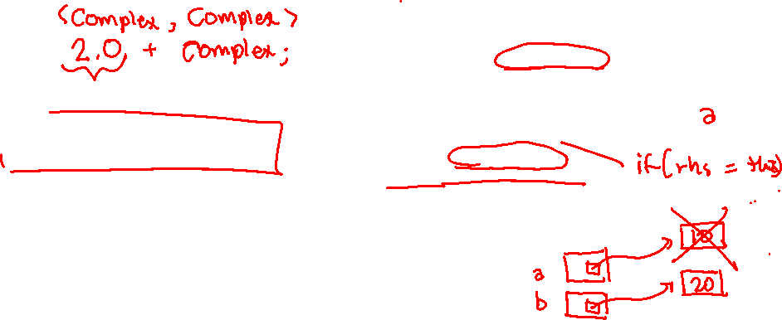


What will happen when we invoke bar()?
If there is an error, how would you fix it?
A. Bad dereference
B. Bad delete
C. Memory leak
D. “Works” fine
E. We’re lost…
Foo::Foo(int val) { Init(val); }
Foo::~Foo() { delete foo_ptr_; }
void Foo::Init(int val) {
foo_ptr_ = new int;
*foo_ptr_ = val;
}
Foo& Foo::operator=(const Foo& rhs) {
delete foo_ptr_;
Init(*(rhs.foo_ptr_));
return *this;
}
void bar() {
Foo a(10);
Foo b(20);
a = a;
}
Notes:
Answer: A (bad dereference) Foo is a class with a private data member int* foo_ptr_

Slide 27
Extra Exercise #1
Write a C++ function that:
Uses new to dynamically allocate an array of strings and uses delete[] to free it
Uses new to dynamically allocate an array of pointers to strings
Assign each entry of the array to a string allocated using new
Cleans up before exiting
Use delete to delete each allocated string
Uses delete[] to delete the string pointer array
(whew!)

