Slide 1
C++ Standard Template Library CSE 333 Summer 2019
Instructor: Aaron Johnston
Teaching Assistants:
Yifan Bai Stuart Kol Daniel Lyu Kris Wong

Slide 2
Administrivia
Midterm on Monday (7/29)!
Review session this Sunday (7/28), 4:30 – 6:30pm in ECE 037
Don’t forget your ONE double-sided notes sheet
More details posted on course website
Instead of an exercise for today: Mid-Quarter Survey
Should take no more than 10 minutes
Worth 3 points in the homework category
Due 10:30am on Monday like normal (right before the midterm)
Please give us your honest feedback!

Slide 3
Lecture Outline
Standard Template Library (STL)
References Revisited

Slide 4
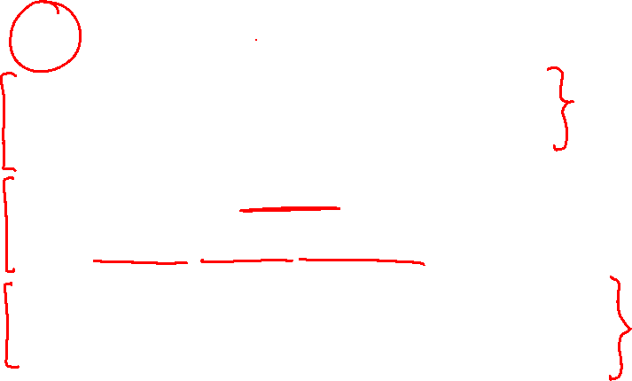
C++’s Standard Library
C++’s Standard Library consists of four major pieces:
The entire C standard library
C++’s input/output stream library
std::cin, std::cout, stringstreams, fstreams, etc.
C++’s standard template library (STL) ☜
Containers, iterators, algorithms (sort, find, etc.), numerics
C+’+’s miscellaneous library
Strings, exceptions, memory allocation, localization

Slide 5
STL Containers ☺
A container is an object that stores (in memory) a collection of other objects (elements)
Implemented as class templates, so hugely flexible
More info in C++ Primer §9.2, 11.2
Several different classes of container
Sequence containers (vector, deque, list, ...)
Associative containers (set, map, multiset, multimap, bitset, ...)
Differ in algorithmic cost and supported operations

Slide 6

STL Containers ☹
STL containers store by value, not by reference
When you insert an object, the container makes a copy
If the container needs to rearrange objects, it makes copies
e.g. if you sort a vector, it will make many, many copies
e.g. if you insert into a map, that may trigger several copies
What if you don’t want this (disabled copy constructor or copying is expensive)?
You can insert a wrapper object with a pointer to the object
We’ll learn about these “smart pointers” soon

Slide 7

Our Tracer Class
Wrapper class for an unsigned int value_
Also holds unique unsigned int id_ (increasing from 0)
Default ctor, cctor, dtor, op=, op< defined
friend function operator<< defined
Private helper method PrintID() to return "(id_,value_)" as a string
Class and member definitions can be found in Tracer.h and Tracer.cc
Useful for tracing behaviors of containers
All methods print identifying messages
Unique id_ allows you to follow individual instances

Slide 8

STL vector
A generic, dynamically resizable array
http://www.cplusplus.com/reference/stl/vector/vector/
Elements are store in contiguous memory locations
Elements can be accessed using pointer arithmetic if you’d like
Random access is O(1) time
Adding/removing from the end is cheap (amortized constant time)
Inserting/deleting from the middle or start is expensive (linear time)

Slide 9
vector/Tracer Example
vectorfun.cc
#include <iostream>
#include <vector>
#include "Tracer.h"
using namespace std;
int main(int argc, char** argv) {
Tracer a, b, c;
vector<Tracer> vec;
cout << "vec.push_back " << a << endl;
vec.push_back(a);
cout << "vec.push_back " << b << endl;
vec.push_back(b);
cout << "vec.push_back " << c << endl;
vec.push_back(c);
cout << "vec[0]" << endl << vec[0] << endl;
cout << "vec[2]" << endl << vec[2] << endl;
return EXIT_SUCCESS;
}
Notes:
- library <vector>
instances
add COPIES DEMO: make
./vectorfun
make vectorcap
./vectorfun

Slide 10






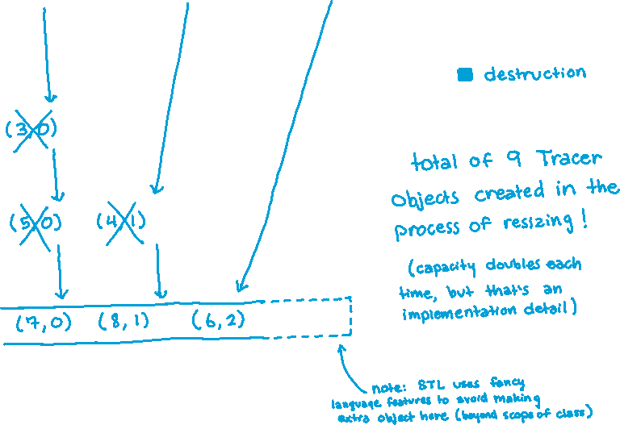
Why All the Copying?
Notes:
DEMO: uncomment vec.reserve(4); in vectorfun.cc
make vectorcap
make

Slide 11

STL iterator
Each container class has an associated iterator class (e.g. vector<int>::iterator) used to iterate through elements of the container
http://www.cplusplus.com/reference/std/iterator/
Iterator range is from begin up to end i.e., [begin , end)
end is one past the last container element!
Some container iterators support more operations than others
All can be incremented (++), copied, copy-constructed
Some can be dereferenced on RHS (e.g. x = *it;)
Some can be dereferenced on LHS (e.g. *it = x;)
Some can be decremented (--)
Some support random access ([], +, -, +=, -=, <, > operators)
Notes:
DEMO: run ./vectoriterator

Slide 12


iterator Example
vectoriterator.cc
#include <vector>
#include "Tracer.h"
using namespace std;
int main(int argc, char** argv) {
Tracer a, b, c;
vector<Tracer> vec;
vec.push_back(a);
vec.push_back(b);
vec.push_back(c);
cout << "Iterating:" << endl;
vector<Tracer>::iterator it;
for (it = vec.begin(); it < vec.end(); it++) {
cout << *it << endl;
}
cout << "Done iterating!" << endl;
return EXIT_SUCCESS;
}
Notes:
Methods begin() and end() return begin and end iterators (which can be assigned and compared – at least equality).
Getting container data is done by dereferencing iterator.

Slide 13
Type Inference (C++11)
The auto keyword can be used to infer types
Simplifies your life if, for example, functions return complicated types
The expression using auto must contain explicit initialization for it to work
// Calculate and return a vector
// containing all factors of n
std::vector<int> Factors(int n);
void foo(void) {
// Manually identified type
std::vector<int> facts1 =
Factors(324234);
// Inferred type
auto facts2 = Factors(12321);
// Compiler error here
auto facts3;
// More code . . .
}

Slide 14
auto and Iterators
Life becomes much simpler!
for (vector<Tracer>::iterator it = vec.begin(); it < vec.end(); it++) {
cout << *it << endl;
}
for (auto it = vec.begin(); it < vec.end(); it++) {
cout << *it << endl;
}

Slide 15
Range for Statement (C++11)
Syntactic sugar similar to Java’s foreach
General format:
declaration defines loop variable
expression is an object representing a sequence
Strings, initializer lists, arrays with an explicit length defined, STL containers that support iterators
for ( declaration : expression ) {
statements
}
// Prints out a string, one
// character per line
std::string str("hello");
for ( auto c : str ) {
std::cout << c << std::endl;
}

Slide 16
Updated iterator Example
vectoriterator_2011.cc
#include <vector>
#include "Tracer.h"
using namespace std;
int main(int argc, char** argv) {
Tracer a, b, c;
vector<Tracer> vec;
vec.push_back(a);
vec.push_back(b);
vec.push_back(c);
cout << "Iterating:" << endl;
// "auto" is a C++11 feature not available on older compilers
for (auto& p : vec) {
cout << p << endl;
}
cout << "Done iterating!" << endl;
return EXIT_SUCCESS;
}
Notes:
in template, "class" is traditional, but may see "typename" instead

Slide 17
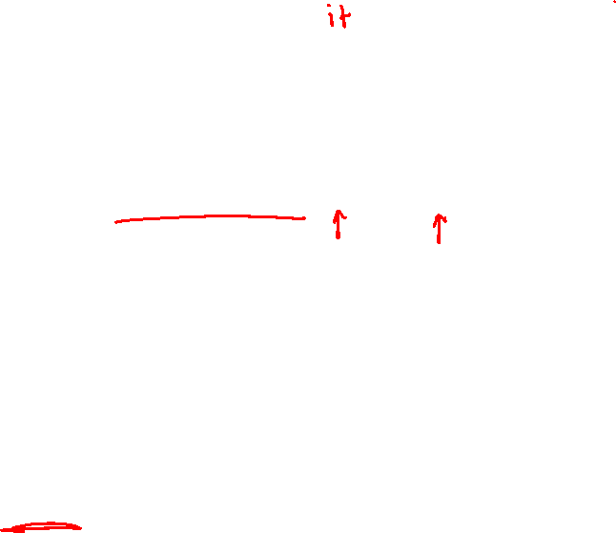
STL Algorithms
A set of functions to be used on ranges of elements
Range: any sequence that can be accessed through iterators or pointers, like arrays or some of the containers
General form:
Algorithms operate directly on range elements rather than the containers they live in
Make use of elements’ copy ctor, =, ==, !=, <
Some do not modify elements
e.g. find, count, for_each, min_element, binary_search
Some do modify elements
e.g. sort, transform, copy, swap
algorithm(begin, end, ...);

Slide 18

Algorithms Example
vectoralgos.cc
#include <vector>
#include <algorithm>
#include "Tracer.h"
using namespace std;
void PrintOut(const Tracer& p) {
cout << " printout: " << p << endl;
}
int main(int argc, char** argv) {
Tracer a, b, c;
vector<Tracer> vec;
vec.push_back(c);
vec.push_back(a);
vec.push_back(b);
cout << "sort:" << endl;
sort(vec.begin(), vec.end());
cout << "done sort!" << endl;
for_each(vec.begin(), vec.end(), &PrintOut);
return 0;
}
Notes:
Run vectoralgos to see Tracer output – lots of copying!!!
http://www.cplusplus.com/reference/algorithm/sort/ -- “On average, linearithmic in the distance between first and last: Performs approximately N*log₂(N) (where N is this distance) comparisons of elements, and up to that many element swaps (or moves).”

Slide 19


STL list
A generic doubly-linked list
http://www.cplusplus.com/reference/stl/list/
Elements are not stored in contiguous memory locations
Does not support random access (e.g. cannot do list[5])
Some operations are much more efficient than vectors
Constant time insertion, deletion anywhere in list
Can iterate forward or backwards
Has a built-in sort member function
Doesn’t copy! Manipulates list structure instead of element values

Slide 20
list Example
listexample.cc
#include <list>
#include <algorithm>
#include "Tracer.h"
using namespace std;
void PrintOut(const Tracer& p) {
cout << " printout: " << p << endl;
}
int main(int argc, char** argv) {
Tracer a, b, c;
list<Tracer> lst;
lst.push_back(c);
lst.push_back(a);
lst.push_back(b);
cout << "sort:" << endl;
lst.sort();
cout << "done sort!" << endl;
for_each(lst.begin(), lst.end(), &PrintOut);
return EXIT_SUCCESS;
}
Notes:
DEMO: run ./listexample
Only 6 Tracers created total – no moving needed during push_back
No copying/moving during sort()

Slide 21
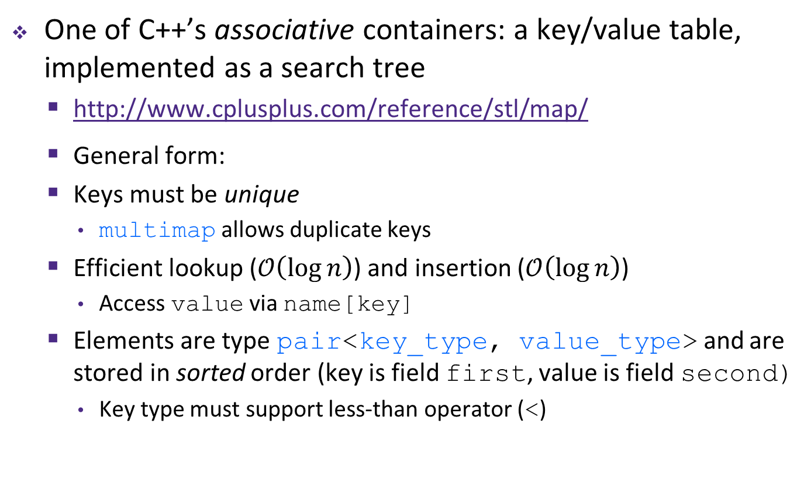
STL map
One of C++’s associative containers: a key/value table, implemented as a search tree
http://www.cplusplus.com/reference/stl/map/
General form:
Keys must be unique
multimap allows duplicate keys
Efficient lookup ($𝒪\left(\log{n}\right)$) and insertion ($𝒪\left(\log{n}\right)$)
Access value via name[key]
Elements are type pair<key_type, value_type> and are stored in sorted order (key is field first, value is field second)
Key type must support less-than operator (<)

Slide 22
map Example
mapexample.cc
void PrintOut(const pair<Tracer, Tracer>& p) {
cout << "printout: [" << p.first << "," << p.second << "]" << endl;
}
int main(int argc, char** argv) {
Tracer a, b, c, d, e, f;
map<Tracer, Tracer> table;
map<Tracer, Tracer>::iterator it;
table.insert(pair<Tracer, Tracer>(a, b));
table[c] = d;
table[e] = f;
cout << "table[e]:" << table[e] << endl;
it = table.find(c);
cout << "PrintOut(*it), where it = table.find(c)" << endl;
PrintOut(*it);
cout << "iterating:" << endl;
for_each(table.begin(), table.end(), &PrintOut);
return EXIT_SUCCESS;
}
Notes:
DEMO: run ./mapexample
Tracer output – lots of copying!!!

Slide 23

Unordered Containers (C++11)
unordered_map, unordered_set
And related classes unordered_multimap, unordered_multiset
Average case for key access is $𝒪\left(1\right)$
But range iterators can be less efficient than ordered map/set
See C++ Primer, online references for details

Slide 24
Lecture Outline
Standard Template Library (STL)
References Revisited

Slide 25
∃ Confusion About References
When should they be used?
Particularly with parameters and return values
When can using them cause trouble?

Slide 26
We’ll go through a bunch of code examples
Try to come up with a response on your own first
Then discuss with your neighbor(s) and come to a consensus
For each, answer:
A. We must NOT use a reference
B. It’s OK but discouraged to use a reference
C. It’s OK and encouraged to use a reference
D. We must use a reference
E. We’re lost…

Slide 27
Parameters 1
param1.cc
#include <cstdlib>
#include <iostream>
using namespace std;
// SHOULD WE BE USING REFERENCES FOR PARAMETERS "a" AND "b"?
// (Answer: ?)
int LeastCommonMultiple(const int &a, const int &b) {
for (int n=1; ; n++) {
if ((n % a == 0) && (n % b == 0))
return n;
}
}
int main(int argc, char **argv) {
int x = 12, y = 14;
int lcm = LeastCommonMultiple(x, y);
cout << "LCM(" << x << "," << y << ") is " << lcm << endl;
return EXIT_SUCCESS;
}

Slide 28
param1.cc
B. It’s OK but discouraged to use a reference
A const reference to a small primitive type (e.g. int, float)
We aren’t changing the argument values (const), so it doesn’t matter if we use a copy or not – reference is optional
Correct behavior, but might have better performance with regular call-by-value

Slide 29
Parameters 2
param2.cc
#include <cmath>
#include <cstdlib>
#include <iostream>
#include "ThreeDPoint.h"
// SHOULD WE BE USING REFERENCES FOR PARAMETERS "a" AND "b"?
// (Answer: ?)
double Distance(const ThreeDPoint &a, const ThreeDPoint &b) {
double dist = pow(a.x-b.x,2) + pow(a.y-b.y,2) + pow(a.z-b.z,2);
return sqrt(dist);
}
int main(int argc, char **argv) {
ThreeDPoint a(1,2,3), b(4,5,6);
int dist = Distance(a, b);
cout << "Distance(a,b) is " << dist << endl;
return EXIT_SUCCESS;
}

Slide 30
param2.cc
C. It’s OK and encouraged to use a reference
A const reference to a complex type (e.g. struct, object instance)
We aren’t changing the argument values (const), so it doesn’t matter if we use a copy or not – reference is optional
Correct behavior and likely performance benefit from not having to copy
Follow-up: Why not pass in a pointer instead?

Slide 31
Return Value 1
ret1.cc
#include <cstdlib>
#include <iostream>
typedef struct Point_st {
double x, y, z;
} Point;
// SHOULD WE BE USING A REFERENCE FOR THE RETURN VALUE?
// (Answer: ?)
Point &MakePoint(const int x, const int y, const int z) {
Point retval = {x, y, z};
return retval;
}
int main(int argc, char **argv) {
Point p = MakePoint(1, 2, 3);
std::cout << p.x << "," << p.y << "," << p.z << std::endl;
return EXIT_SUCCESS;
}

Slide 32
ret1.cc
A. We must NOT use a reference
A reference to a stack-allocated complex type
Never return a reference (or pointer to) a local variable
Destructor is also called on object when returning

Slide 33
Copy Constructor
Complex1.h
#ifndef _COMPLEX_H_
#define _COMPLEX_H_
#include <iostream>
namespace complex {
class Complex {
public:
// Copy constructor -- should we pass a reference or not?
// (Answer: ?)
Complex(const Complex &copyme) {
real_ = copyme.real_;
imag_ = copyme.image_;
}
private:
double real_, imag_;
}; // class Complex
} // namespace complex
#endif // _COMPLEX_H_

Slide 34
Complex1.h
D. We must use a reference
A const reference to a complex type
We aren’t changing the argument’s values so it doesn’t matter if we use a copy or not, in theory
A copy constructor must take a reference, otherwise it would need to call itself to make a (call-by-value) copy of the argument…

Slide 35
operator+
Complex2.h
#include <iostream>
namespace complex {
class Complex {
public:
// Should operator+ return a reference or not?
// (Answer: ?)
Complex &operator+(const Complex &a) const {
Complex tmp(0,0);
tmp.real_ = this->real_ + a.real_;
tmp.imag_ = this->imag_ + a.imag_;
return tmp;
}
private:
double real_, imag_;
}; // class Complex
} // namespace complex

Slide 36
Complex2.h
A. We must NOT use a reference
A reference to a stack-allocated complex type
Never return a reference (or pointer to) a local variable
Destructor is also called on object when returning

Slide 37
Assignment Operator
Complex3.h
#include <iostream>
namespace complex {
class Complex {
public:
// Should the assignment operator return a reference?
// (Answer: ?)
Complex &operator=(const Complex &a) {
if (this != &a) {
this->real_ = a.real_;
this->imag_ = a.imag_;
}
return *this;
}
private:
double real_, imag_;
}; // class Complex
} // namespace complex

Slide 38


Complex3.h
D. We must use a reference
A reference to *this, the object this method was called on
All of the “work” is done in the method body; the return value is only there for chaining (but required for chaining to work correctly)
Follow-up: What happens in (a = b) = c; if we don’t use a reference?

Slide 39
operator+=
Complex4.h
#include <iostream>
namespace complex {
class Complex {
public:
// Should += return a reference?
// (Answer: ?)
Complex &operator+=(const Complex &a) {
this->real_ += a.real_;
this->imag_ += a.imag_;
return *this;
}
private:
double real_, imag_;
}; // class Complex
} // namespace complex

Slide 40
Complex4.h
D. We must use a reference
A reference to *this, the object this method was called on
All of the “work” is done in the method body; the return value is only there for chaining (but required for chaining to work correctly)
You hardly see people chain +=, but it is allowed by the primitive data types, so we follow suit
Style/code quality: overloaded operators should have similar semantics to basic definitions to avoid programmer surprises

Slide 41
operator<<
Complex5.h
#include <iostream>
namespace complex {
class Complex {
public:
double real() const { return real_; };
double imag() const { return imag_; };
private:
double real_, imag_;
}; // class Complex
} // namespace complex
// Should operator<< return a reference?
// (Answer: ?)
std::ostream &operator<<(std::ostream &out,
const complex::Complex &a) {
out << "(" << a.real() << " + " << a.imag() << "i)";
return out;
}

Slide 42
Complex5.h
D. We must use a reference
A reference to out, the ostream object provided as an reference argument
The return value is only there for chaining (but required for chaining to work correctly)
Copying of streams is disallowed (and doesn’t make sense)

Slide 43
Extra Exercise #1
Using the Tracer.h/.cc files from lecture:
Construct a vector of lists of Tracers
i.e. a vector container with each element being a list of Tracers
Observe how many copies happen ☺
Use the sort algorithm to sort the vector
Use the list.sort() function to sort each list

