Slide 1
C++ Intro to Networking CSE 333 Summer 2019
Instructor: Aaron Johnston
Teaching Assistants:
Yifan Bai Stuart Kol Daniel Lyu Kris Wong

Slide 2
About how long did Exercise 13 take?
0-1 Hours
1-2 Hours
2-3 Hours
3-4 Hours
4+ Hours
I prefer not to say

Slide 3
Administrivia
No exercise today
Only 3 exercises left in the quarter!
HW3 due Friday (8/9)
Remember to use hw3fsck to check your index file!
Using 1 late day lets you submit until 11:59pm on Sunday night
Final late cutoff: 2 late days, or 11:59pm Monday night

Slide 4
Lecture Outline
C++ Casts Review
C++ Conversions
Introduction to Networks

Slide 5
Lecture Objectives
Review C++ casts: identify when they are appropriate
Understand how C++ converts between types (and what can go wrong!)
Get a feeling for the “landscape” of computer networks
Know how we organize them (the 7 layer cake) and why
What each layer is responsible for

Slide 6
C++ Casts Review
static_cast
Checked at compile time
Convert within class hierarchy, or between primitives
dynamic_cast
Check at compile time and runtime
Convert within class hierarchy
const_cast
Add or strip const
reinterpret_cast
Reinterpret the same bits
E.g. Interpret a pointer as a value

Slide 7
C++ Casts Review
static_cast
Checked at compile time
Convert within class hierarchy, or between primitives
dynamic_cast
Check at compile time and runtime
Convert within class hierarchy
const_cast
Add or strip const
reinterpret_cast
Reinterpret the same bits
E.g. Interpret a pointer as a value
// the address of a double
int64_t x = 0x7fffff8740;
// convert to a pointer
double *y = ________________________<double*>(x);

Slide 8
C++ Casts Review
static_cast
Checked at compile time
Convert within class hierarchy, or between primitives
dynamic_cast
Check at compile time and runtime
Convert within class hierarchy
const_cast
Add or strip const
reinterpret_cast
Reinterpret the same bits
E.g. Interpret a pointer as a value
// an integer value
int32_t x = 16;
// convert to a float so we can do precise math
float *y = ________________________<float*>(x);

Slide 9
C++ Casts Review
static_cast
Checked at compile time
Convert within class hierarchy, or between primitives
dynamic_cast
Check at compile time and runtime
Convert within class hierarchy
const_cast
Add or strip const
reinterpret_cast
Reinterpret the same bits
E.g. Interpret a pointer as a value
A
// a pointer of type B we know refers to a C
C c;
B *x = &c;
// convert to a C pointer
C *y = ________________________<C*>(x);
B
C

Slide 10
C++ Casts Review
static_cast
Checked at compile time
Convert within class hierarchy, or between primitives
dynamic_cast
Check at compile time and runtime
Convert within class hierarchy
const_cast
Add or strip const
reinterpret_cast
Reinterpret the same bits
E.g. Interpret a pointer as a value
A
// a pointer of type B, don’t know what’s inside
void Foo(B *x) {
// convert to a C pointer
C *y = ________________________<C*>(x);
}
B
C

Slide 11
Lecture Outline
C++ Casts Review
C++ Conversions
Introduction to Networks

Slide 12
Lecture Objectives
Review C++ casts: identify when they are appropriate
Understand how C++ converts between types (and what can go wrong!)
Get a feeling for the “landscape” of computer networks
Know how we organize them (the 7 layer cake) and why
What each layer is responsible for

Slide 13
Assignment and Inheritance
C++ allows you to assign the value of a derived class to an instance of a base class
Known as object slicing
It’s legal since b = d passes type checking rules
But b doesn’t have space for any extra fields in d
slicing.cc
class Base {
public:
Base(int xi) : x(xi) { }
int x;
};
class Der1 : public Base {
public:
Der1(int yi) : Base(16), y(yi) { }
int y;
};
void foo() {
Base b(1);
Der1 d(2);
d = b; //
b = d; //
}
Notes:
d = b; // compiler error
b = d; // what happens to y?

Slide 14
STL and Inheritance
Recall: STL containers store copies of values
What happens when we want to store mixes of object types in a single container? (e.g. Stock and DividendStock)
You get sliced ☹
#include <list>
#include "Stock.h"
#include "DividendStock.h"
int main(int argc, char** argv) {
Stock s;
DividendStock ds;
list<Stock> li;
li.push_back(s); // OK
li.push_back(ds); // OUCH!
return EXIT_SUCCESS;
}

Slide 15
STL and Inheritance
Instead, store pointers to heap-allocated objects in STL containers
No slicing! ☺
sort() does the wrong thing ☹
You have to remember to delete your objects before destroying the container ☹
Smart pointers!

Slide 16
Implicit Conversion
The compiler tries to infer some kinds of conversions
When types are not equal and you don’t specify an explicit cast, the compiler looks for an acceptable implicit conversion
void bar(std::string x);
void foo() {
int x = 5.7; // conversion, float -> int
char c = x; // conversion, int -> char
bar("hi"); // conversion, (const char*) -> string
}

Slide 17
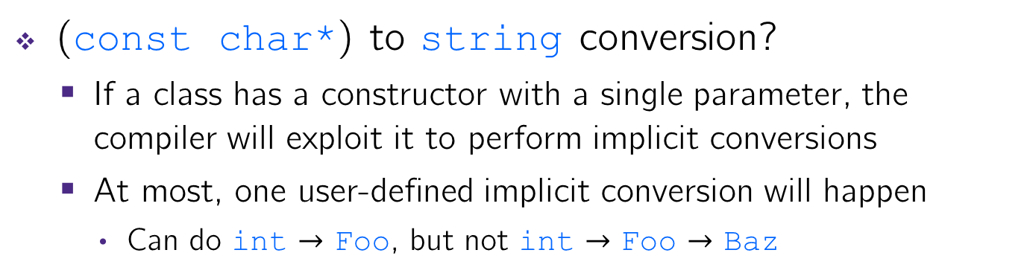
Sneaky Implicit Conversions
(const char*) to string conversion?
If a class has a constructor with a single parameter, the compiler will exploit it to perform implicit conversions
At most, one user-defined implicit conversion will happen
Can do int $→$ Foo, but not int $→$ Foo $→$ Baz
class Foo {
public:
Foo(int xi) : x(xi) { }
int x;
};
int Bar(Foo f) {
return f.x;
}
int main(int argc, char** argv) {
return Bar(5); // equivalent to return Bar(Foo(5));
}

Slide 18
Avoiding Sneaky Implicits
Declare one-argument constructors as explicit if you want to disable them from being used as an implicit conversion path
Usually a good idea
class Foo {
public:
explicit Foo(int xi) : x(xi) { }
int x;
};
int Bar(Foo f) {
return f.x;
}
int main(int argc, char** argv) {
return Bar(5); // compiler error
}

Slide 19

Lecture Outline
C++ Casts Review
C++ Conversions
Introduction to Networks
Layers upon layers upon layers…

Slide 20
Lecture Objectives
Review C++ casts: identify when they are appropriate
Understand how C++ converts between types (and what can go wrong!)
Get a feeling for the “landscape” of computer networks
Know how we organize them (the 7 layer cake) and why
What each layer is responsible for

Slide 21


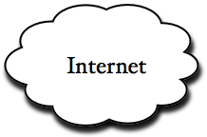




Networks From 10,000 ft
clients
servers

Slide 22
The Physical Layer
Individual bits are modulated onto a wire or transmitted over radio
Physical layer specifies how bits are encoded at a signal level
Many choices, e.g., encode “1” as +1v, “0” as -0v; or “0”=+1v, “1”=-1v, …
0 1 0 1
computer
computer
copper wire
optical cable
radio frequency band
NIC
NIC
physical
physical
Notes:
NIC = network interface controller

Slide 23
The Data Link Layer
Multiple computers on a LAN contend for the network medium
Media access control (MAC) specifies how computers cooperate
Link layer also specifies how bits are “packetized” and network interface controllers (NICs) are addressed
00:1d:4f:47:0d:48
4c:44:1e:8f:12:0e
7a:37:8e:fc:1a:ea
de:ad:be:ef:ca:fe
01:23:32:10:ab:ba
computer
computer
computer
computer
computer
NIC
NIC
NIC
NIC
NIC
ethernet
destination address | source address | data
ethernet header |  | ethernet payload
data link
data link
physical
physical
Notes:
https://en.wikipedia.org/wiki/MAC_address
Analogy: everyone in a room shouting at once – communication gets garbled. If someone else is already shouting, the just wait a little bit before trying again.

Slide 24
The Network Layer (IP)
Internet Protocol (IP) routes packets across multiple networks
Every computer has a unique IP address
Individual networks are connected by routers that span networks
128.95.10.55
128.95.10.72
128.95.10.95
host
host
host
128.95.10.1
ethernet
router
128.95.4.1
ethernet
host
host
host
network
network
128.95.4.3
128.95.4.10
128.95.4.12
data link
data link
physical
physical
Notes:
DEMO: run ipconfig /all

Slide 25
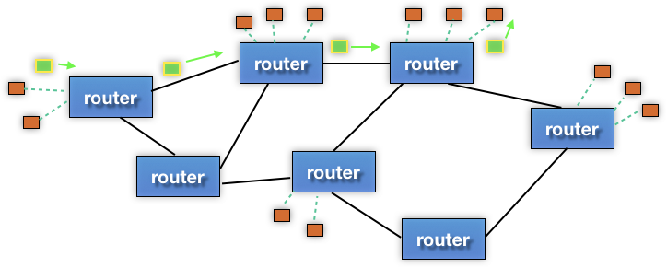
The Network Layer (IP)
There are protocols to:
Let a host map an IP to MAC address on the same network
Let a router learn about other routers to get IP packets one step closer to their destination
destination
source
network
network
network
data link
data link
data link
physical
physical
physical
Notes:
Example of lost packets: “glitch-y” video stream

Slide 26
The Network Layer (IP)
Packet encapsulation:
An IP packet is encapsulated as the payload of an Ethernet frame
As IP packets traverse networks, routers pull out the IP packet from an Ethernet frame and plunk it into a new one on the next network
IP header | IP payload
destination address | source address | data
ethernet header |  | ethernet payload
network
network
network
data link
data link
data link
physical
physical
physical

Slide 27
The Transport Layer (TCP)
Transmission Control Protocol (TCP):
Provides applications with reliable, ordered, congestion-controlled byte streams
Sends stream data as multiple IP packets (differentiated by sequence numbers) and retransmits them as necessary
When receiving, puts packets back in order and detects missing packets
A single host (IP address) can have up to 2¹⁶ = 65,535 “ports”
Kind of like an apartment number at a postal address (your applications are the residents who get mail sent to an apt. #)
transport
transport
network
network
network
data link
data link
data link
physical
physical
physical
Notes:
Port # analogy: IP address is address of apartment complex, port # will be apartment # of resident/application
DEMO: pull up https://en.wikipedia.org/wiki/List_of_TCP_and_UDP_port_numbers#Well-known_ports and find FTP, SSH, HTTP, and then show registered ports (1024+).

Slide 28
The Transport Layer (TCP)
Packet encapsulation – one more nested layer!
src, dst, port |  | TCP payload
+ seq #
TCP header | TCP chunk 1
TCP header | TCP chunk 2
IP header | IP payload
IP header | IP payload
ethernet header | ethernet payload
ethernet header | ethernet payload
transport
transport
network
network
network
data link
data link
data link
physical
physical
physical
Notes:
Useful analogy: How would you send a book by mail via postcards? (postal service stops delivering packages – only letters & postcards)
Split the book into multiple postcards, marking each with a sequence number for ordering.
Send each one-by-one through the mail.
Receiver sends back postcards to acknowledge receipt and indicate which got lost in the mail.

Slide 29
The Transport Layer (TCP)
Applications use OS services to establish TCP streams:
The “Berkeley sockets” API
A set of OS system calls
Clients connect() to a server IP address + application port number
Servers listen() for and accept() client connections
Clients and servers read() and write() data to each other
transport
transport
network
network
network
data link
data link
data link
physical
physical
physical
Notes:
BSD – Berkeley Software Distribution

Slide 30
The Transport Layer (UDP)
User Datagram Protocol (UDP):
Provides applications with unreliable packet delivery
UDP is a really thin, simple layer on top of IP
Datagrams still are fragmented into multiple IP packets
transport
transport
network
network
network
data link
data link
data link
physical
physical
physical
Notes:
Datagram named loosely after telegram.
Analogy: just shouting things to your friend across the room and hoping that they hear it.
Example application: video streaming to not wait for every packet in sequence.

Slide 31
The (Mostly Missing) Layers 5 & 6
Layer 5: Session Layer
Supposedly handles establishing and terminating application sessions
Remote Procedure Call (RPC) kind of fits in here
Layer 6: Presentation Layer
Supposedly maps application-specific data units into a more network-neutral representation
Encryption (SSL) kind of fits in here
presentation
presentation
session
session
transport
transport
network
network
network
data link
data link
data link
physical
physical
physical
Notes:
Open Systems Interconnection (OSI) is an effort to standardize computer networking that was started in 1977.
https://en.wikipedia.org/wiki/OSI_model

Slide 32
The Application Layer
Application protocols
The format and meaning of messages between application entities
Example: HTTP is an application-level protocol that dictates how web browsers and web servers communicate
HTTP is implemented on top of TCP streams
application
application
presentation
presentation
session
session
transport
transport
network
network
network
data link
data link
data link
physical
physical
physical

Slide 33
The Application Layer
Packet encapsulation:
HTTP header | HTTP payload (e.g. chunk of HTML page)
TCP header | TCP payload
IP header | IP payload
destination address | source address | data
ethernet header |  | ethernet payload

Slide 34
The Application Layer
Packet encapsulation:
ethernet header | IP header | TCP header | HTTP header | HTTP payload (e.g. chunk of HTML page)

Slide 35
The Application Layer
Popular application-level protocols:
DNS: translates a domain name (e.g. www.google.com) into one or more IP addresses (e.g. 74.125.197.106)
Domain Name System
An hierarchy of DNS servers cooperate to do this
HTTP: web protocols
Hypertext Transfer Protocol
SMTP, IMAP, POP: mail delivery and access protocols
Secure Mail Transfer Protocol, Internet Message Access Protocol, Post Office Protocol
SSH: secure remote login protocol
Secure Shell
bittorrent: peer-to-peer, swarming file sharing protocol

Slide 36
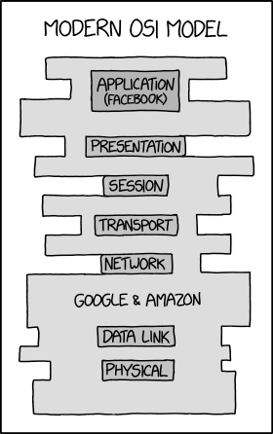
The Future of Networking?
https://xkcd.com/2105/

