Slide 1
DNS, Client-Side Networking CSE 333 Summer 2019
Instructor: Aaron Johnston
Teaching Assistants:
Yifan Bai Stuart Kol Daniel Lyu Kris Wong

Slide 2
Administrivia
Exercise 14 out today
HW3 due today
Remember to use hw3fsck to check your index file!
Using 1 late day lets you submit until 11:59pm on Sunday night
Final late cutoff: 2 late days, or 11:59pm Monday night
Final exam 2 weeks from today (8/23)
1 hour (in lecture), 2 pages allowed as note sheets
Will focus on post-midterm topics (C++ templates and on), but may build off midterm topics

Slide 3

Networking Layers

Slide 4
Networking Layers
application
application
presentation
presentation
session
session
transport
transport
network
network
network
data link
data link
data link
physical
physical
physical

Slide 5

The Application Layer
Application protocols
The format and meaning of messages between application entities
Example: HTTP is an application-level protocol that dictates how web browsers and web servers communicate
HTTP is implemented on top of TCP streams
application
application
presentation
presentation
session
session
transport
transport
network
network
network
data link
data link
data link
physical
physical
physical

Slide 6
The Sockets API
Berkeley sockets originated in 4.2BSD Unix (1983)
It is the standard API for network programming
Available on most OSs
Written in C
POSIX Socket API
A slight update of the Berkeley sockets API
A few functions were deprecated or replaced
Better support for multi-threading was added
Notes:
https://en.wikipedia.org/wiki/Berkeley_sockets

Slide 7
Socket API: Client TCP Connection
We’ll start by looking at the API from the point of view of a client connecting to a server over TCP
There are five steps:
Figure out the IP address and port to which to connect
Create a socket
Connect the socket to the remote server
.read() and write() data using the socket
Close the socket

Slide 8


Lecture Objectives
Understand how IP addresses are represented and how DNS is used to look them up
Know what each of the 5 steps of client-side networking does and why it is important
Non-objective: be able to write client-side networking code from scratch after this lecture
You’ll have plenty of code to practice with at home ☺
Copy and paste is not necessarily a bad thing here

Slide 9
Step 1: Figure Out IP Address and Port
Several parts:
Network addresses
Data structures for address info
DNS - Doman Name System – finding IP addresses

Slide 10



IPv4 Address Structures
// IPv4 4-byte address
struct in_addr {
uint32_t s_addr; // Address in network byte order
};
// An IPv4-specific address structure
struct sockaddr_in {
sa_family_t sin_family; // Address family: AF_INET
in_port_t sin_port; // Port in network byte order
struct in_addr sin_addr; // IPv4 address
unsigned char sin_zero[8]; // Pad out to 16 bytes
};
struct sockaddr_in:
family | port | addr | zero
0
2
4
8
16

Slide 11


IPv6 Address Structures
// IPv6 16-byte address
struct in6_addr {
uint8_t s6_addr[16]; // Address in network byte order
};
// An IPv6-specific address structure
struct sockaddr_in6 {
sa_family_t sin6_family; // Address family: AF_INET6
in_port_t sin6_port; // Port number
uint32_t sin6_flowinfo; // IPv6 flow information
struct in6_addr sin6_addr; // IPv6 address
uint32_t sin6_scope_id; // Scope ID
};
struct sockaddr_in6:
addr
fam | port | flow |  |  |  |  |  |  |  |  |  |  |  |  |  |  |  |  | scope
0
2
4
8
24
28

Slide 12

Generic Address Structures
Commonly create struct sockaddr_storage, then pass pointer cast as struct sockaddr* to connect()
// A mostly-protocol-independent address structure.
// Pointer to this is parameter type for socket system calls.
struct sockaddr {
sa_family_t sa_family; // Address family (AF_* constants)
char sa_data[14]; // Socket address (size varies
// according to socket domain)
};
// A structure big enough to hold either IPv4 or IPv6 structs
struct sockaddr_storage {
sa_family_t ss_family; // Address family
// padding and alignment; don’t worry about the details
char __ss_pad1[_SS_PAD1SIZE];
int64_t __ss_align;
char __ss_pad2[_SS_PAD2SIZE];
};
Notes:
Common parameter type is struct sockaddr *

Slide 13
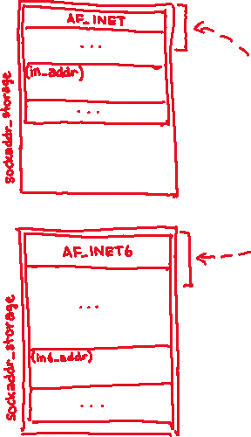

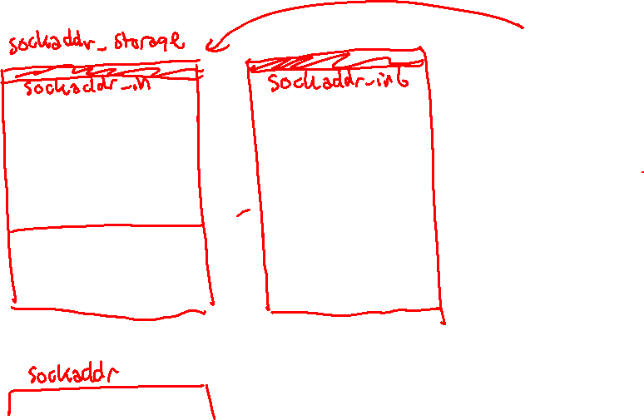
Address Structures Review
Notes:
Common parameter type is struct sockaddr *

Slide 14
Address Conversion
int inet_pton(int af, const char* src, void* dst);
Converts human-readable string representation (“presentation”) to network byte ordered address
Returns 1 (success), 0 (bad src), or -1 (error)
int inet_pton(int af, const char* src, void* dst);
#include <stdlib.h>
#include <arpa/inet.h>
int main(int argc, char **argv) {
struct sockaddr_in sa; // IPv4
struct sockaddr_in6 sa6; // IPv6
// IPv4 string to sockaddr_in (192.0.2.1 = C0:00:02:01).
inet_pton(AF_INET, "192.0.2.1", &(sa.sin_addr));
// IPv6 string to sockaddr_in6.
inet_pton(AF_INET6, "2001:db8:63b3:1::3490", &(sa6.sin6_addr));
return EXIT_SUCCESS;
}
genaddr.cc
Notes:
DEMO: compile genaddr.cc and open ./genaddr in gdb
next 2 to move past both calls to inet_pton()
print sa for IPv4 struct sockaddr_in fields (mostly garbage)
print /x sa.sin_addr to show bytes of IP addr in hex (automatically interpreted in little-endian)
x /4bx &sa.sin_addr to show in big-endian
print sa6 for IPv6 struct sockaddr_in6 fields (looks like garbage)
x /16bx &sa6.sin6_addr to show in big-endian

Slide 15
Address Conversion
int inet_pton(int af, const char* src, void* dst);
Converts network addr in src into buffer dst of size size
Returns dst on success; NULL on error
const char* inet_ntop(int af, const void* src, char* dst, socklen_t size);
#include <stdlib.h>
#include <arpa/inet.h>
int main(int argc, char **argv) {
struct sockaddr_in6 sa6; // IPv6
char astring[INET6_ADDRSTRLEN]; // IPv6
// IPv6 string to sockaddr_in6.
inet_pton(AF_INET6, "2001:0db8:63b3:1::3490", &(sa6.sin6_addr));
// sockaddr_in6 to IPv6 string.
inet_ntop(AF_INET6, &(sa6.sin6_addr), astring, INET6_ADDRSTRLEN);
std::cout << astring << std::endl;
return EXIT_SUCCESS;
}
genstring.cc
Notes:
Notice that inet_ntop() will chop off leading 0 in front of hextet “0db8”

Slide 16
Domain Name System
People tend to use DNS names, not IP addresses
The Sockets API lets you convert between the two
It’s a complicated process, though:
A given DNS name can have many IP addresses
Many different IP addresses can map to the same DNS name
An IP address will reverse map into at most one DNS name
A DNS lookup may require interacting with many DNS servers
You can use the Linux program “dig” to explore DNS
dig @server name type (+short)
server: specific name server to query
type: A (IPv4), AAAA (IPv6), ANY (includes all types)
Notes:
dig demo:
man dig (hit spacebar twice to get to “SIMPLE USAGE”)
dig www.google.com | more
dig @ns1.google.com www.google.com
dig @ns1.google.com www.google.com any
dig attu.cs.washington.edu +short
dig -x 128.208.1.139 +short
ns = “name server”

Slide 17
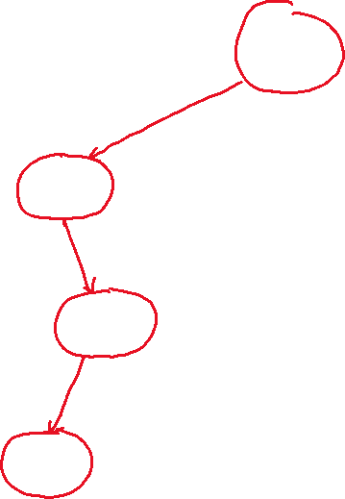

DNS Hierarchy
.
Root Name Servers
com
cn
edu
• • •
org
Top-level Domain Servers
facebook
google
• • •
netflix
apache
wikipedia
• • •
fsf
docs
mail
news
• • •
www
news
• • •
www
Notes:
Can do: dig en.wikipedia.org +trace > trace.txt
https://en.wikipedia.org/wiki/Root_name_server
https://en.wikipedia.org/wiki/Domain_Name_System

Slide 18

Resolving DNS Names
The POSIX way is to use getaddrinfo()
A complicated system call found in #include <netdb.h>
Basic idea:
Tell getaddrinfo() which host and port you want resolved
String representation for host: DNS name or IP address
Set up a “hints” structure with constraints you want respected
getaddrinfo() gives you a list of results packed into an “addrinfo” structure/linked list
Returns 0 on success; returns negative number on failure
Free the struct addrinfo later using freeaddrinfo()
int getaddrinfo(const char* hostname,
const char* service, const struct addrinfo* hints, struct addrinfo** res);
Notes:
http://man7.org/linux/man-pages/man3/getaddrinfo.3.html
https://en.wikipedia.org/wiki/Getaddrinfo

Slide 19


getaddrinfo
getaddrinfo() arguments:
hostname – domain name or IP address string
service – port # (e.g. "80") or service name (e.g. "www") or NULL/nullptr
struct addrinfo {
int ai_flags; // additional flags
int ai_family; // AF_INET, AF_INET6, AF_UNSPEC
int ai_socktype; // SOCK_STREAM, SOCK_DGRAM, 0
int ai_protocol; // IPPROTO_TCP, IPPROTO_UDP, 0
size_t ai_addrlen; // length of socket addr in bytes
struct sockaddr* ai_addr; // pointer to socket addr
char* ai_canonname; // canonical name
struct addrinfo* ai_next; // can form a linked list
};

Slide 20
DNS Lookup Procedure
Create a struct addrinfo hints
Zero out hints for “defaults”
Set specific fields of hints as desired
Call getaddrinfo() using &hints
Resulting linked list res will have all fields appropriately set
See dnsresolve.cc
struct addrinfo {
int ai_flags; // additional flags
int ai_family; // AF_INET, AF_INET6, AF_UNSPEC
int ai_socktype; // SOCK_STREAM, SOCK_DGRAM, 0
int ai_protocol; // IPPROTO_TCP, IPPROTO_UDP, 0
size_t ai_addrlen; // length of socket addr in bytes
struct sockaddr* ai_addr; // pointer to socket addr
char* ai_canonname; // canonical name
struct addrinfo* ai_next; // can form a linked list
};
Notes:
CODE WALKTHROUGH: dnsresolve.cc
DEMO: ./dnsresolve (shows usage message)
./dnsresolve www.google.com
./dnsresolve attu.cs.washington.edu

Slide 21
Socket API: Client TCP Connection
There are five steps:
Figure out the IP address and port to connect to
Create a socket
Connect the socket to the remote server
.read() and write() data using the socket
Close the socket

Slide 22
Step 2: Creating a Socket
Use the socket() system call
Creating a socket doesn’t bind it to a local address or port yet
Returns file descriptor or -1 on error
int socket(int domain, int type, int protocol);
socket.cc
#include <arpa/inet.h>
#include <stdlib.h>
#include <string.h>
#include <unistd.h>
#include <iostream>
int main(int argc, char** argv) {
int socket_fd = socket(AF_INET, SOCK_STREAM, 0);
if (socket_fd == -1) {
std::cerr << strerror(errno) << std::endl;
return EXIT_FAILURE;
}
close(socket_fd);
return EXIT_SUCCESS;
}
Notes:
Analogy: tin can telephone – socket produces your tin can/Styrofoam cup
domain: AF_INET, AF_INET6
type: SOCK_STREAM, SOCK_DGRAM, 0
protocol: IPPROTO_TCP, IPPROTO_UDP, 0

Slide 23
Step 3: Connect to the Server
The connect() system call establishes a connection to a remote host
sockfd: Socket file description from Step 2
addr and addrlen: Usually from one of the address structures returned by getaddrinfo in Step 1 (DNS lookup)
Returns 0 on success and -1 on error
connect() may take some time to return
It is a blocking call by default
The network stack within the OS will communicate with the remote host to establish a TCP connection to it
This involves ~2 round trips across the network
int connect(int sockfd, const struct sockaddr* addr, socklen_t addrlen);

Slide 24
Connect Example
See connect.cc
// Get an appropriate sockaddr structure.
struct sockaddr_storage addr;
size_t addrlen;
LookupName(argv[1], port, &addr, &addrlen);
// Create the socket.
int socket_fd = socket(addr.ss_family, SOCK_STREAM, 0);
if (socket_fd == -1) {
cerr << "socket() failed: " << strerror(errno) << endl;
return EXIT_FAILURE;
}
// Connect the socket to the remote host.
int res = connect(socket_fd,
reinterpret_cast<sockaddr*>(&addr),
addrlen);
if (res == -1) {
cerr << "connect() failed: " << strerror(errno) << endl;
}

Slide 25

How do we error check read() and write()?
A. ferror()
B. Return value less than expected
C. Return value of 0 or NULL
D. Return value of -1
E. We’re lost…

Slide 26
Step 4: read()
If there is data that has already been received by the network stack, then read will return immediately with it
read() might return with less data than you asked for
If there is no data waiting for you, by default read() will block until something arrives
How might this cause deadlock?
Can read() return 0?
Notes:
Deadlock: both server and client call read but have nothing to read

Slide 27
Step 4: read()
Assume we have:
int socket_fd; // fd of connected socket
char readbuf[BUF]; // read buffer
int res; // to store read result
Write C++ code to read in BUF characters from socket_fd
If error occurs, send error message to user and exit()
Notes:
While students are working, prep demo (needs two terminals).
CODE WALKTHROUGH: sendreceive.cc

Slide 28
Step 4: write()
write() queues your data in a send buffer in the OS and then returns
The OS transmits the data over the network in the background
When write() returns, the receiver probably has not yet received the data!
If there is no more space left in the send buffer, by default write() will block

Slide 29
Read/Write Example
See sendreceive.cc
while (1) {
int wres = write(socket_fd, readbuf, res);
if (wres == 0) {
cerr << "socket closed prematurely" << endl;
close(socket_fd);
return EXIT_FAILURE;
}
if (wres == -1) {
if (errno == EINTR)
continue;
cerr << "socket write failure: " << strerror(errno) << endl;
close(socket_fd);
return EXIT_FAILURE;
}
break;
}
Notes:
sendreceive demo:
(term1) ./sendreceive
(term2) nc -l 3333; (term1) ./sendreceive 127.0.0.1 3333; (term2) hello, world!
(term2) nc -l 3333; (term1) ./sendreceive 127.0.0.1 3333; (term2) Ctrl-D
(term1) ./sendreceive 127.0.0.1 1111
(term1) ./sendreceive 127.0.0.0 3333

Slide 30
Step 5: close()
Nothing special here – it’s the same function as with file I/O
Shuts down the socket and frees resources and file descriptors associated with it on both ends of the connection
int close(int fd);

Slide 31
Extra Exercise #1
Write a program that:
Reads DNS names, one per line, from stdin
Translates each name to one or more IP addresses
Prints out each IP address to stdout, one per line

