Slide 1
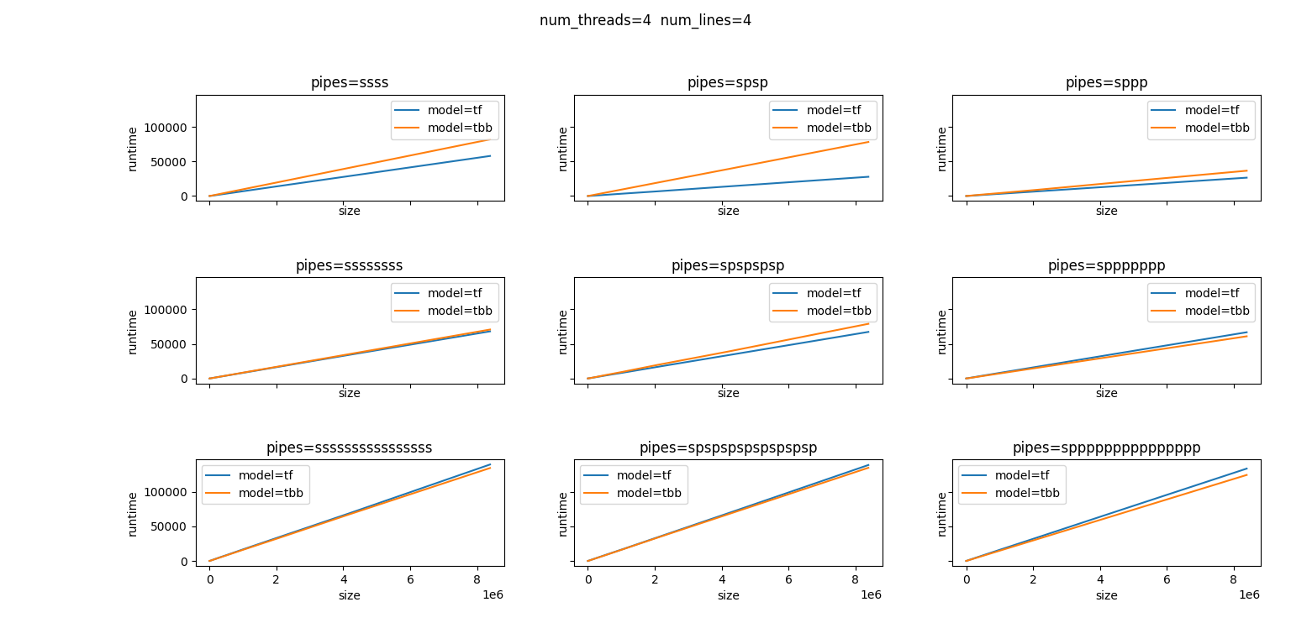
Experiment results：tf_vs_tbb (with work)

Slide 2
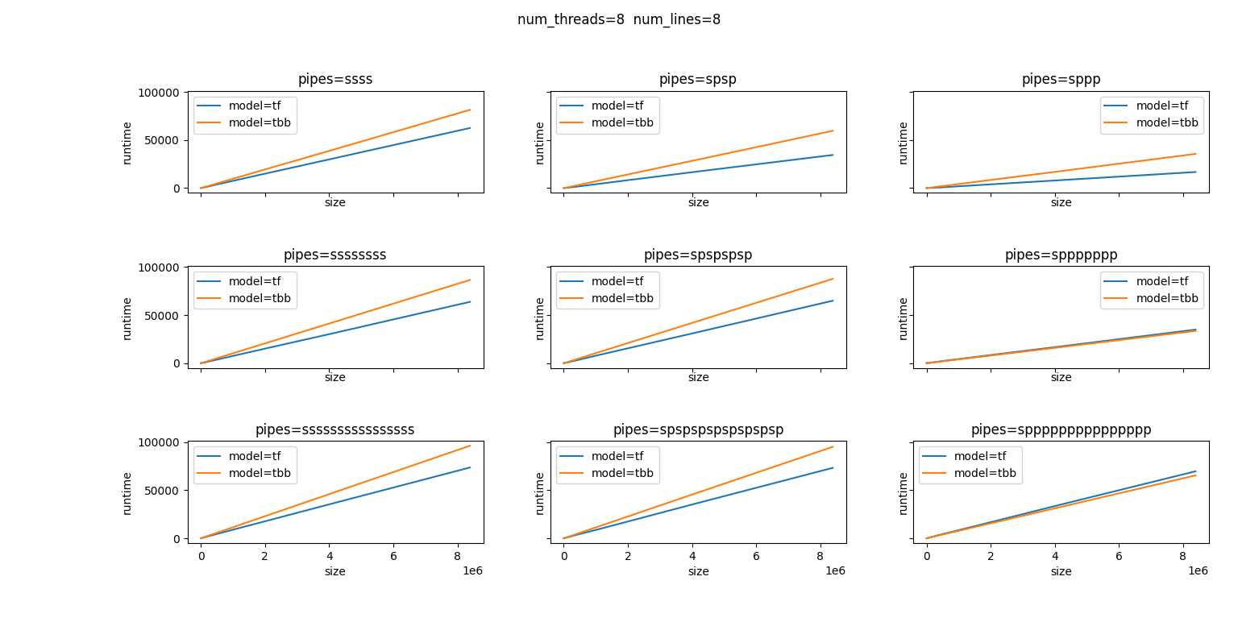
Experiment results：tf_vs_tbb (with work)

Slide 3
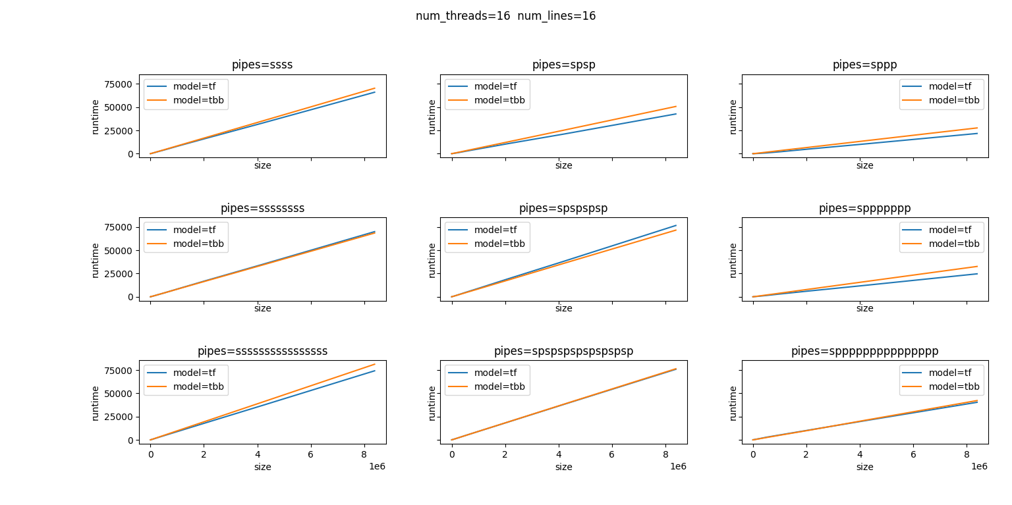
Experiment results：tf_vs_tbb (with work)

Slide 4
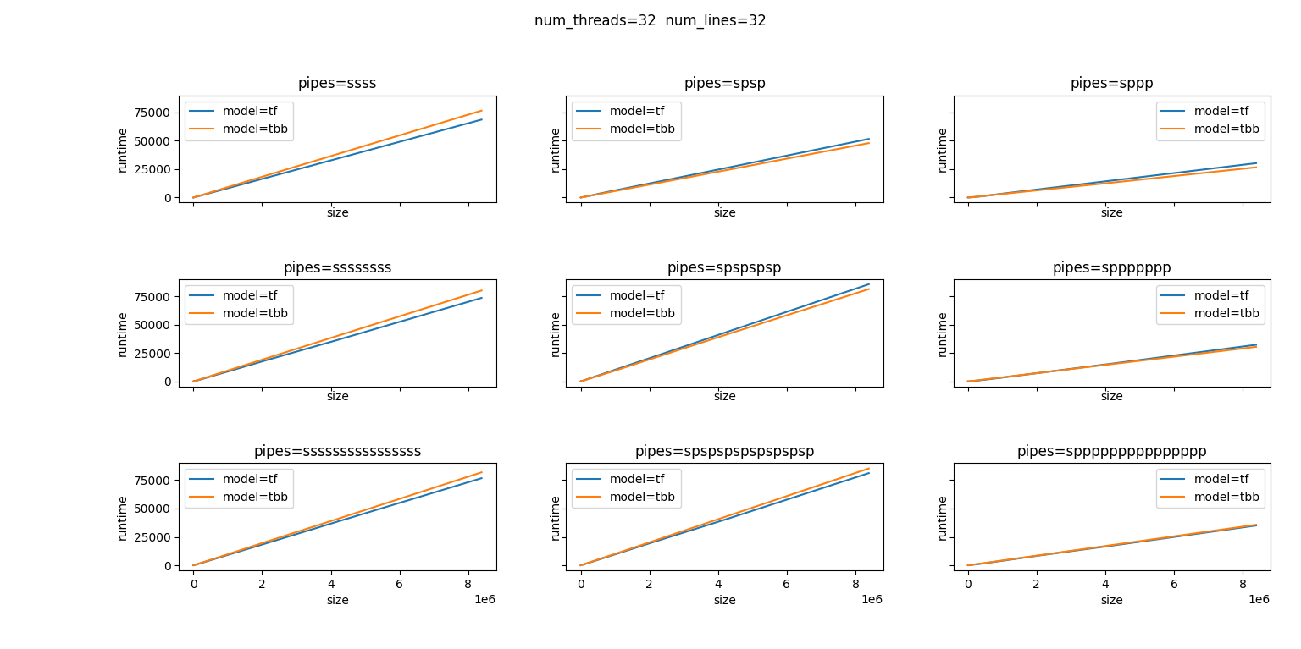
Experiment results：tf_vs_tbb (with work)

Slide 5
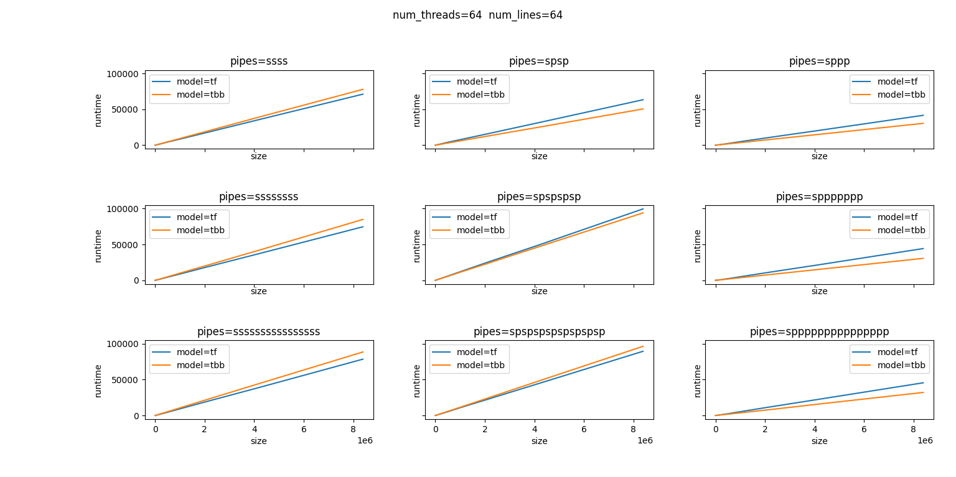
Experiment results：tf_vs_tbb (with work)

Slide 6
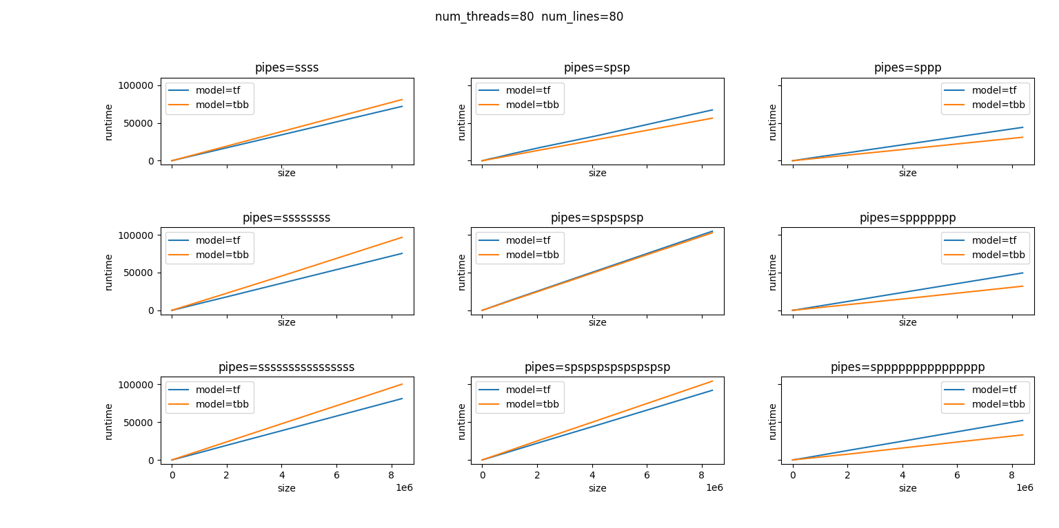
Experiment results：tf_vs_tbb (with work)

Slide 7
