Slide 1
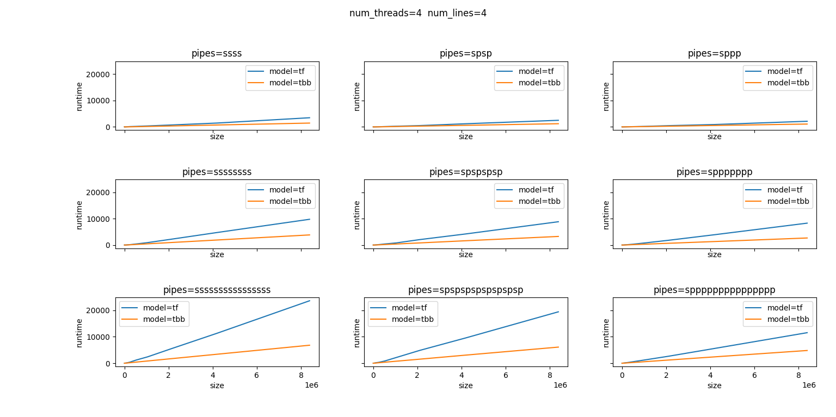
Experiment results：tf_vs_tbb (no work)

Slide 2
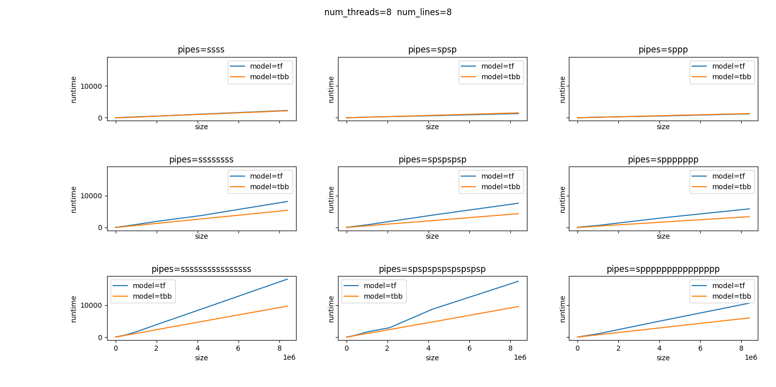
Experiment results：tf_vs_tbb (no work)

Slide 3
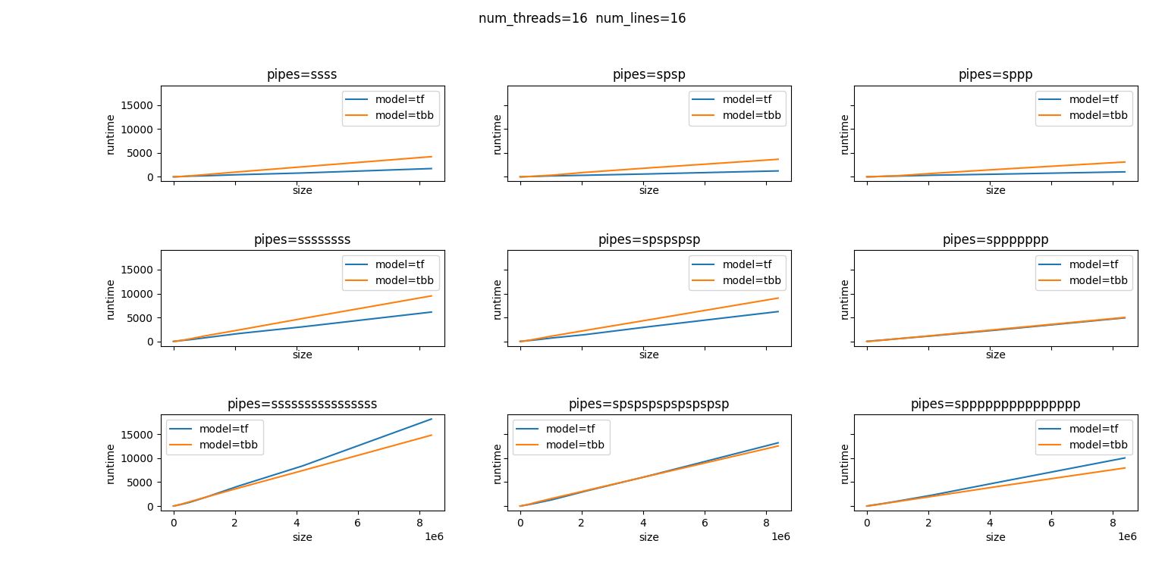
Experiment results：tf_vs_tbb (no work)

Slide 4
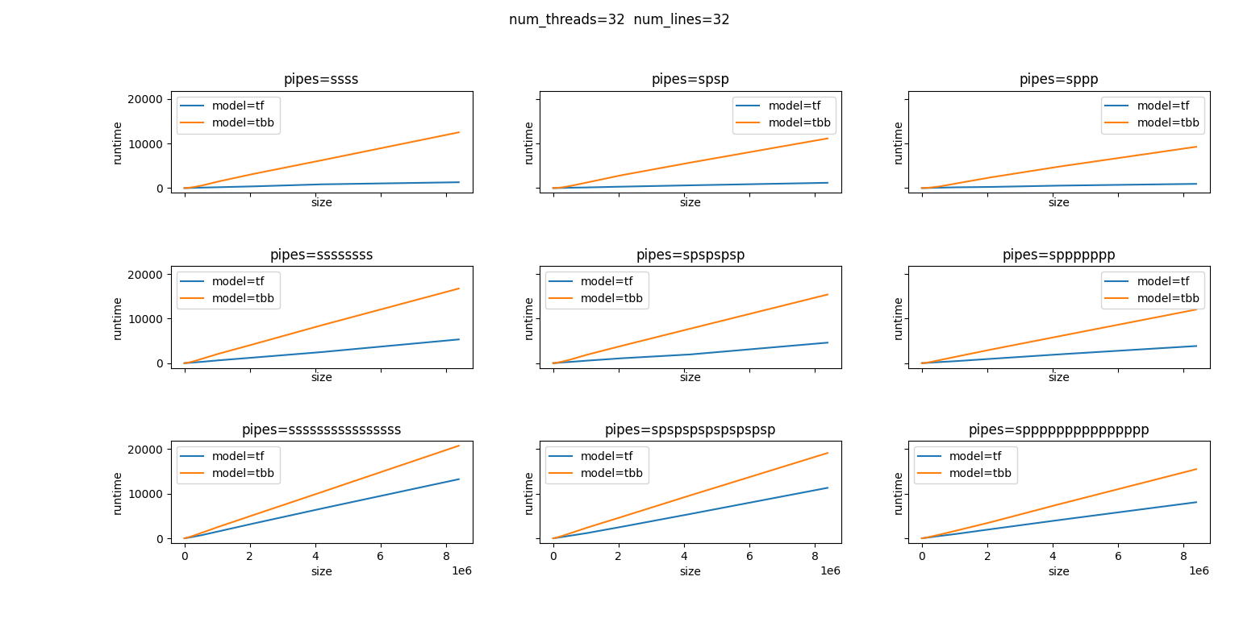
Experiment results：tf_vs_tbb (no work)

Slide 5
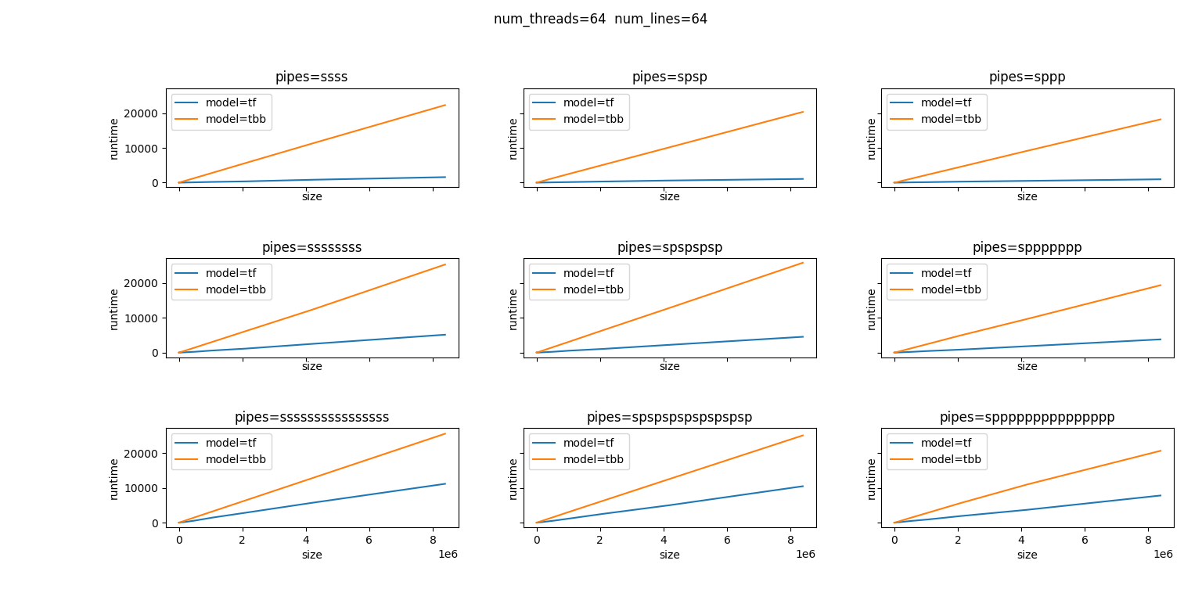
Experiment results：tf_vs_tbb (no work)

Slide 6
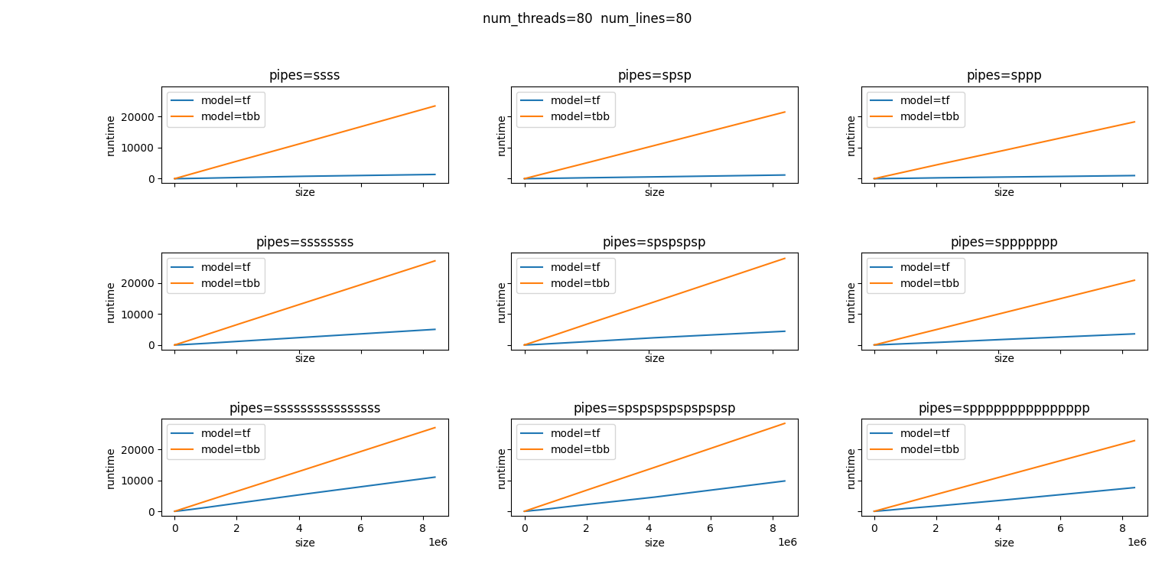
Experiment results：tf_vs_tbb (no work)

Slide 7
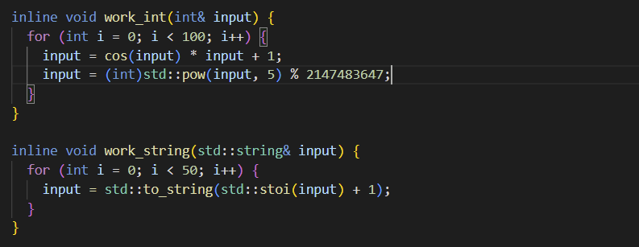
Experiment results：normal_vs_efficient

Slide 8
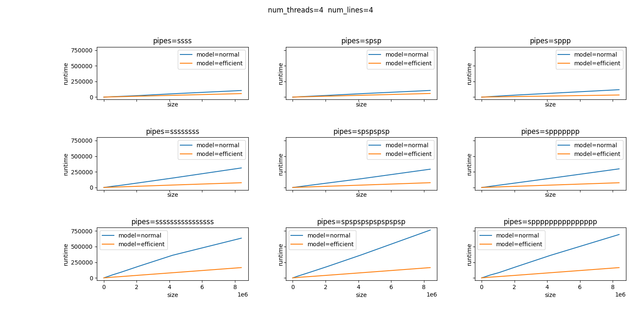
Experiment results：normal_vs_efficient_int

Slide 9
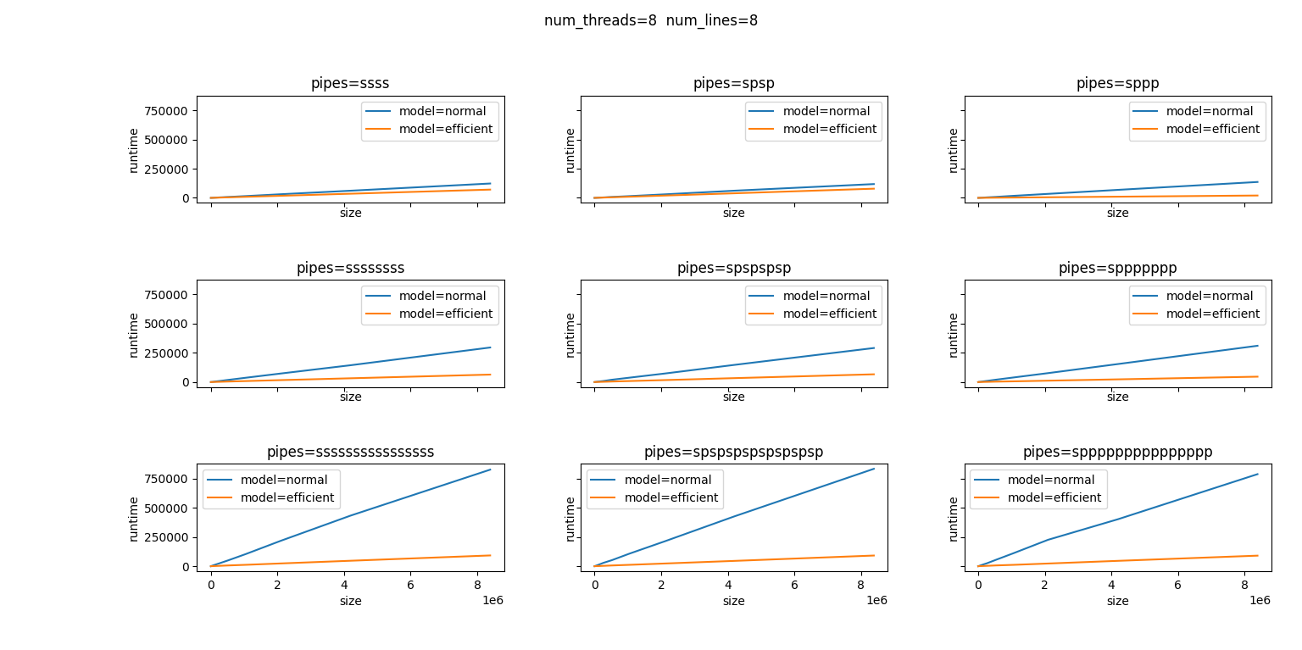
Experiment results：normal_vs_efficient_int

Slide 10

Experiment results：normal_vs_efficient_int

Slide 11
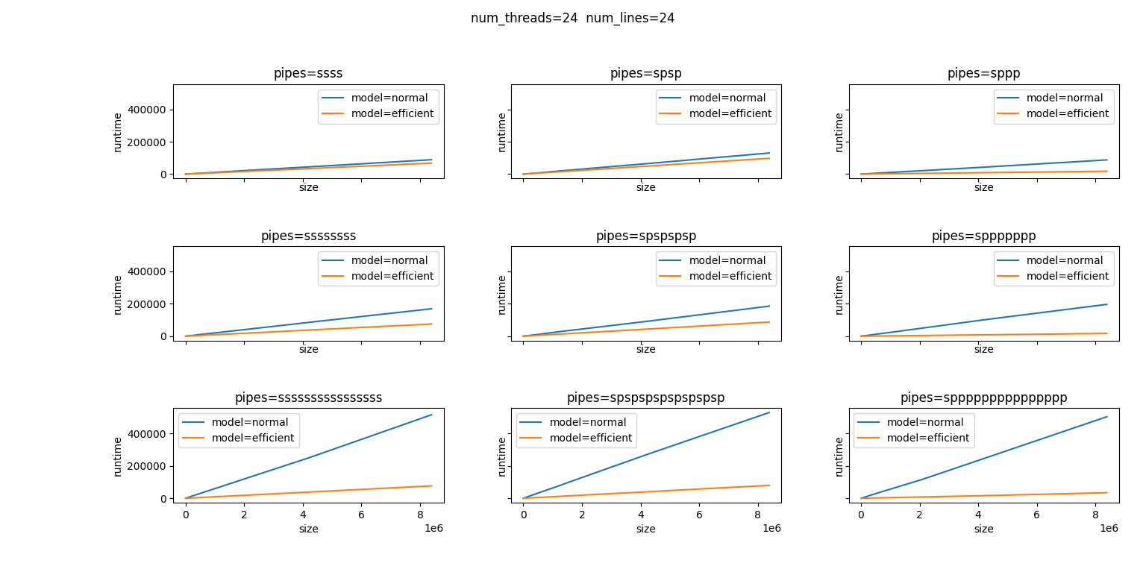
Experiment results：normal_vs_efficient_int

Slide 12
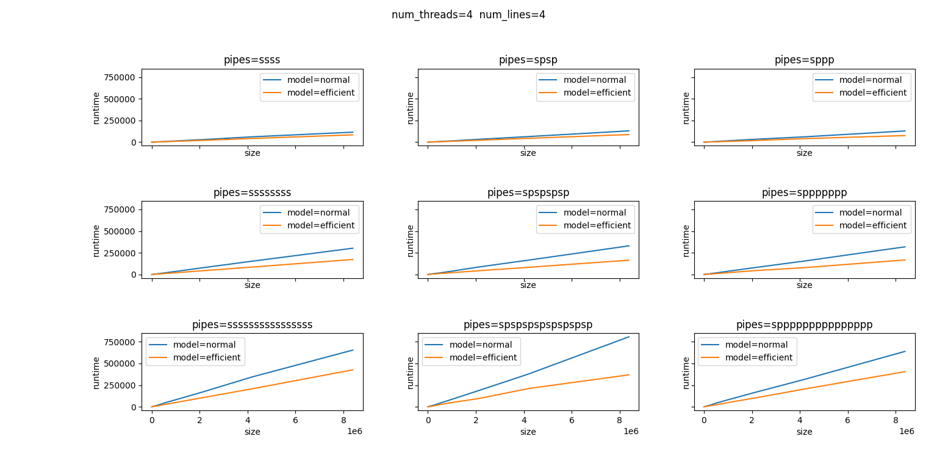
Experiment results：normal_vs_efficient_string

Slide 13
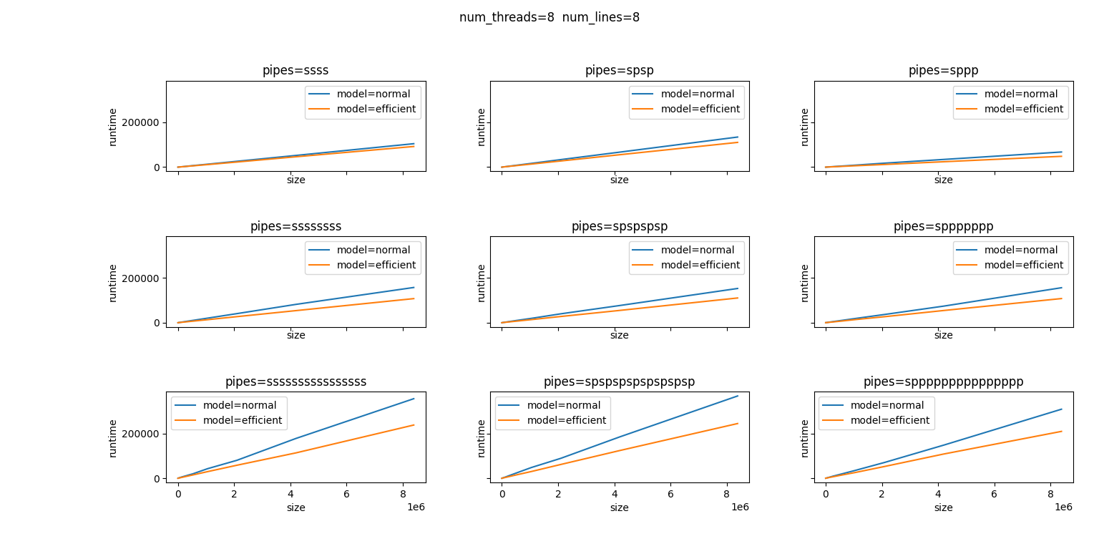
Experiment results：normal_vs_efficient_string

Slide 14
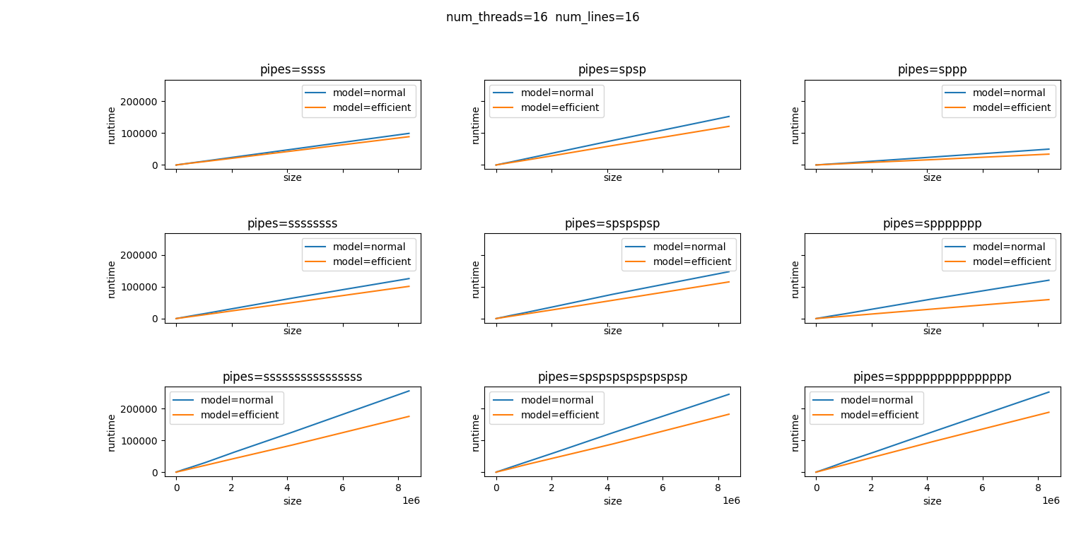
Experiment results：normal_vs_efficient_string

Slide 15
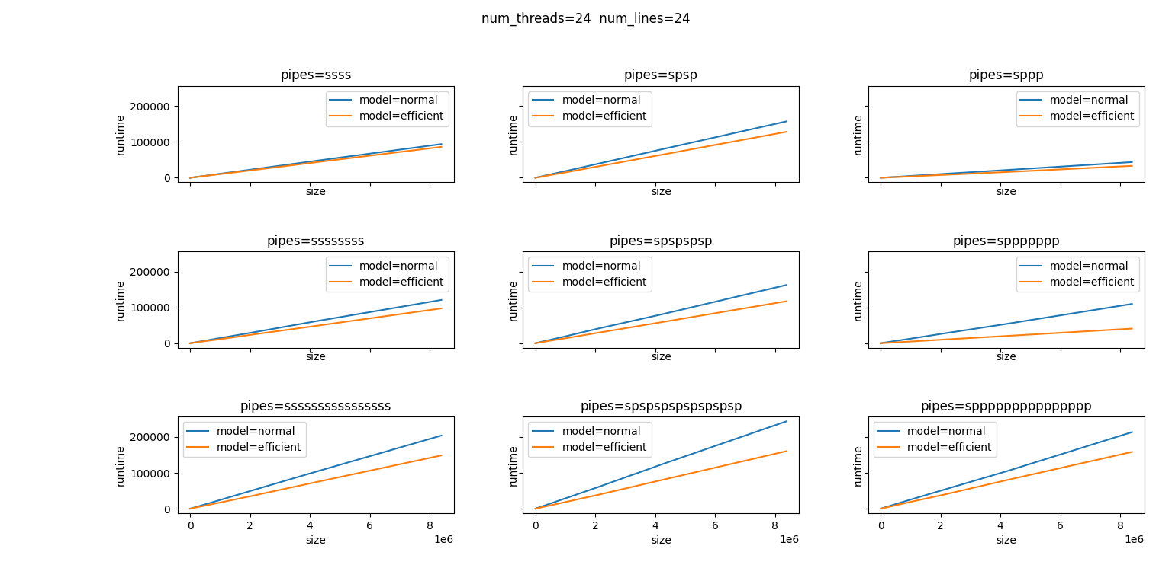
Experiment results：normal_vs_efficient_string

Slide 16
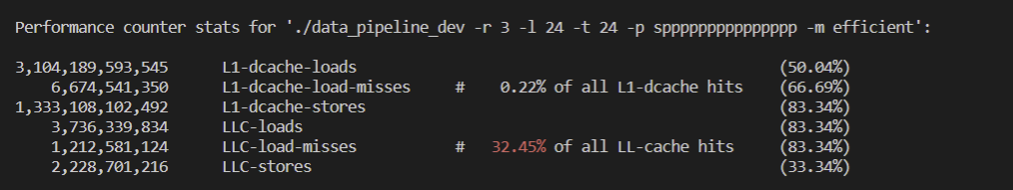
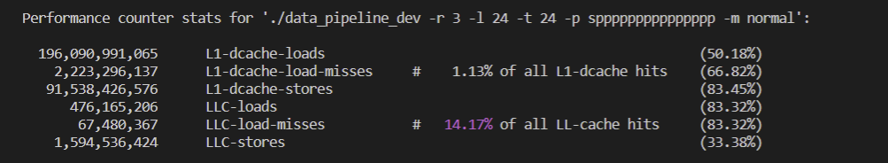
Experiment results：normal_vs_efficient

