Slide 1
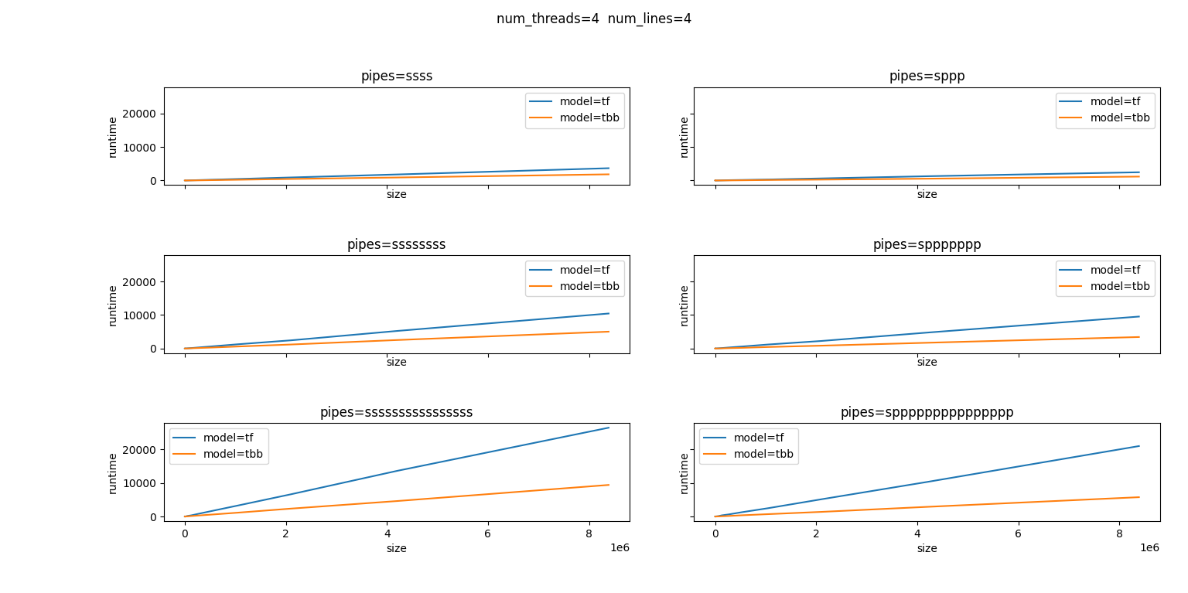
Experiment results：tf_vs_tbb

Slide 2
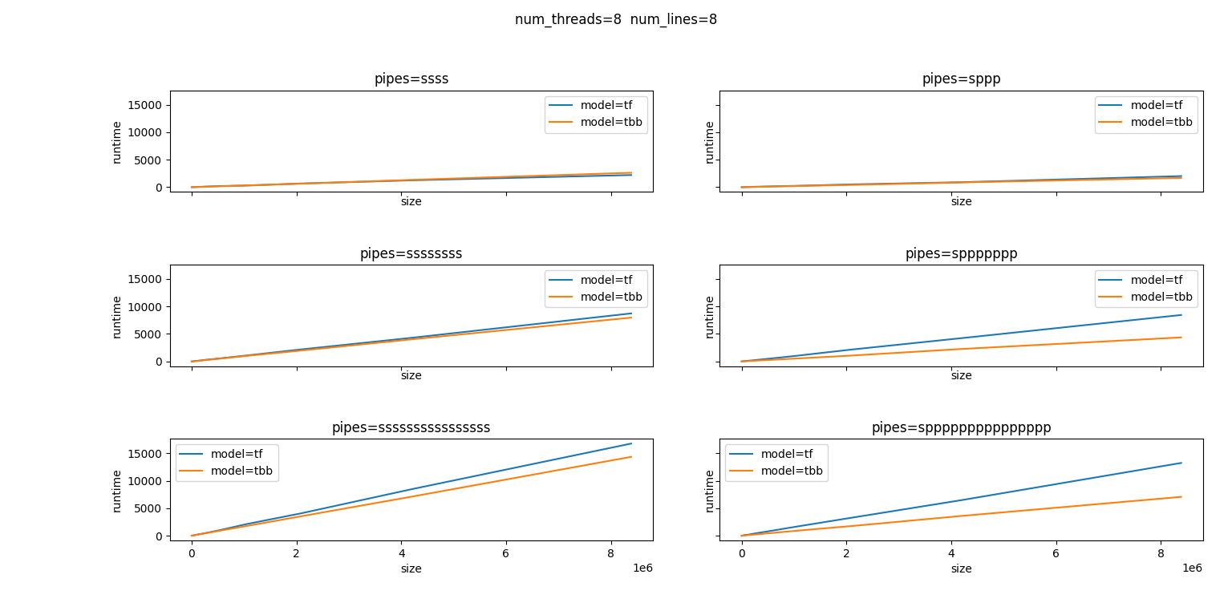
Experiment results：tf_vs_tbb

Slide 3
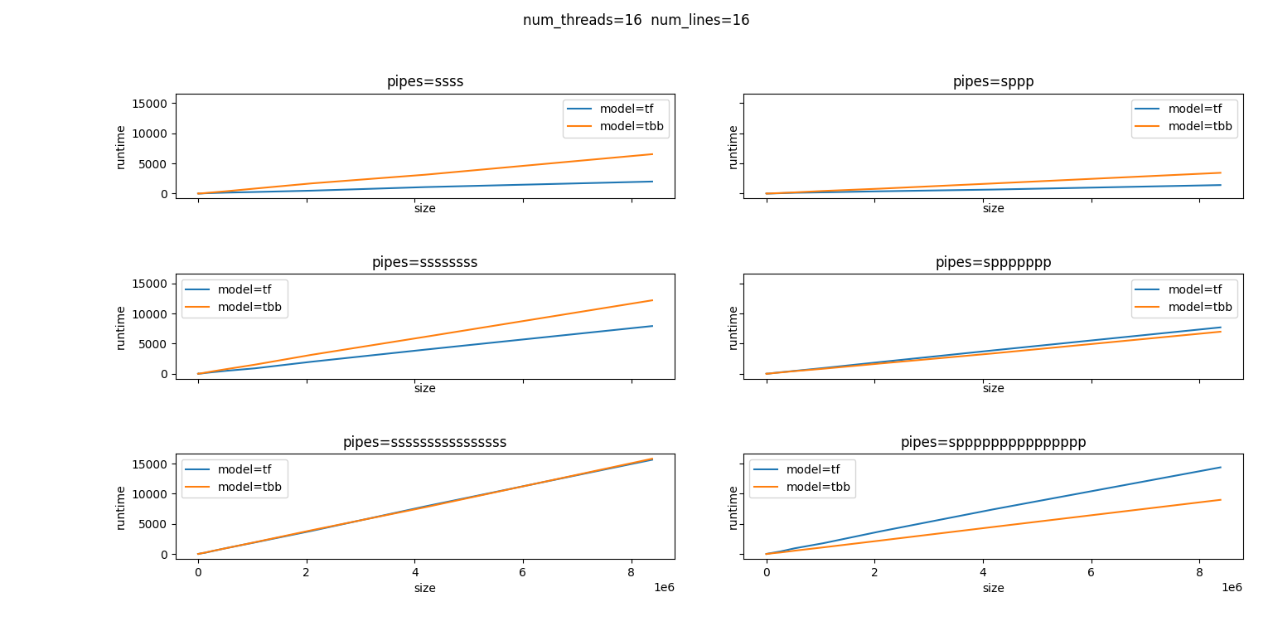
Experiment results：tf_vs_tbb

Slide 4
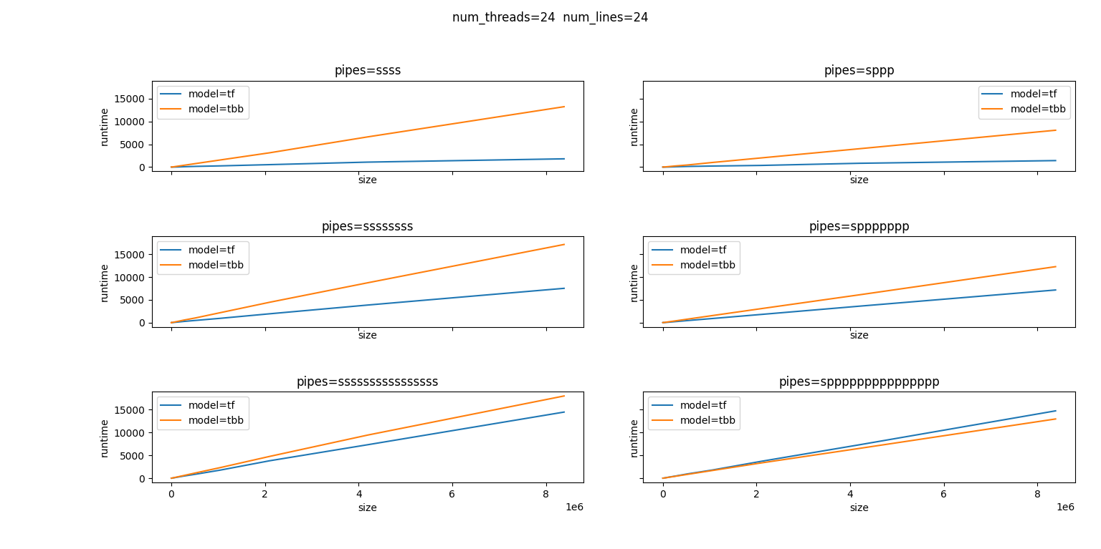
Experiment results：tf_vs_tbb

Slide 5
Experiment results：tf_vs_tbb
Compared to tbb, taskflow performs not very well when num_threads is small.
The runtime of taskflow doesn’t change when num_threads varies, while the runtime of tbb seems proportional to num_threads.
We can clearly see that tbb parallel pipeline is faster than serial pipeline when other variables fixed, but this is not true in taskflow.

Slide 6
Experiment results：tf_vs_tbb
model=tf num_threads=24 num_rounds=3 num_lines=24 pipes=ssss
14,985,624,620 L1-dcache-loads (51.70%)
148,461,801 L1-dcache-load-misses # 0.99% of all L1-dcache hits (67.86%)
7,893,658,952 L1-dcache-stores (83.30%)
75,626,403 LLC-loads (82.49%)
20,507,107 LLC-load-misses # 27.12% of all LL-cache hits (83.58%)
30,516,263 LLC-stores (34.14%)
11.919676981 seconds time elapsed

Slide 7
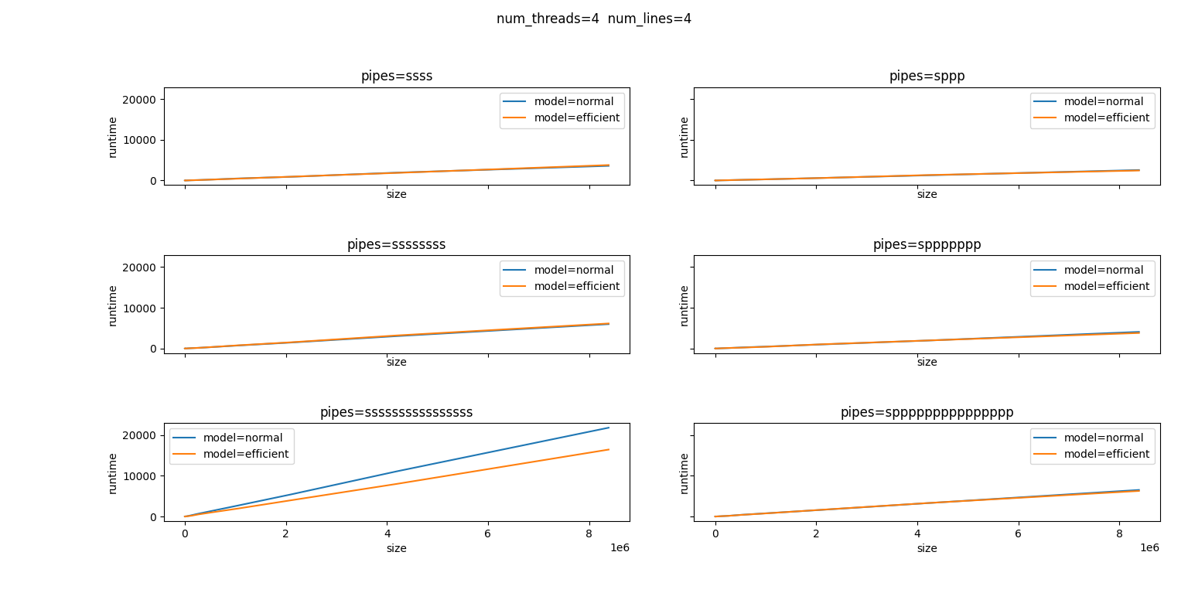
Experiment results：normal_vs_efficient

Slide 8
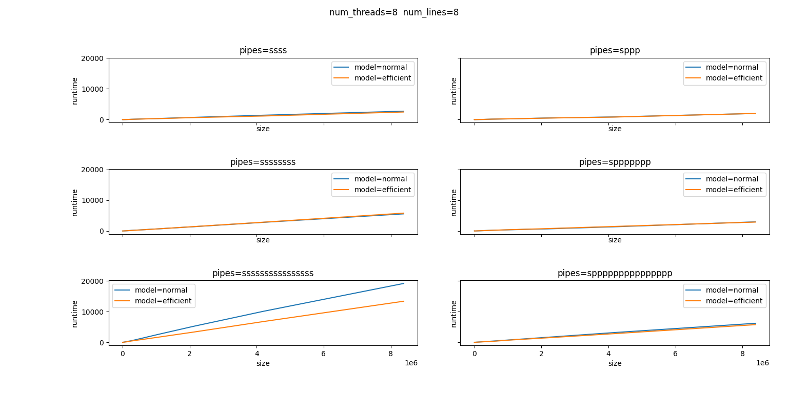
Experiment results：normal_vs_efficient

Slide 9
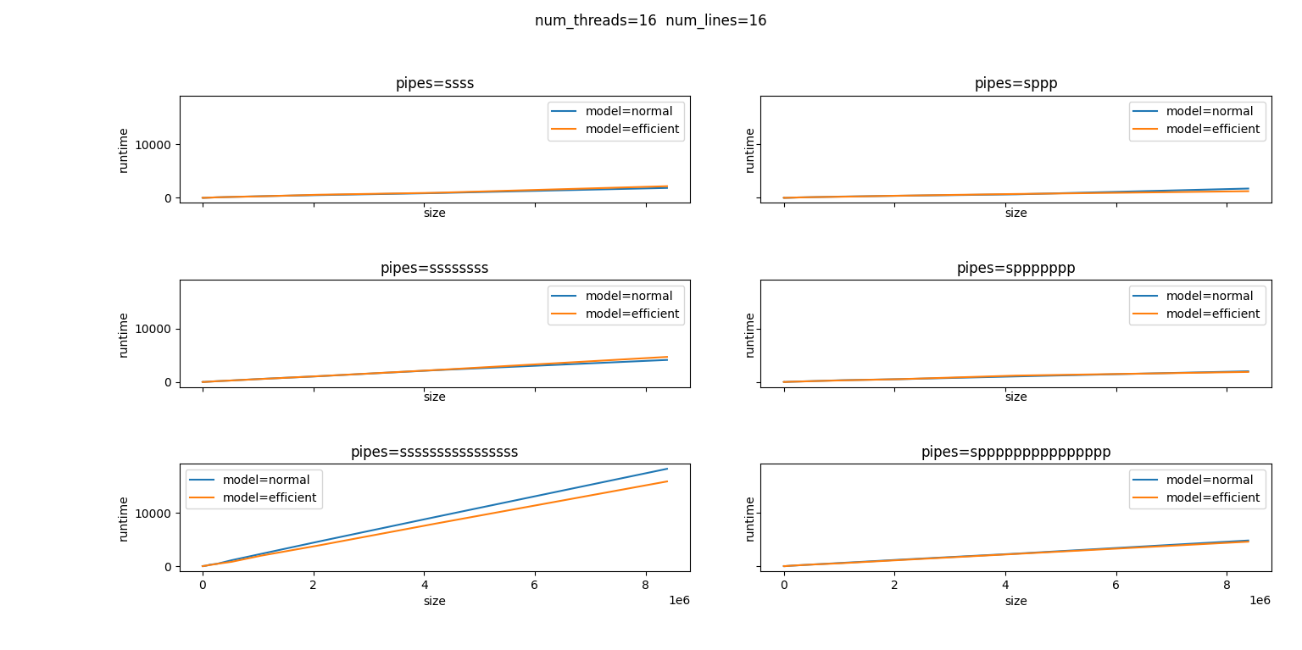
Experiment results：normal_vs_efficient

Slide 10
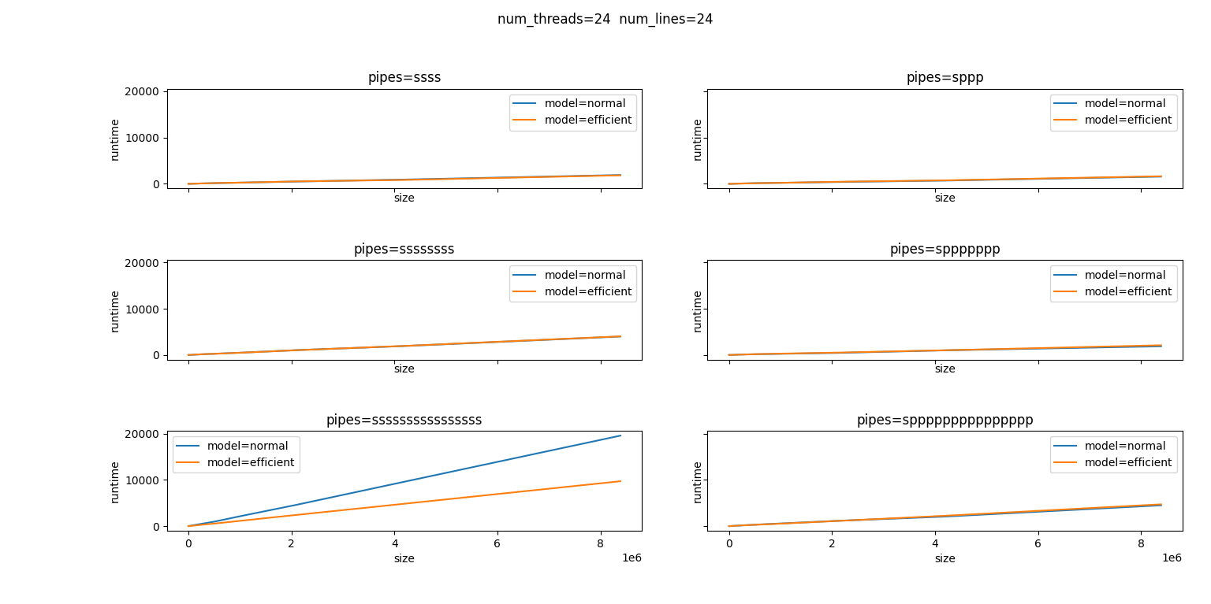
Experiment results：normal_vs_efficient

