Slide 1
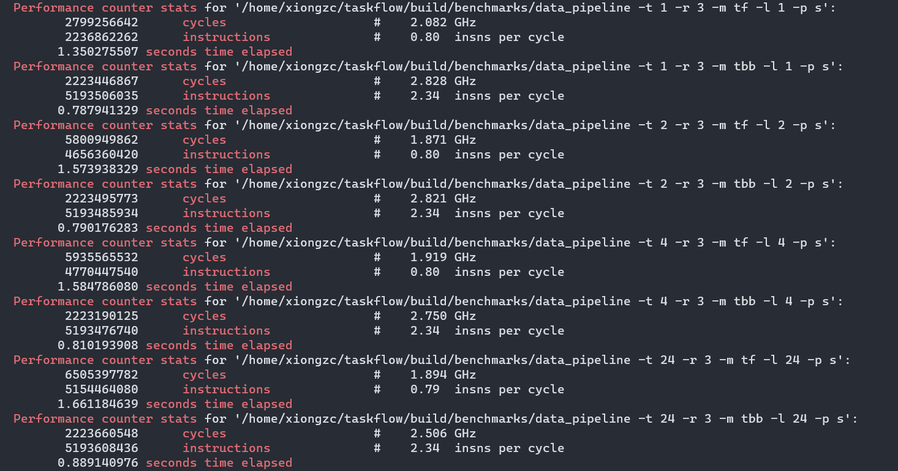
Perf: cycles&instructions

Slide 2
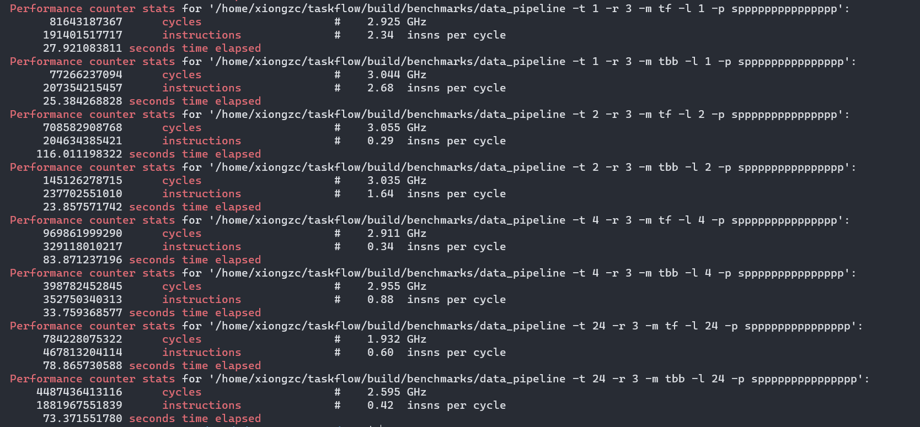
Perf: cycles&instructions

Slide 3
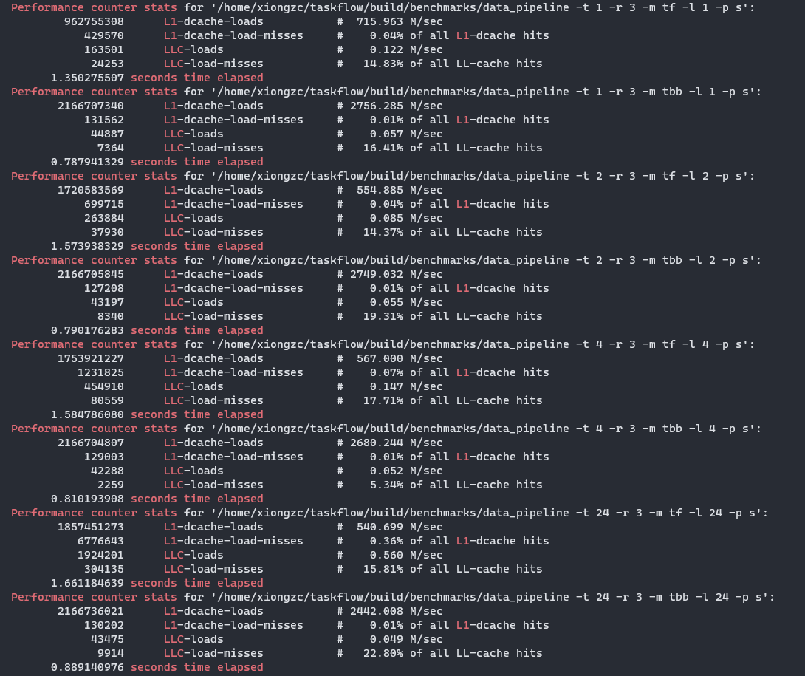
Perf: cache

Slide 4
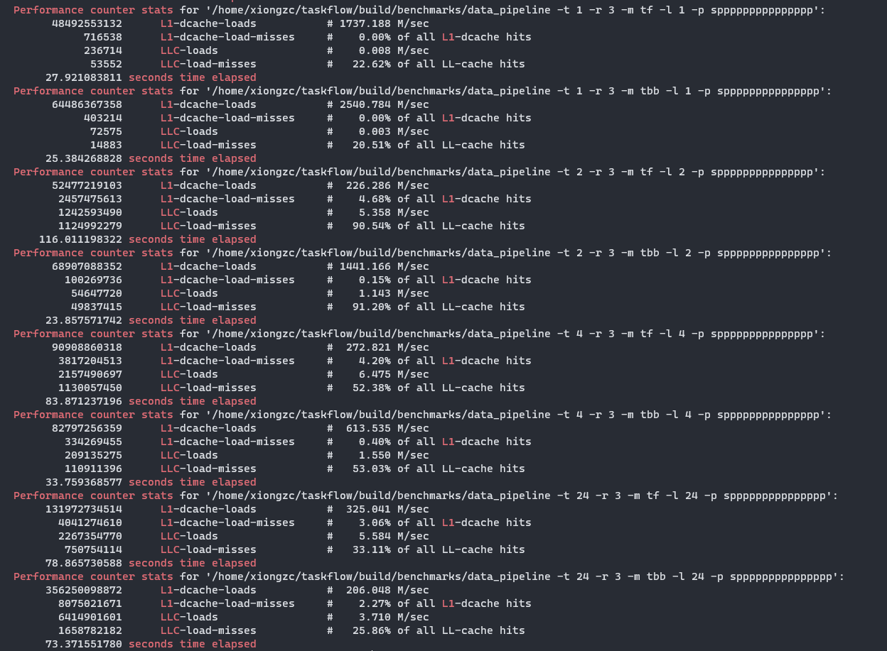
Perf: cache

Slide 5
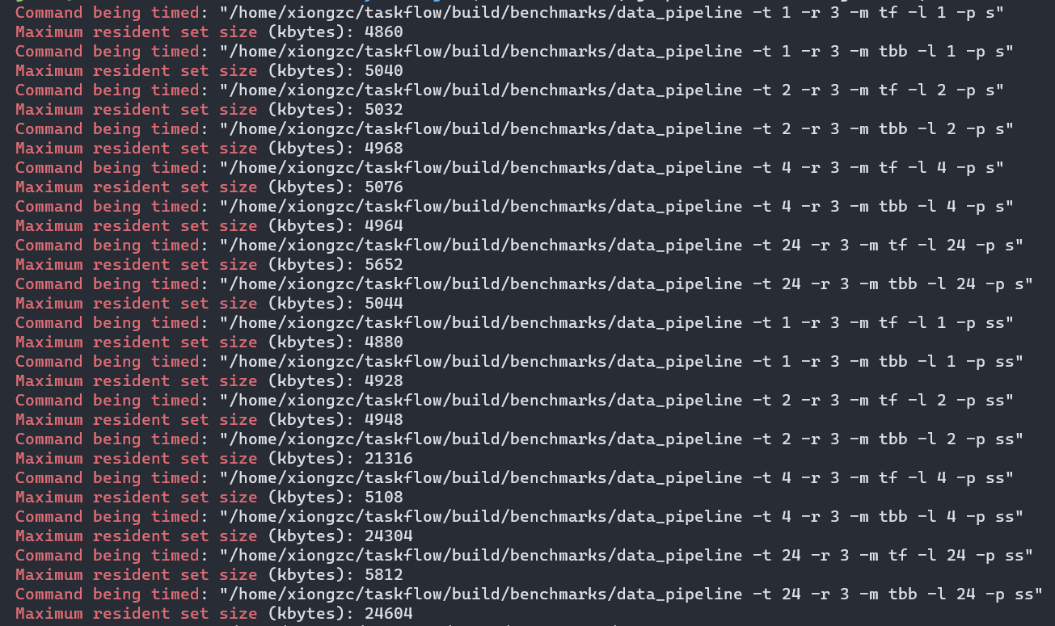
Time: memory usage

Slide 6
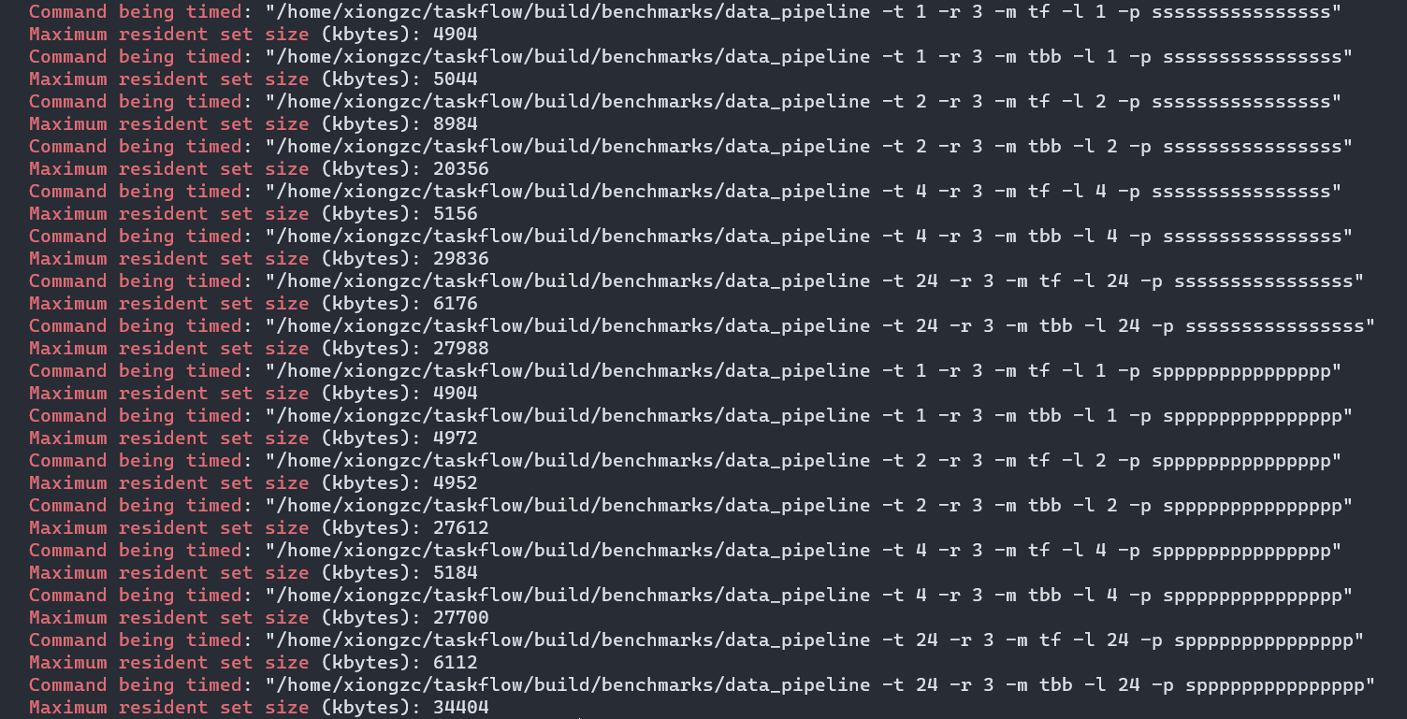
Time: memory usage

Slide 7
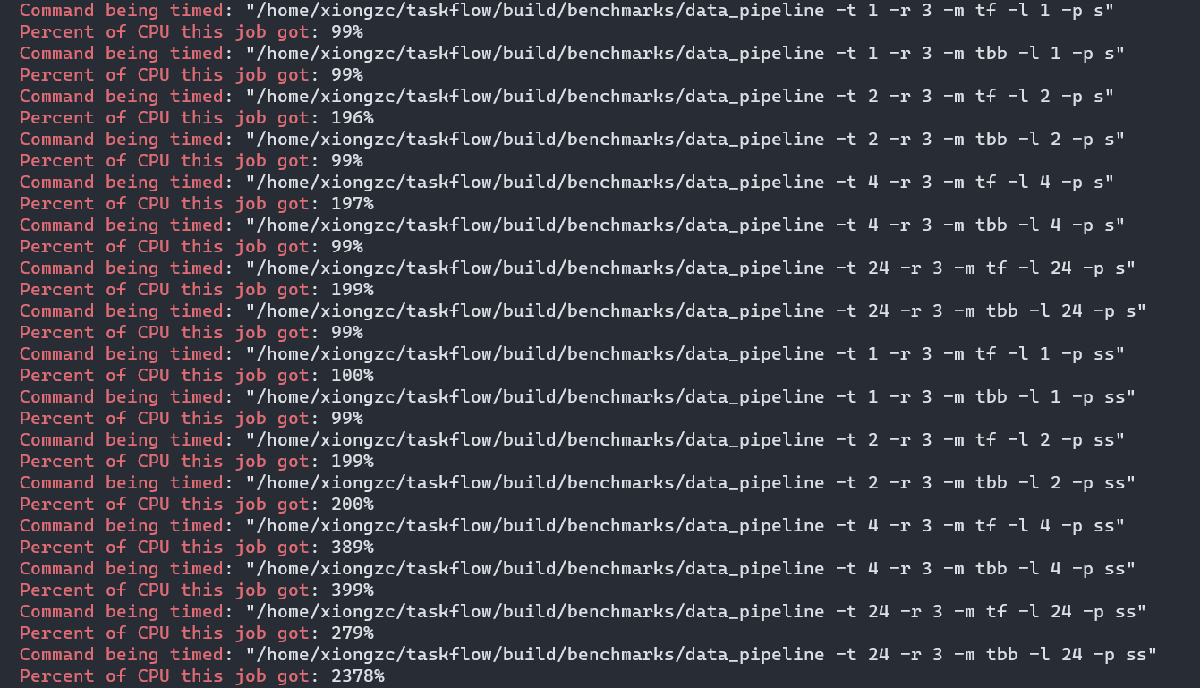
Time: cpu usage

Slide 8
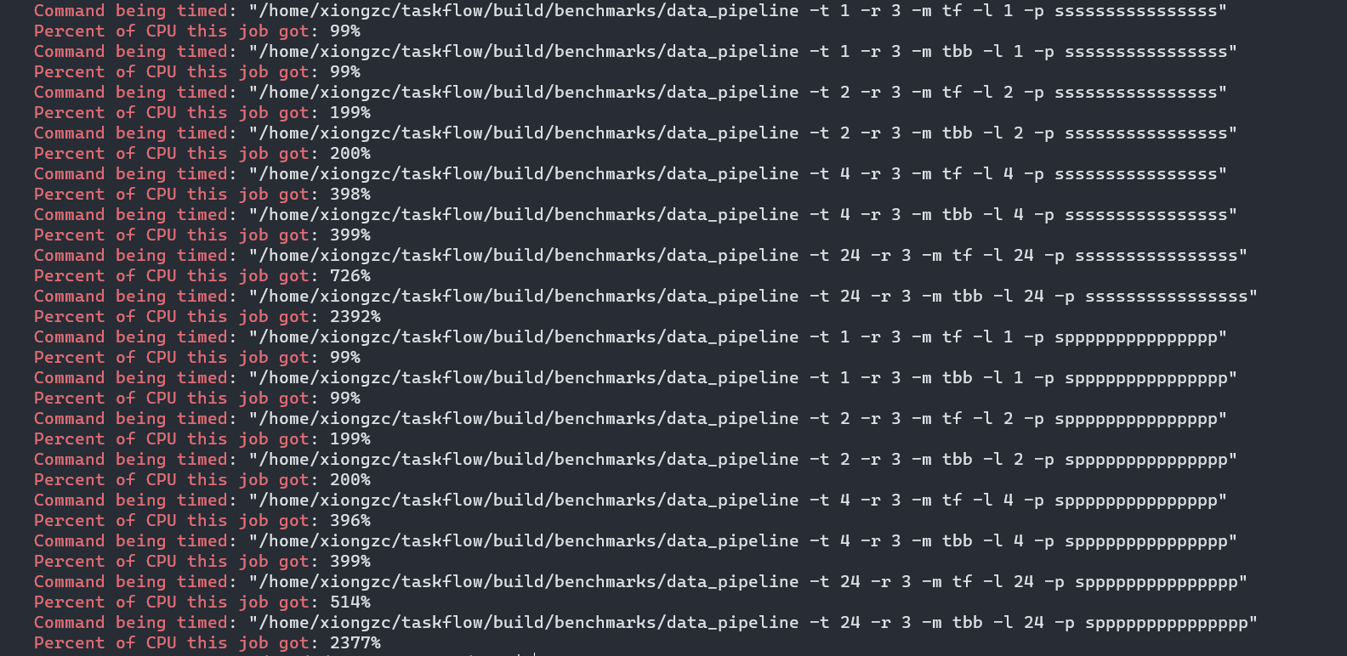
Time: cpu usage

Slide 9
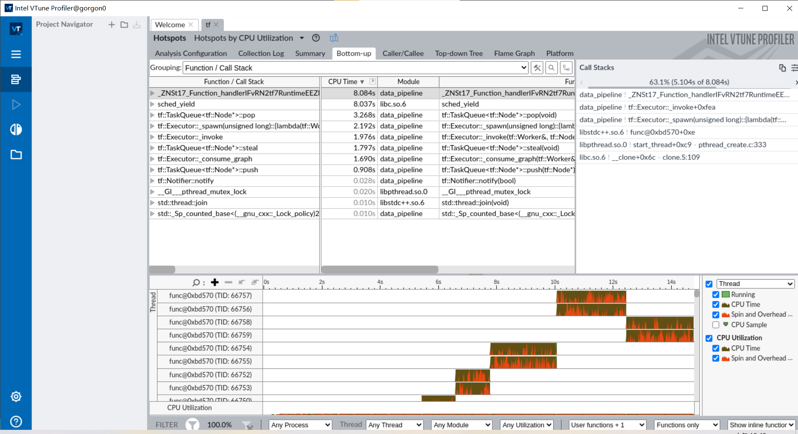
Vtune: hotspots

Slide 10
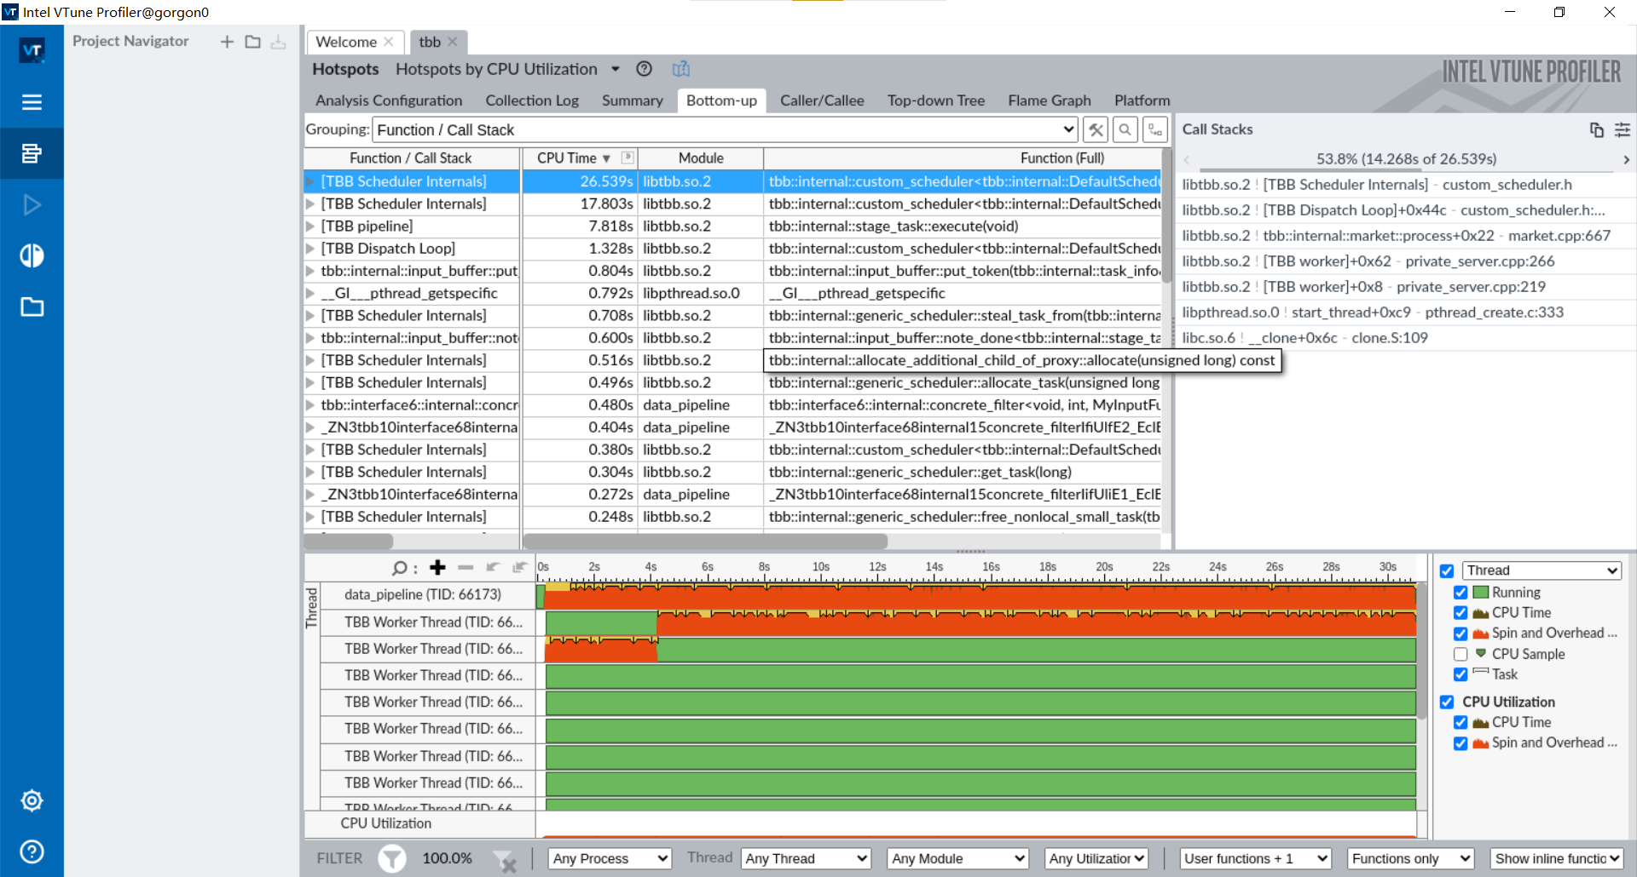
Vtune: hotspots

