Slide 1

Web Threading
David CATUHE - @deltakosh
Babylon.js / Microsoft

Slide 2
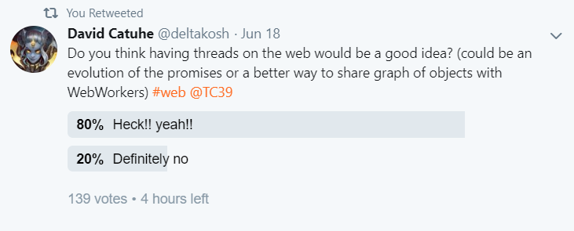
What is the problem?
Today “multi-threading” is more a “multi-process” approach
We MUST be able to better leverage multi core CPUs (even on mobile) to improve web experiences and be on par with native applications
Examples for Babylon.js:
Frustum culling
Animation
Physics / collisions
Particles
IA
Would be beneficial for the entire web ecosystem

Slide 3
Why not Web Workers?
They cannot run a specific function from your current context
They cannot share objects (only ArrayBuffers).
Transferable objects do not help either as we could have thousands of objects to pass back and forth per frame and only using ArrayBuffer is not enough
They require a separated js file to run
Impossible to run a specific function without dealing with a lot of plumbing
No context capture
They are a bit like Processes where we need Threads

Slide 4
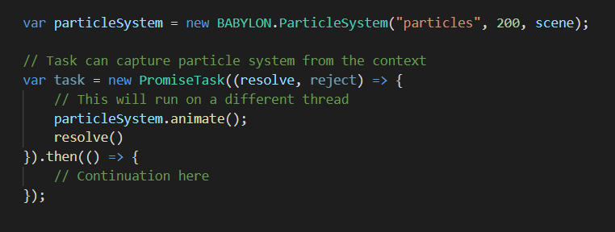
How ? Leverage promises
Create PromiseTask that could be handled by a scheduler and ran on a different native thread (User will not have control on thread count)
Code change is minimal for developers
Can capture context directly (no need for transferable objects)

Slide 5
But…
A lot of friction from TC39 influencers
JavaScript enginesV8 is architected under the assumption one thread is in an isolate at one time
Would require huge development effort from browser vendors
Some experiments:
https://webkit.org/blog/7846/concurrent-javascript-it-can-work/

Slide 6
How ? Improve web workers
Extend transferables to user object graph
Maybe restrain that feature to workers only
Allow us to efficiently work with OffscreenCanvas
Could be limited to POCO objects?
Ignore DOM/WebGL to make it simple
Allow worker creation from a function (not only from a script file)
Good intermediate solution

Slide 7

How?
Any other ideas?

