Slide 1
GENDER-INCLUSIVE LANGUAGE IN GAMES AND ITS LOCALIZATION CHALLENGES
Elina Bytskevich & Gabriel Tutone
W3C Workshop on Web Games
June 2019
Notes:
- Goals of the presentation: 1) raise awareness and 2) open an educated debate on the matter.

Slide 2
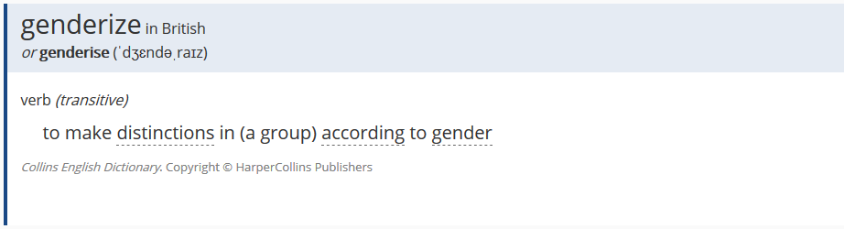
What is ‘genderize’?
Example:
Notes:
Genderize is something that we do on a daily basis without even realizing it.
Depending on your language, you might be wondering if this refers to grammatical gender or semantic gender.

Slide 3
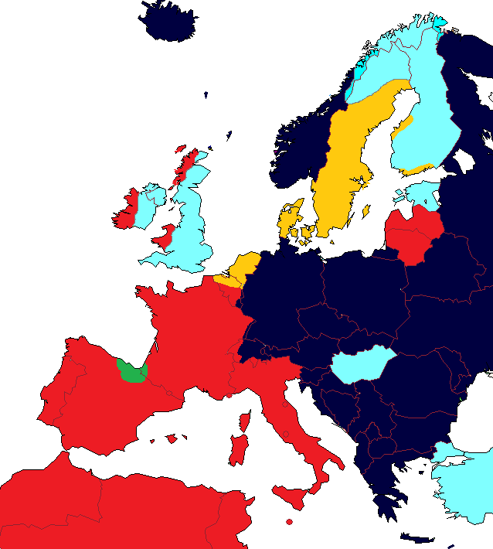
Grammatical gender
6,900 languages in the world → ¼ gendered
Common systems of gender division:
Light blue: no gender
Yellow: common/neuter
Green: animate/inanimate
Red: masculine/feminine
Dark blue: masculine/feminine/neuter
Notes:
I say ‘depending on your language’ because there are around 6900 languages in the world, and ¼ are gendered.
Let’s have a closer look at languages in Europe:
Light blue: English, Finnish…
Yellow: Dutch, Danish…
Green: Basque
Red: French, Italian, Spanish, Portuguese…
Dark blue: German, Russian…

Slide 4
What is ‘gender inclusive language’?
Gender inclusive language is a form of language that is not biased toward a particular sex or social representation of gender.
Gender neutrality:
when the gender of the person referred to is unknown or indeterminate
when we want to include in our speech people who identify themselves as non-binary or genderless
Notes:
Since we have seen English does not have a grammatical gender-division system, it means semantic gender.
Advocates of gender-inclusiveness argue that achieving this kind of language is possible and consider that gendered language often implies male superiority and reflects an unequal state of society.

Slide 5
Gender inclusive language: challenges
Advocates:
Gendered language often implies male superiority
Detractors:
Gender-inclusive language leads to unnatural grammar
Notes:
Since we have seen English does not have a grammatical gender-division system, it means semantic gender.
Advocates of gender-inclusiveness argue that achieving this kind of language is possible and consider that gendered language often implies male superiority and reflects an unequal state of society.

Slide 6

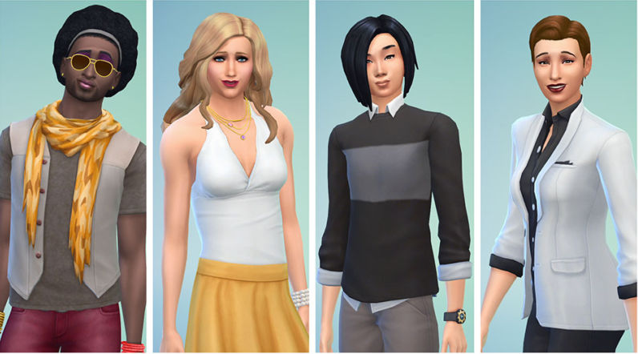
When should we use gender-inclusive language?
Player’s gender unknown
Non-binary characters
Notes:
There have always been female and gender-fluid players, but only recently have they gained more visibility thanks to feminist and LGBT+ movements.

Slide 7
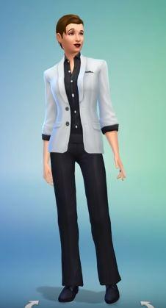

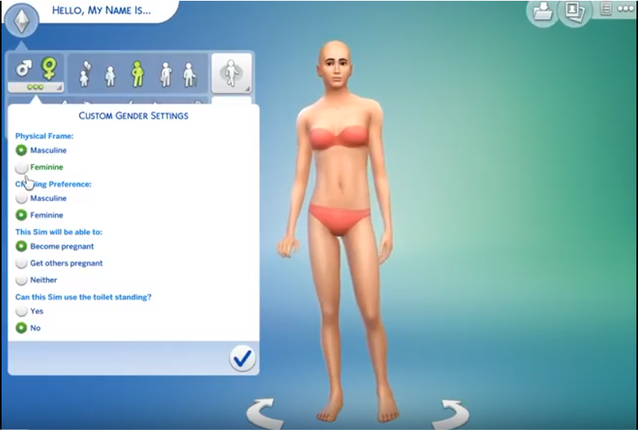
Examples (I)
The Sims 4 (Electronic Arts, 2014)
Flexible creation menu (May 2016)
Notes:
EA had already introduced LGBT+ characters and same-sex relationships in their previous titles.
They went a step further and offered players total flexibility when creating their characters.

Slide 8
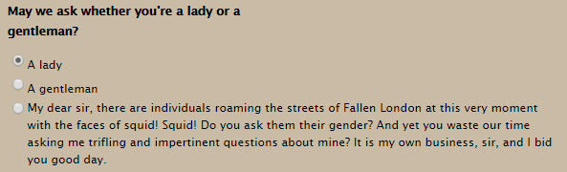
Examples (II)
Fallen London (Failbetter Games, 2009)
3rd option in character creation

Slide 9
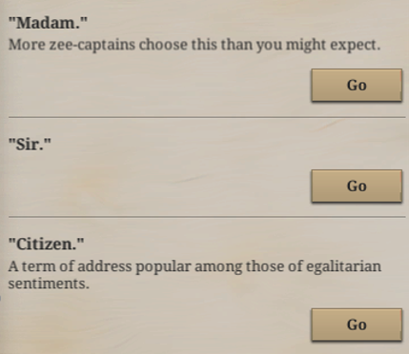
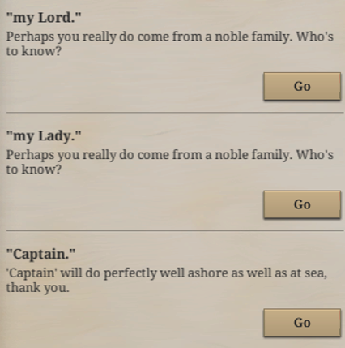
Examples (III)
Sunless Sea (Failbetter Games, 2015)
Preferred form of address

Slide 10

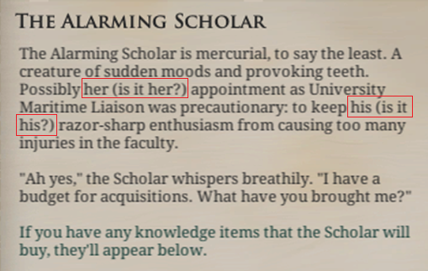
Examples (IV)
Sunless Sea (Failbetter Games, 2015)
Androgynous characters

Slide 11
How ‘gender-inclusive language’ is used?
How?
Using not gender-specific nouns & pronouns
Example: policeman/policewoman → police officer
Example: he/him & she/her → they/them
Duplicating structures (gender-binary)
Example: “he or she” / “actor and actresses”
Restructuring the sentence
Example: “when you were a little boy” → “in your childhood”
Notes:
After these examples, let’s revisit what gender-inclusive language is and how we can introduce it in our games.
These solutions apply not only to English, but also to other languages.

Slide 12
Using gender-inclusive language: French, Italian, German, Russian & Spanish
French
German
Creation of neuter & inclusive language
Lo/lu ; li/lia (articles), ille ; iel/yel (pronouns)
Adding gender endings:
Cher.e.s ami.e.s
Use of asterisk to indicate variations
Example: der*die Priester*in
Spanish
Use of @, ‘x’ or ‘e’ to replace a/o
Example: todos → tod@s / todxs / todes
Italian
Russian
Use of asterisk to replace a/o
Example: bambino/a → bambin*
Use of @ to indicate plural
Example: ragazzi/e → ragazz@
Avoid constructions using gender endings
Impersonal or plural verb forms
No solution to accommodate for gender fluidity
Notes:
Now let’s see what options we have to introduce gender inclusiveness or neutrality when none of the solutions mentioned above is really suitable.
At Keywords we carried out a study for a client where we had to revise the localized text and see if it was suitable for gender-fluid players, as well as not content-offensive.

Slide 13
Challenges in localization
Current academic standards do not support inclusive language
More costly
Length restrictions
Not supported in dubbing or text-to-speech engines
Notes:
Using not gender-specific terms is less natural and leads to convoluted language.
Duplicating structures is more costly.
Restructuring the sentence may introduce length issues (especially in games for mobile devices).

Slide 14

Conclusions
Rely on sensitive readers
Society changes, language needs to adapt
Multiple approaches
No unique rule to rule them all!
Notes:
Society changes, so language needs to adapt.
Multiple approaches to cover this reality.
We must rely on sensitive players who can give us their feedback on our localization.

Slide 15
Thanks!
Questions?

