Slide 1
W3C Workshop on Web Games (Gamepad)
2019/6/28
Kelvin Yong
Steve Agoston
Sony

Slide 2
W3C Gamepad
W3C Gamepad first working draft created in 2012

Slide 3
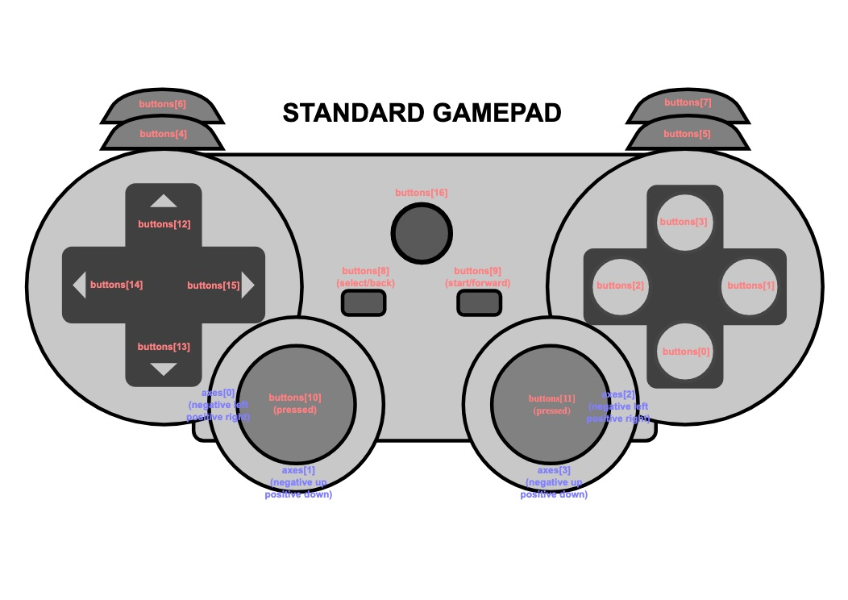
W3C Gamepad
2014 spec provides basic gamepad functionality
* Image source: https://www.w3.org/TR/2014/WD-gamepad-20140225/

Slide 4
W3C Gamepad
Fast forward to 2019. . .
* Image source: https://www.w3.org/TR/2014/WD-gamepad-20140225/

Slide 5
W3C Gamepad
2 major interests from several groups
Standardize gamepad inputs
Support modern controller features in the gamepad spec
Touch surface(s)
Light indicator(s)
Haptic(s)
Accelerometer
Gyroscope

Slide 6
W3C Gamepad
V1 Work Stream: Move the current gamepad spec from WD to CR
Clarify terminology for current gamepad functionality
Address privacy and security issues
Current open issues: https://github.com/w3c/gamepad/issues
* Image source: https://www.w3.org/TR/2014/WD-gamepad-20140225/

Slide 7
W3C Gamepad
V2 Work Stream: Add support for modern gamepad features
Touchpad
Proposal: https://github.com/w3c/gamepad/issues/27
Implementation of proposal in Chrome and Firefox
Circular touch surface
Single touch point
Rectangular touch surface
Single touch point
Rectangular touch surface
Multiple touch points

Slide 8
W3C Gamepad
V2 Work Stream: Add support for modern gamepad features
Light indicator
Proposal: https://github.com/w3c/gamepad/issues/67
Implementation in Chrome and Firefox in progress
Single light indicator
Multiple light indicators
Multi-color light indicator
Single color light indicator

Slide 9
Thank you!
Questions/Comments: kelvin.yong@sony.com

