Slide 1

MiniApps CG Work Intro
2021/3

Slide 2

MiniApps CG Work Overview
3
2
Manifest
5
1
Package
4
MiniApp URI (Addressing)
Lifecycle
Pages
(Widget)
request
Package Server
delivery
User Agent （super apps, OS, browser…）
# | MiniApp Specs (incubated in CG) | Transposed to WG | TAG Reviewed
1 | MiniApp URI Scheme | Note | Y
2 | MiniApp Packaging | Normative | informally
3 | MiniApp Manifest | Normative | Y
4 | MiniApp Widget Requirements | Note | N
5 | MiniApp Lifecycle | Normative | Y

Slide 3
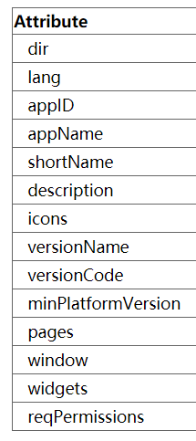
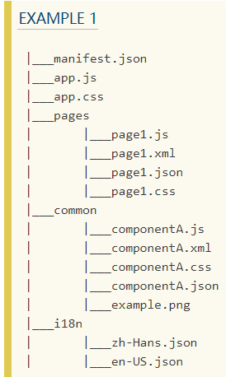
MiniApp Packaging & Manifest (Normative)
The package is a ZIP-based file containing necessary resources that construct a MiniApp.
The Manifest is an extension of Web App Manifest to describe & configure a MiniApp.
Metadata inherited from WAM
To Do:
Naming convention
Additional configurations (e.g. refined permission model)
i18n
MiniApp-specific extensions
"versionName": "1.0.0",
"versionCode": 1,
"minPlatformVersion": "1.0.0",
"pages": [ "pages/index/index", "pages/detail/detail" ],
"window": {
"navigationBarTextStyle": "black", "navigationBarTitleText": "Demo", "navigationBarBackgroundColor": "#f8f8f8", "backgroundColor": "#ffffff",
"fullscreen": false },
…
To Do:
1. Page layout template
5. Security (digital signature)
6. dereferencing process
7. Widgets
8. Other APIs (IoT, TV, …)
2. Page-specific manifest
3. UI components & APIs
4. i18n

Slide 4
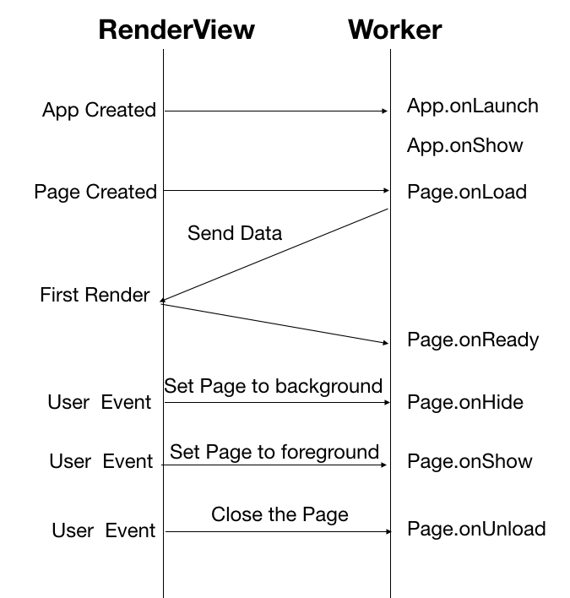
MiniApp Lifecycle (Normative)
Global Application lifecycle APIs:
onLaunch(object: Object): callback after first initialization.
onShow(object: Object): callback when switching to foreground display.
onHide(): callback when switching to the background.
onError(error: String): callback of MiniApp error.
MiniApp page lifecycle APIs:
onLoad(query: Object): callback when the page is loaded.
onReady(): callback after the page’s first rendering.
onShow(): callback when switching to foreground display.
onHide(): callback when switching to the background.
onUnload(): callback when destroying a MiniApp page.
To Do:
Define the “first render”
Web IDL for the lifecycle APIs

Slide 5
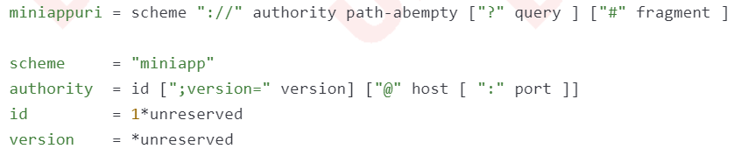
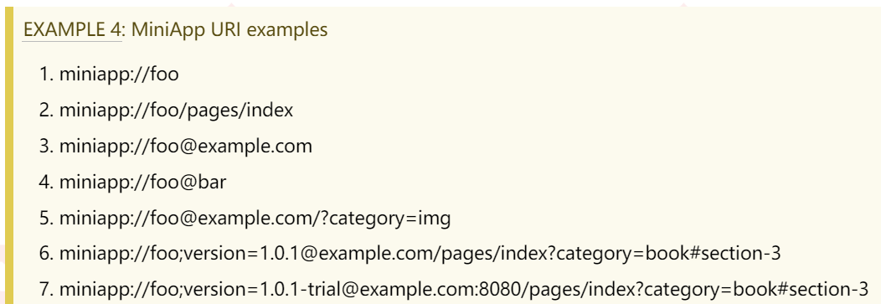
MiniApp Addressing (WG Note)
Previous Work (‘miniapp://’ scheme):
To Be (HTTP(s) scheme/deep-linking):
To Do:
Practice experience of deep-linking
Standard syntax component
Dereference algorithm
More security consideration

