Slide 1

MiniApps CG Work Intro
2021/3

Slide 2

MiniApps CG Work Overview
3
MiniApp specs:
MiniApp URI Scheme
MiniApp Packaging*
MiniApp Manifest*
MiniApp Widget Requirements
MiniApp Lifecycle*
(* transferred to WG as normative)
Manifest
5
2
1
Package
Lifecycle
MiniApp URI (Addressing)
4
Pages
(Widget)
User Agent
Package Server

Slide 3
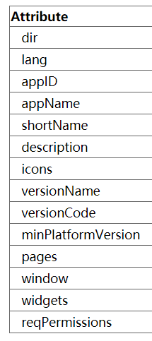
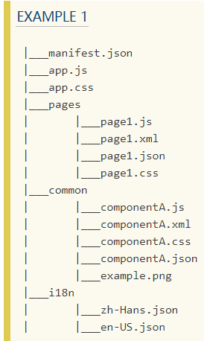
MiniApp Packaging & Manifest
A MiniApp package is a ZIP-based file (to be registered as ‘application/miniapp-pkg+zip‘).
A MiniApp Manifest is an extension of Web App Manifest.
Basic metadata inherited from Web App Manifest.
To Do:
Naming convention (manifest members)
Additional configurations (e.g. refined permission model)
i18n support
Version control for platform compatibility
Page routing, window style, permission control
To Do:
1. Page layout template/markup language
5. Security consideration (digital signature)
6. Package dereferencing process
7. Widgets
8. Other APIs (IoT, TV, …)
2. Page-specific manifest?
3. UI components & APIs
4. i18n support

Slide 4
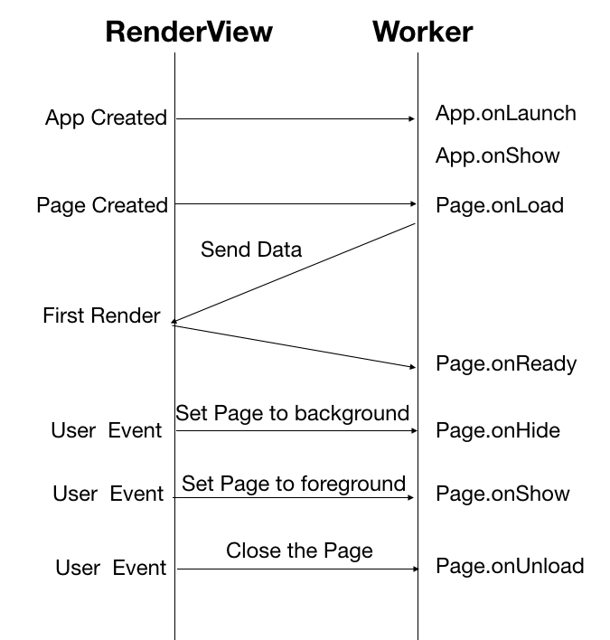
MiniApp Lifecycle
Global Application lifecycle APIs:
onLaunch(object: Object): callback after first initialization.
onShow(object: Object): callback when switching to foreground display.
onHide(): callback when switching to the background.
onError(error: String): callback of MiniApp error.
MiniApp page lifecycle APIs:
onLoad(query: Object): callback when the page is loaded.
onReady(): callback after the page’s first rendering.
onShow(): callback when switching to foreground display.
onHide(): callback when switching to the background.
onUnload(): callback when destroying a MiniApp page.
To Do:
Define "first render"
Web IDL for the Lifecycle API

Slide 5
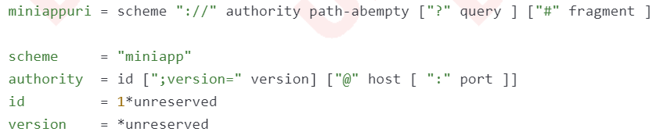
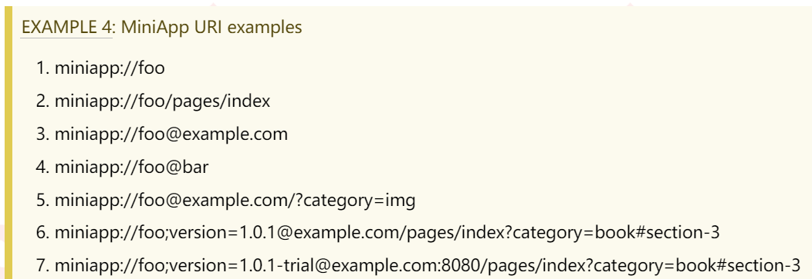
MiniApp Addressing
Previous Work (‘miniapp’ scheme):
To Be (HTTP(s) scheme/deep-linking):
To Do:
Practice experience of deep-linking
Standardize syntax component
Dereference algorithm
More security consideration
Notes:
To Do:
给出 deep-linking 的实践建议
规范语法部件格式
对于 URI 的解引用算法
安全性考虑
就像普通的 Web 网页需要用到 URL 来定位一样，MiniApp 也用到了统一资源定位符 URI 来定位资源。而 MiniApp Addressing 机制则定义了MiniApp的定位方式。
在之前 Miniapp CG 的工作中，我们设计了 miniapp uri 的 scheme、 authority、path、id 和 version 等信息和 MiniApp 的映射关系。
在 miniapp Addressing 中，会给出 scheme 的最佳实践经验，而非规定 scheme，比如使用 deep linking 的方式。
我们还会规范 MiniApp URI 中的包信息、页面路径、参数信息的语法格式，以及这些语法部件在小程序中的含义。
miniapp Addressing 还会定义宿主平台对 MiniApp 定位协议的解引用算法；
并且会提出 Addressing 过程中的安全性相关的建议。

