Slide 1
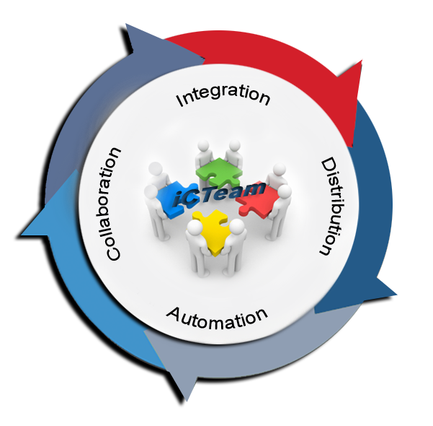


Inside!
iCTeam
Eclipsecon 2013
26 Mar 2013 16:15 – 16:45
Room : Back Bay
- Jyothi G Shivashankar (Robert Bosch Engineering and Business Solutions)
- Ryan D Brooks (The Boeing Company)
RBEI | 14/01/2013 | © Robert Bosch Engineering and Business Solutions Limited 2013. All rights reserved, also regarding any disposal, exploitation, reproduction, editing, distribution, as well as in the event of applications for industrial property rights.

Slide 2
Agenda
1
The parallel industries in Embedded SW Engineering
Automotive
Aerospace
2
The parallel Collaboration concepts
Eclipse
AUTOSAR
RBEI | 14/01/2013 | © Robert Bosch Engineering and Business Solutions Limited 2013. All rights reserved, also regarding any disposal, exploitation, reproduction, editing, distribution, as well as in the event of applications for industrial property rights.

Slide 3
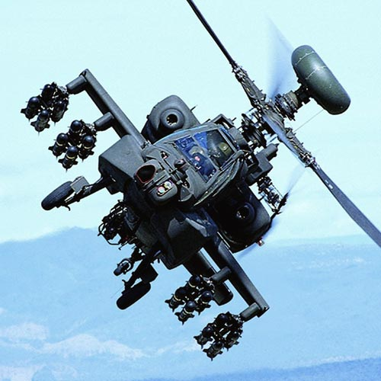

This ALM is a confluence of two parallels
Aerospace
Automotive
RBEI | 14/01/2013 | © Robert Bosch Engineering and Business Solutions Limited 2013. All rights reserved, also regarding any disposal, exploitation, reproduction, editing, distribution, as well as in the event of applications for industrial property rights.

Slide 4
Challenges for Aerospace & Automotive industries
Safety Standards
Engineering Efficiency and Quality
Dependency analysis
Complete Lifecycle Support
Variant management
Project overview
Manage Complexity
Product Line Engineering features
Support development of software compliant to Safety standards like DO-178B and ISO 26262
Traceability reports
Package/Component Analysis
Release management
Toolchain Integration
Data exchange with customer
Integrated RDCT
RBEI | 14/01/2013 | © Robert Bosch Engineering and Business Solutions Limited 2013. All rights reserved, also regarding any disposal, exploitation, reproduction, editing, distribution, as well as in the event of applications for industrial property rights.

Slide 5
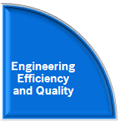





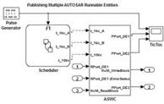

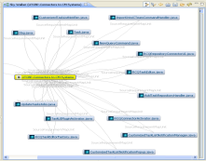
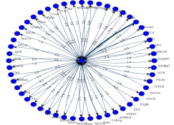
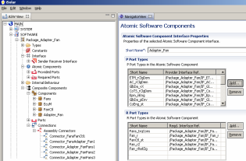
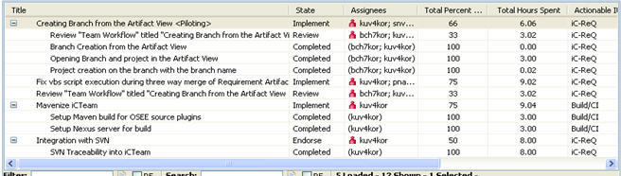

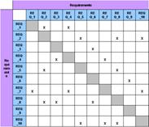
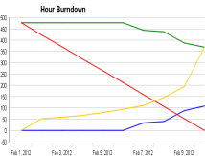
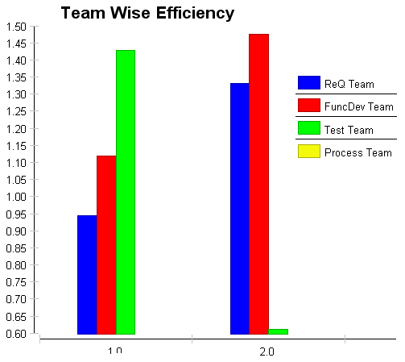
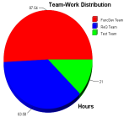



Improve Engineering Efficiency and Quality
Changes & Requirements
Design
Customer
Simulink
AUTOSAR
ClearQuest
JIRA
DOORS
Dependency Viewers
Traceability Matrix Reports Vertical Horizontal
MY DASHBOARD
Improve Engineering efficiency and Quality
Configuration Management
Tasks & Assignments
CODE
Files
A-TASK-1.1
A-TASK-1.1
A-TASK
A-TASK-1
A-TASK-1.2
A-TASK-1.2
A-TASK-2
A-TASK-1.3
A-TASK-1.3
Clear Case
SVN
GIT
TEST Cases
A-TASK-2.1
A-TASK-2.1
B-TASK
B-TASK-1
A-TASK-2.2
A-TASK-2.2
B-TASK-1
B-TASK-1.1
B-TASK-1.1
B-TASK-1.2
B-TASK-1.2
B-TASK-1.3
B-TASK-1.3
RBEI | 14/01/2013 | © Robert Bosch Engineering and Business Solutions Limited 2013. All rights reserved, also regarding any disposal, exploitation, reproduction, editing, distribution, as well as in the event of applications for industrial property rights.

Slide 6

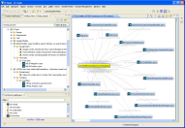
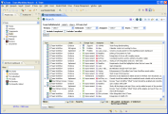

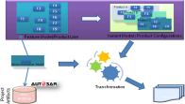
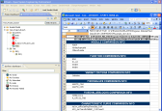

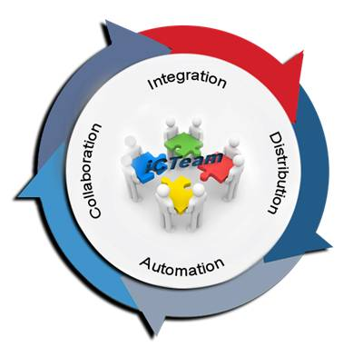
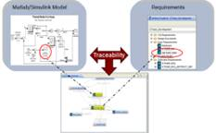
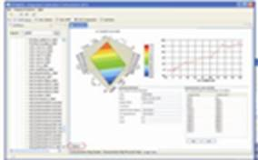


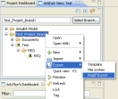

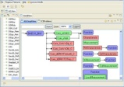
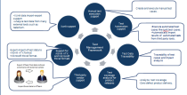
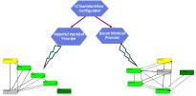
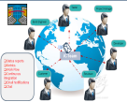


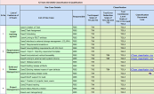

Complete Lifecycle Support
Requirements Management
Document Management
Requirements
Project Mgmt
Design
Model Based
Development
Feature / Product Line
Calibration
Data Manager
Document Mgmt
Impact Analysis
Model Traceability
Calib Data Manager
Software Sharing Support
Verification & Validation
Dependency Mgmt
Software Sharing
Configuration
Continuous
Integration
Automotive Standards Editors
Test Mgmt
Workflow
Collaboration
Build Mgmt
Traceability
ISO 26262
RBEI | 14/01/2013 | © Robert Bosch Engineering and Business Solutions Limited 2013. All rights reserved, also regarding any disposal, exploitation, reproduction, editing, distribution, as well as in the event of applications for industrial property rights.

Slide 7
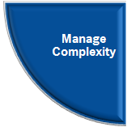
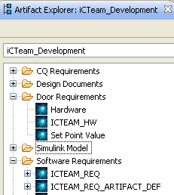
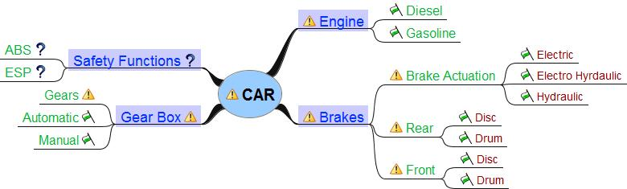
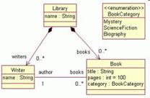
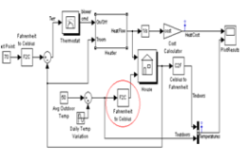
Managing Complexity
Documents & Artefacts
Code
Product Lines
P1
F1
F1.1
F2
F2.2
Design
P2
F1
F1.2
F3
F3.1
P3
F1
F1.2
F2
F2.1
F3
F3.2
Feature Model
Architecture
Family Model
Requirements
Product Line
Management
RBEI | 14/01/2013 | © Robert Bosch Engineering and Business Solutions Limited 2013. All rights reserved, also regarding any disposal, exploitation, reproduction, editing, distribution, as well as in the event of applications for industrial property rights.

Slide 8
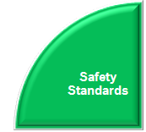
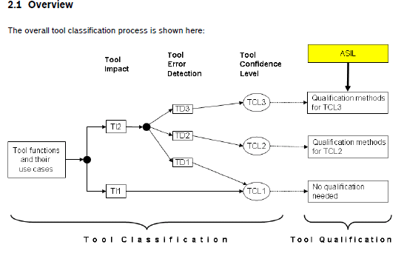
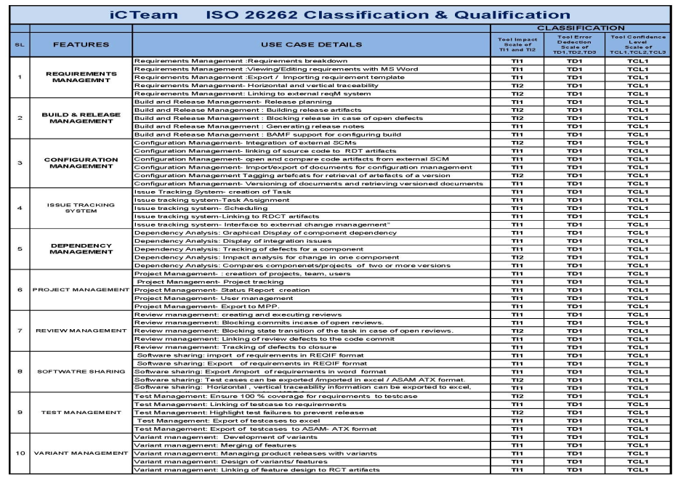
Conformance to Safety Critical standards
ISO 26262 is a Functional Safety standard, titled "Road vehicles -- Functional safety”
The standard ISO 26262 is an adaptation of the Functional Safety standard IEC 61508 for Automotive Electric/Electronic Systems. ISO 26262 defines functional safety for automotive equipment applicable throughout the lifecycle of all automotive electronic and electrical safety-related systems.
VDC Research reports that adherence to ISO 26262 and AUTOSAR is expected to increase significantly in the next two years.
iCTeam ISO 26262 Classification Results
iCTeam is qualified as per ISO26262 standard to support Automotive embedded software development of safety level of up to ASIL-D
RBEI | 14/01/2013 | © Robert Bosch Engineering and Business Solutions Limited 2013. All rights reserved, also regarding any disposal, exploitation, reproduction, editing, distribution, as well as in the event of applications for industrial property rights.

Slide 9
Improve Engineering Efficiency and Quality
Functional Analysis
Requirements
Product Decomposition
Tier 1:
System
System
Function
System
Requirement
System
Design
System
Design
Design
Allocation
Dependency
Requirement Trace
Hierarchical
Subsystem
Function
Tier 2:
Subsystem
Design
Subsystem
Requirement
Subsystem
Subsystem
Subsystem
Design
Design
Allocation
Hierarchical
Hierarchical
Requirement Trace
Tier 3:
Component
Software
Design
Software
Requirement
Software
Component
Hardware
Component
Software
Component
Design
Verification
Verification
Allocation
Hierarchical
Test
Procedure
Hardware
Requirement
Automated
Test
Software
Unit
Notes:
Transformed Systems Engineering away from an activity conducted by a few experts largely during the early phases of a product development, towards an overall systems engineering approach integrated throughout the product lifecycle with all developers contributing.
This was achieved through tight integration around a common data model and repository which significantly reduced data redundancy and inconsistency.
With the ability to store and relate all the data at time of creation, it is possible to maintain and ensure that requirements are being decomposed and met and see live metrics throughout the project.

Slide 10
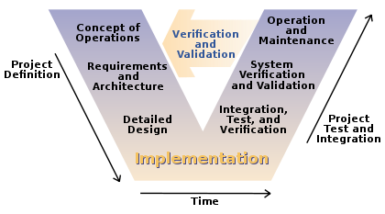
Complete Lifecycle Support
Change managed processes integrated directly into toolset supporting
overall systems engineering approach across the full life-cycle.
Advanced test capabilities from software qualification through production and flight test
Earned Value (EV) metrics are automatically derived from engineering data as a by-product
The V-model of the Systems Engineering Process
http://en.wikipedia.org/wiki/V_model
Notes:
Systems Engineering is an interdisciplinary process that reaches full effectiveness when applied throughout a system's entire life cycle.
OSEE's feature set includes process management, configuration management, requirements management, testing, validation, and project management.
Customized workflows can be defined. Integrated processes and workflows allow engineers to less time on process training and manual metrics reporting.
Customized work definitions model the team's workflow and actively guide them through the work to be completed.
Work Definitions are created and stored in OSEE and consist of state machines with their own widgets, rules, and routing.
Each state can be assigned, statused, and transitioned.

Slide 11
Managing Complexity
Edit Artifacts / Change Report
Merge
Create Branch
Flag Ship Program Build 1
Commit
Working Branches
Transactions
Flag Ship Program – Build 2
Flag Ship Program – Build 3
Baseline Branches
Introduce
International Program X – Build 1
International Program X – Build 2
Common Branch ( User Artifacts, Action Data, etc…)
Time →
Notes:
The success of a product often leads to many variants of it being developed in parallel. The challenge is to mange this tremendous complexity in a way that avoids creating significant quality, cost, and schedule issues. The ability to effectively flow changes to all the desired variants is essential to meeting this challenge.

Slide 12
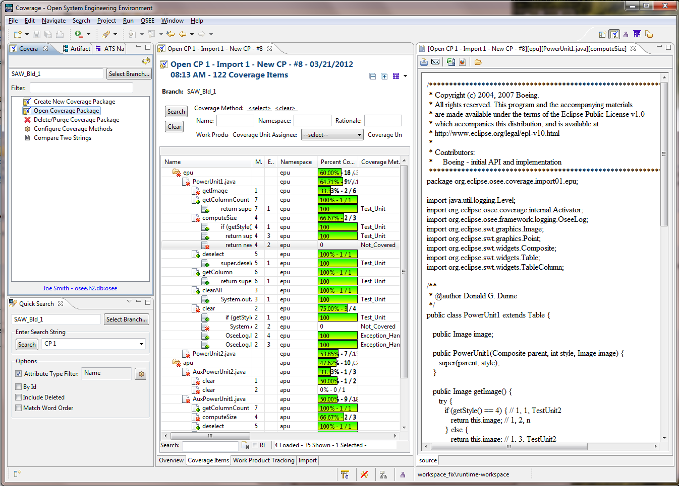
Conformance to Safety Critical standards
Structural coverage analysis and disposition (including across variants)
System safety analysis and reporting
Automatic generation of
MIL-STD-498 software documents (SRS, STP, STD, SSDD, STR, SDD, VDD, etc.)
Notes:
Structural Coverage Analysis
Test Environment coordinates with target software to capture raw coverage data
Raw coverage data is imported into OSEE
ATS used to disposition coverage methods
ATS provides tracking of code, test, and requirements changes needed to resolve missing coverage
Auto generation of coverage reports for delivery to customer
Safety Critical Analysis
Traceability thread from System and Subsystem functions through all levels of requirements down to code and test units
Safety Criticality and Development Assurance Level

Slide 13


This ALM is a confluence of two parallels
eclipse ~ AUTOSAR
~
RBEI | 14/01/2013 | © Robert Bosch Engineering and Business Solutions Limited 2013. All rights reserved, also regarding any disposal, exploitation, reproduction, editing, distribution, as well as in the event of applications for industrial property rights.

Slide 14
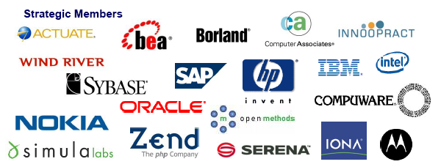


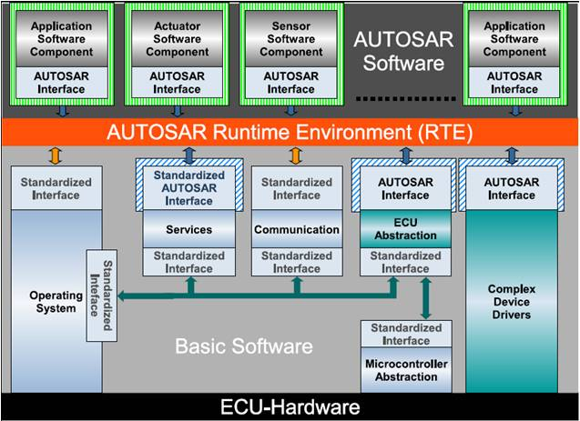







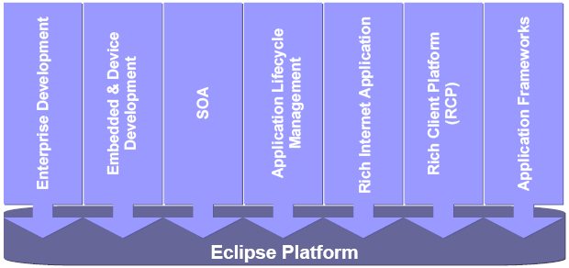
Eclipse ~ AUTOSAR : Similarities in concepts and principles
Compete Here !
Collaborate Here
14
RBEI | 14/01/2013 | © Robert Bosch Engineering and Business Solutions Limited 2013. All rights reserved, also regarding any disposal, exploitation, reproduction, editing, distribution, as well as in the event of applications for industrial property rights.

Slide 15
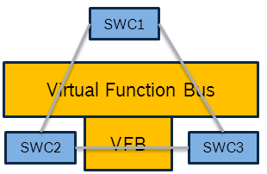
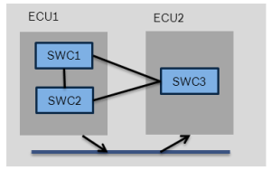
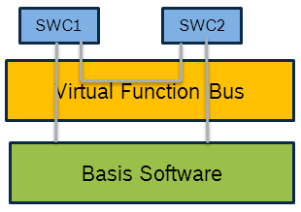
Lifecycle support in iCTeam
Requirement Definition
System Testing
Function Design
Functional Testing
AUTOSAR
Architecture Design
Architecture Testing
SWC1
N/W Design
Integration Testing
ECU Design
ECU Testing
ECU Extract
Embedded Design
Unit Testing
BAMF
RBEI | 14/01/2013 | © Robert Bosch Engineering and Business Solutions Limited 2013. All rights reserved, also regarding any disposal, exploitation, reproduction, editing, distribution, as well as in the event of applications for industrial property rights.

Slide 16
Thank You Q & A
RBEI | 14/01/2013 | © Robert Bosch Engineering and Business Solutions Limited 2013. All rights reserved, also regarding any disposal, exploitation, reproduction, editing, distribution, as well as in the event of applications for industrial property rights.

Slide 17
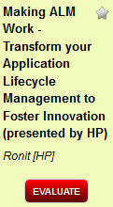

Give Feedback on the Sessions
1
Sign In: www.eclipsecon.org
2
Select Session Evaluate
3
Vote

