Slide 1
Docker
Contain yourselves

Slide 2
Who am I?
Angel Avila
11 years in software
Full stack developer in OSEE 5 years
Java lover growing fond of others
2 years dev ops experience
Love soccer and music

Slide 3
What is Docker
Open Source project
2013 origin
Rapidly growing
All about containers
Mini VMs
Any OS (we’ll focus on Linux)
Usually in tens of MBs in size
Gateway to cloud computing
Not the only container based solution
Most popular
Kubernetes and Docker can be used together
Bright future
Notes:
Isolation is done on the kernel level without the need for a guest operating system, so containers are much more efficient, fast, and lightweight (2)
Containerization is the first step to moving an application to the cloud. Containers can be run from anywhere on any machine that has Docker installed (1)

Slide 4
What is Docker (Terms)
Docker, inc
Docker Engine
What most people mean when they say “Docker”
Client-Server Application
Docker CLI
The client of the engine
Docker Daemon
The Server of the engine
Docker Swarm
Clustering and scheduling tool for Containers

Slide 5
What is Docker (Terms)
Container
Visualize as mini VM
Share OS Kernel
No need to emulate all hardware
Image
A Snapshot of a container
Think ISO Image for a VM
Registry
Where Images are stored
Docker Hub default
Host
Machine running Docker Engine

Slide 6
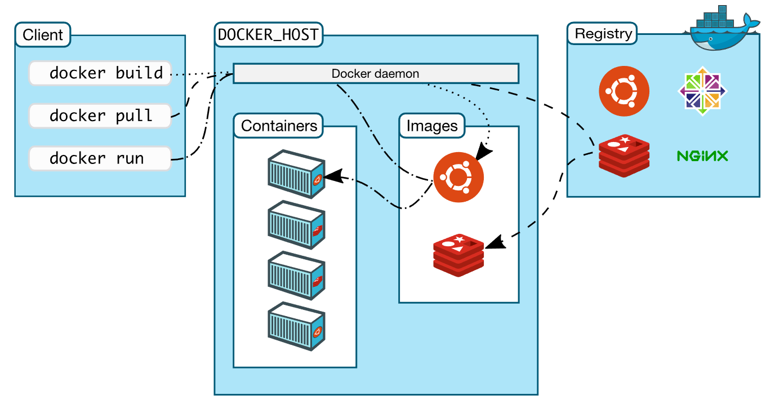
What is Docker

Slide 7
Why is Docker
Standardization
Same set up every time!
Regardless of hardware
Windows or Linux host
CI Efficiency
CD and Testing
Consistent environments means better pre-prod testing
Security
Apps are segregated from each other
Complete control over traffic flow
Notes:
Standardization: No more having to worry about libraries or drivers on host machine. Image takes care of building the right dependencies every time
CI –Efficiency: Docker enables you to build a container image and use that same image across every step of the deployment process. A huge benefit of this is the ability to separate non-dependent steps and run them in parallel. The length of time it takes from build to production can be sped up notably (3)

Slide 8
Requirements
Windows 10 64bit Enterprise
Virtualization enabled in BIOS
Enabled by default
4GB RAM
CPU SLAT-capable feature
My PC -> Right Click -> Properties sett chip type
Check at
https://ark.intel.com/content/www/us/en/ark.html#@PanelLabel122139
Example:
https://ark.intel.com/content/www/us/en/ark/products/88970/intel-core-i7-6820hq-processor-8m-cache-up-to-3-60-ghz.html
Hyper-V installed and working
https://docs.microsoft.com/en-us/virtualization/hyper-v-on-windows/quick-start/enable-hyper-v
Virtualization Enabled

Slide 9
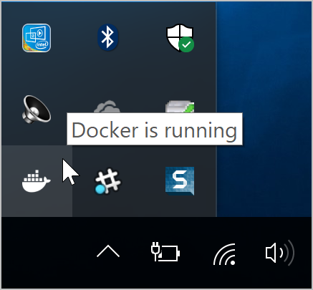
Getting Started
Download Docker from:
\\sw\mes\MSA\ipt-cee\Software\Docker
Run:
$ docker –version
Currently have Docker version 18.09.2, build 6247962
Ensure Windows Containers
Right click on docker task bar icon
Verify there’s an option that says “switch to Linux containers”
Run:
$docker run winamd64/hello-world
Set up Proxies:
Right-Click taskbar icon -> Settings -> Proxies
Manual proxy configuration
HTTP: http://www-proxy.boeing.com:31060
HTTPS: https://www-proxy.boeing.com:31060
Make sure ‘Use same for both’ is selected
Restart Docker – right click tastbar icon “Restart”
$ docker run winamd64/hello-world
Notes:
If docker command is not recognized go to System Properties -> Environment Variables -> System Variables -> PATH and move up C:\Program Files..\resources\bin

Slide 10
Getting Started
Switch to Linux containers
Right click -> Switch To Linux Containers
Set up Proxies:
Right-Click taskbar icon -> Settings -> Proxies
Manual proxy configuration
HTTP: http://www-proxy.boeing.com:31060
HTTPS: https://www-proxy.boeing.com:31060
Make sure ‘Use same for both’ is selected
$ docker run hello-world

Slide 11
Getting Command
$ docker --help
Image Commands
$ docker build –t <tag name> .
The ‘.’ tells docker where the Dockerfile is
$ docker images or docker image ls
$ docker rmi <image id>
Container Commands
$ docker ps
$ docker rm <container id>
$ docker run <docker id or tag name>
$ docker run –p <docker id or tag>
Run with port mapping

Slide 12
Images
Dockerfile
Instruction set or script for building image
First line is base Image usually an OS type
FROM <base image>
Each additional line is a ‘layer’
ADD src dst
Moves file from host to image
COPY src dst
Copies file from host or image src folder to dst
RUN vs CMD vs ENTRYPOINT
RUN is usually associated with installing packages
e.g: RUN apk add --no-cache bash
CMD is default command when container is run without command
e.g: CMD ["usr/bin/java", "-jar", "app.jar"]
If a command is given at run of container CMD will be ignored
ENTRYPOINT
Similar to CMD but allows params and will not be ignore
Base Image – has no parent usually an OS like Ubuntu, alpine etc
Child images – built from base image and add functionality
Official Images – Maintained by Docker e.g. busybox, hello-world etc
User images – images created by you and me
Created locally shared by Registry

Slide 13

Breath

Slide 14
Getting Useful
$ docker pull busybox
$ docker run busybox
$ docker run busybox echo "hello from busybox“
$ docker run -it busybox sh
Attaches a TTY to container so we can run as many commands as we like
Need Powershell on PC
docker rm $(docker ps -a -q -f status=exited) or docker system prune
Nifty command to clear containers

Slide 15
Getting Useful
In a directory with app.jar, create file named Dockerfile
With the following commands:
FROM openjdk:8-jre-alpine
We could start from pure alpine image but would have to do jdk installs
COPY app.jar app.jar
CMD ["usr/bin/java", "-jar", "app.jar"]
EXPOSE 8080

Slide 16
Getting Useful
$docker build -t appy .
$docker image ls
$docker run -p 8001:8080 appy
http://localhost:8001/
We’re running a java server on a linux container!

Slide 17
What is Docker Swarm
Docker Swarm
Consists of one or more nodes: physical or virtual machines running Docker Engine
Clustering and scheduling tool
vs Kubernetes
Abstraction is now at Service level
Stack
Services (you are here)
Container (covered)
Manager Nodes
Maintaining cluster state
Scheduling services
Also a worker node
Worker Nodes
Sole purpose is to execute containers
Cannot have a worker node without at least one manager node

Slide 18
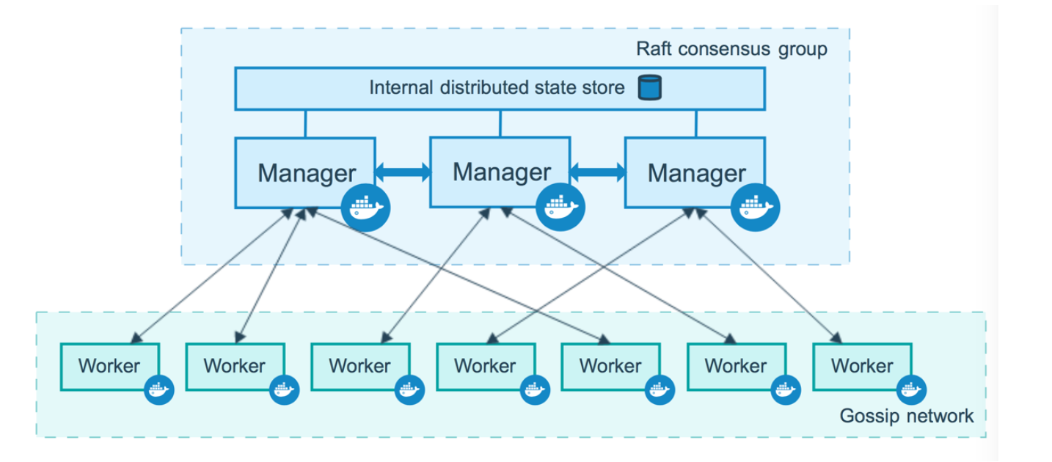
What is Docker Swarm

Slide 19
Registry
Image repo
Holds and delivers images
Can be tagged with versions
No version defaults to latest
Docker hub is default
To verify run:
$ docker pull aavila19/oseedocker:firsti
Boeing’s official registry
https://git.web.boeing.com/users/sign_in
Requires setting up token
$ docker login registry.web.boeing.com

Slide 20
Why is Docker Swarm
Connect multiple hosts (CLOUD!)
High availability
Declarative configuration
Similar to images, they are reproducible
Rolling updates!
Load balancing
Supports and encourages microservice architecure

Slide 21
Getting Started
Grab docker-compose.yml file from
\\sw\mes\MSA\ipt-cee\Software\Docker\dontpeek
$docker swarm init
Start a swarm from host
$docker swarm join
$docker swarm leave
Look at docker-compose.yml
$docker-compose up

Slide 22
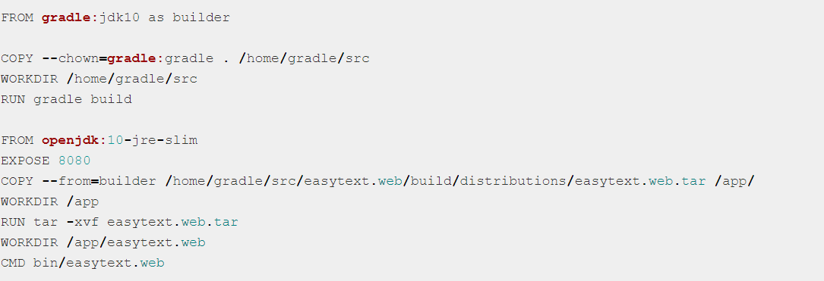
Multi Stage Builds
Optimizes Dockerfiles
Each instruction adds a layer
Hard to remember to do cleanup
Easier to read and maintain

Slide 23
Volumes
Containers are essentially read-only layers
Data is cleared on stop
On run container has no data outside of Dockerfile
Volumes are used to preserve data from container to container
Data persists after container is deleted
VOLUME /dest

Slide 24
Running CI
https://git.web.boeing.com/profile/personal_access_tokens
Create Personal Access Token
Grab token value and save in safe location
docker login registry.web.boeing.com
Username is Boeing email without @boeing.com
docker run -p 8000:20152 registry.web.boeing.com/angel.d.avila/osee-docker

