Slide 1


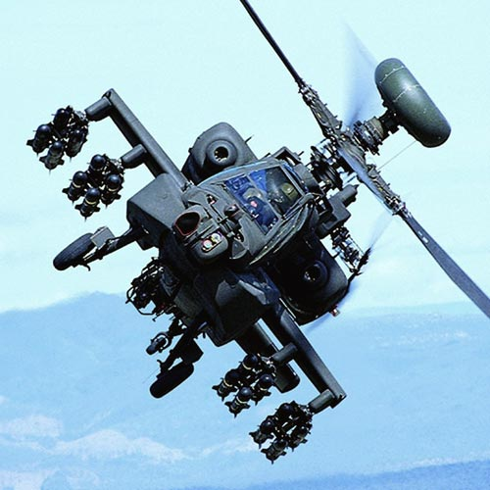


Safety inside ! ensured with technology
Jyothi G Shivashankar (Robert Bosch Engineering and Business Solutions)
Ryan D Brooks (The Boeing Company)
Eclipsecon 2014 20 Mar 2014 13:30 – 14:05 Room : Grand Peninsula B
RBEI | 15/01/2014 | © Robert Bosch Engineering and Business Solutions Limited 2013. All rights reserved, also regarding any disposal, exploitation, reproduction, editing, distribution, as well as in the event of applications for industrial property rights.

Slide 2
Agenda
1
Safety Standards
2
Application Life Cycle Management system
Key OSEE Features
Traceability reports
Variant management
Impact Analysis
Partner integration
3
The Safety Cycle
DO-178B conformance report
ISO26262
PLM – ALM integration
RBEI | 15/01/2014 | © Robert Bosch Engineering and Business Solutions Limited 2013. All rights reserved, also regarding any disposal, exploitation, reproduction, editing, distribution, as well as in the event of applications for industrial property rights.

Slide 3
Safety Standards for Safety Critical systems
Stringent standards require evidence of the quality of:
Developed Artifacts
AND
Development Processes
IEC 61508 Safety life cycle
Series of phases from initiation and specifications of safety requirements, covering design and development of safety features in a safety-critical system, and ending in decommissioning of that system
RTCA/DO-254 Design Assurance Guidance for Airborne Electronic hardware is a document providing guidance for the development of airborne electronic hardware
DO-178B
Software Considerations in Airborne Systems and Equipment Certification is a document dealing with the safety of software used in certain airborne systems
RBEI | 15/01/2014 | © Robert Bosch Engineering and Business Solutions Limited 2013. All rights reserved, also regarding any disposal, exploitation, reproduction, editing, distribution, as well as in the event of applications for industrial property rights.
Notes:
The development of safety critical systems is governed by stringent standards which require engineers to provide sufficient evidence of the quality not only of the developed artifacts but of the processes by which these artifacts are developed. For instance, DO-178B "Software Considerations in Airborne Systems and Equipment Certification" provides guidelines for the production of avionics software. Similar standards exist for other domains, such as automotive and industrial automation.

Slide 4

Key OSEE Features for Safety Critical Systems
System Safety Analysis
Code Coverage
End-to-end traceability
Variant management
Integrated workflows and processes
Deliverable document generation
Copyright © 2014 Boeing. Made available under the Eclipse Public License.
Notes:
Certification at the most rigorous level is costly, so it is important to correctly determine the design assurance level of each component.

Slide 5
Safety and Assessing Criticality
Hazard Analysis
Different types of hazards
Potential failure scenarios
Design Assurance Level
Determined based on the effects of a failure:
Catastrophic
Hazardous
Major
Minor
No Effect
The DAL drives the appropriate level of rigor required
Certification at the most rigorous level is costly
Copyright © 2014 Boeing. Made available under the Eclipse Public License.
Notes:
Certification at the most rigorous level is costly, so it is important to correctly determine the design assurance level of each component.

Slide 6
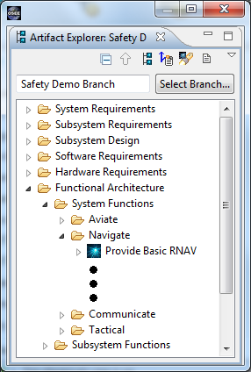
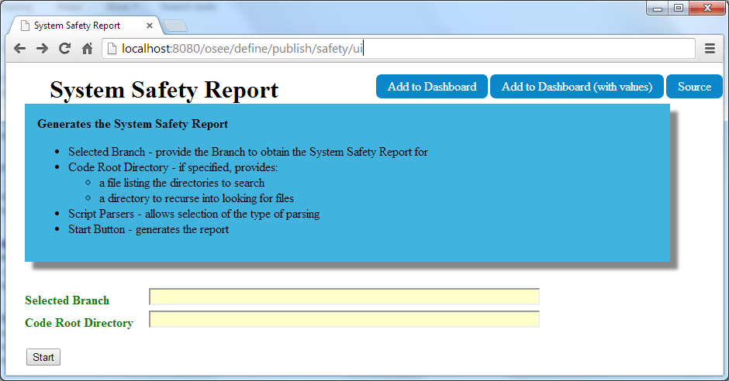
System Requirement
Subsystem Function
- Safety Criticality
Requirement Trace
Software Requirement
- Dev Assurance Level
Design
Design
Subsystem
Requirement
System Function
- Safety Criticality
- SFHA Hazard(s)
Code
Code
Code
Requirement Trace
Dependency
Software Requirement
- Dev Assurance Level
Subsystem
Requirement
Subsystem Function
- Safety Criticality
Design
Code
Code
Software Requirement
- Dev Assurance Level
Notes:
Traceability thread from System and Subsystem functions through all levels of requirements down to code units
Safety Criticality and Development Assurance Level consistency checking

Slide 7
Code Coverage
Test Environment coordinates with mission software to capture raw coverage data
Raw coverage data is imported and merged into OSEE Database
ATS used to disposition coverage methods
ATS provides tracking of code, test, and requirement changes needed to resolve missing coverage
Auto generation of coverage reports for delivery to customer
Currently, OSEE supports statement level coverage which is needed for certifying Level C software
Copyright © 2014 Boeing. Made available under the Eclipse Public License.

Slide 8
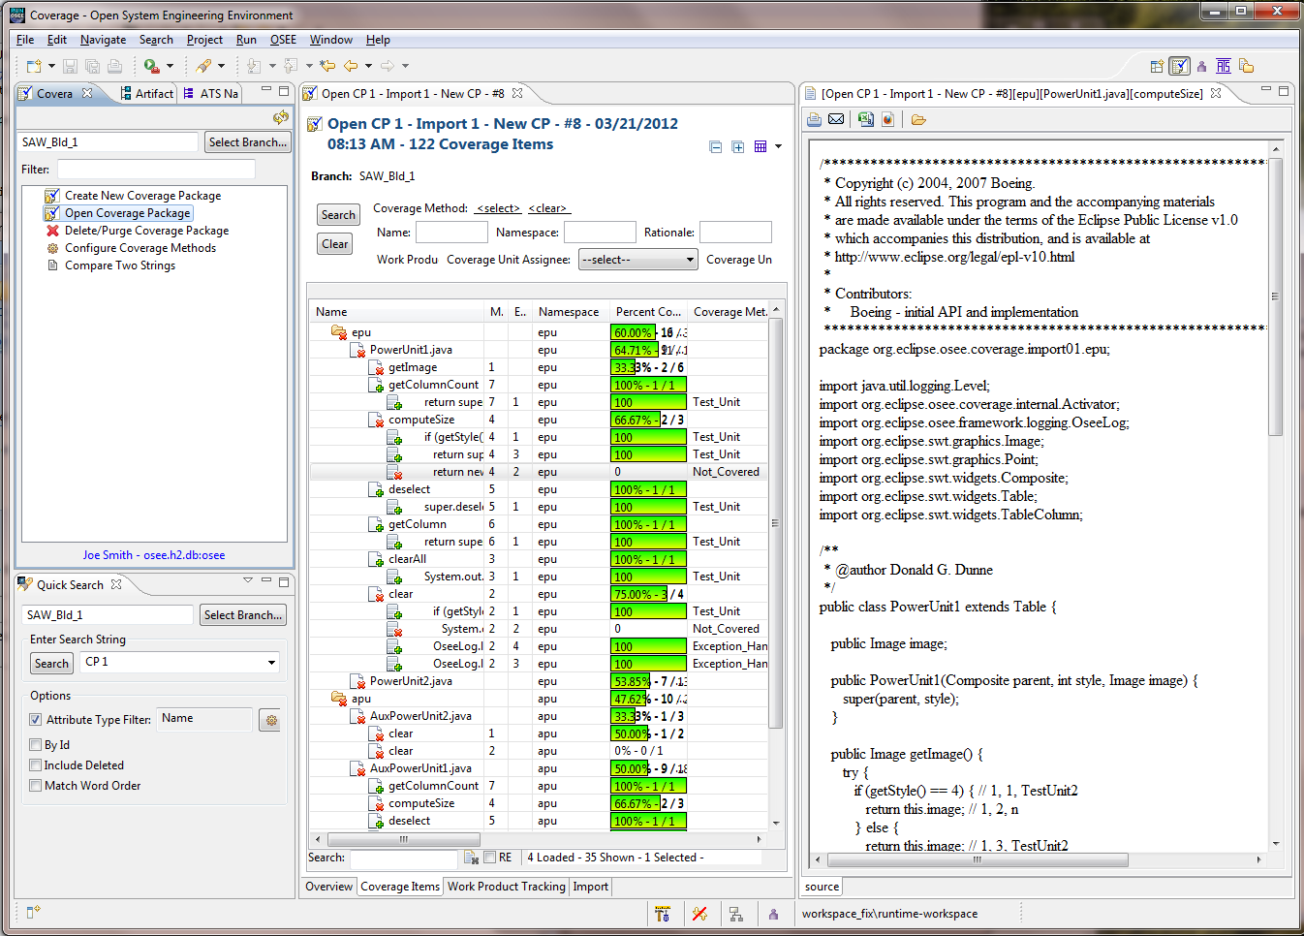

Slide 9
Systems Engineering Data Model
Functional Analysis
Requirements
Product Decomposition
Tier 1:
System
System
Function
System
Requirement
System
Design
System
Design
Design
Allocation
Dependency
Requirement Trace
Hierarchical
Subsystem
Function
Tier 2:
Subsystem
Design
Subsystem
Requirement
Subsystem
Subsystem
Subsystem
Design
Design
Allocation
Hierarchical
Hierarchical
Requirement Trace
Tier 3:
Component
Software
Design
Software
Requirement
Software
Component
Hardware
Component
Software
Component
Design
Verification
Verification
Allocation
Hierarchical
Test
Procedure
Hardware
Requirement
Automated
Test
Software
Unit

Slide 10

Variants and Exponential Complexity
As the number of variants increases,
complexity grows exponentially
Why?
Managing commonality v.s. specialization
Team size increases (communication, etc.)
Task switching with engineers working on multiple variants
OSEE eases the cost of managing this complexity
complexity
# of variants
Copyright © 2014 Boeing. Made available under the Eclipse Public License.

Slide 11
Manage Variants / Product Lines
Edit Artifacts / Change Report
Merge
Create Branch
Flag Ship Program Build 1
Commit
Working Branches
Transactions
Flag Ship Program – Build 2
Flag Ship Program – Build 3
Baseline Branches
Introduce
International Program X – Build 1
International Program X – Build 2
Common Branch ( User Artifacts, Action Data, etc…)
Time →

Slide 12
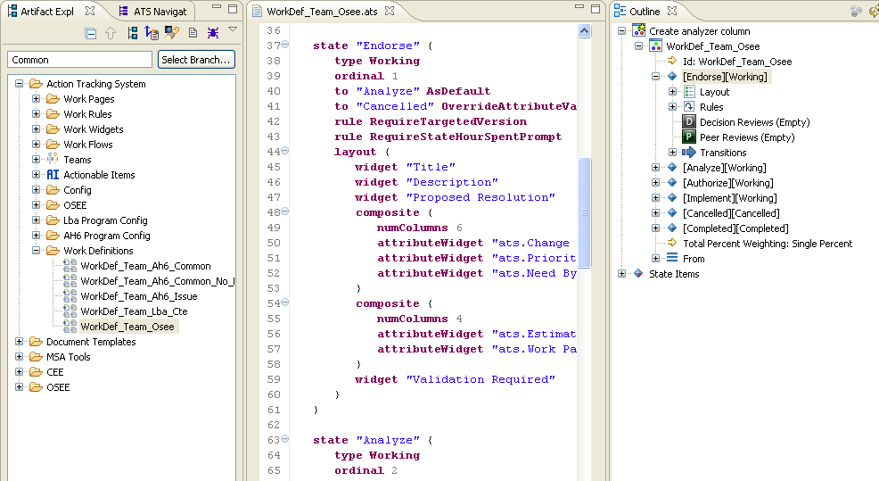
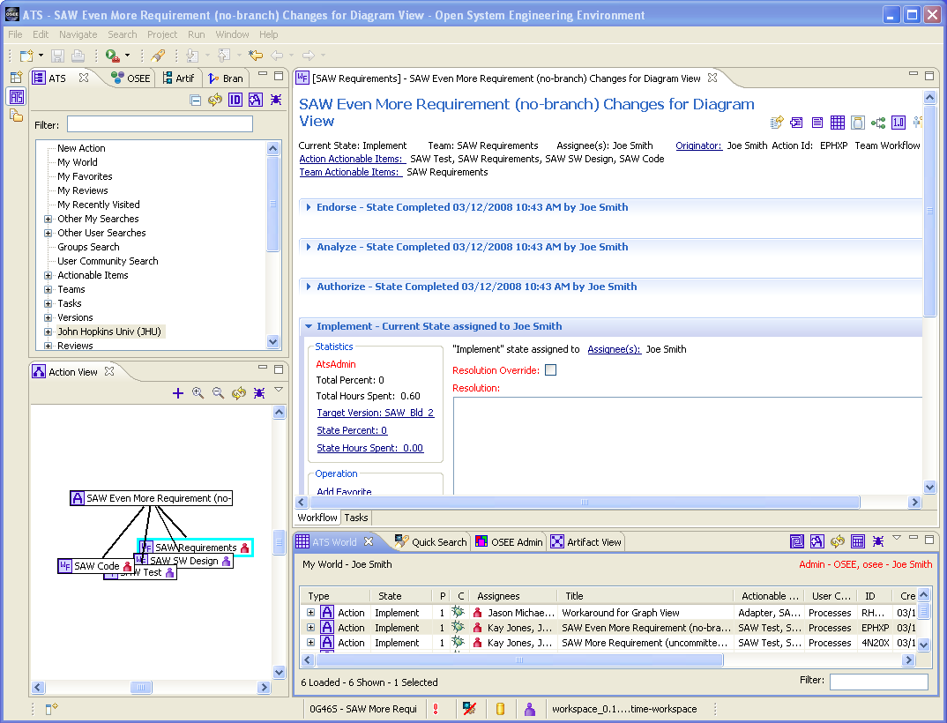
Integrated Process and Workflow
Integrated processes and workflows in OSEE allow engineers to focus more on engineering and less on process training and manual metrics reporting.
Work Definitions model the team's workflow and actively guide them through the work to be completed.
Work Definitions are user-defined and consist of state machines with their own widgets, rules, and routing.
Each state can be assigned, statused, and transitioned.
Copyright © 2014 Boeing. Made available under the Eclipse Public License.

Slide 13
Safety Standards for Safety Critical systems
IEC 61508 Safety life cycle
Series of phases from initiation and specifications of safety requirements, covering design and development of safety features in a safety-critical system, and ending in decommissioning of that system
RTCA/DO-254 Design Assurance Guidance for Airborne Electronic hardware is a document providing guidance for the development of airborne electronic hardware
DO-178B
Software Considerations in Airborne Systems and Equipment Certification is a document dealing with the safety of software used in certain airborne systems
ISO 26262
Functional Safety standard, titled "Road vehicles – Functional safety".
Functional safety features form an integral part of each product development phase, ranging from the specification > design > implementation > integration > >verification> validation> production release
RBEI | 15/01/2014 | © Robert Bosch Engineering and Business Solutions Limited 2013. All rights reserved, also regarding any disposal, exploitation, reproduction, editing, distribution, as well as in the event of applications for industrial property rights.

Slide 14
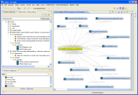
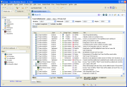



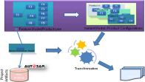
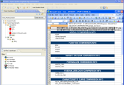

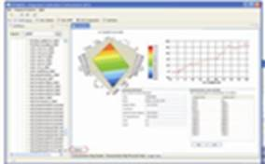
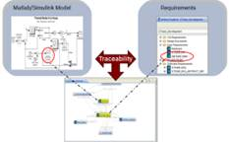


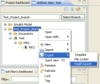

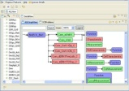
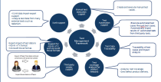

ALM – Application Life Cycle Management
Requirements Management
An integrated solution that provides seamless workflow from requirements to release
Requirements
Project Mgmt
Project Management
Design
Variant Management
Calibration Workflow
Model Based
Development
Feature / Product Line
Calibration
Data Manager
Document Mgmt
Traceability reports
Impact Analysis
Model Traceability
Calib Data Manager
Software Sharing Support
Partner Integration
Impact Analysis
Verification & Validation
Dependency Mgmt
Software Sharing
Automotive Stds Editors
Automotive Standards Editors
Test Mgmt
Continuous
Integration
Build Mgmt
RBEI | 15/01/2014 | © Robert Bosch Engineering and Business Solutions Limited 2013. All rights reserved, also regarding any disposal, exploitation, reproduction, editing, distribution, as well as in the event of applications for industrial property rights.

Slide 15
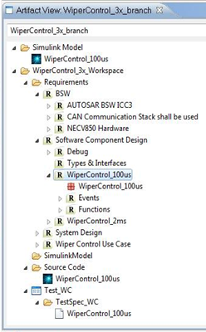
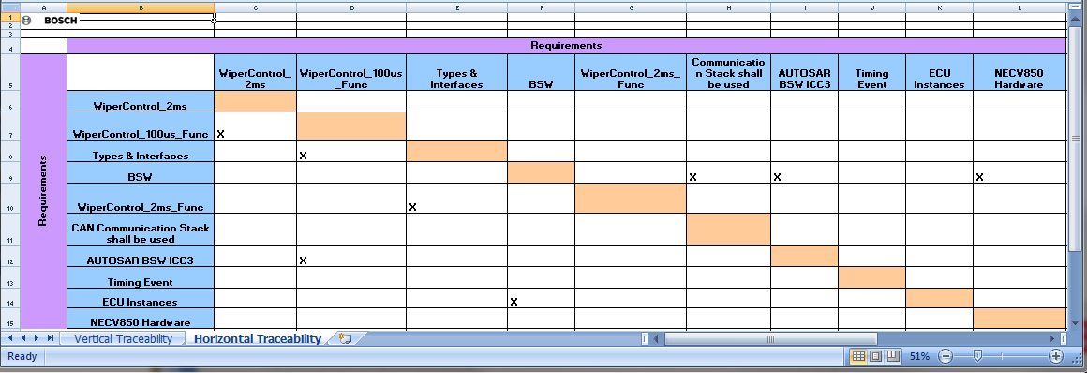
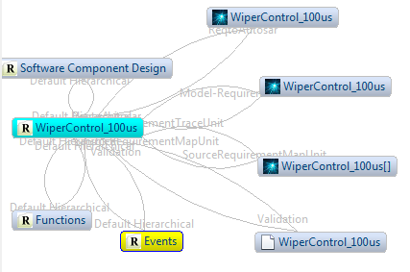
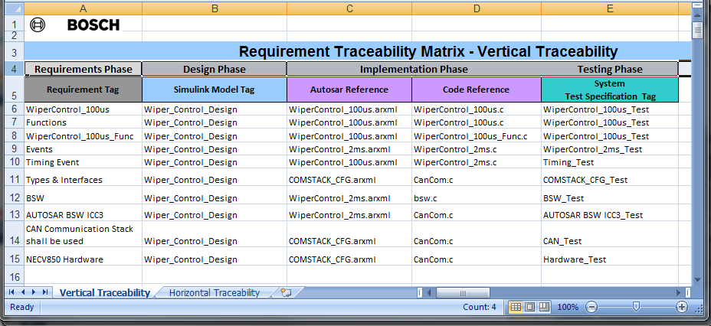
Traceability reports – Horizontal & Vertical
Graphical Dependency view
Horizontal Traceability report
Simulink Model
Vertical Traceability report
linked
Requirement
Implementation
Source Code
Test case
RBEI | 15/01/2014 | © Robert Bosch Engineering and Business Solutions Limited 2013. All rights reserved, also regarding any disposal, exploitation, reproduction, editing, distribution, as well as in the event of applications for industrial property rights.

Slide 16
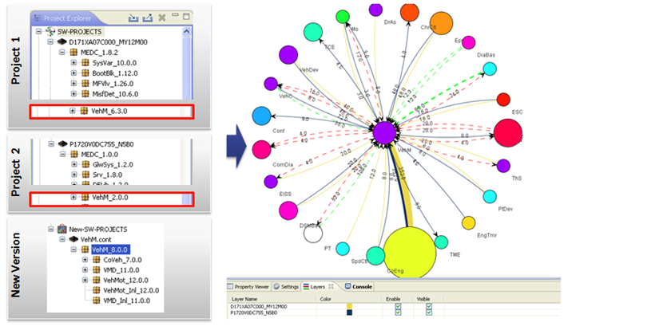
Impact Analysis – Graphical viewer
This graph indicates
“dependency conflicts” that
arises due to the change
Proj-an_1.0.1
Simn_1.8.2 billmn_1.12.0 mfbnver_1.3.4 msddat_10.6.2
Proj-Pf_1.0.3
Govn_1.8.2 rim-pin_1.12.0 servcon_1.3.4
This color indicate
Important information like
“team to contact” to solve
The issue
New-Proj-Sr_2.0.3
Turbo-vn_1.8.2 rperv-pin_1.12.0 conserv_1.3.4 vermfb_1.3.4 datmsr_10.6.2
Different project are
Indicated as layers in the graph
RBEI | 15/01/2014 | © Robert Bosch Engineering and Business Solutions Limited 2013. All rights reserved, also regarding any disposal, exploitation, reproduction, editing, distribution, as well as in the event of applications for industrial property rights.

Slide 17
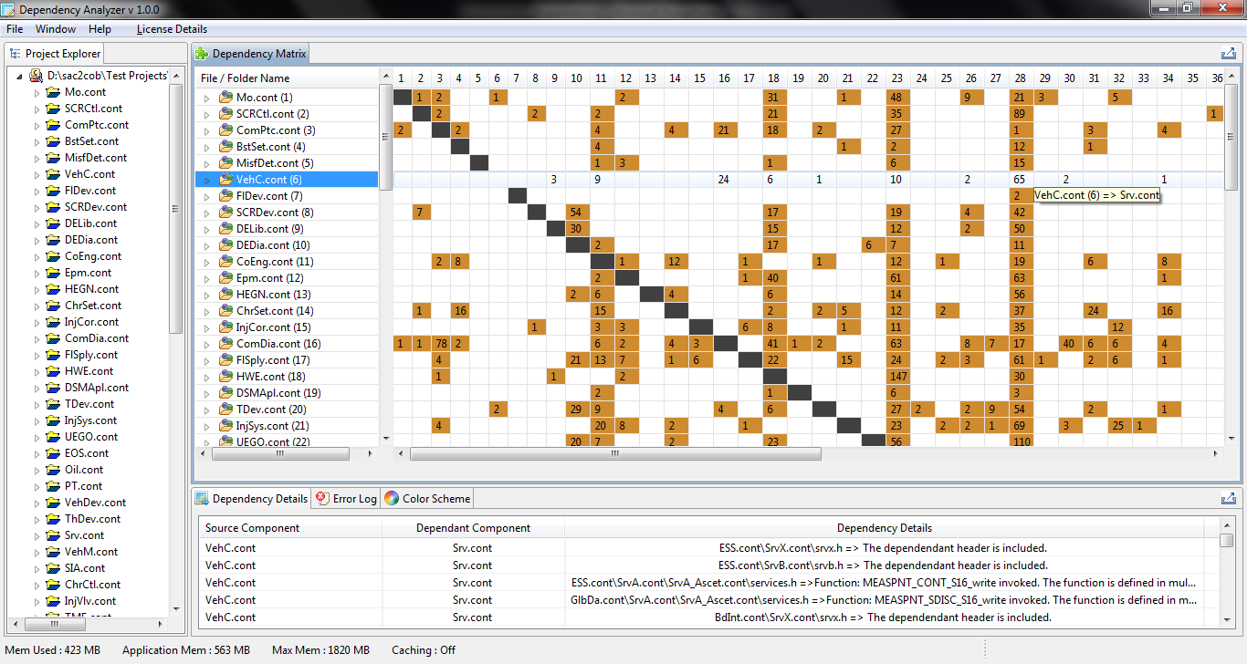
Impact Analysis – Matrix report
arcentc bemfultr
segmtri referenc
Intlfrs
omtcom lengme ortlongr Tlmunit Ctlru directLr
hiltep
fulltre
sysl (1)
repmg (2)
scertn.cert (3)
calibn (4)
portnl (5)
VehC.cont (6)
asicrd (7)
pincd (8)
labeln.impl (9)
sysrp (10)
repn1 (11)
scert.cont (12)
calibn (13)
portnl.hdr (14)
pingn (15)
asicrd (16)
pincd (17)
labeln.cont (18)
portnl (19)
pingn (20)
asicrd.serv (21)
pincd (22)
arcentc bemfultr
segmtri referenc
Intlfrs
omtcom lengme ortlongr Tlmunit Ctlru directLr
hiltep
fulltre
arcentc bemfultr
Segmtri refpin fincalc
RBEI | 15/01/2014 | © Robert Bosch Engineering and Business Solutions Limited 2013. All rights reserved, also regarding any disposal, exploitation, reproduction, editing, distribution, as well as in the event of applications for industrial property rights.

Slide 18
Impact Analysis – Architecture
UI
DSM Matrix Visualization (SWT)
Graphs (JUNG)
Source Project
Model
Dependency Detail Model
C / C++ wrapper model
ECLIPSE CDT
Eclipse Platform
RBEI | 15/01/2014 | © Robert Bosch Engineering and Business Solutions Limited 2013. All rights reserved, also regarding any disposal, exploitation, reproduction, editing, distribution, as well as in the event of applications for industrial property rights.

Slide 19
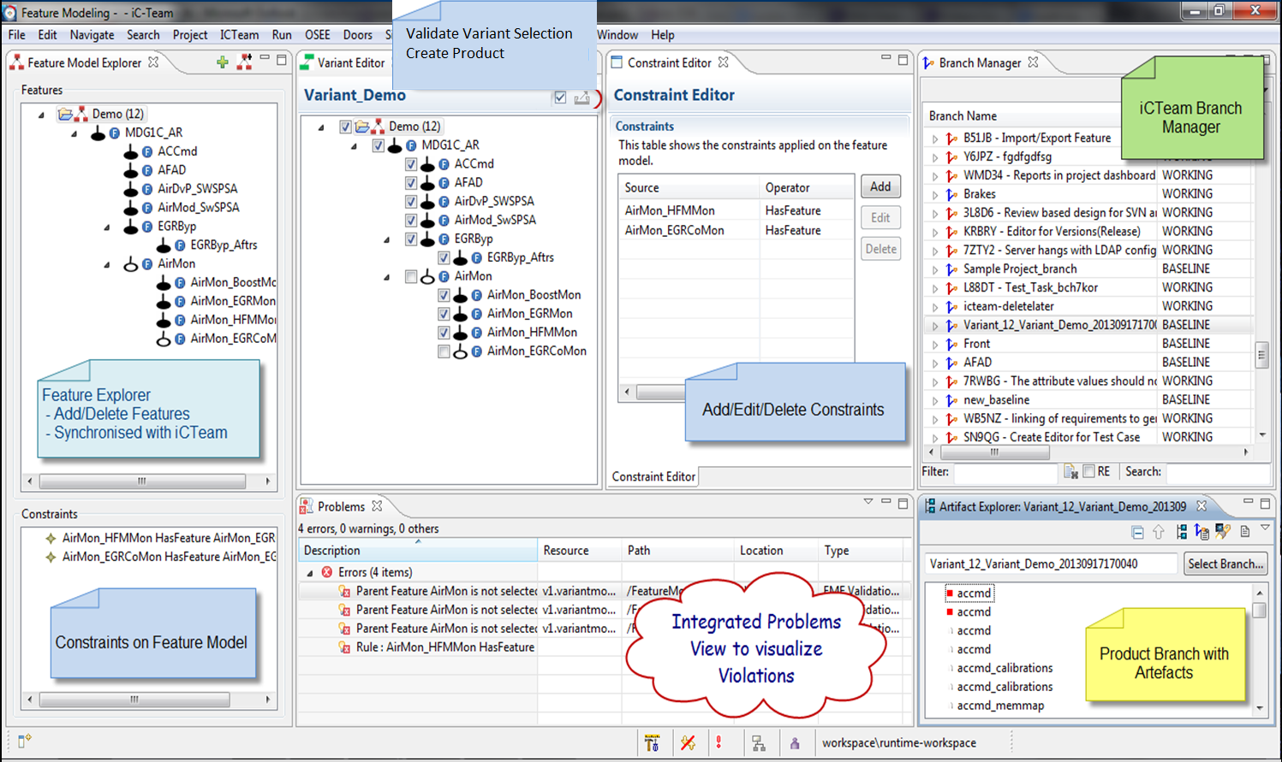
Product Line Engineering
RBEI | 15/01/2014 | © Robert Bosch Engineering and Business Solutions Limited 2013. All rights reserved, also regarding any disposal, exploitation, reproduction, editing, distribution, as well as in the event of applications for industrial property rights.

Slide 20
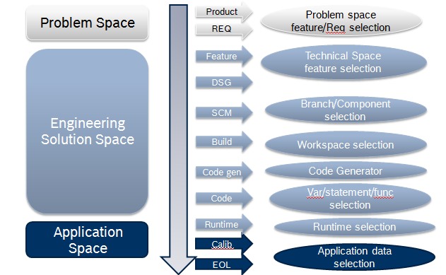
Product Line Engineering - Architecture
System Constant Editor
Feature constraint Editor
Feature Validator
Extended Feature Model editor
Variant Release Manager
EMF Feature Model
PLE Branch
Manager
OSEE Application Framework
Feature Model
Features, Constraints
Variant Model
Feature Selections, Variant Values
Evaluation Model
Concrete Feature Model
Verification Model
Verified Variants
Define PL
0…x Variants
Evaluate, verify
RBEI | 15/01/2014 | © Robert Bosch Engineering and Business Solutions Limited 2013. All rights reserved, also regarding any disposal, exploitation, reproduction, editing, distribution, as well as in the event of applications for industrial property rights.

Slide 21



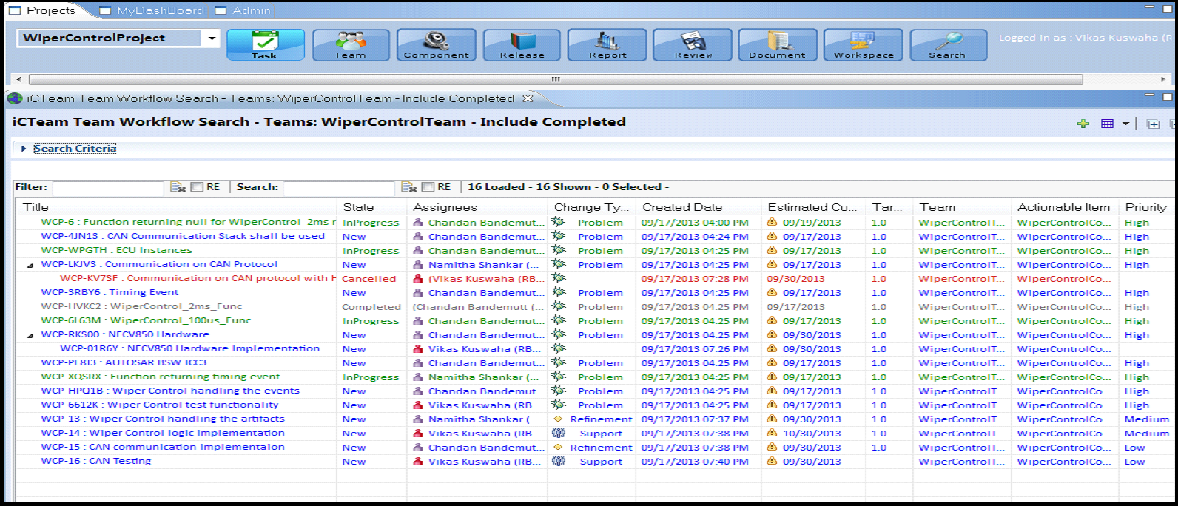

Integrating the development partners
OEM
OEM Project Management
Requirements
Acceptance Testing
REQUIREMENTS - Define
- Review
ACCEPTANCE TEST
- Test Cases - Results
Supplier - 1
Supplier - 2
SUPPLIER 1
SUPPLIER 1
Supplier 1 Tasks
Supplier 2 Tasks
Software Sharing
Calibration WorkFlow
SOFTWARE SHARING
- Models
- Object code
CALIBRATION WORKFLOW
- Work Packages
- Datasets versioning - Tracking
Shared Build
Calib Data Manager
INTEGRATION & SHARED BUILD
- Build tools of Suppliers
- Object Code
VERSION MANAGEMENT
- Object codes - Datasets
Common Workflow and Tool chain used by both OEM and Suppliers for joint development
RBEI | 15/01/2014 | © Robert Bosch Engineering and Business Solutions Limited 2013. All rights reserved, also regarding any disposal, exploitation, reproduction, editing, distribution, as well as in the event of applications for industrial property rights.

Slide 22
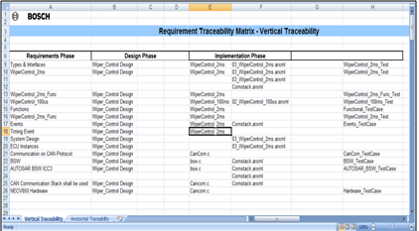
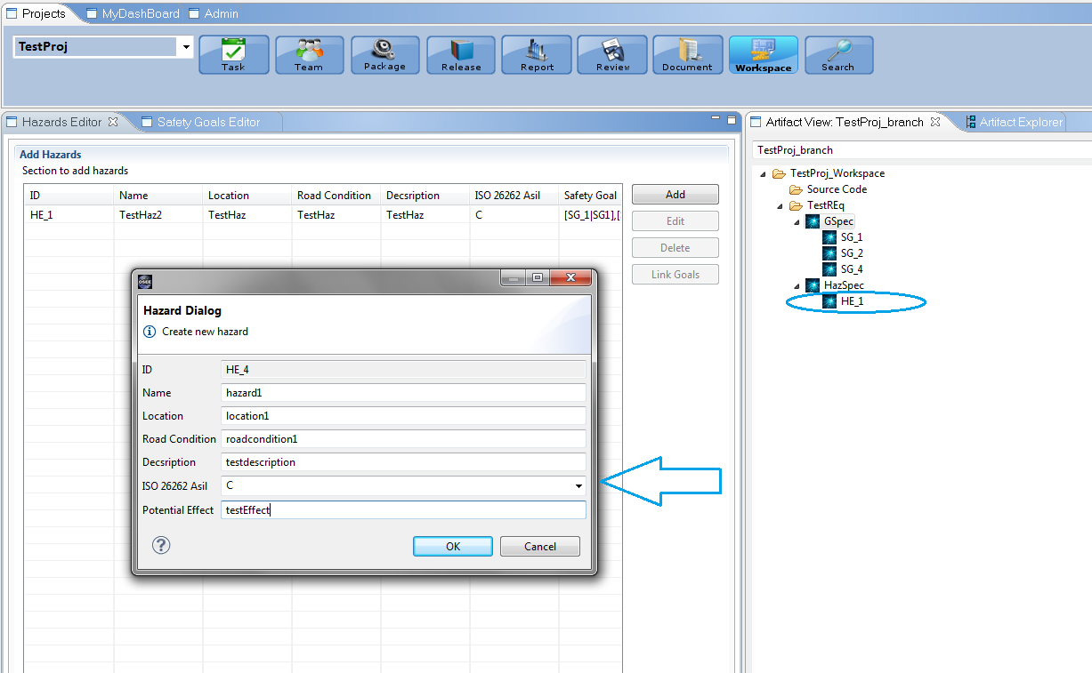
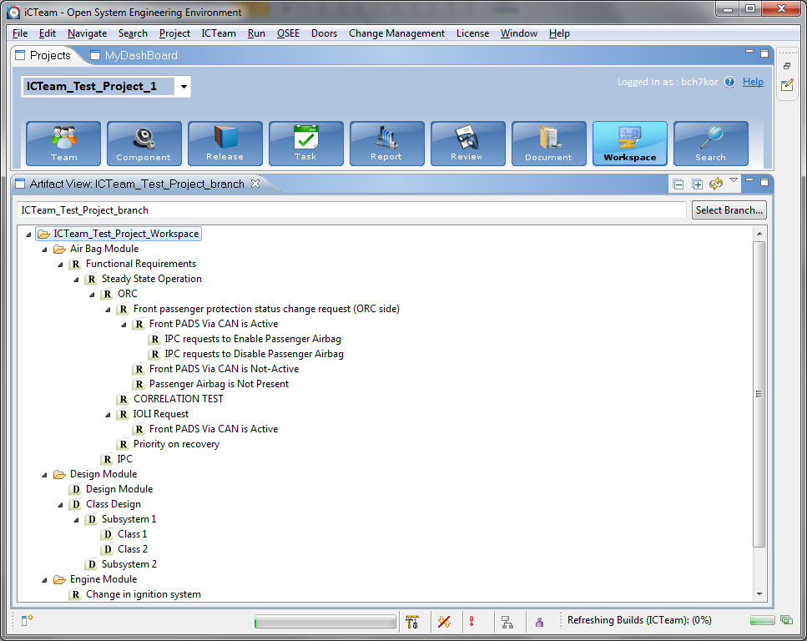
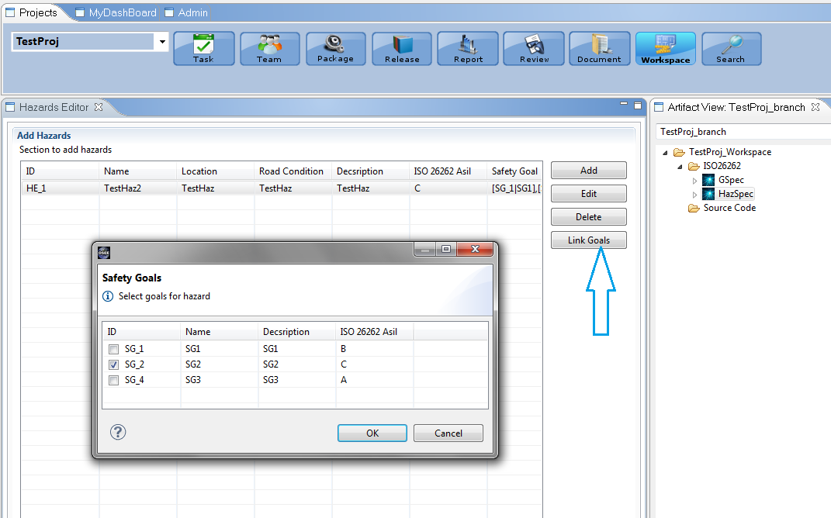
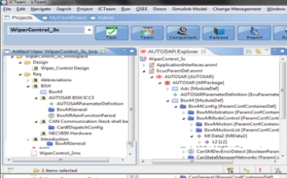
Risk & Hazard assessment
Safety System Concept & Safety Goals
Safety System Functional Requirements
Safety System Technical requirements & Implementation
Safety System Validation & Improvement
Safety Life Cycle
RBEI | 15/01/2014 | © Robert Bosch Engineering and Business Solutions Limited 2013. All rights reserved, also regarding any disposal, exploitation, reproduction, editing, distribution, as well as in the event of applications for industrial property rights.

Slide 23
System Engineering
Requirements
Design
Validation
Production
Hardware Req
Hardware design
Hardware simulation
Hardware test plan
Hardware defects
Hardware changes
PLM
Safety Requirements to HW and SW requirements
Integrated Bill of Material
Integration
Integration
Release
Safety Goals
Safety Concept
ISO 26262 Reports
Safety Req
Hazard Identification
Traceability
ISO 26262
Software Req
Software design
Software unit test
Software test plan
Defects
Software changes
ALM
ALM-PLM
Integration
ALM-PLM
Integration
ALM-PLM
Integration
ALM
PLM
RBEI | 15/01/2014 | © Robert Bosch Engineering and Business Solutions Limited 2013. All rights reserved, also regarding any disposal, exploitation, reproduction, editing, distribution, as well as in the event of applications for industrial property rights.

Slide 24
Thank You Demo
RBEI | 15/01/2014 | © Robert Bosch Engineering and Business Solutions Limited 2013. All rights reserved, also regarding any disposal, exploitation, reproduction, editing, distribution, as well as in the event of applications for industrial property rights.

Slide 25


Evaluate This Session
1
Sign-in: www.eclipsecon.org
2
Select session from schedule
3
Evaluate:

