Slide 1
A hybrid architecture for interactive verifiable computation
Victor Vu, Srinath Setty,
Andrew J. Blumberg, and Michael Walfish
The University of Texas at Austin

Slide 2
Problem statement: verifiable computation
“f”, x
client
server
y, aux.
check whether y = f(x), without computing f(x)
The motivation is 3rd party computing: cloud, volunteers, etc.
This should be:
1. Unconditional, meaning no assumptions about the server
2. General-purpose, meaning arbitrary f
3. Practical, or at least conceivably practical soon

Slide 3
Complexity theory and cryptography offer solutions.
[bcc88, gmr89, almss92, as92, Kilian92]
“f”, x
client
y’
server
y
queries
...
responses
reject
accept
But the costs are ludicrous
Hundreds of trillions of CPU years to verify multiplication of 500×500 matrices
This does not save work for the client

Slide 4
Built systems have brought the theory closer to practice.
Zaatar: a PCP-based efficient argument protocol
Reduces costs by >10²⁰
General-purpose! But requires crypto, setup cost.
Setty et al. hotos11
ndss12
security12
eurosys13
CMT: an interactive proof system
Drastically cuts costs relative to its base
Limited expressiveness. But no crypto, no setup costs!
Cormode et al. itcs12
Thaler et al. hotcloud12
Pinocchio: an argument protocol
Non-interactive! See next talk.
Parno et al. oakland13

Slide 5
Can we get the low (non-cryptographic) verification costs of CMT with the general-purposeness of Zaatar?
Contributions of Allspice:
Extension of CMT to wider class of computations, reducing verification costs by 10-100× for these computations
Static analysis to compile high-level computations to the best protocol for the computation
Experiments and analysis to compare the protocols

Slide 6
The rest of this talk:
Background: CMT and Zaatar
CMT, improved
Design of Allspice:
foo.sfdl
compiler
foo.c
Zaatar
Experimental evaluation

Slide 7
CMT [cmt itcs12] refines the “Muggles” interactive proof [gkr stoc08]
client
server
“f”, x
y
y₀
y₁
…
…
…
…
…
…
x₀
x₁
x_{n}
accept/reject
+ No cryptography! Promises efficiency.
– Computations must be circuits (and highly regular).

Slide 8
×
+
×
+
×
+
×
Unfortunately, the arithmetic circuit model of computation does not really handle != tests, comparisons, fractions, etc.

Slide 9
Zaatar refines an efficient argument protocol of Ishai et al. [iko ccc07]
client
server
“f”, x⁽¹⁾, x⁽²⁾, …
y⁽¹⁾, y⁽²⁾, …
proof vectors:
w⁽¹⁾, w⁽²⁾, …

Slide 10
A proof vector is equivalent to an encoded execution trace, in the “constraint” model of computation.
f ( )
proof vector
219
2047
1013
1 = (Z₁ − Z₂ ) • M
0 = Z₃ − Z₄
0 = Z₃Z₅ + Z₆ − 5
Z₁=23
Z₂=187
….
0
1
23
187
computation represented as constraints over a finite field (F_{p})
solution to constraints
805
encoded, using
QAPs [ggpr eurocrypt13].

Slide 11
Zaatar refines an efficient argument protocol of Ishai et al. [iko ccc07]
client
server
“f”, x⁽¹⁾, x⁽²⁾, …
y⁽¹⁾, y⁽²⁾, …
proof vectors:
one set of query vectors
w⁽¹⁾, w⁽²⁾, …
response(query):
return <query, w^{(j)}>
checks
responses (scalars)
accept/reject
– There are setup costs, so batching is required
– There are crypto costs, so batch size is high
+ The computational model is general-purpose

Slide 12
Equivalence between a computation and a set of constraints:
Input/output pair correct ⟺ constraints satisfiable.
Example:
Dec-by-three(X)
Y = X − 3
0 = Z − X,
0 = Z – 3 – Y
Suppose X = 7.
if Y = 4 …
if Y = 5 …
0 = Z – 7
0 = Z – 3 – 4
0 = Z – 7
0 = Z – 3 – 5
… there is a solution
… there is no solution

Slide 13
circuit gates
same
0 = (Z₁ – Z₂ ) • M – Z₃,
0 = (1 – Z₃) • (Z₁ – Z₂ )
Z₃ ← (Z₁ != Z₂)
“Z₁ < Z₂”
log |F_{p}| constraints
loops
unrolled
RAM access
???
Our compiler applies this transformation.
This work has been extended [Parno et al. oakland13].

Slide 14
CMT
– Limited expressiveness
+ No setup costs
+ No crypto
vs.
Zaatar
+ General-purpose
– Requires setup costs
– Requires crypto
CMT, improved
Observe: setup costs and hence batching are acceptable (batching fits data parallel cloud computations).
What we need: small batch sizes to break even.

Slide 15
Background: CMT and Zaatar
Design of Allspice
CMT, improved
foo.sfdl
compiler
foo.c
Zaatar
Experimental evaluation

Slide 16
×
+
Recall: CMT requires arithmetic circuits, which have limited expressiveness
×
+
×
+
×
0 = (Z₁ – Z₂ ) • M – Z₃,
0 = (1 – Z₃) • (Z₁ – Z₂ )
Recall:
Z₃ ← (Z₁ != Z₂)
x
z₁
y
Solution: circuits that take advice
z₂
z₃
check
advice
m
0

Slide 17
client
“f”, x
server
y, z_{advice}
y
0
…
x
z_{advice}
accept/reject
How do we ensure regularity?
Is this efficient?

Slide 18
(1) We give up on regularity by using batching.
client
“f”, x^{(j)}
server
y^{(j)}, z_{advice}
^{(j)}
…
…
(2) For efficiency, the advice must be small relative to the running time (sublinear number of != and < operations).

Slide 19
Zaatar
foo.c
compiler
CMT, improved
…
Our compiler is derived from Fairplay [mnps security04]; it turns the program into list of assignments (SSA).
We replaced the back-end (now it is constraints or circuits-with-advice) and front-end (now it is C, inspired by [Parno et al., oakland13]).
Protocol choice based on cost models, microbenchmarks, input size.

Slide 20
Background: CMT and Zaatar
Design of Allspice
CMT, improved
foo.sfdl
compiler
foo.c
Zaatar
Experimental evaluation

Slide 21
Benchmark computations:
Matrix multiplication
Polynomial evaluation
Root finding for polynomials
PAM clustering
Longest common subequence
Floyd-Warshall all-pairs shortest paths
Evaluation testbed:
It uses a cluster at Texas Advanced Computing Center (tacc)
Each machine runs Linux on an Intel Xeon 2.53 GHz with 48gb of ram.

Slide 22
When CMT-improved applies, what is the reduction in the break-even point?
computation costs
CPU time
verification costs
break-even
point
# instances
When does CMT-improved apply?
What are the servers’ costs?

Slide 23
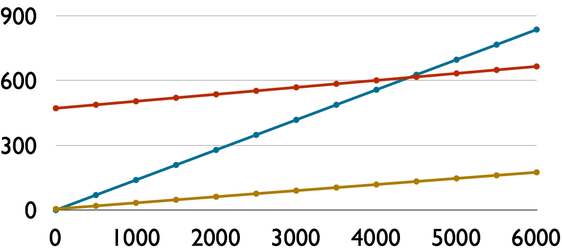
CMT-improved has very low break-even batch sizes for 128x128 matrix multiplication.
local
Zaatar (slope = 32 ms/comp.)
running time (seconds)
CMT-improved (slope = 28 ms/comp.)
batch size
break-even batch size
under CMT-improved
break-even batch size
under Zaatar

Slide 24
When CMT-improved is applicable, it has low batch sizes.
 | polynomial evaluation (m=256) |  |  | root finding by bisection (m=256, L=8)
 | batch size | client’s work |  | batch size | client’s work
Zaatar | 280 | 1.3 min |  | 210 | 2.7 min
CMT-improved | 7 | 2 s |  | 15 | 11 s
But, of our benchmarks, CMT-improved does not apply to:
PAM clustering
Longest common subsequence
Floyd-Warshall

Slide 25
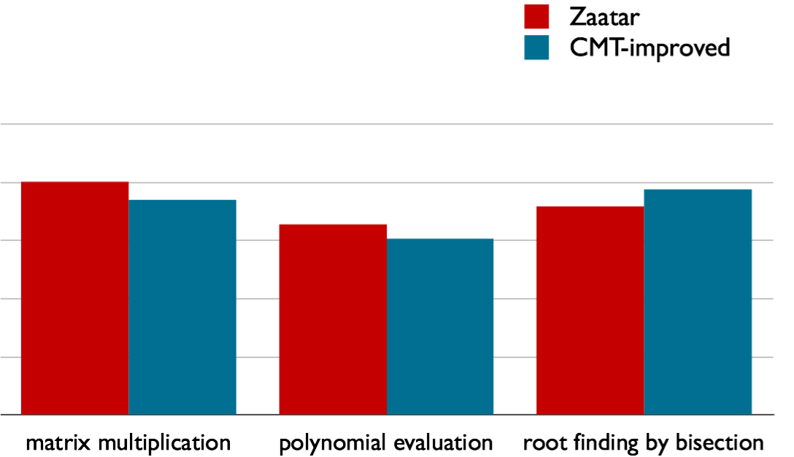
The servers of Zaatar and CMT-improved have similar costs.
10⁴
17.1 min
8.4 min
12.7 min
6.5 min
3.2 min
1.8 min
10²
running time (seconds)
10⁰
(m=128)
(m=512)
(m=256,L=8)

Slide 26
Related work, limitations, summary, and conclusion

Slide 27
We describe the landscape in terms of our three goals.
Gives up being unconditional or general-purpose:
Replication [Castro & Liskov TOCS02], trusted hardware [Chiesa & Tromer ICS10, Sadeghi et al. TRUST10], auditing [Haeberlen et al. SOSP07, Monrose et al. NDSS99]
Special-purpose [Freivalds MFCS79, Golle & Mironov RSA01, Sion VLDB05, Benabbas et al. CRYPTO11, Boneh & Freeman EUROCRYPT11]
Unconditional and general-purpose but not aimed toward practice:
Use fully homomorphic encryption [Gennaro et al., Chung et al. CRYPTO10]
Proof-based verifiable computation [GMR85, Ben-Or et al. STOC88, BFLS91, Kilian STOC92, ALMSS92, AS92, GKR STOC08]
*[Ben-Sasson et al. ITCS13, STOC13, CRYPTO13, Bitansky et al. TCC13]

Slide 28
Experimental results are now available from three projects
Pepper, Ginger, Zaatar [hotos11, ndss12, security12, eurosys13]
CMT [cmt itcs12, Thaler et al. hotcloud12]
Pinocchio [ggpr eurocrypt13, Parno et al. oakland13]
 | Zaatar | Pinocchio
Client setup costs | x | ~2-4 x
Client per-instance costs | c | ~8-12 c
Server costs | x | ~2-4 x
Setup amortizes over | batch | all instances of f()
Who can do setup? | client | anyone
Non-interactive | No | Yes
Zero-knowledge | No | Yes
Public verifiability | No | Yes

Slide 29
Limitations:
The computational model is hermetic.
Setup costs are not ideal (though tolerable).
The server’s burden is too high, still.

Slide 30
Summary and conclusion
Allspice’s performance and applicability is the best in the literature.
Improves and broadens CMT, thereby slashing verification costs compared to the cryptographic protocols.
Handles general-purpose computations by failing over to Zaatar when CMT-improved does not apply.
Future work: improve computational model, integrate with storage, reduce costs for the server, …
We predict that proof-based verifiable computation will ultimately be a key tool in real systems.

