Slide 1
Making verifiable computation a systems problem
Michael Walfish
The University of Texas at Austin

Slide 2
From a systems perspective, it is an exciting time for this area!
When we started …
… there were no implementations
… my colleagues thought I was a lunatic
Today …
… there is a rich design space
… the work can be called “systems” with a straight face

Slide 3
A key trade-off is performance versus expressiveness.
 |  |  | applicable computations
 | setup costs |  | “regular” | straightline | pure, no RAM | stateful, RAM
none (w/ fast worker) |  |  | Thaler [crypto13]
none |  |  | CMT, TRMP [itcs,Hotcloud12]
low |  |  |  | Allspice [Oakland13]
medium |  |  | Pepper [ndss12] | Ginger [Security12] | Zaatar [Eurosys13] | Pantry [sosp13]
high |  |  |  |  | Pinocchio [Oakland13] | Pantry [sosp13]
better
(1)
lower cost,
less crypto
more expressive
(2)
better crypto properties:
ZK, non-interactive, etc.
ship with compilers
(Includes only implemented systems.)

Slide 4
We investigate:
What are the verifiers’ variable (verification, per-instance) costs, and how do they compare to native execution?
What are the verifiers’ fixed (per-computation or per-batch setup) costs, and how do they amortize?
What are the workers’ overheads?

Slide 5
Experimental setup and ground rules
A system is included iff it has published experimental results.
Data are from our re-implementations and match or exceed published results.
All experiments are run on the same machines (2.7Ghz, 32GB RAM). Average 3 runs (experimental variation is minor).
For a few systems, we extrapolate from detailed microbenchmarks
Measured systems:
General-purpose: IKO, Pepper, Ginger, Zaatar, Pinocchio
Special-purpose: CMT, Pepper-tailored, Ginger-tailored, Allspice
Benchmarks: 150×150 matrix multiplication and clustering algorithm (others in our papers)

Slide 6
Pinocchio
Pepper, Ginger, Zaatar
setup costs are per-computation
setup costs are per-batch
V
F, EK_{F}
W
V
W
F, x⁽¹⁾
y⁽¹⁾
x⁽¹⁾
x⁽²⁾
y⁽¹⁾
y⁽²⁾
x⁽²⁾
. . .
y⁽²⁾
x^{(B)}
y^{(B)}
. . .
q
x^{(B)}
y^{(B)}

Slide 7
Experimental setup and ground rules
A system is included iff it has published experimental results.
Data are from our re-implementations and match or exceed published results.
All experiments are run on the same machines (2.7Ghz, 32GB RAM). Average 3 runs (experimental variation is minor).
For a few systems, we extrapolate from detailed microbenchmarks
Measured systems:
General-purpose: IKO, Pepper, Ginger, Zaatar, Pinocchio
Special-purpose: CMT, Pepper-tailored, Ginger-tailored, Allspice
Benchmarks: 150×150 matrix multiplication and clustering algorithm (others in our papers)

Slide 8
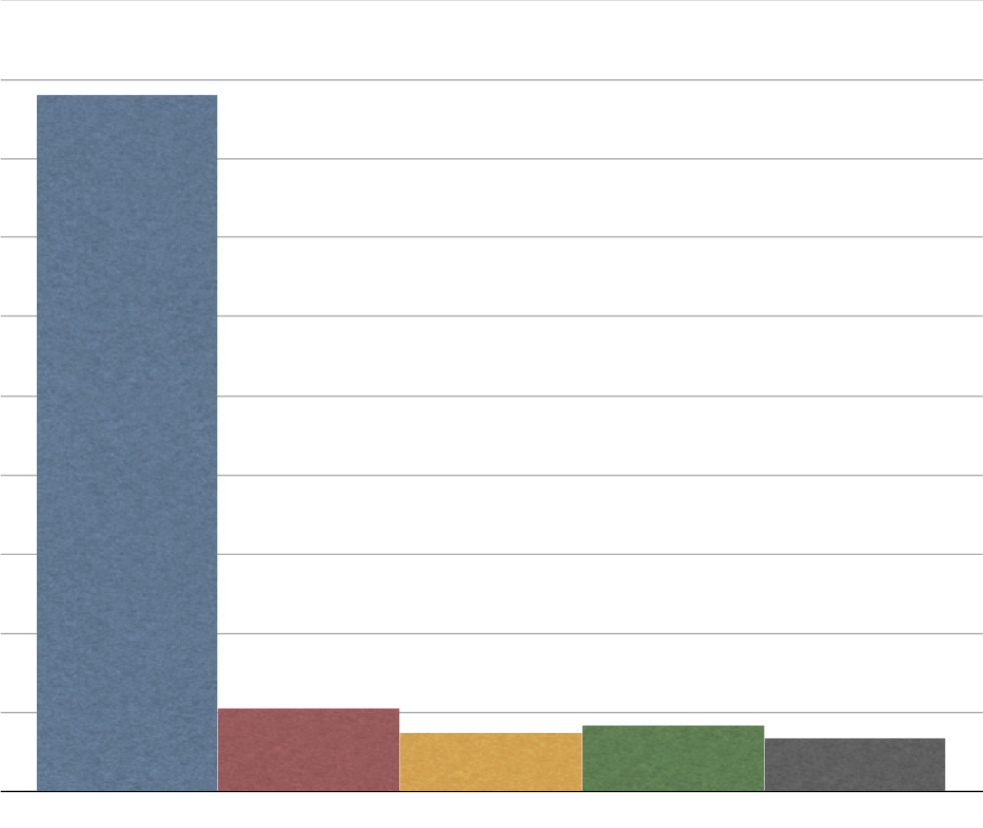
Verification cost sometimes beats (unoptimized) native execution.
10²⁶
Ishai et al. (PCP-based efficient argument)
10²³
10²⁰
10¹⁷
150×150 matrix multiplication
verification cost
(ms of CPU time)
10¹⁴
10¹¹
10⁸
50 ms
10⁵
Pepper
Ginger
Zaatar
Pinocchio
10²
0
5 ms

Slide 9
Some of the general-purpose protocols have reasonable cross-over points.
1.6 days
instances of 150x150 matrix multiplication

Slide 10
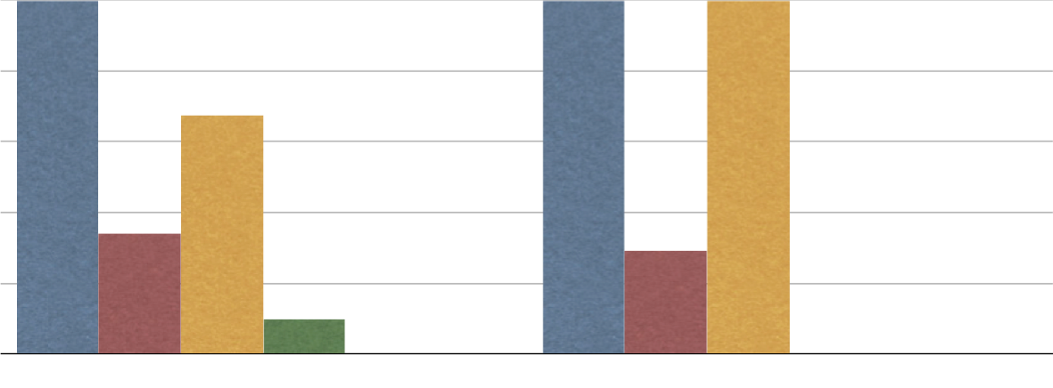
The cross-over points can sometimes improve with special-purpose protocols.
4.5M
1.2B
450K
60K
50.5K
45K
cross-over point
30K
25.5K
22K
15K
7.4K
N/A
7
1
Ginger
Zaatar
Allspice
CMT
Ginger
Zaatar
Allspice
CMT
Pinocchio
Pinocchio
Ginger-tailored
Ginger-tailored
matrix multiplication (m=150)
PAM clustering (m=20, d=128)

Slide 11
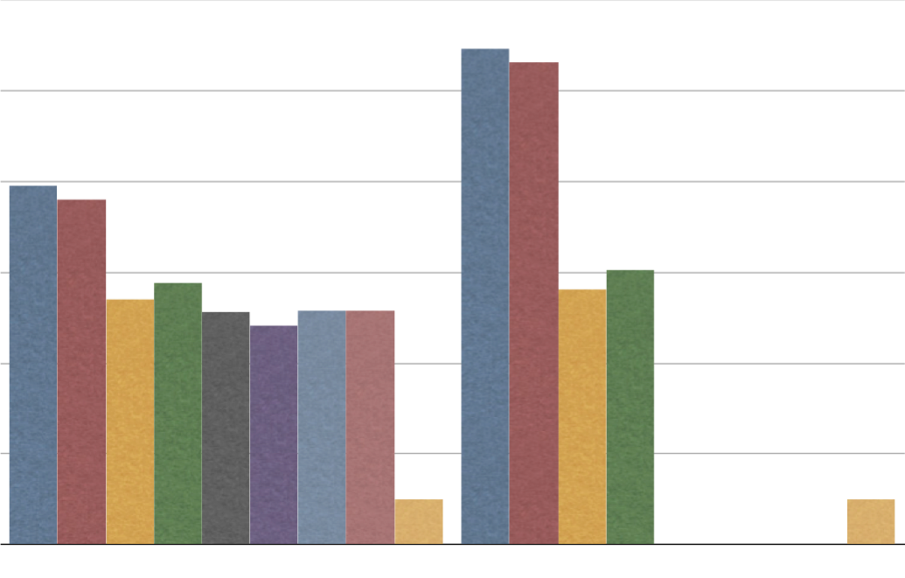
The worker’s costs are pretty much preposterous.
10¹¹
10⁹
10⁷
10⁵
worker’s cost
normalized to native C
10³
10¹
N/A
0
Pepper
Ginger
Zaatar
CMT
Pepper
Ginger
Zaatar
CMT
Allspice
Allspice
Pinocchio
native C
Pinocchio
native C
Pepper-tailored
Ginger-tailored
Pepper-tailored
Ginger-tailored
matrix multiplication (m=150)
PAM clustering (m=20, d=128)

Slide 12
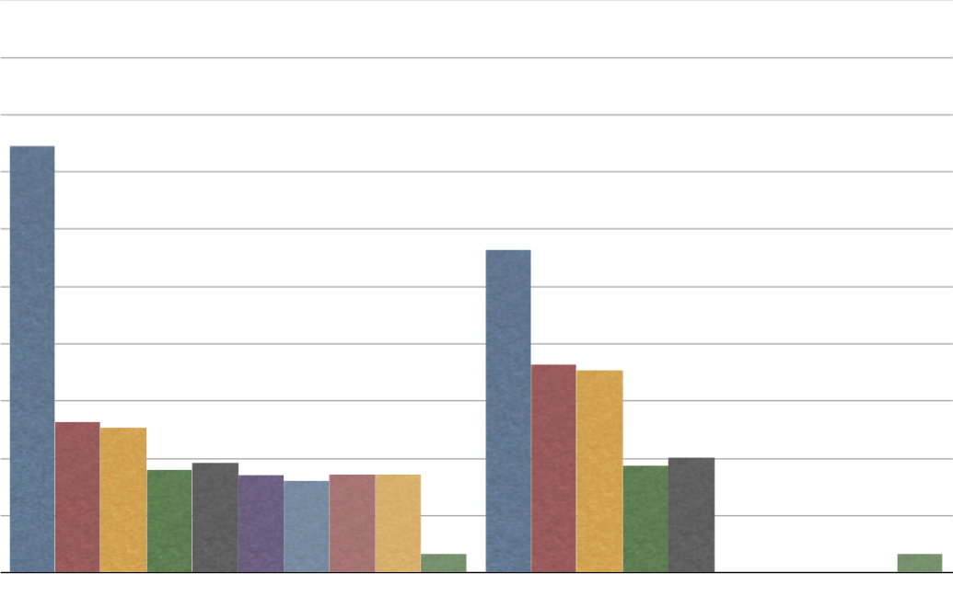
The worker’s costs are pretty much preposterous.
10²³
10²⁰
10¹⁷
10¹⁴
worker’s cost
normalized to native C
10¹¹
10⁸
10⁵
N/A
10²
0
IKO
Zaatar
CMT
IKO
CMT
Ginger
Pepper
Pepper
Ginger
Allspice
Zaatar
Allspice
Pinocchio
native C
Pinocchio
native C
Pepper-tailored
Pepper-tailored
Ginger-tailored
Ginger-tailored
matrix multiplication (m=150)
PAM clustering (m=20, d=128)

Slide 13
Summary of performance in this area
None of the systems is at true practicality
Worker’s costs still a disaster (though lots of progress)
Verifier gets close to practicality, with special-purposeness
Otherwise, there are setup costs that must be amortized
(We focused on CPU; network costs are similar.)

Slide 14
 |  |  | applicable computations
 | setup costs |  | “regular” | straightline | pure, no RAM | stateful, RAM
none (w/ fast worker) |  |  | Thaler [crypto13]
none |  |  | CMT [itcs12]
low |  |  |  | Allspice [Oakland13]
medium |  |  | Pepper [ndss12] | Ginger [Security12] | Zaatar [Eurosys13] | Pantry [sosp13]
high |  |  |  |  | Pinocchio [Oakland13] | Pantry [sosp13]
better
(1)
(2)

Slide 15
Pantry [sosp13] creates verifiability for real-world computations
before:
after:
query, digest
V
W
DB
F, x
result
V
W
y
V supplies all inputs
F is pure (no side effects)
All outputs are shipped back
F, x
V
W
RAM
y
map(), reduce(), input filenames
V
W_{i}
output filenames

Slide 16
Recall the compiler pipeline.
(The last step differs among Ginger, Zaatar, Pinocchio.)
QAP
V
F(){
[subset of C]
}
constraints on circuit execution
arith. circuit
W
F, x
V
y
W

Slide 17
Programs compile to constraints on circuit execution.
dec-by-three.c
f(X) {
Y = X − 3;
return Y;
}
compiler
0 = Z − X,
0 = Z – 3 – Y
Input/output pair correct ⟺ constraints satisfiable.
As an example, suppose X = 7.
if Y = 4 …
if Y = 5 …
0 = Z – 7
0 = Z – 3 – 4
0 = Z – 7
0 = Z – 3 – 5
… there is a solution
… there is no solution

Slide 18
The pipeline decomposes into two phases.
0 = X + Z₁
0 = Y + Z₂
0 = Z₁Z₃ − Z₂
….
QAP
V
F(){
[subset of C]
}
arith. circuit
W
constraints (E)
“If E(X=x,Y=y) is satisfiable, computation is done right.”
=
“E(X=x,Y=y) has a
satisfying assignment”
F, x
V
y
W
Design question: what can we put in the constraints so that satisfiability implies correct storage interaction?

Slide 19
How can we represent storage operations? (1)
Representing “load(addr)” explicitly would be horrifically expensive.
Straw man: variables M₀, …, M_{size} contain state of memory.
B = M₀ + (A − 0) • F₀
B = M₁ + (A − 1) • F₁
B = M₂ + (A − 2) • F₂
…
B = M_{size} + (A − size) • F_{size}
B = load(A)
Requires two variables for every possible memory address!

Slide 20
How can we represent storage operations? (2)
Consider self-certifying blocks:
digest
?
cli.
serv.
hash(block) = digest
block
They bind references to values
They provide a substrate for verifiable RAM, file systems, …
[Merkle crypto87, Fu et al. osdi00, Mazières & Shasha podc02, Li et al. osdi04]
Key idea: encode the hash checks in constraints
This can be done (reasonably) efficiently
Folklore: “this should be doable.” (Pantry’s contribution: “it is.”)

Slide 21
We augment the subset of C with the semantics of untrusted storage
block = vget(digest): retrieves block that must hash to digest
hash(block) = vput(block): stores block; names it with its hash
add_indirect(digest d, value x) {
value z = vget(d);
y = z + x;
return y;
}
d = hash(Z)
y = Z + x
Worker is obliged to supply the “correct” Z (meaning something that hashes to d).

Slide 22
Putting the pieces together
C with RAM,
search trees
[Merkle 87]
subset of C
+
{vput, vget}
QAP
V
circuit
W
map(), reduce()
constraints (E)
F, x
V
y
W
recall:
“I know a satisfying assignment to E(X=x,Y=y)”
=
checks-of-hashes pass ⟺ satisfying assignment identified
checks-of-hashes pass ⟺ storage interaction is correct
storage abstractions can be built from {vput(), vget()}

Slide 23
The verifier is assured that a MapReduce job was performed correctly—without ever touching the data.
map(), reduce(), in_digests
V
out_digests
M_{i}
R_{i}
The two phases are handled separately:
mappers
reducers
…
…
in = vget(in_digest);
out = map(in);
for r=1,…,R:
d[r] = vput(out[r])
for m=1,…,M:
in[m] = vget(e[m]);
out = reduce(in);
out_digest = vput(out);
in_digests
…
…
…

Slide 24
Example: for a DNA subsequence search, the verifier saves work, relative to performing the computation locally.
A mapper gets 1000 nucleotides and outputs matching locations
Vary mappers from 200 to 1200; reducers from 20 to 120

Slide 25
Pantry applies fairly widely
Our implemented applications include:
query, digest
V
W
DB
result
Verifiable queries in (highly restricted) subset of SQL
Privacy-preserving facial recognition
Our implementation works with Zaatar and Pinocchio

Slide 26
Major problems remain for this area
Setup costs are high (for the general-purpose systems)
Verification costs are high, relative to native execution
Evaluation baselines are highly optimistic
Example:100×100 matrix multiplication takes 2 ms on modern hardware; no VC system beats this.
Worker overhead is 1000×
The computational model is a toy
Loops are unrolled, memory operations are expensive

Slide 27
Summary and take-aways
A framework for organizing the research in this area is performance versus expressiveness.
Pantry extends verifiability to stateful computations, including MapReduce, DB queries, RAM, etc.
Major problems remain for all of the systems
Setup costs are high (for the general-purpose systems), and verification does not beat optimized native execution
Worker costs are too high, by many orders of magnitude
The computational model is a toy

