Slide 1
(Implementations of) verifiable computation and succinct arguments: survey and wishlist
Michael Walfish
NYU

Slide 2
“f”, x
client (verifier)
server (prover)
y, short proof
without executing f,
can check that: “y = f(x)”
more generally: “prover knows w s.t. y = f(x,w)”
gmr85
bcc88
Kilian92
Micali94
bg02
gos06
iko07
gkr08
ggp10
Groth10
Lipmaa12
ggpr12
bcct13
…
The motivation is 3rd party computing: cloud, etc.
Ideal requirements:
Efficiency (client CPU, communication, server CPU)
Privacy of w (desirable in some applications)
Practicality (as real people understand the term)

Slide 3
Good news:
sbw11
cmt12
smbw12
trmp12
svpbbw12
sbvbpw13
vsbw13
pghr13
Thaler13
bcgtv13
bfrsbw13
bfr13
dfkp13
bctv14a
bctv14b
bcggmtv14
fl14
kppsst14
fgv14
bbfr14
wsrhbw15
cfhkknpz15
ctv15
Running code; cost reductions of 10²⁰ vs. theory
Compilers from C to verifiable computations
Stateful computations; remote inputs, outputs
Concretely efficient verifiers
SOSP (!)
Bad news:
Small computations, extreme expense, etc.
Useful only for special-purpose applications

Slide 4
This talk
Summary of state of the art
(2) Reality check
(3) Next steps

Slide 5
Common framework in state of the art systems:
front-end
(program translator)
back-end
(probabilistic proof protocol)
main(){
...
}
verifier
central construction: QAPs [ggpr12]
x
y, π
C program
arithmetic circuit
(non-det. input)
prover
interactive argument [iko07]
non-interactive argument [Groth10, Lipmaa12, ggpr12]
interactive proof [gkr08]

Slide 6
Attempt 1: Use PCPs that are asymptotically short
[almss92, AS92]
[bghsv05, bghsv06, Dinur07, bs08, Meir12, bcgt13]
verifier
prover
...
...
...
accept/reject
“short” PCP
This does not meet the efficiency requirements (because |PCP| > running time of f).

Slide 7
Attempt 2: Use arguments or CS proofs
[Kilian92, Micali94]
verifier
prover
hash tree digest
...
accept/reject
“short” PCP
But the constants seem too high …

Slide 8
Attempt 3: Use long PCPs interactively
[iko07, smbw12, svpbbw12]
commit request
verifier
prover
commit response
L(•) = <•,v>
z ⊗ z
queries: q₁, q₂, q₃, …
...
v
accept/reject
Hadamard encoding of v
z
q₁•v q₂•v q₃•v
Achieves simplicity, with good constants …
… but pre-processing is required (because |q_{i}|=|v|)
… and prover’s work is quadratic; address that shortly

Slide 9
Attempt 4: Use long PCPs non-interactively
[bciop13]
verifier
prover
E(q₁), E(q₂), E(q₃)…
L(•) = <•,v>
z ⊗ z
...
v
accept/reject
Hadamard encoding of v
z
E(q₁•v) E(q₂•v) E(q₃•v)
Query process now happens “in the exponent”
… pre-processing still required (again because |q_{i}|=|v|)
… prover’s work still quadratic; addressing that soon

Slide 10
Recap
 | efficient (short) PCPs | arguments, CS proofs | arguments w/ preprocessing | SNARGs w/ preprocessing
who | almss92, as92, bgshv, Dinur, … | Kilian92, Micali94 | iko07, smbw12, svpbbw12 | ggpr12, bciop13, …
what | classical PCP | commit to PCP by hashing | commit to long PCP using linearity | encrypt queries to a long PCP
security | unconditional | CRHFs | linearly HE | knowledge-of-exponent
why/why not | not efficient for V | constants are unfavorable | simple | simple, non-interactive
(Thanks to Rafael Pass.)

Slide 11
Final attempt: apply linear query structure to GGPR’s QAPs
[Groth10, Lipmaa12, ggpr12]
prover
L(•) {
return <•,v>;
}
z ⊗ z
queries
h
v
z
z
Addresses the issue of quadratic costs.
PCP structure implicit in GGPR. Made explicit in [bciop13, sbvbbw13].

Slide 12
QAPs [ggpr12]
, x, y
D(t), P_{x,y}(t, Z)
[high-degree polynomials]
Z=z is satisfying assignment ⟺ ∃ H(t) such that D(t) • H(t)=P_{x,y}(t, z)
This can be checked probabilistically.
Choose random τ. Then check: D(τ) • H(τ) = P_{x,y}(τ, z)
?
P_{x,y}(τ,z) can be evaluated by querying M(•) = <•,z>
P_{x,y}(τ, z) = (<A(τ), z> + L₁)(<B(τ), z> + L₂) – (<C(τ), z> + L₃)

Slide 13
client
server
commit request
w
commit response
PCP verifier
w
q₁, q₂, …, q_{u}
queries
π(q₁), …, π(q_{u})
responses
(z, h)
linearity test
quad corr. test
circuit test
|w|=|Z|²
(z, z ⊗ z)
π(•)=<•,w>
|w|=|Z|+|C|
[ggpr Eurocrypt 2013]
new quad.test
Any computation has a linear PCP whose proof vector is (quasi)linear in the computation size.
Shows connection between PCPs, QAPs (Also shown by [bciop tcc13].)

Slide 14
“Zaatar”
[sbvbbw13]
“Pinocchio,” “libsnark”
[pghr13, bctv14a]
plaintext queries
queries in exponent
interactive argument
[iko07]
snarg, zk-snark with pre-processing
[Groth10, bcct12, ggpr12]
QAPs
pre-processing
avoidable in theory [bcct13, bctv14b, ctv15]
standard assumptions
amortize over batch
interactive
non-falsifiable assumptions
amortize indefinitely
non-interactive, ZK, …
All recent systems based on ggpr
sbvbpw13, pghr13, bfrsbw13, bcgtv13, bcggmtv14, bbfr14, bctv14a, bctv14b, fl14, kppsst14, wsrbw15, cfhkknpz15, ctv15

Slide 15
Common framework in state of the art systems:
front-end
(program translator)
back-end
(argument variants)
verifier
main(){
...
}
x
y, π
QAPs
C program
arithmetic circuit
(non-det. input)
[ggpr12]
prover

Slide 16
State of the art front-ends
fetch-decode-execute
“CPU”
C prog
MIPS
.exe
…
Verbose circuits (costly)
Good amortization
Great programmability
CPU state
circuit is unrolled CPU execution
[bcgtv13, bctv14a, bctv14b, ctv15]
“ASIC”
C prog
Concise circuits
Amortization worse
How is programmability?
each line translates to gates
[sbvbpw13, vsbw13, pghr13, bfrsbw13, bcggmtv14, bbfr14, fl14, kppsst14, wsrbw15, cfhkknpz15]

Slide 17
Front-ends trade off performance and expressiveness
 |  |  | applicable computations
 | concrete costs |  | special-purpose | pure | stateful | general loops | function pointers
lower |  |  | Thaler crypto13
 |  |  | CMT, TRMP itcs, Hotcloud12
 |  |  | Pepper, Ginger smbw ndss12 svpbbw Security12 Trueset, Zerocash kppsst Security14, bcggmtv Oakland15 | Zaatar sbvbpw Eurosys13 Pinocchio pghr Oakland13 | Geppetto cfhkknpz Oakland15 Pantry bfrsbw sosp13 | Buffet wsrhbw ndss15
higher
highest (still theory)
better
[Your work here! ]
ASIC
?
BCTV
Security14
BCGTV
crypto13
CPU
Proof-carrying data
bctv crypto14, ctv Eurocrypt15

Slide 18
Summary of common framework:
front-end
(program translator)
back-end
(argument variants)
“CPU”
…
verifier
main(){
...
}
x
y, π
QAPs
[ggpr12]
prover
“ASIC”

Slide 19
Summary of state of the art
(2) Reality check
(3) Next steps

Slide 20
Quick performance study
Back-end: BCTV’s optimized GGPR/Pinocchio implementation
Front-ends: implementations or re-implementations of
Zaatar (ASIC) [sbvbpw Eurosys13]
BCTV (CPU) [Security14]
Buffet (ASIC) [wsrhbw ndss15]

Slide 21
Landscape of front-ends (again)
 |  |  | applicable computations
 | concrete costs |  | special-purpose | pure | stateful | general loops | function pointers
lower |  |  | Thaler crypto13
 |  |  | CMT, TRMP itcs, Hotcloud12
 |  |  | Pepper, Ginger smbw ndss12 svpbbw Security12 Trueset, Zerocash kppsst Security14, bcggmtv Oakland15 | Zaatar sbvbpw Eurosys13 Pinocchio pghr Oakland13 | Geppetto cfhkknpz Oakland15 Pantry bfrsbw sosp13 | Buffet wsrhbw ndss15
higher
highest (still theory)
better
BCTV
Security14
BCGTV
crypto13
Proof-carrying data
bctv crypto14, ctv Eurocrypt15

Slide 22
Quick performance study
Back-end: BCTV’s optimized GGPR/Pinocchio implementation
Front-ends: implementations or re-implementations of:
Zaatar (ASIC) [sbvbpw Eurosys13]
BCTV (CPU) [Security14]
Buffet (ASIC) [wsrhbw ndss15]
Evaluation platform: cluster at Texas Advanced Computing Center (tacc)
Each machine runs Linux on an Intel Xeon 2.7 GHz with 32gb of ram.

Slide 23
What are the verifier’s costs?
What are the prover’s costs?
Proof length 288 bytes
V per-instance 6 ms + (|x| + |y|)･3 µs
V pre-processing |C|･180 µs
P per-instance |C|･60 µs +|C|log |C|･0.9µs
P’s memory requirements O(|C|log|C|)
(|C|: circuit size)
How do the front-ends compare to each other?
Are the constants good or bad?

Slide 24
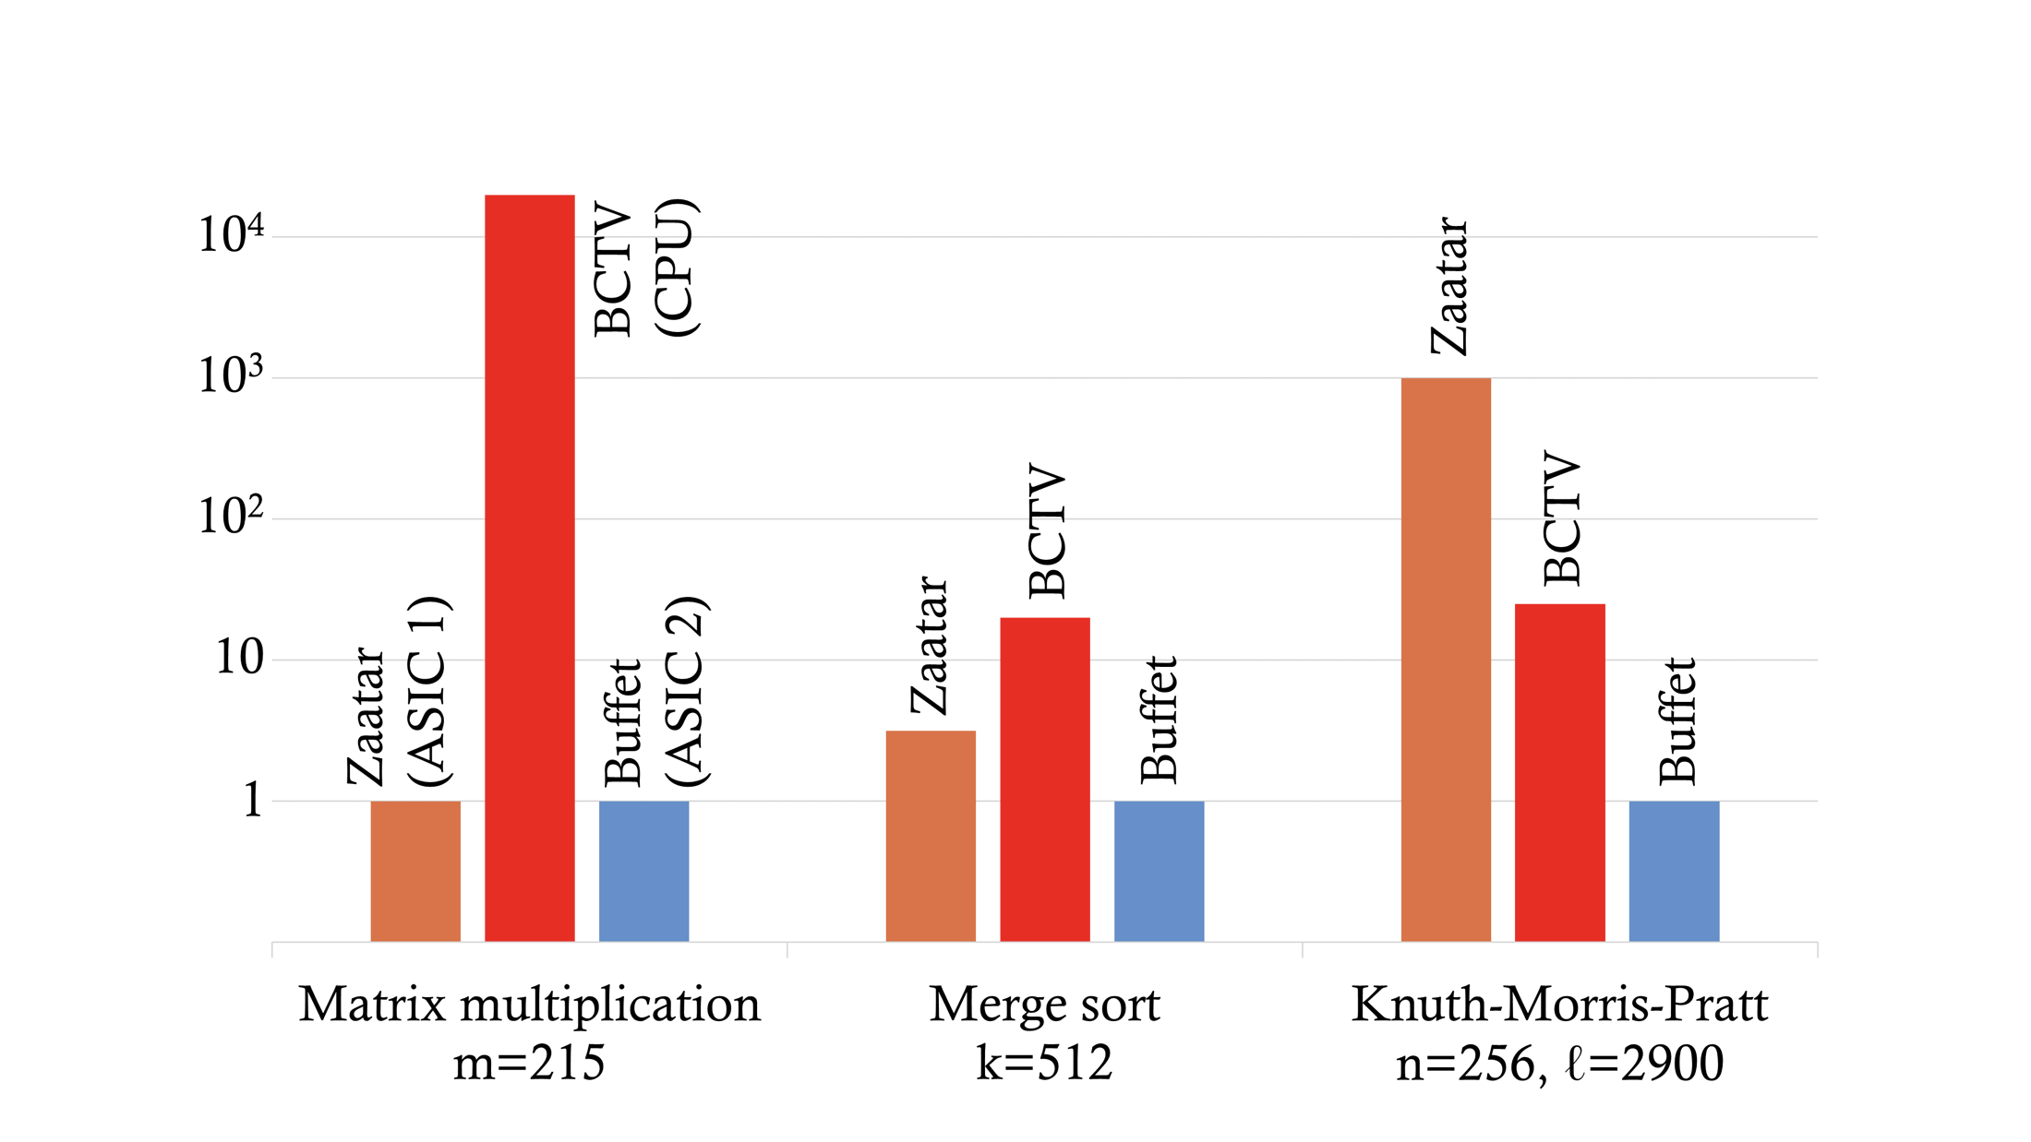
How does the prover’s cost vary with the choice of front-end?
Extrapolated prover execution time, normalized to Buffet

Slide 25
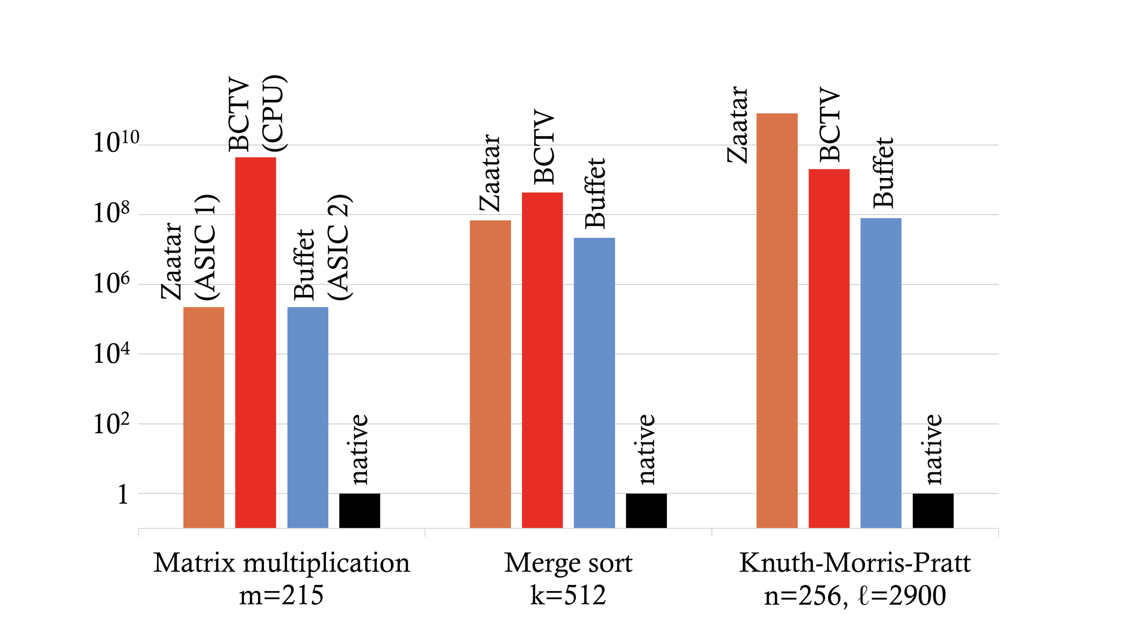
All of the front-ends have terrible concrete performance
Extrapolated prover execution time, normalized to native execution

Slide 26
The maximum input size is far too small to be called practical
Zaatar
BCTV
Buffet
approach | ASIC | CPU | ASIC
m × m mat. mult | 215 | 7 | 215
merge sort m elements | 256 | 32 | 512
KMP str len: m substr len: k | m=320, k=32 | m=160, k=16 | m=2900, k=256
The data reflect a “gate budget” of ≈10⁷ gates.
Pre-processing costs 10-30 minutes; proving costs 8-13 minutes

Slide 27
Summary of concrete performance
Front-end: generality brings a concrete price (but better in theory)
Verifier’s “variable costs”: genuinely inexpensive
Verifier’s “pre-processing”: depends on your perspective
Prover’s computational costs: near-total disaster
Memory: creates scaling limit for verifier and prover
Alternatives?
Proof-carrying data [bcct13, bctv14b, ctv15]: better in theory, but most concrete costs are orders of magnitude worse
GKR-derived systems [cmt12, vsbw13, …]: great verifier performance; some expressivity limitations

Slide 28
Where do we go from here?
One option: target domains where prover cost is tolerable
Anonymity for Bitcoin: Zerocash [bcggmtv Oakland14]
Location-private tolling [pbb Security09]: Pantry [bfrsbw sosp13]
Another option: try to motivate theoretical advances

Slide 29
Summary of state of the art
(2) Reality check
(3) Next steps

Slide 30
What we need:
1000x improvements in prover performance …
… and verifier’s pre-processing costs (ideally)
Inexpensive handling of state …
… and more generally, “the outside world”
Standard assumptions (ideally)
What we are less worried about:
Non-interactivity (depending on the application)
Pre-processing (if costs are reasonable)
Succinctness (proof can be bigger, verifier can work harder)

Slide 31
Wishlist (1)
Probabilistic proof protocols that do not require circuits
Variant: special-purpose algorithms for outsourcing pieces of computations, which integrate with circuit verification
More efficient reductions from programs to circuits

Slide 32
Wishlist (2)
Construct short PCPs that are efficient and simple
Endow IKO’s arguments with more properties or lower costs
Reuse the pre-processing work beyond a batch
Make the protocol zero knowledge
Enhance efficiency via stronger assumptions and/or analysis
Lots of other ideas needed; we don’t know what they are!
Improve GGPR’s QAPs or the cryptography used to query it (disclaimer: the status quo represents massive progress!)
Apply and possibly develop special-purpose proof systems for cryptographic operations (to accelerate verifier via offloading)

Slide 33
Conclusion and take-aways
Exciting area, with good news and bad news:
Lots of progress, but …
… “it’s been implemented” != “it’s plausibly deployable”
Overhead rooted in circuit representation and QAPs
Theoretical breakthroughs are needed
Incentive: the potential is huge!
(http://www.pepper-project.org)

