Slide 1





High Performance Active End-to-end Network Monitoring
Les Cottrell, Connie Logg, Warren Matthews, Jiri Navratil, Ajay Tirumala – SLAC
Prepared for the Protocols for Long Distance Networks Workshop,
CERN, February 2003
Partially funded by DOE/MICS Field Work Proposal on Internet End-to-end Performance Monitoring (IEPM), by the SciDAC base program, and also supported by IUPAP

Slide 2
Outline
High performance testbed
  Challenges for measurements at high speeds
Simple infrastructure for regular high-performance measurements
  Results

Slide 3






Testbed
12 cpu
servers
6 cpu
servers
7606
T640
GSR
OC192/POS
(10Gbits/s)
4 disk
servers
4 disk
servers
Sunnyvale
2.5Gbits/s
6 cpu
servers
7606
Sunnyvale section deployed for SC2002
(Nov 02)

Slide 4
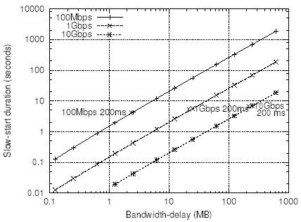
Problems: Achievable TCP throughput
Typically use iperf
  Want to measure stable throughput (i.e. after slow start)
  Slow start takes quite long at high BW*RTT
  GE for RTT from California to Geneva (RTT=182ms) slow start takes ~ 5s
  So for slow start to contribute < 10% to throughput measured need to run for 50s
  About double for Vegas/FAST TCP
T_{s}~2*ceiling(log₂(W/MSS))*RTT
W=RTT*BW
So developing Quick Iperf
  Use web100 to tell when out of slow start
  Measure for 1 second afterwards
  90% reduction in duration and bandwidth used
Notes:
SStime=2*ceiling(log2(W/MSS))*RTT
αβχδεφγηιϕκλμνοπθρστυϖωξψζΑΒΧΔΕΦΓΗΙϑΚΛΜΝΟΠΘΡΣΤΥςΩΞΨΖ‾1234567890−=∼!≅#∃%⊥&∗()_+;’,./:”<>?

Slide 5
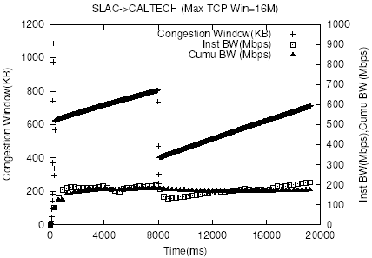
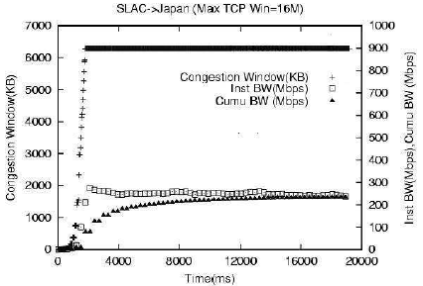
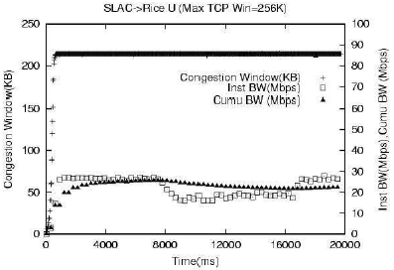
Examples (stock TCP, MTU 1500B)
BW*RTT~800KB,
Tcp_win_max=16MB
24ms RTT
140ms RTT
BW*RTT~5MB
Rcv_window=256KB
BW*RTT=1.6MB, 132ms
Notes:
Caltech is typical (BW*RTT=800KB, max TCP window 16MB), RTT=24ms
Rice has a small receive window of 256KB but BW*RTT=1.6MB, RTT=45ms
Japan (apan.jp) has 132ms

Slide 6
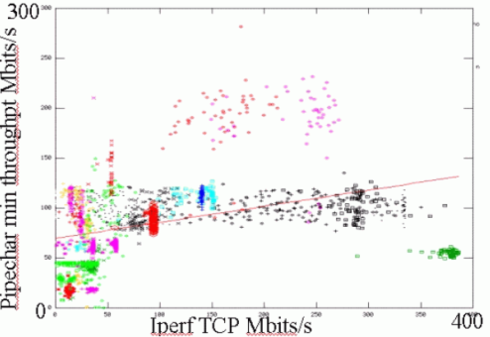
Problems: Achievable bandwidth
Typically use packet pair dispersion or packet size techniques (e.g. pchar, pipechar, pathload, pathchirp, …)
  In our experience current implementations fail for > 155Mbits/s and/or take a long time to make a measurement
Developed a simple practical packet pair tool ABwE
  Typically uses 40 packets, tested up to 950Mbits/s
  Low impact
  Few seconds for measurement (can use for real-time monitoring)
Notes:
Pipechar typically takes 4 minutes to make a measurement

Slide 7
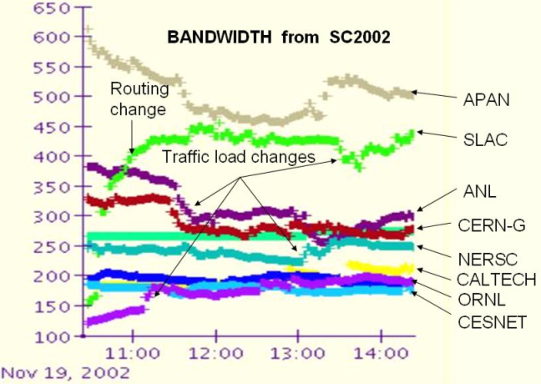
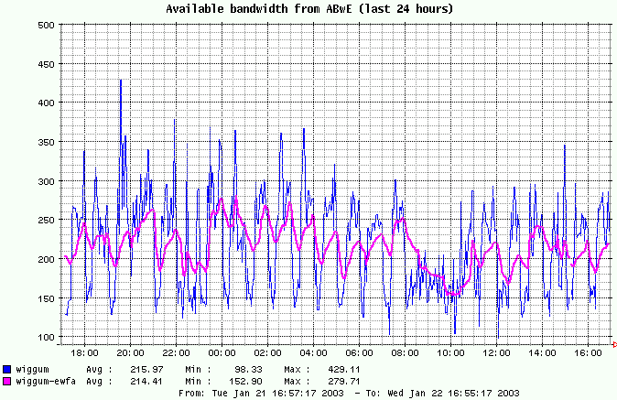
ABwE Results
Typically use packet pair dispersion or packet size techniques (e.g. pchar, pipechar, pathload, pathchirp, …)
Measurements 1 minute separation
Normalize with iperf
Note every hour sudden dip in available bandwidth
Notes:
Drops caused by a cron job copying data to NFS file every hour.

Slide 8
Problem: File copy applications
Some tools (e.g. bbcp will not allow a large enough window – currently limited to 2MBytes)
Same slow start problem as iperf
Need big file to assure not cached
  E.g. 2GBytes, at 200 Mbits/s takes 80s to transfer, even longer at lower speeds
  Looking at whether can get same effect as a big file but with a small (64MByte) file, by playing with commit
Many more factors involved, e.g. adds file system, disks speeds, RAID etc.
Maybe best bet is to let the user measure it for us.

Slide 9
Passive (Netflow) Measurements
Use Netflow measurements from border router
  Netflow records time, duration, bytes, packets etc./flow
  Calculate throughput from Bytes/duration
  Validate vs. iperf, bbcp etc.
  No extra load on network, provides other SLAC & remote hosts & applications, ~ 10-20K flows/day, 100-300 unique pairs/day
  Tricky to aggregate all flows for single application call
    Look for flows with fixed triplet (sce & dst addr, and port)
    Starting at the same time +- 2.5 secs, ending at roughly same time - needs tuning missing some delayed flows
    Check works for known active flows
    To ID application need a fixed server port (bbcp peer-to-peer but have modified to support)
    Investigating differences with tcpdump
  Aggregate throughputs, note number of flows/streams

Slide 10
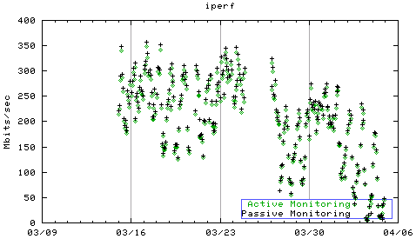
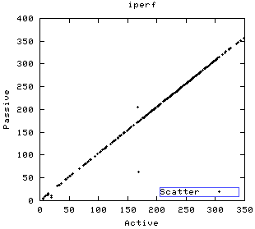
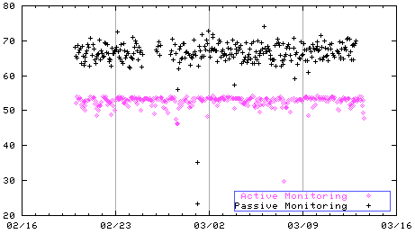
Passive vs active
Iperf SLAC to Caltech (Feb-Mar ’02)
450
+ Active
+ Passive
Mbits/s
Passive
0
Active
Date
Bbftp SLAC to Caltech (Feb-Mar ’02)
Iperf matches well
80
BBftp reports under
what it achieves
Mbits/s
+ Active
+ Passive
0
Date

Slide 11
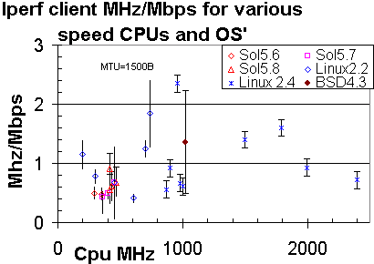
Problems: Host configuration
Need fast interface and hi-speed Internet connection
Need powerful enough host
Need large enough available TCP windows
Need enough memory
Need enough disk space

Slide 12
Windows and Streams
Well accepted that multiple streams and/or big windows are important to achieve optimal throughput
Can be unfriendly to others
Optimum windows & streams changes with changes in path, hard to optimize
For 3Gbits/s and 200ms RTT need a 75MByte window

Slide 13
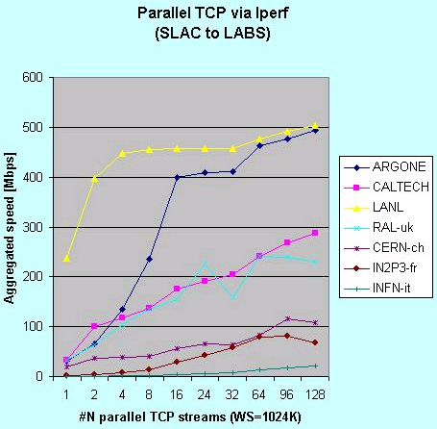
Even with big windows (1MB) still need multiple streams with stock TCP
ANL, Caltech & RAL reach a knee (between 2 and 24 streams) above this gain in throughput slow
Above knee performance still improves slowly, maybe due to squeezing out others and taking more than fair share due to large number of streams

Slide 14
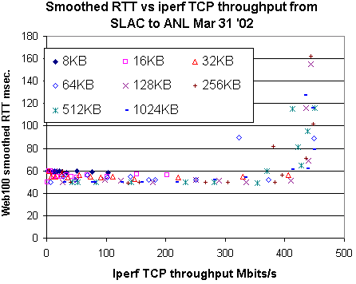
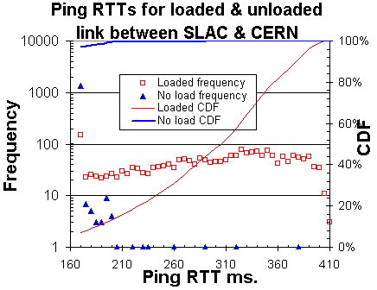
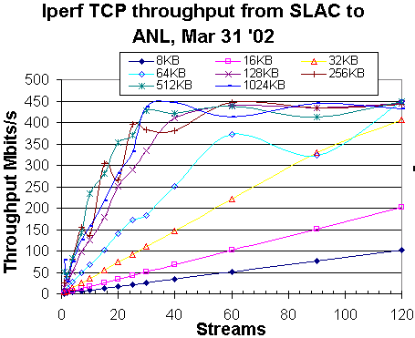
Impact on others

Slide 15
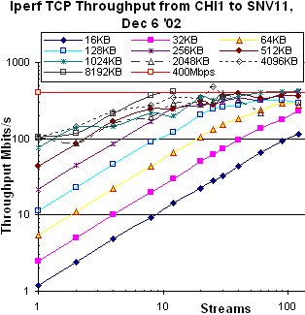
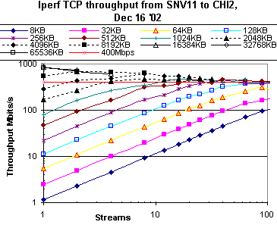
Configurations 1/2
Do we measure with standard parameters, or do we measure with optimal?
Need to measure all to understand effects of parameters, configurations:
  Windows, streams, txqueuelen, TCP stack, MTU
  Lot of variables
Examples of 2 TCP stacks
  FAST TCP no longer needs multiple streams, this is a major simplification (reduces # variables by 1)
Stock TCP,
1500B MTU
65ms RTT
FAST TCP,
1500B MTU
65ms RTT
FAST TCP,
1500B MTU
65ms RTT

Slide 16
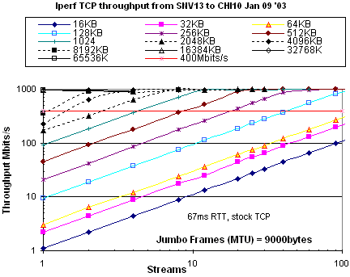
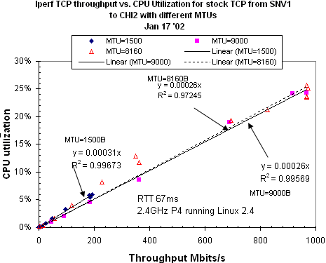
Configurations: Jumbo frames
Become more important at higher speeds:
  Reduce interrupts to CPU and packets to process
  Similar effect to using multiple streams (T. Hacker)
Jumbo can achieve >95% utilization SNV to CHI or GVA with 1 or multiple stream up to Gbit/s
Factor 5 improvement over 1500B MTU throughput for stock TCP (SNV-CHI(65ms) & CHI-AMS(128ms))
Alternative to a new stack

Slide 17
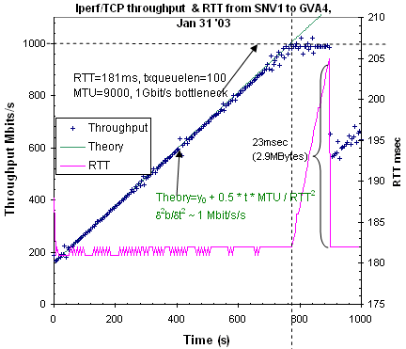
Time to reach maximum throughput
Notes:
23ms~320 9000 Byte MTUs, 1916 1500 Byte MTUs

Slide 18
Other gotchas
Linux memory leak
Linux TCP configuration caching
What is the window size actually used/reported
32 bit counters in iperf and routers wrap, need latest releases with 64bit counters
Effects of txqueuelen
Routers do not pass jumbos

Slide 19
Repetitive long term measurements

Slide 20
IEPM-BW = PingER NG
Driven by data replication needs of HENP, PPDG, DataGrid
  No longer ship plane/truck loads of data
    Latency is poor
    Now ship all data by network (TB/day today, double each year)
  Complements PingER, but for high performance nets
Need an infrastructure to make E2E network (e.g. iperf, packet pair dispersion) & application (FTP) measurements for high-performance A&R networking
Started SC2001

Slide 21
Tasks
Develop/deploy a simple, robust ssh based E2E app & net measurement and management infrastructure for making regular measurements
  Major step is setting up collaborations, getting trust, accounts/passwords
  Can use dedicated or shared hosts, located at borders or with real applications
  COTS hardware & OS (Linux or Solaris) simplifies application integration
Integrate base set of measurement tools (ping, iperf, bbcp …), provide simple (cron) scheduling
Develop data extraction, reduction, analysis, reporting, simple forecasting & archiving

Slide 22
Purposes
Compare & validate tools
  With one another (pipechar vs pathload vs iperf or bbcp vs bbftp vs GridFTP vs Tsunami)
  With passive measurements,
  With web100
Evaluate TCP stacks (FAST, Sylvain Ravot, HS TCP, Tom Kelley, Net100 …)
  Trouble shooting
  Set expectations, planning
  Understand
    requirements for high performance, jumbos
    performance issues, in network, OS, cpu, disk/file system etc.
  Provide public access to results for people & applications

Slide 23
Measurement Sites
Production, i.e. choose own remote hosts, run monitor themselves:
  SLAC (40) San Francisco, FNAL (2) Chicago, INFN (4) Milan, NIKHEF (32) Amsterdam, APAN Japan (4)
Evaluating toolkit:
  Internet 2 (Michigan), Manchester University, UCL, Univ. Michigan, GA Tech (5)
Also demonstrated at:
  iGrid2002, SC2002
Using on Caltech / SLAC / DataTag / Teragrid / StarLight / SURFnet testbed
If all goes well 30-60 minutes to install monitoring host, often problems with keys, disk space, ports blocked, not registered in DNS, need for web access, disk space
SLAC monitoring over 40 sites in 9 countries

Slide 24

278
17
TRIUMF
NIKHEF
56
Monitor
LANL
KEK
120
17
300
433
CERN
478
FNAL
IN2P3
NERSC
CAnet
Surfnet
ANL
65
CERN
CHI
110
ESnet
Renater
RAL
220
SLAC
SNV
80
ORN
NY
UCL
UManc
SLAC
31
323
JLAB
JAnet
DL
ORNL
BNL
NNW
Stanford
42
44
APAN
290
95
93
Stanford
RIKEN
GARR
INFN-Roma
11
100Mbps
GE
APAN
Geant
INFN-Milan
CalREN
15
SEA
SNV
NY
220
Abilene
ATL
CESnet
220
HSTN
IPLS
CLV
68
SOX
133
Caltech
SDSC
Rice
UIUC
31
UTDallas
UMich
I2
125
18
140
UFL
226
84
Notes:
Boxes with bold border are monitoring sites
Crosshatched boxes and network collaborators
Boxes with diagonal lines are PPDG/GriPhyN collaborators
Open boxes are EDG collaborators
Grey characters are the “GigaPoPs” that the nodes connect to in the ISP
Italics are hosts with 100Mbits/s NICs, others have GE NICs
Clouds are ISPs. There is not enough space to show all the ISPs outside the US.

Slide 25
Results
Time series data, scatter plots, histograms
CPU utilization required (MHz/Mbits/s) jumbo and standard, new stacks
Forecasting
Diurnal behavior characterization
Disk throughput as function of OS, file system, caching
Correlations with passive, web100

Slide 26
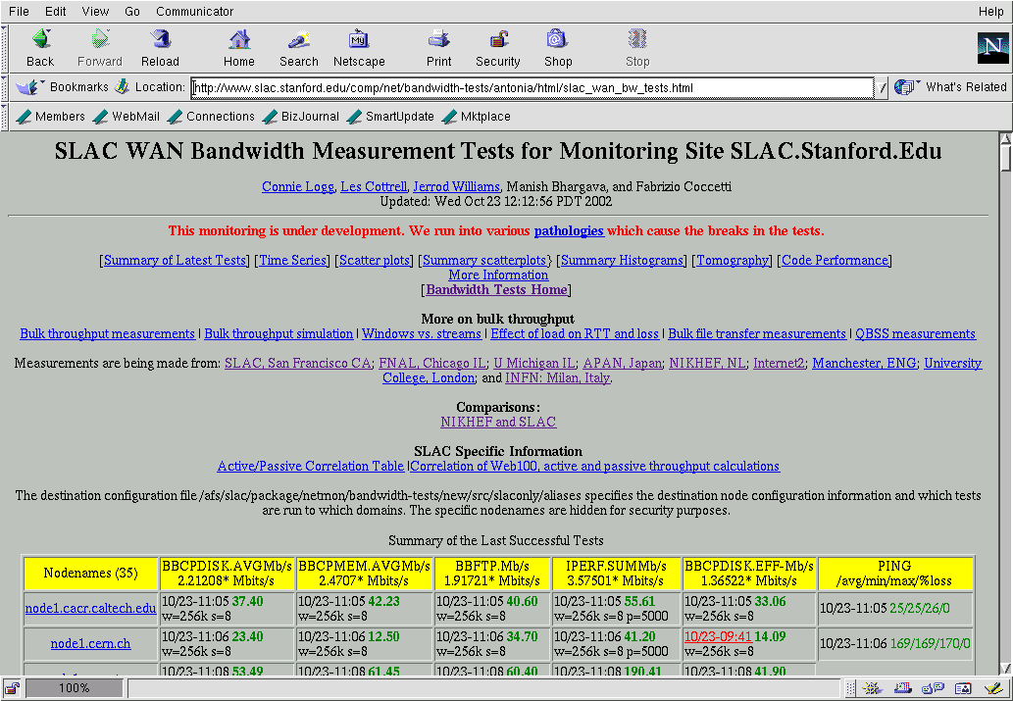
www.slac.stanford.edu/comp/net/bandwidth-tests/antonia/html/slac_wan_bw_tests.html

Slide 27
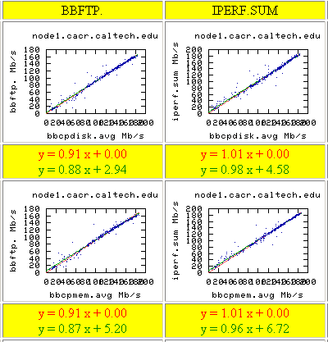
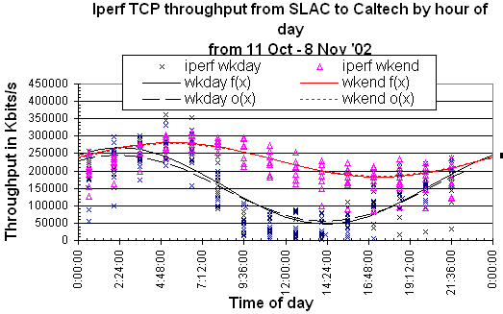
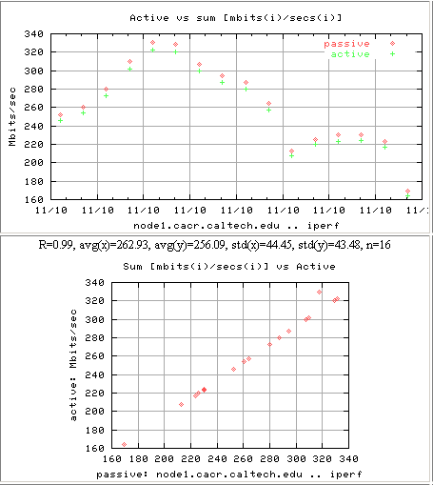
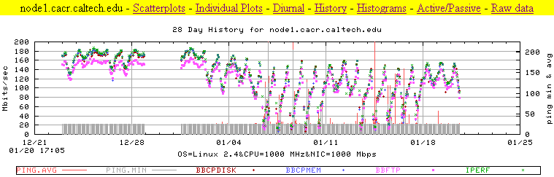
Excel

Slide 28
Problem Detection
Must be lots of people working on this ?
Our approach is:
  Rolling averages if have recent data
  Diurnal changes

Slide 29
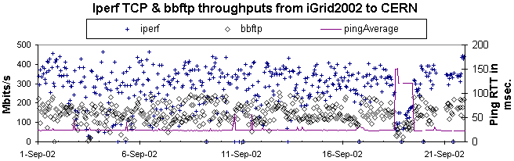
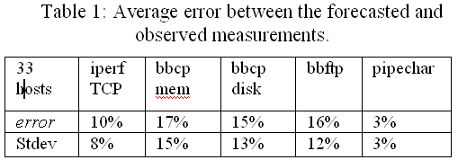
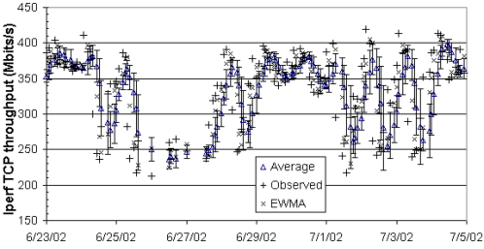
Rolling Averages
Step changes
Diurnal Changes
EWMA~Avg of last 5 points +- 2%

Slide 30
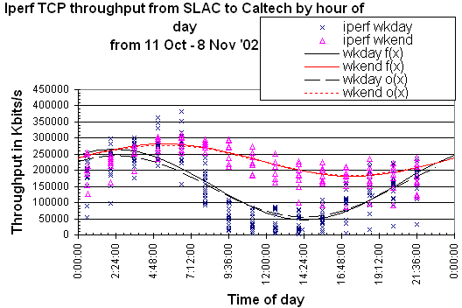
Fit to α*sin(t+φ)+γ
Indicate “diurnalness” by δφ, can look at previous week at same time, if do not have recent measurements, 25% hosts show strong diurnalness

Slide 31
Alarms
Too much to keep track of
Rather not wait for complaints
Automated Alarms
Rolling average à la RIPE-TTM

Slide 32
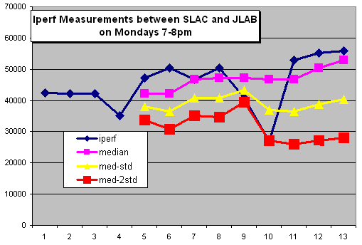
Week number

Slide 33
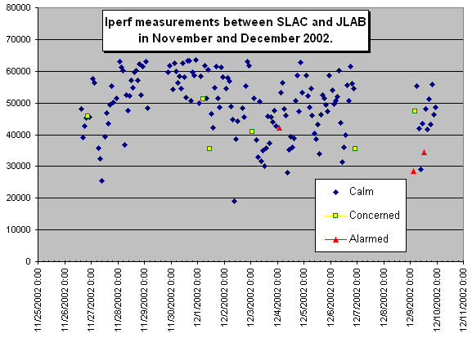

Slide 34
Action
However concern is generated
  Look for changes in traceroute
  Compare tools
  Compare common routes
  Cross reference other alarms

Slide 35
Next steps
Rewrite (again) based on experiences
  Improved ability to add new tools to measurement engine and integrate into extraction, analysis
    GridFTP, tsunami, UDPMon, pathload …
  Improved robustness, error diagnosis, management
Need improved scheduling
Want to look at other security mechanisms

Slide 36
More Information
IEPM/PingER home site:
  www-iepm.slac.stanford.edu/
IEPM-BW site
  www-iepm.slac.stanford.edu/bw
Quick Iperf
  http://www-iepm.slac.stanford.edu/bw/iperf_res.html
ABwE
  Submitted to PAM2003

