Slide 1
SCinet
Caltech-SLAC experiments
SC2002
Baltimore, Nov 2002
Acknowledgments
netlab.caltech.edu/FAST
Prototype
C. Jin, D. Wei
Theory
D. Choe (Postech/Caltech), J. Doyle, S. Low, F. Paganini (UCLA), J. Wang, Z. Wang (UCLA)
Experiment/facilities
  Caltech: J. Bunn, C. Chapman, C. Hu (Williams/Caltech), H. Newman, J. Pool, S. Ravot (Caltech/CERN), S. Singh
  CERN: O. Martin, P. Moroni
  Cisco: B. Aiken, V. Doraiswami, R. Sepulveda, M. Turzanski, D. Walsten, S. Yip
  DataTAG: E. Martelli, J. P. Martin-Flatin
  Internet2: G. Almes, S. Corbato
  Level(3): P. Fernes, R. Struble
  SCinet: G. Goddard, J. Patton
  SLAC: G. Buhrmaster, R. Les Cottrell, C. Logg, I. Mei, W. Matthews, R. Mount, J. Navratil, J. Williams
  StarLight: T. deFanti, L. Winkler
Major sponsors
ARO, CACR, Cisco, DataTAG, DoE, Lee Center, NSF
Notes:
Berkeley, June 7, 2002 (Bannister, Walrand, Fisher)
IPAM, Arrowhead, June 10, 2002 (Doyle, Low, Willinger)
Postech-Caltech Symposium, Pohang, S. Korea, Sept 30, 2002 (Jin Lee)
Annual Allerton Conference on Communication, Control, and Computing, Monticello, IL, Oct 3, 2002 (Hajek, Srikant)
IEEE Computer Communications Workshop (CCW), Santa Fe, NM, Oct 14, 2002 (Kunniyur), presenter: Dawn
Lee Center Industry Workshop, Oct 18, 2002, Pasadena (include Cheng Jin’s slides)
Major addition: TCP/IP decomposition slides (Infocom 2003)
Lee Center Faculty lunch, Caltech, Nov 11, 2002 (Rutledge)
Washington University, St Louis, Nov 15, 2002 (Lihao Xu)
Doyle/Wolpert Workshop, Caltech, Dec 2-3, 2002 (Doyle)
DARPA NMS PI Meeting, Reston, VA, Jan 9-10, 2003 (Sri Kumar)
Caltech for Guy Almes and Stanislav Shalunov (Internet2), Jan 13, 2003 (Low)
SISL (Social & Information Science Lab) Seminar, Caltech, Jan 16, 2003 (Ledyard)
UCLA, CS, Jan 21, 2003 (Kleinrock)
HENP WG meeting + Joint Tech Workshop, Florida, Jan 29-Feb 2, 2003 (presenter: Wei)
Protocol for Fast Long-Distance Networks, CERN, Geneva, Feb 3-4, 2003 (Martin-Flatin)

Slide 2



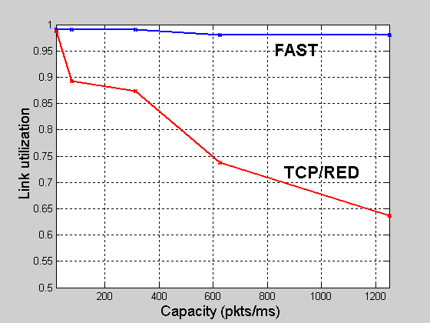

FAST Protocols for Ultrascale Networks
Internet: distributed feedback control system
TCP: adapts sending rate to congestion
AQM: feeds back congestion information
WAN in Lab
Caltech
research & production networks
R_{f} (s)
Chicago
CERN
x
y
TCP
AQM
StarLight
q
R_{b}’(s)
p
Calren2/Abilene
Geneva
Multi-Gbps
50-200ms delay
SURFNet
Theory
Experiment
Amsterdam
People
Implementation
equilibrium
Faculty
Doyle (CDS,EE,BE)
Low (CS,EE)
Newman (Physics)
Paganini (UCLA)
Staff/Postdoc
Bunn (CACR)
Jin (CS)
Ravot (Physics)
Singh (CACR)
Students
Choe (Postech/CIT)
Hu (Williams)
J. Wang (CDS)
Z.Wang (UCLA)
Wei (CS)
Industry
Doraiswami (Cisco)
Yip (Cisco)
155Mb/s
10Gb/s
slow
start
FAST
retransmit
Partners
CERN, Internet2, CENIC, StarLight/UI, SLAC, AMPATH, Cisco
time
out
FAST
recovery
netlab.caltech.edu/FAST
Notes:
Berkeley, June 7, 2002 (Bannister, Walrand, Fisher)
IPAM, Arrowhead, June 10, 2002 (Doyle, Low, Willinger)
Postech-Caltech Symposium, Pohang, S. Korea, Sept 30, 2002 (Jin Lee)
Annual Allerton Conference on Communication, Control, and Computing, Monticello, IL, Oct 3, 2002 (Hajek, Srikant)
IEEE Computer Communications Workshop (CCW), Santa Fe, NM, Oct 14, 2002 (Kunniyur), presenter: Dawn
Lee Center Industry Workshop, Oct 18, 2002, Pasadena (include Cheng Jin’s slides)
Major addition: TCP/IP decomposition slides (Infocom 2003)
Lee Center Faculty lunch, Caltech, Nov 11, 2002 (Rutledge)
Washington University, St Louis, Nov 15, 2002 (Lihao Xu)
Doyle/Wolpert Workshop, Caltech, Dec 2-3, 2002 (Doyle)
Guy Almes visit, Caltech Jan 13, 2003 (Low)
Social & Information Science Lab Seminar, Caltech Jan 16, 2003 (Ledyard)
UCLA, CS, Jan 21, 2003 (Kleinrock)
HENP Working Group Meeting, Feb 1, 2003, Florida International U (Newman)
Joint Technical Workshop, Feb 2-5, 2003, Florida International U, (Paul Love, presenter: Wei)
1st Workshop on Fast Long-distance Network, Feb 3-4, 2003, CERN, Geneva (JP Martin-Flatin/Low)

Slide 3
FAST project
Protocols for ultrascale networks
  >100 Gbps throughput, 50-200ms delay
  Theory, algorithms, design, implement, demo, deployment
Faculty
  Doyle (CDS, EE, BE): complex systems theory
  Low (CS, EE): PI, networking
  Newman (Physics): application, deployment
  Paganini (EE, UCLA): control theory
Research staff
  3 postdocs, 3 engineers, 8 students
Collaboration
  Cisco, Internet2/Abilene, CERN, DataTAG (EU), …
Funding
  NSF, DoE, Lee Center (AFOSR, ARO, Cisco)

Slide 4
Outline
Motivation
Theory
  TCP/AQM
  TCP/IP
Experimental results

Slide 5
High Energy Physics
  Large global collaborations
    2000 physicists from 150 institutions in >30 countries
    300-400 physicists in US from >30 universities & labs
  SLAC has 500TB data by 4/2002, world’s largest database
  Typical file transfer ~1 TB
    At 622Mbps: ~ 4 hrs
    At 2.5Gbps: ~ 1 hr
    At 10Gbps: ~15min
    Gigantic elephants!
  LHC (Large Hadron Collider) at CERN, to open 2007
    Generate data at PB (10¹⁵B)/sec
    Filtered in realtime by a factor of 10⁶ to 10⁷
    Data stored at CERN at 100MB/sec
    Many PB of data per year
    To rise to Exabytes (10¹⁸B) in a decade

Slide 6

HEP high speed network
… that must change

Slide 7


HEP Network (DataTAG)
NewYork
ABILENE
UK
SuperJANET4
It
GARR-B
STARLIGHT
ESNET
GENEVA
GEANT
Wave Triangle
NL
CALREN
STAR-TAP
SURFnet
Fr
Renater
2.5 Gbps Wavelength Triangle 2002
10 Gbps Triangle in 2003
Newman (Caltech)

Slide 8
Network upgrade 2001-06
’01
155
’02
622
’03
2.5
’04
5
’05
10

Slide 9
Projected performance
’01
155
’02
622
’03
2.5
’04
5
’05
10
Ns-2: capacity = 155Mbps, 622Mbps, 2.5Gbps, 5Gbps, 10Gbps
100 sources, 100 ms round trip propagation delay
J. Wang (Caltech)

Slide 10
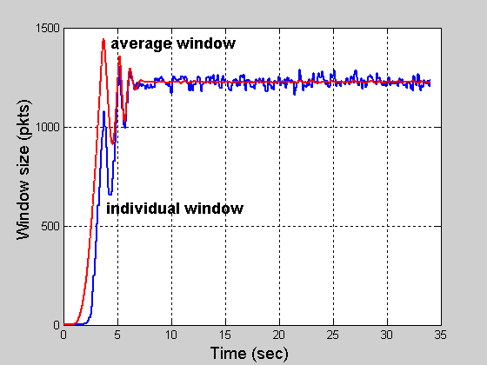
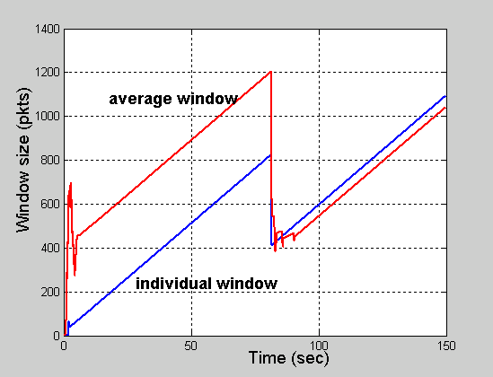
Projected performance
FAST
TCP/RED
Ns-2: capacity = 10Gbps
100 sources, 100 ms round trip propagation delay
J. Wang (Caltech)

Slide 11
Outline
Motivation
Theory
  TCP/AQM
  TCP/IP
Experimental results

Slide 12
Protocol decomposition
Files
HTTP
TCP
IP
Routers
packets
packets
packets
packets
packets
packets
from J. Doyle

Slide 13
Protocol Decomposition
HOT (Doyle et al)
Minimize user response time
Heavy-tailed file sizes
WWW, Email, Napster, FTP, …
Applications
TCP/AQM
Duality model
Maximize aggregate utility
IP
Shortest-path routing
Minimize path costs
Transmission
Power control
Maximize channel capacity
Ethernet, ATM, POS, WDM, …

Slide 14
Congestion Control
Heavy tail ➔ Mice-elephants
Internet
Elephant
Mice
efficient & fair sharing
small delay
queueing + propagation
Congestion control
CDN
Notes:
Extensive research over (almost) the past decade has established that whereever you look whatever you measure, you always see heavy tail on the Internet and at web servers. The implication for us is the 20-80 rule: 20% of the files generate 80% of Internet traffic. 20-80 may not be the exact breakdown, but heavy tail does suggests a simple picture where there are two types of files, usually referred to as mice and elephants. While most TCP connections are mice, most packets belong to elephants.
Mice and elephants have different requirements. Elephants desire large average bandwidth while mice desire small delay. The goal of end-to-end congestion control is efficient and fair sharing of network bandwidth among elephants, but the way we perform congestion control also has strong implication on the queueing delay experienced by mice. Ideally, we’d control the elephants to maximally utilize the network, in such a way that leaves the network queues mostly empty, so that mice can fly through the network without much queueing delay. As we will see later, the current protocol, Reno with DropTail, is doing exactly the wrong thing – it maximizes the queue delay (and loss) for mice.
We believe that if we do our congestion control right, then there should not be much loss or queueing delay. Delay then depends mainly on propagation delay. To reduce that, we need content distribution networks.

Slide 15
Congestion control
x_{i}(t)

Slide 16
Congestion control
p_{l}(t)
x_{i}(t)
Example congestion measure p_{l}(t)
  Loss (Reno)
  Queueing delay (Vegas)

Slide 17
TCP/AQM
p_{l}(t)
AQM:
DropTail
RED
REM/PI
AVQ
TCP:
Reno
Vegas
x_{i}(t)
Congestion control is a distributed asynchronous algorithm to share bandwidth
It has two components
  TCP: adapts sending rate (window) to congestion
  AQM: adjusts & feeds back congestion information
They form a distributed feedback control system
  Equilibrium & stability depends on both TCP and AQM
  And on delay, capacity, routing, #connections

Slide 18
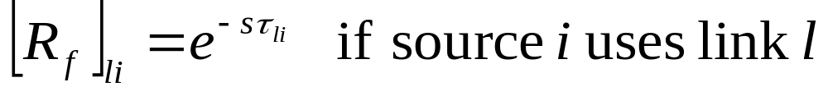
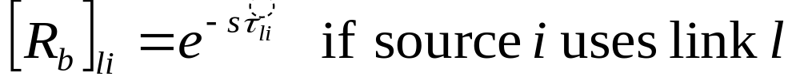
Network model
x
y
R_{f}(s)
F₁
G₁
TCP
Network
AQM
F_{N}
G_{L}
q
p
R_{b}’(s)

Slide 19
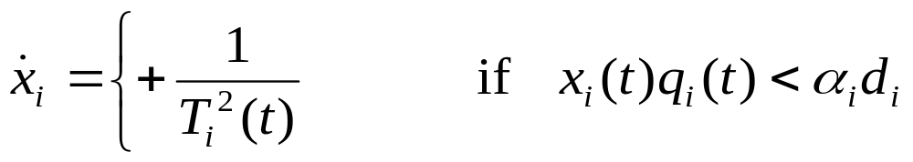
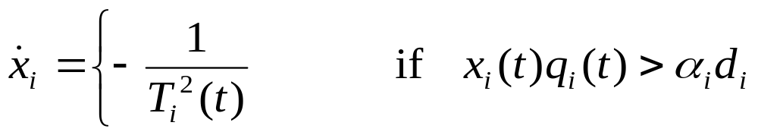


Vegas model
for every RTT
{ if W/RTT_{min} – W/RTT < α then W ++
if W/RTT_{min} – W/RTT > α then W -- }
queue size
F_{i}:
E2E queueing delay
G_{l}:
Link queueing delay

Slide 20
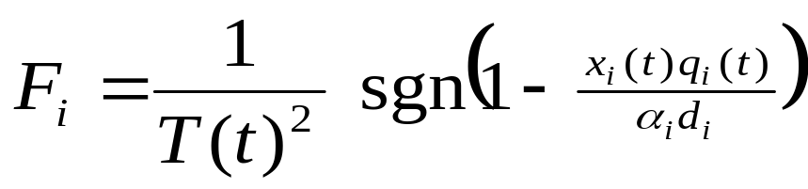
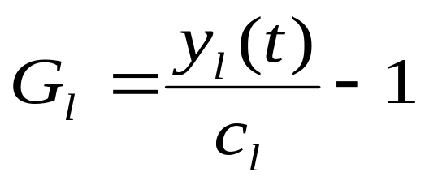
Vegas model
x
y
R_{f}(s)
F₁
G₁
TCP
Network
AQM
F_{N}
G_{L}
q
p
R_{b}’(s)

Slide 21
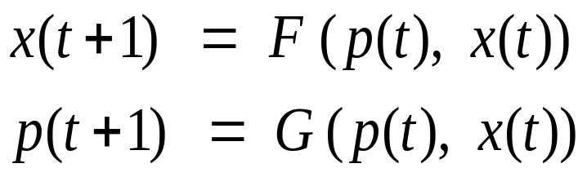
Methodology
Protocol (Reno, Vegas, RED, REM/PI…)
Equilibrium
Performance
  Throughput, loss, delay
Fairness
Utility
Dynamics
Local stability
Cost of stabilization

Slide 22



Model
Network
  Links l of capacities c_{l}
Sources s
  L(s) - links used by source s
  U_{s}(x_{s}) - utility if source rate = x_{s}
x₁
c₁
c₂
x₂
x₃

Slide 23
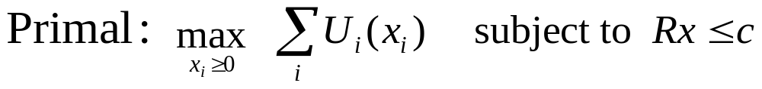
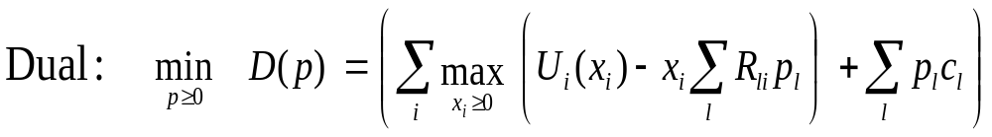
Duality Model of TCP
Primal-dual algorithm:
Individual optimization
Notes:
So we have the primal problem that maximizes aggregate utility subject to capacity constraints. Its dual problem is to minimize a certain function we call D(p). We call the vector p the congestion meausre and ….
The primal dual algorithm takes the following general form where the source rate vector x(t+1) in the next period is a certain function F of the current price vector p(t) and source rates x(t), and the price p(t+1) is a certain function G of the current prices and rates.

Slide 24
Duality Model of TCP
Source algorithm iterates on rates
Link algorithm iterates on prices
With different utility functions
Primal-dual algorithm:
Reno, Vegas
DropTail, RED, REM
Notes:
So the source algorithm is this F that iterates on prices and rates to produce a new rate, and the link algorithm is this G that iterates on prices and rates to produce a new price.
In TCP, F is carried out by Reno and Vegas, they are just different F’s. G is carried out by queue managements, active or inactive, such as DropTail, RED, or REM, they are just different G’s.
The different pairs (F, G) all try to solve the primal problem, but with different utility functions. That’s all.

Slide 25
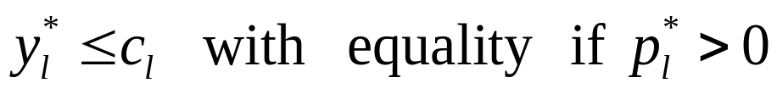
Duality Model of TCP
(x*,p*) primal-dual optimal if and only if
Primal-dual algorithm:
Reno, Vegas
DropTail, RED, REM
Notes:
So the source algorithm is this F that iterates on prices and rates to produce a new rate, and the link algorithm is this G that iterates on prices and rates to produce a new price.
In TCP, F is carried out by Reno and Vegas, they are just different F’s. G is carried out by queue managements, active or inactive, such as DropTail, RED, or REM, they are just different G’s.
The different pairs (F, G) all try to solve the primal problem, but with different utility functions. That’s all.

Slide 26
Duality Model of TCP
Any link algorithm that stabilizes queue
generates Lagrange multipliers
solves dual problem
Primal-dual algorithm:
Reno, Vegas
DropTail, RED, REM
Notes:
So the source algorithm is this F that iterates on prices and rates to produce a new rate, and the link algorithm is this G that iterates on prices and rates to produce a new price.
In TCP, F is carried out by Reno and Vegas, they are just different F’s. G is carried out by queue managements, active or inactive, such as DropTail, RED, or REM, they are just different G’s.
The different pairs (F, G) all try to solve the primal problem, but with different utility functions. That’s all.

Slide 27
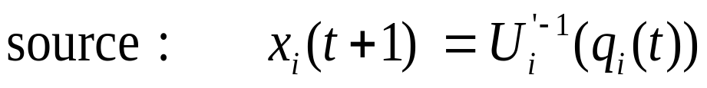
Gradient algorithm
Gradient algorithm
Theorem (ToN’99)
Converge to optimal rates in asynchronous
environment

Slide 28
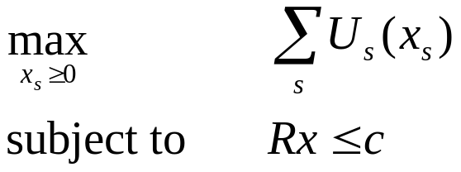
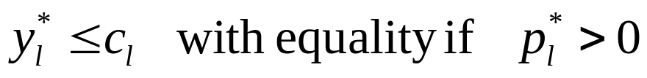
Summary: duality model
Flow control problem
Primal-dual algorithm
Reno, Vegas
DropTail, RED, REM
TCP/AQM
  Maximize utility with different utility functions
Theorem (Low 00): (x*,p*) primal-dual optimal iff

Slide 29
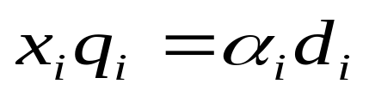
Equilibrium of Vegas
Network
Link queueing delays: p_{l}
Queue length: c_{l}p_{l}
Sources
Throughput: x_{i}
E2E queueing delay : q_{i}
Packets buffered:
Utility funtion: U_{i}(x) = α_{i} d_{i} log x
  Proportional fairness

Slide 30
Validation (L. Wang, Princeton)
Source rates (pkts/ms)
# src1 src2 src3 src4 src5
5.98 (6)
2.05 (2) 3.92 (4)
0.96 (0.94) 1.46 (1.49) 3.54 (3.57)
0.51 (0.50) 0.72 (0.73) 1.34 (1.35) 3.38 (3.39)
0.29 (0.29) 0.40 (0.40) 0.68 (0.67) 1.30 (1.30) 3.28 (3.34)
# queue (pkts) baseRTT (ms)
19.8 (20) 10.18 (10.18)
59.0 (60) 13.36 (13.51)
127.3 (127) 20.17 (20.28)
237.5 (238) 31.50 (31.50)
416.3 (416) 49.86 (49.80)

Slide 31
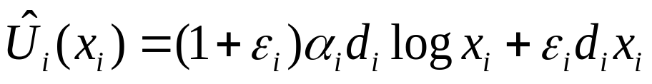
Persistent congestion
Vegas exploits buffer process to compute prices (queueing delays)
Persistent congestion due to
  Coupling of buffer & price
  Error in propagation delay estimation
Consequences
  Excessive backlog
  Unfairness to older sources
Theorem (Low, Peterson, Wang ’02)
A relative error of ε_{i} in propagation delay estimation
distorts the utility function to

Slide 32
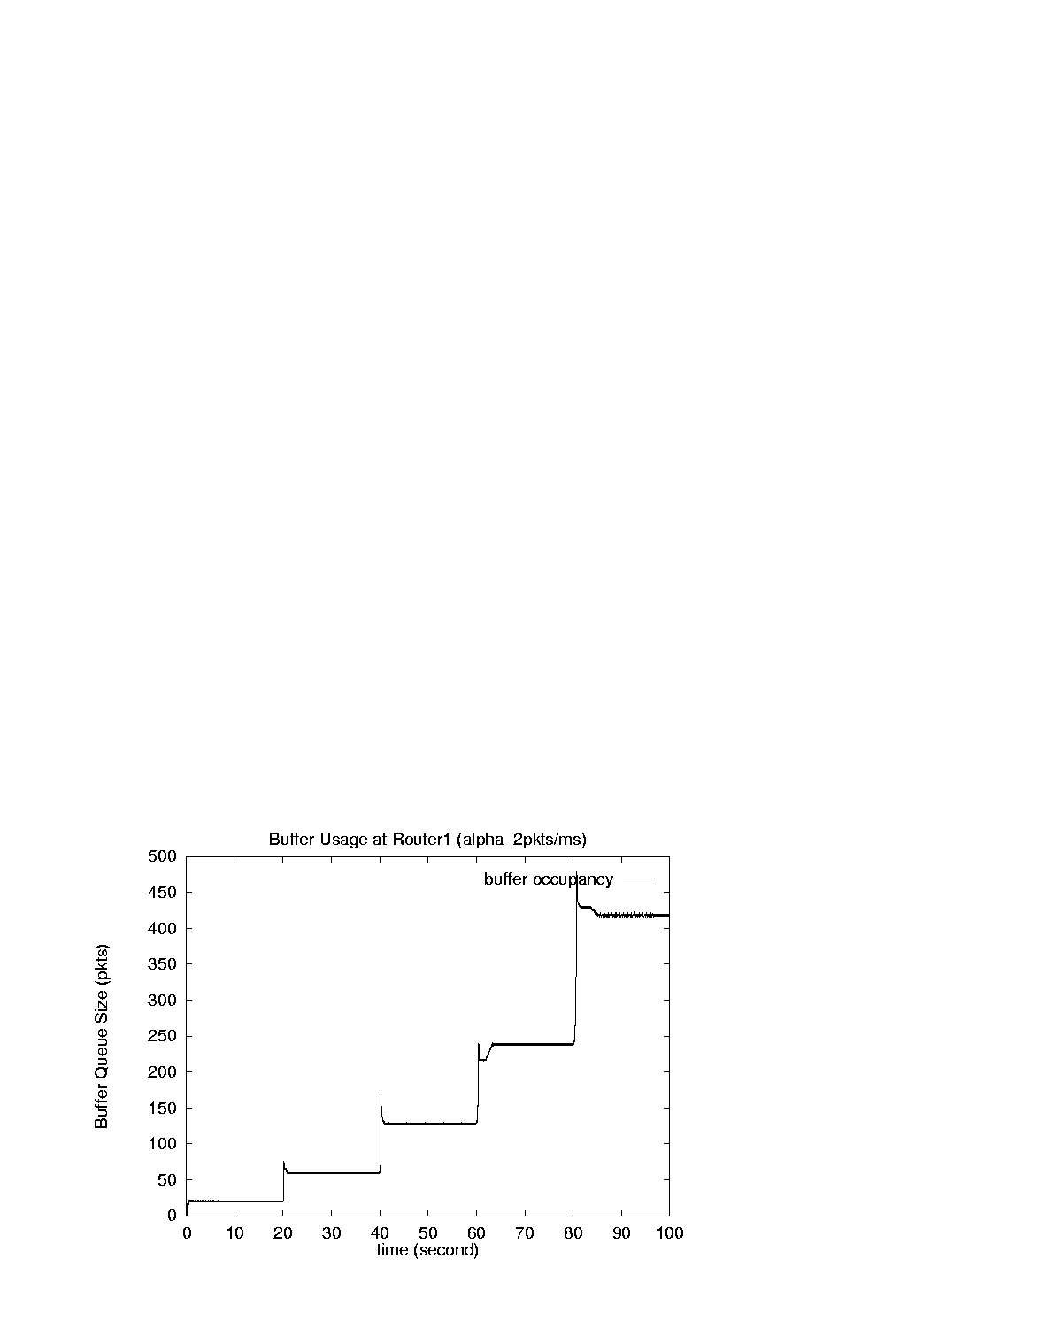
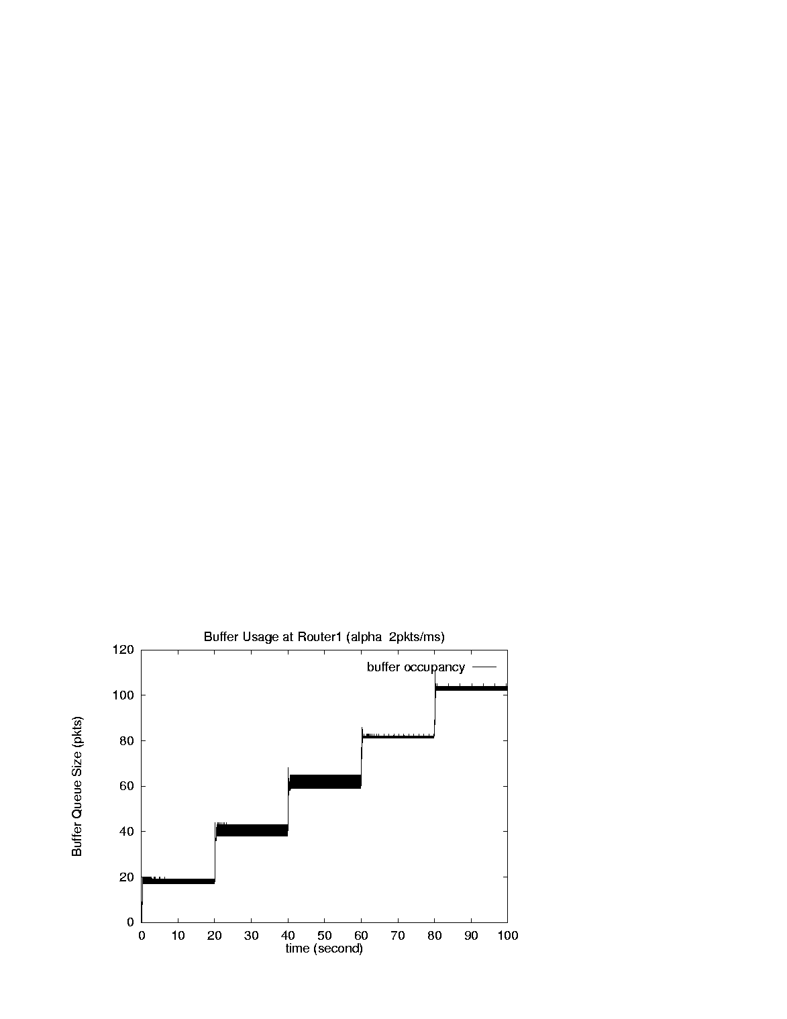
Validation (L. Wang, Princeton)
Without estimation error
With estimation error
Single link, capacity = 6 pkt/ms, α_{s} = 2 pkts/ms, d_{s} = 10 ms
With finite buffer: Vegas reverts to Reno

Slide 33
Validation (L. Wang, Princeton)
Source rates (pkts/ms)
# src1 src2 src3 src4 src5
5.98 (6)
2.05 (2) 3.92 (4)
0.96 (0.94) 1.46 (1.49) 3.54 (3.57)
0.51 (0.50) 0.72 (0.73) 1.34 (1.35) 3.38 (3.39)
0.29 (0.29) 0.40 (0.40) 0.68 (0.67) 1.30 (1.30) 3.28 (3.34)
# queue (pkts) baseRTT (ms)
19.8 (20) 10.18 (10.18)
59.0 (60) 13.36 (13.51)
127.3 (127) 20.17 (20.28)
237.5 (238) 31.50 (31.50)
416.3 (416) 49.86 (49.80)

Slide 34
Methodology
Protocol (Reno, Vegas, RED, REM/PI…)
Equilibrium
Performance
  Throughput, loss, delay
Fairness
Utility
Dynamics
Local stability
Cost of stabilization

Slide 35
TCP/RED stability
Small effect on queue
  AIMD
  Mice traffic
  Heterogeneity
Big effect on queue
  Stability!

Slide 36
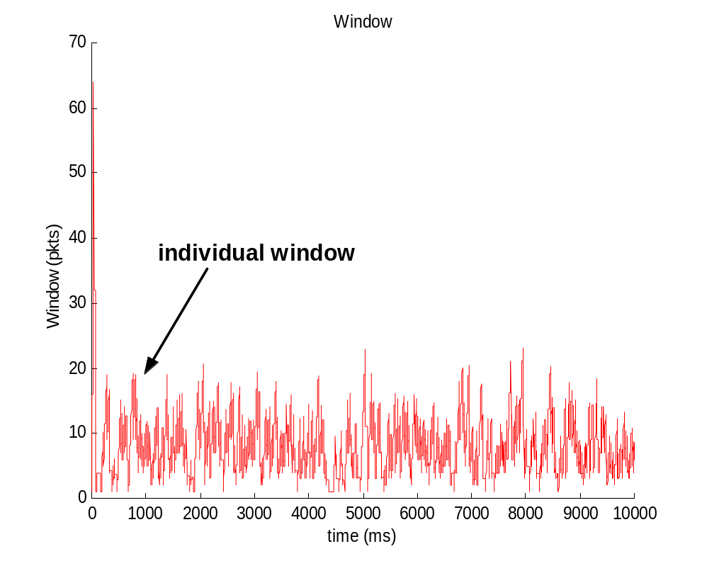
Stable: 20ms delay
Window
Ns-2 simulations, 50 identical FTP sources, single link 9 pkts/ms, RED marking

Slide 37
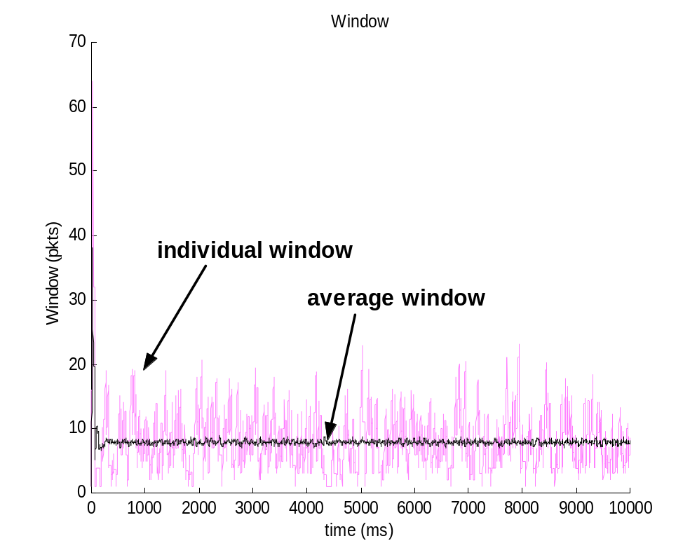
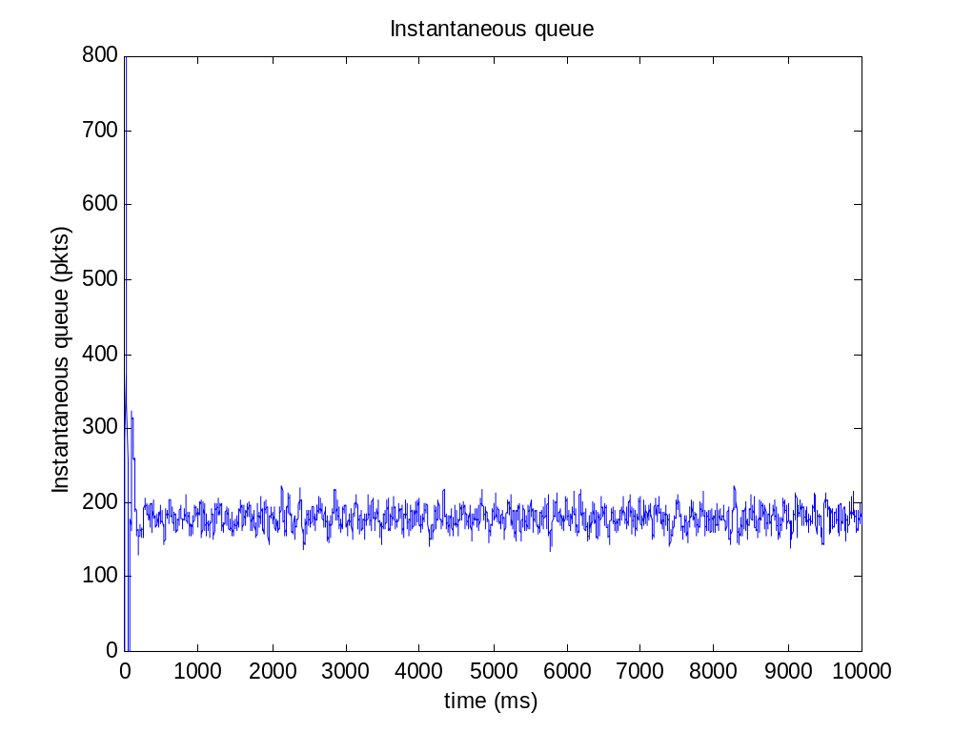
Stable: 20ms delay
Window
Queue
Ns-2 simulations, 50 identical FTP sources, single link 9 pkts/ms, RED marking

Slide 38
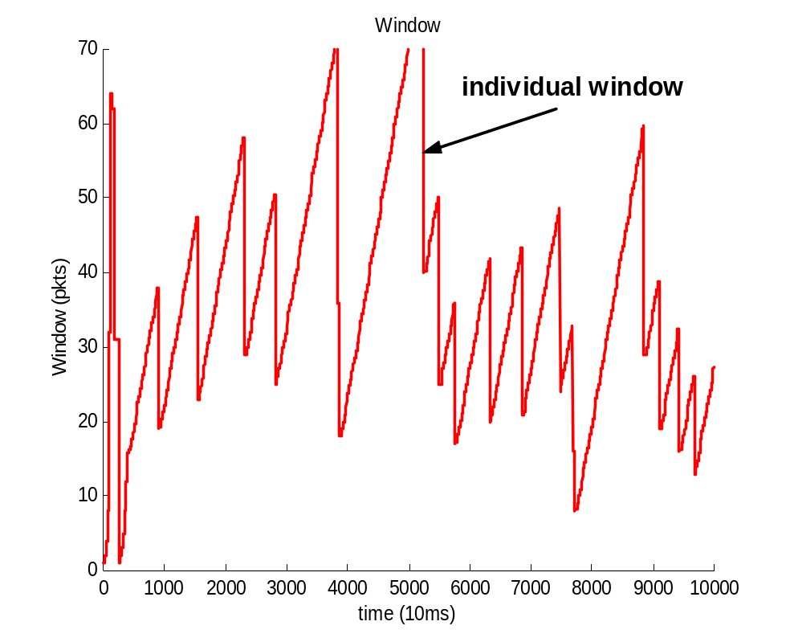
Unstable: 200ms delay
Window
Ns-2 simulations, 50 identical FTP sources, single link 9 pkts/ms, RED marking

Slide 39
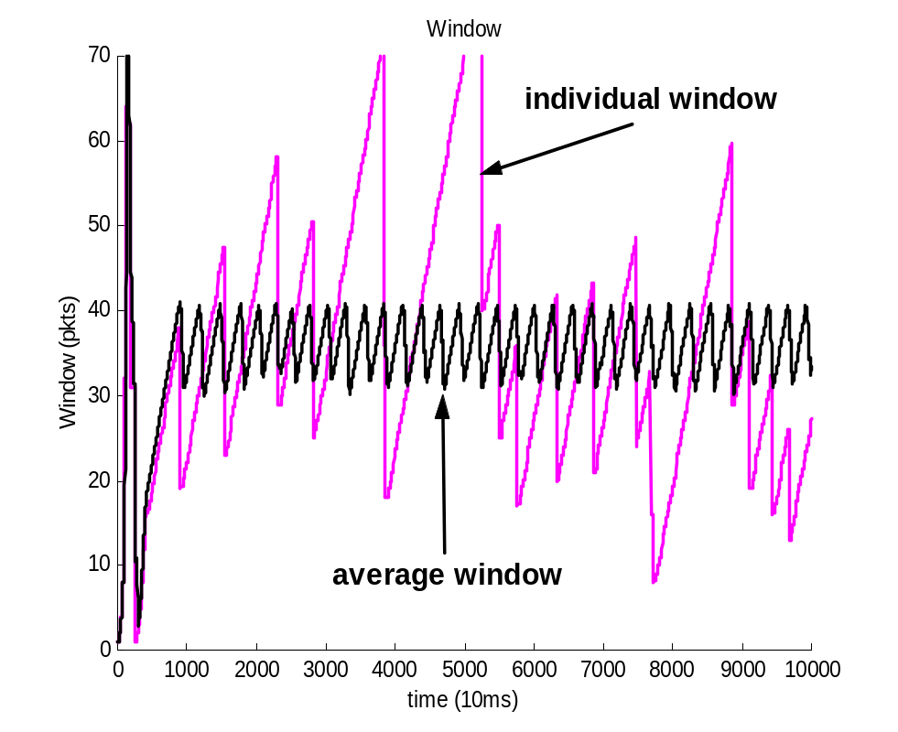
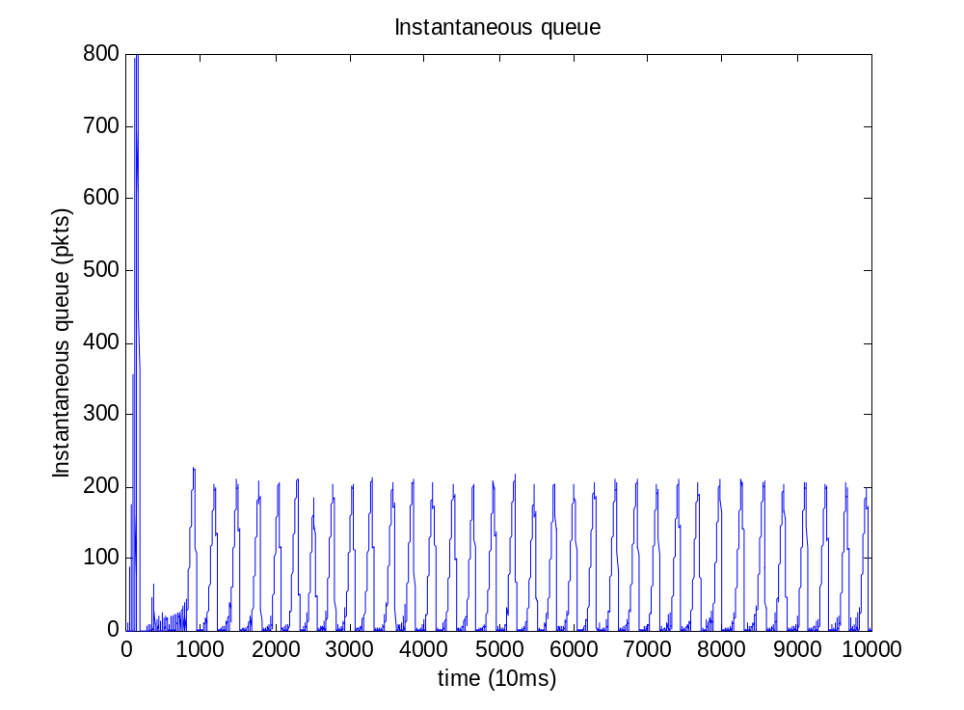
Unstable: 200ms delay
Window
Queue
Ns-2 simulations, 50 identical FTP sources, single link 9 pkts/ms, RED marking

Slide 40
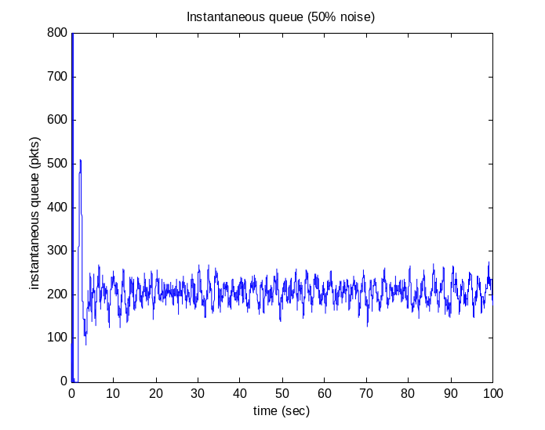
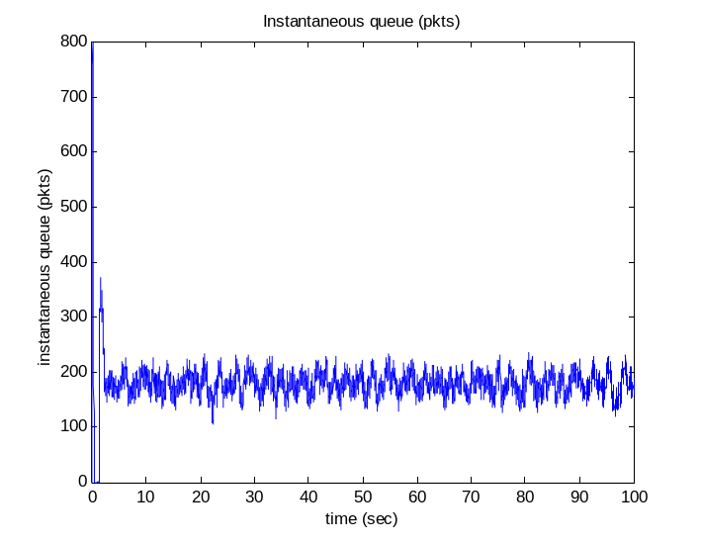
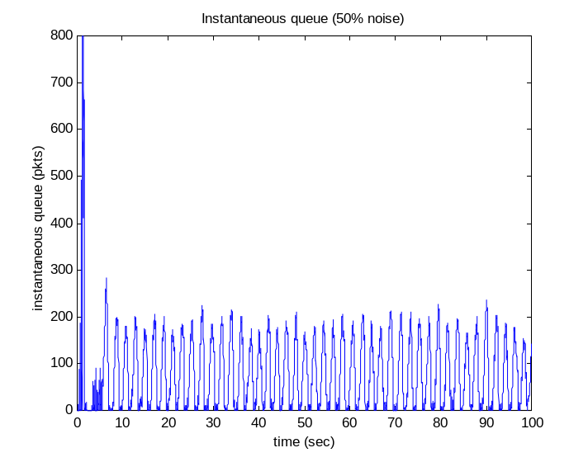
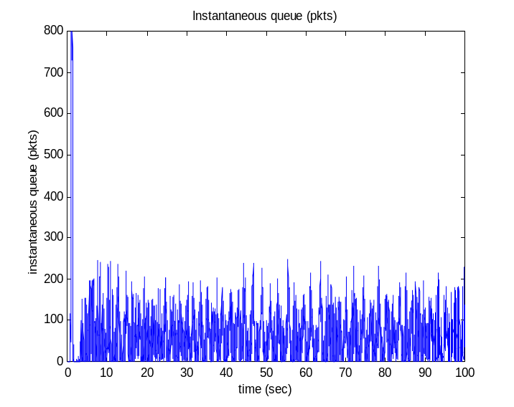
Other effects on queue
20ms
30% noise
avg delay 16ms
200ms
30% noise
avg delay 208ms

Slide 41
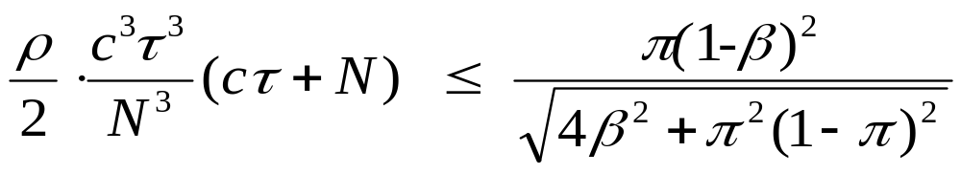
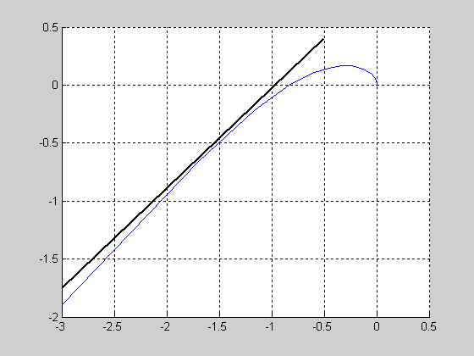

Stability condition
Theorem: TCP/RED stable if
TCP:
Small τ
Small c
Large N
RED:
Small ρ
Large delay
ω=0

Slide 42
Stability: Reno/RED
x
y
R_{f}(s)
F₁
G₁
TCP
Network
AQM
F_{N}
G_{L}
q
p
R_{b}’(s)
TCP:
Small τ
Small c
Large N
RED:
Small ρ
Large delay
Theorem (Low et al, Infocom’02)
Reno/RED is stable if

Slide 43
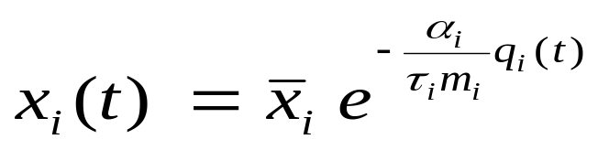
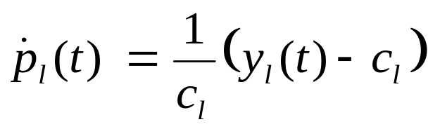
Stability: scalable control
x
y
R_{f}(s)
F₁
G₁
TCP
Network
AQM
F_{N}
G_{L}
q
p
R_{b}’(s)
Theorem (Paganini, Doyle, Low, CDC’01)
Provided R is full rank, feedback loop is locally stable for arbitrary delay, capacity, load and topology

Slide 44
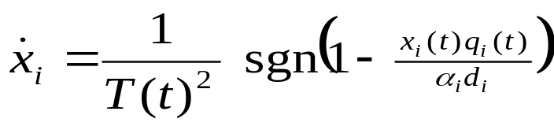
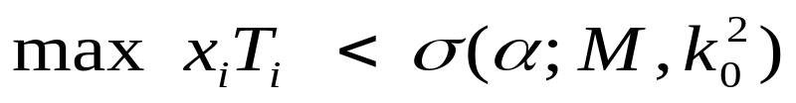
Stability: Vegas
x
y
R_{f}(s)
F₁
G₁
TCP
Network
AQM
F_{N}
G_{L}
q
p
R_{b}’(s)
Theorem (Choe & Low, Infocom’03)
Provided R is full rank, feedback loop is locally stable if

Slide 45
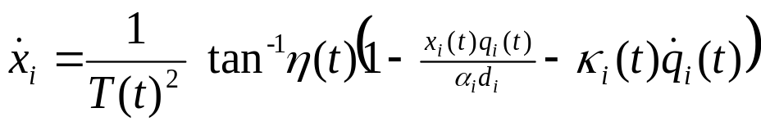
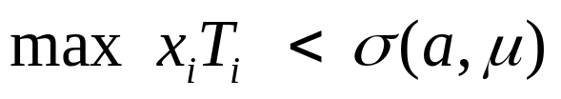
Stability: Stabilized Vegas
x
y
R_{f}(s)
F₁
G₁
TCP
Network
AQM
F_{N}
G_{L}
q
p
R_{b}’(s)
Theorem (Choe & Low, Infocom’03)
Provided R is full rank, feedback loop is locally stable if

Slide 46
Stability: Stabilized Vegas
x
y
R_{f}(s)
F₁
G₁
TCP
Network
AQM
F_{N}
G_{L}
q
p
R_{b}’(s)
Application
Stabilized TCP with current routers
Queueing delay as congestion measure has right scaling
Incremental deployment with ECN

Slide 47
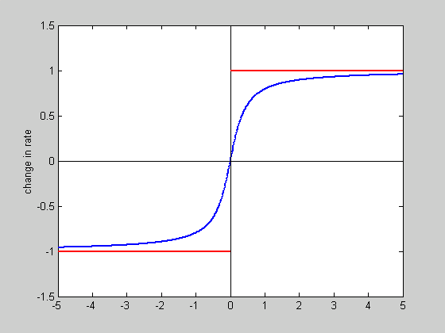
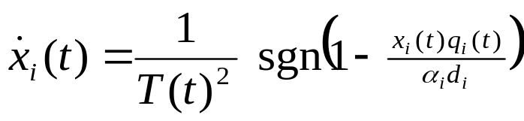
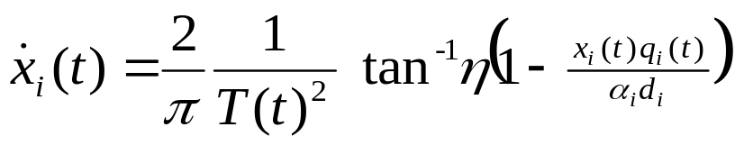
Approximate model

Slide 48
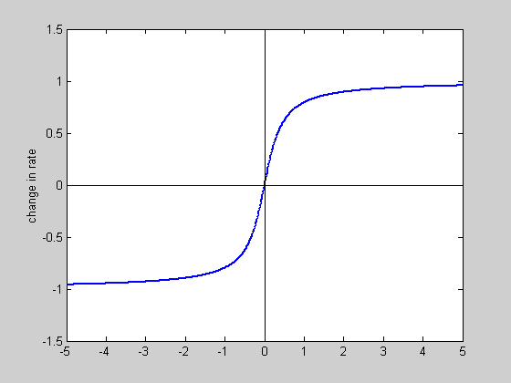
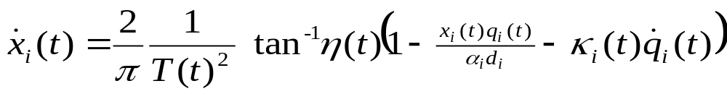
Stabilized Vegas

Slide 49
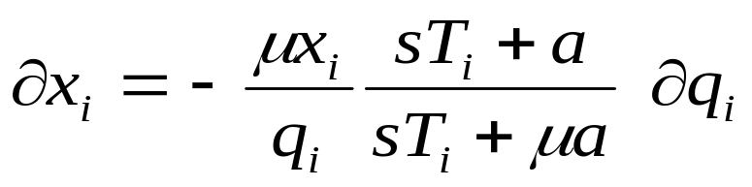
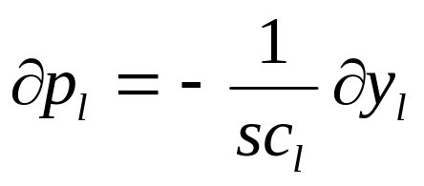
Linearized model
x
y
R_{f}(s)
F₁
G₁
TCP
Network
AQM
F_{N}
G_{L}
q
p
R_{b}’(s)
Additional phase lead

Slide 50
Outline
Motivation
Theory
  TCP/AQM
  TCP/IP
Experimental results

Slide 51
Protocol Decomposition
HOT (Doyle et al)
Minimize user response time
Heavy-tailed file sizes
WWW, Email, Napster, FTP, …
Applications
TCP/AQM
Duality model
Maximize aggregate utility
IP
Shortest-path routing
Minimize path costs
Transmission
Power control
Maximize channel capacity
Ethernet, ATM, POS, WDM, …

Slide 52
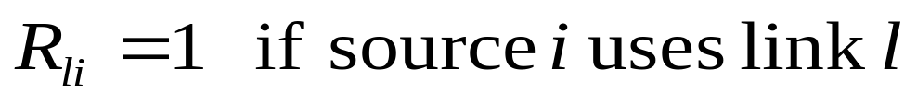
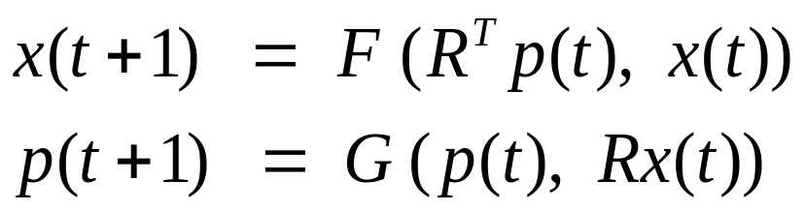
Network model
x
y
R
F₁
G₁
TCP
Network
AQM
F_{N}
G_{L}
q
p
R^{T}
IP routing
Reno, Vegas
DT, RED, …

Slide 53


Duality model of TCP/AQM
Primal-dual algorithm
Reno, Vegas
DT, RED, REM/PI, AVQ
Flow control problem
TCP/AQM
  Maximize utility with different utility functions
Theorem (Low 00): (x*,p*) primal-dual optimal iff

Slide 54
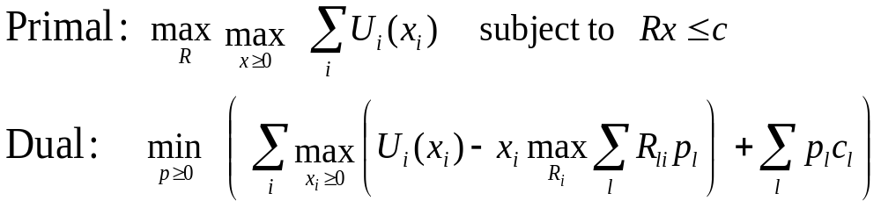
Motivation

Slide 55
Motivation
Shortest path routing!
Can TCP/IP maximize utility?

Slide 56
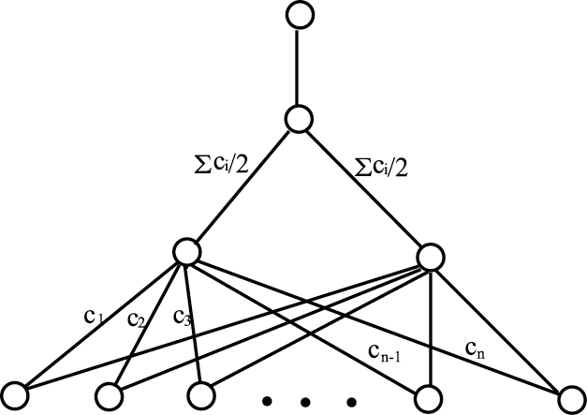
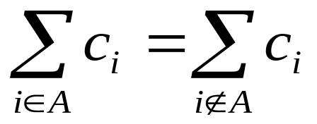
TCP-AQM/IP
Theorem (Wang et al, Infocom’03)
Primal problem is NP-hard
Proof
Reduce integer partition to primal problem
Given: integers {c₁, …, c_{n}}
Find: set A s.t.

Slide 57
TCP-AQM/IP
Theorem (Wang et al, Infocom’03)
Primal problem is NP-hard
Achievable utility of TCP/IP?
Stability?
Duality gap?
Conclusion: Inevitable tradeoff between
achievable utility
routing stability

Slide 58
Ring network
destination
Single destination
Instant convergence of TCP/IP
Shortest path routing
  Link cost = α p_{l}(t) + β d_{l}
price
static
r
routing
TCP/AQM
IP
α p_{l}(0)
α p_{l}(1)
…
…
r(0)
r(1)
r(t), r(t+1) ,

Slide 59
Ring network
destination
Stability: r_{α} ?
Utility: V_{α} ?
r* : optimal routing
V* : max utility
r
TCP/AQM
IP
α p_{l}(0)
α p_{l}(1)
…
…
r(0)
r(1)
r(t), r(t+1) ,

Slide 60
Ring network
destination
Stability: r_{α} ?
Utility: V_{α} ?
link cost = α p_{l}(t) + β d_{l}
Theorem (Infocom 2003)
“No” duality gap
Unstable if β = 0
starting from any r(0), subsequent r(t) oscillates between 0 and 1
r

Slide 61


Ring network
destination
Stability: r_{α} ?
Utility: V_{α} ?
link cost = α p_{l}(t) + β d_{l}
Theorem (Infocom 2003)
Solve primal problem asymptotically
as
r

Slide 62
Ring network
destination
Stability: r_{α} ?
Utility: V_{α} ?
link cost = α p_{l}(t) + β d_{l}
Theorem (Infocom 2003)
α large: globally unstable
α small: globally stable
α medium: depends on r(0)
r

Slide 63


General network
Conclusion: Inevitable tradeoff between
achievable utility
routing stability
random graph
20 nodes, 200 links
Achievable utility

Slide 64
Outline
Motivation
Theory
  TCP/AQM
  TCP/IP
  Non-adaptive sources
  Content distribution
Implementation
WAN in Lab

Slide 65
Current protocols
Equilibrium problems
  Unfairness to connections with large delay
  At high bandwidth, equilibrium loss probability too small
    Unreliable
Stability problems
  Unstable as delay, or as capacity scales up!
  Instability causes large slow-timescale oscillations
    Long time to ramp up after packet losses
    Jitters in rate and delay
    Underutilization as queue jumps between empty & high

Slide 66
Fast AQM Scalable TCP
Equilibrium properties
  Uses end-to-end delay and loss
  Achieves any desired fairness, expressed by utility function
  Very high utilization (99% in theory)
Stability properties
  Stability for arbitrary delay, capacity, routing & load
  Robust to heterogeneity, evolution, …
  Good performance
    Negligible queueing delay & loss (with ECN)
    Fast response

Slide 67
Implementation
Sender-side kernel modification
Build on
  Reno, NewReno, SACK, Vegas
  New insights
Difficulties due to
  Effects ignored in theory
  Large window size
First demonstration in SuperComputing Conf, Nov 2002
Developers: Cheng Jin & David Wei
FAST Team & Partners

Slide 68
Implementation
Packet level effects
  Burstiness (pacing helps)
Bottlenecks in host
  Interrupt control
  Request buffering
Coupling of flow and error control
Rapid convergence
TCP monitor/debugger
equilibrium
slow
start
FAST
retransmit
time
out
FAST
recovery

Slide 69
Outline
Motivation
Theory
  TCP/AQM
  TCP/IP
Experimental results
WAN in Lab

Slide 70

FAST Protocols for Ultrascale Networks
Internet: distributed feedback control system
TCP: adapts sending rate to congestion
AQM: feeds back congestion information
WAN in Lab
Caltech
research & production networks
R_{f} (s)
Chicago
CERN
x
y
TCP
AQM
StarLight
q
R_{b}’(s)
p
Calren2/Abilene
Geneva
Multi-Gbps
50-200ms delay
SURFNet
Theory
Experiment
Amsterdam
People
Implementation
equilibrium
Faculty
Doyle (CDS,EE,BE)
Low (CS,EE)
Newman (Physics)
Paganini (UCLA)
Staff/Postdoc
Bunn (CACR)
Jin (CS)
Ravot (Physics)
Singh (CACR)
Students
Choe (Postech/CIT)
Hu (Williams)
J. Wang (CDS)
Z.Wang (UCLA)
Wei (CS)
Industry
Doraiswami (Cisco)
Yip (Cisco)
155Mb/s
10Gb/s
slow
start
FAST
retransmit
Partners
CERN, Internet2, CENIC, StarLight/UI, SLAC, AMPATH, Cisco
time
out
FAST
recovery
netlab.caltech.edu/FAST
Notes:
Berkeley, June 7, 2002 (Bannister, Walrand, Fisher)
IPAM, Arrowhead, June 10, 2002 (Doyle, Low, Willinger)
Postech-Caltech Symposium, Pohang, S. Korea, Sept 30, 2002 (Jin Lee)
Annual Allerton Conference on Communication, Control, and Computing, Monticello, IL, Oct 3, 2002 (Hajek, Srikant)
IEEE Computer Communications Workshop (CCW), Santa Fe, NM, Oct 14, 2002 (Kunniyur), presenter: Dawn
Lee Center Industry Workshop, Oct 18, 2002, Pasadena (include Cheng Jin’s slides)

Slide 71

Network
(Sylvain Ravot, caltech/CERN)

Slide 72

FAST BMPS
10
#flows
Geneva-Sunnyvale
9
7
FAST
2
Baltimore-Sunnyvale
1
Internet2
Land Speed
Record
2
FAST
Standard MTU
Throughput averaged over > 1hr
1

Slide 73
FAST BMPS
 | flows | Bmps Peta | Thruput Mbps | Distance km | Delay ms | MTU B | Duration s | Transfer GB | Path
Alaska-Amsterdam 9.4.2002 | 1 | 4.92 | 401 | 12,272 | - | - | 13 | 0.625 | Fairbanks, AL – Amsterdam, NL
MS-ISI 29.3.2000 | 2 | 5.38 | 957 | 5,626 | - | 4,470 | 82 | 8.4 | MS, WA – ISI, Va
Caltech-SLAC 19.11.2002 | 1 | 9.28 | 925 | 10,037 | 180 | 1,500 | 3,600 | 387 | CERN -Sunnyvale
Caltech-SLAC 19.11.2002 | 2 | 18.03 | 1,797 | 10,037 | 180 | 1,500 | 3,600 | 753 | CERN -Sunnyvale
Caltech-SLAC 18.11.2002 | 7 | 24.17 | 6,123 | 3,948 | 85 | 1,500 | 21,600 | 15,396 | Baltimore -Sunnyvale
Caltech-SLAC 19.11.2002 | 9 | 31.35 | 7,940 | 3,948 | 85 | 1,500 | 4,030 | 3,725 | Baltimore -Sunnyvale
Caltech-SLAC 20.11.2002 | 10 | 33.99 | 8,609 | 3,948 | 85 | 1,500 | 21,600 | 21,647 | Baltimore -Sunnyvale
Mbps = 10⁶ b/s; GB = 2³⁰ bytes

Slide 74





Aggregate throughput
88%
FAST
Standard MTU
Utilization averaged over > 1hr
90%
90%
Average utilization
92%
95%
1hr
1hr
6hr
1.1hr
6hr
1 flow 2 flows 7 flows 9 flows 10 flows

Slide 75

SCinet
Caltech-SLAC experiments
SC2002
Baltimore, Nov 2002
Highlights
10
FAST TCP
Standard MTU
Peak window = 14,255 pkts
Throughput averaged over > 1hr
925 Mbps single flow/GE card
9.28 petabit-meter/sec
1.89 times LSR
8.6 Gbps with 10 flows
34.0 petabit-meter/sec
6.32 times LSR
21TB in 6 hours with 10 flows
Implementation
Sender-side modification
Delay based
Geneva-Sunnyvale
9
7
#flows
FAST
2
Baltimore-Sunnyvale
1
I2 LSR
1
2
Internet: distributed feedback
system
Theory
Experiment
Geneva
x
R_{f} (s)
TCP
AQM
7000km
Sunnyvale
Baltimore
R_{b}’(s)
p
3000km
Chicago
1000km
netlab.caltech.edu/FAST
C. Jin, D. Wei, S. Low
FAST Team and Partners
Notes:
Berkeley, June 7, 2002 (Bannister, Walrand, Fisher)
IPAM, Arrowhead, June 10, 2002 (Doyle, Low, Willinger)
Postech-Caltech Symposium, Pohang, S. Korea, Sept 30, 2002 (Jin Lee)
Annual Allerton Conference on Communication, Control, and Computing, Monticello, IL, Oct 3, 2002 (Hajek, Srikant)
IEEE Computer Communications Workshop (CCW), Santa Fe, NM, Oct 14, 2002 (Kunniyur), presenter: Dawn
Lee Center Industry Workshop, Oct 18, 2002, Pasadena (include Cheng Jin’s slides)

Slide 76
FAST vs Linux TCP
 | flows | Bmps Peta | Thruput Mbps | Distance km | Delay ms | MTU B | Duration s | Transfer GB | Path
Linux TCP txqueulen=100 | 1 | 1.86 | 185 | 10,037 | 180 | 1,500 | 3600 | 78 | CERN - Sunnyvale
Linux TCP txqueulen=10000 | 1 | 2.67 | 266 | 10,037 | 180 | 1,500 | 3600 | 111 | CERN - Sunnyvale
FAST 19.11.2002 | 1 | 9.28 | 925 | 10,037 | 180 | 1,500 | 3600 | 387 | CERN -Sunnyvale
Linux TCP txqueulen=100 | 2 | 3.18 | 317 | 10,037 | 180 | 1,500 | 3600 | 133 | CERN - Sunnyvale
Linux TCP txqueulen=10000 | 2 | 9.35 | 931 | 10,037 | 180 | 1,500 | 3600 | 390 | CERN - Sunnyvale
FAST 19.11.2002 | 2 | 18.03 | 1,797 | 10,037 | 180 | 1,500 | 3600 | 753 | CERN -Sunnyvale
Mbps = 10⁶ b/s; GB = 2³⁰ bytes; Delay = propagation delay
Linux TCP expts: Jan 28-29, 2003

Slide 77




Aggregate throughput
92%
FAST
Standard MTU
Utilization averaged over 1hr
2G
48%
Average utilization
95%
1G
27%
16%
19%
txq=100
txq=10000
Linux TCP Linux TCP FAST
Linux TCP Linux TCP FAST

Slide 78

Effect of MTU
Linux TCP
(Sylvain Ravot, Caltech/CERN)

Slide 79

Caltech-SLAC entry
Rapid recovery
after possible
hardware glitch
Power glitch
Reboot
100-200Mbps ACK traffic

Slide 80
SCinet
Caltech-SLAC experiments
SC2002
Baltimore, Nov 2002
Acknowledgments
netlab.caltech.edu/FAST
Prototype
C. Jin, D. Wei
Theory
D. Choe (Postech/Caltech), J. Doyle, S. Low, F. Paganini (UCLA), J. Wang, Z. Wang (UCLA)
Experiment/facilities
  Caltech: J. Bunn, C. Chapman, C. Hu (Williams/Caltech), H. Newman, J. Pool, S. Ravot (Caltech/CERN), S. Singh
  CERN: O. Martin, P. Moroni
  Cisco: B. Aiken, V. Doraiswami, R. Sepulveda, M. Turzanski, D. Walsten, S. Yip
  DataTAG: E. Martelli, J. P. Martin-Flatin
  Internet2: G. Almes, S. Corbato
  Level(3): P. Fernes, R. Struble
  SCinet: G. Goddard, J. Patton
  SLAC: G. Buhrmaster, R. Les Cottrell, C. Logg, I. Mei, W. Matthews, R. Mount, J. Navratil, J. Williams
  StarLight: T. deFanti, L. Winkler
Major sponsors
ARO, CACR, Cisco, DataTAG, DoE, Lee Center, NSF
Notes:
Berkeley, June 7, 2002 (Bannister, Walrand, Fisher)
IPAM, Arrowhead, June 10, 2002 (Doyle, Low, Willinger)
Postech-Caltech Symposium, Pohang, S. Korea, Sept 30, 2002 (Jin Lee)
Annual Allerton Conference on Communication, Control, and Computing, Monticello, IL, Oct 3, 2002 (Hajek, Srikant)
IEEE Computer Communications Workshop (CCW), Santa Fe, NM, Oct 14, 2002 (Kunniyur), presenter: Dawn
Lee Center Industry Workshop, Oct 18, 2002, Pasadena (include Cheng Jin’s slides)

Slide 81
FAST URL’s
FAST website
http://netlab.caltech.edu/FAST/
Cottrell’s SLAC website
http://www-iepm.slac.stanford.edu
/monitoring/bulk/fast

Slide 82
Outline
Motivation
Theory
  TCP/AQM
  TCP/IP
  Non-adaptive sources
  Content distribution
Implementation
WAN in Lab

Slide 83
S
S
OPM
R
λ₁
λ₁
R
fiber spool
S
S
S
λ₂₀
EDFA
EDFA
λ₂₀
S
R
R
S
S
500 km
H
: server
electronic
crossconnect
(Cisco 15454)
Max path length = 10,000 km
Max one-way delay = 50ms
R
: router

Slide 84
Unique capabilities
WAN in Lab
  Capacity: 2.5 – 10 Gbps
  Delay: 0 – 100 ms round trip
Configurable & evolvable
  Topology, rate, delays, routing
  Always at cutting edge
Risky research
  MPLS, AQM, routing, …
Integral part of R&A networks
  Transition from theory, implementation, demonstration, deployment
  Transition from lab to marketplace
Global resource
λ₁
λ₁
R1
λ₂
λ₂
R2
λ₃
λ₃
λ₄
λ₁₈
R10
λ₁₉
λ₁₉
λ₂₀
λ₂₀
(a) Physical network

Slide 85
Unique capabilities
WAN in Lab
  Capacity: 2.5 – 10 Gbps
  Delay: 0 – 100 ms round trip
Configurable & evolvable
  Topology, rate, delays, routing
  Always at cutting edge
Risky research
  MPLS, AQM, routing, …
Integral part of R&A networks
  Transition from theory, implementation, demonstration, deployment
  Transition from lab to marketplace
Global resource
λ₁
λ₂
λ₂₀
R1
R2
λ₃
λ₁₉
λ₄
R10
R3
(b) Logical network

Slide 86
Unique capabilities
WAN in Lab
  Capacity: 2.5 – 10 Gbps
  Delay: 0 – 100 ms round trip
Configurable & evolvable
  Topology, rate, delays, routing
  Always at cutting edge
Risky research
  MPLS, AQM, routing, …
Integral part of R&A networks
  Transition from theory, implementation, demonstration, deployment
  Transition from lab to marketplace
Global resource
WAN in Lab
Caltech
research & production networks
Chicago
CERN
StarLight
Calren2/Abilene
Geneva
Multi-Gbps
50-200ms delay
SURFNet
Experiment
Amsterdam

Slide 87
Coming together …
Clear & present
Need
Resources

Slide 88
Coming together …
Clear & present
Need
Resources

Slide 89
Coming together …
Clear & present
Need
FAST
Protocols
Resources

Slide 90
FAST Protocols for Ultrascale Networks
Internet: distributed feedback control system
TCP: adapts sending rate to congestion
AQM: feeds back congestion information
WAN in Lab
Caltech
research & production networks
R_{f} (s)
Chicago
CERN
x
y
TCP
AQM
StarLight
q
R_{b}’(s)
p
Calren2/Abilene
Geneva
Multi-Gbps
50-200ms delay
SURFNet
Theory
Experiment
Amsterdam
People
Implementation
equilibrium
Faculty
Doyle (CDS,EE,BE)
Low (CS,EE)
Newman (Physics)
Paganini (UCLA)
Staff/Postdoc
Bunn (CACR)
Jin (CS)
Ravot (Physics)
Singh (CACR)
Students
Choe (Postech/CIT)
Hu (Williams)
J. Wang (CDS)
Z.Wang (UCLA)
Wei (CS)
Industry
Doraiswami (Cisco)
Yip (Cisco)
155Mb/s
10Gb/s
slow
start
FAST
retransmit
Partners
CERN, Internet2, CENIC, StarLight/UI, SLAC, AMPATH, Cisco
time
out
FAST
recovery
netlab.caltech.edu/FAST
Notes:
Berkeley, June 7, 2002 (Bannister, Walrand, Fisher)
IPAM, Arrowhead, June 10, 2002 (Doyle, Low, Willinger)
Postech-Caltech Symposium, Pohang, S. Korea, Sept 30, 2002 (Jin Lee)
Annual Allerton Conference on Communication, Control, and Computing, Monticello, IL, Oct 3, 2002 (Hajek, Srikant)
IEEE Computer Communications Workshop (CCW), Santa Fe, NM, Oct 14, 2002 (Kunniyur), presenter: Dawn
Lee Center Industry Workshop, Oct 18, 2002, Pasadena (include Cheng Jin’s slides)

Slide 91
Backup slides

Slide 92
TCP Congestion States
ack for syn/ack
cwnd > ssthresh
pacing? gamma?
Established
High
Throughput
Slow Start

Slide 93
From Slow Start to
High Throughput
Linux TCP handshake differs from the TCP specification
Is 64 KB too small for ssthresh?
  1 Gbps x 100 ms = 12.5 MB !
What about pacing?
Gamma parameter in Vegas

Slide 94
TCP Congestion States
Established
High
Throughput
Slow Start
3 dup acks
Time-out *
FAST’s
Retransmit
retransmision
timer fired

Slide 95
High Throughput
Update cwnd as follows:
    +1 pkts in queue < α + kq’
    - 1 otherwise
Packet reordering may be frequent
Disabling delayed ack can generate many dup acks
Is THREE the right number for Gbps?

Slide 96
TCP Congestion States
Established
High
Throughput
Slow Start
3 dup acks
snd_una >
recorded snd_nxt
FAST’s
Retransmit
FAST’s
Recovery
send packet if
in_flight < cwnd
retransmit packet
record snd_nxt
reduce cwnd/ssthresh

Slide 97
When Loss Happens
Reduce cwnd/ssthresh only when loss is due to congestion
Maintain in_flight and send data when in_flight < cwnd
Do FAST’s Recovery until snd_una >= recorded snd_nxt

Slide 98
TCP Congestion States
Established
High
Throughput
Slow Start
3 dup acks
Time-out *
FAST’s
Retransmit
retransmision
timer fired
FAST’s
Recovery
retransmit packet
record snd_nxt
reduce cwnd/ssthresh

Slide 99
When Time-out Happens
Very bad for throughput
Mark all unacknowledged pkts as lost and do slow start
Dup acks cause false retransmits since receiver’s state is unknown
Floyd has a “fix” (RFC 2582).

Slide 100
TCP Congestion States
ack for syn/ack
Established
cwnd > ssthresh
High
Throughput
Slow Start
3 dup acks
snd_una >
recorded snd_nxt
Time-out *
FAST’s
Retransmit
retransmision
timer fired
FAST’s
Recovery
retransmit packet
record snd_nxt
reduce cwnd/ssthresh

Slide 101
Individual Packet States
Birth
Sending
In Flight
Received
queueing
Queued
Dropped
Buffered
out of order queue
and no memory
ack’d
Freed
Delivered

Slide 102

SCinet
Bandwidth Challenge
SC2002
Baltimore, Nov 2002
Highlights
FAST TCP
Standard MTU
Peak window = 14,100 pkts
940 Mbps single flow/GE card
9.4 petabit-meter/sec
1.9 times LSR
9.4 Gbps with 10 flows
37.0 petabit-meter/sec
6.9 times LSR
16TB in 6 hours with 7 flows
Implementation
Sender-side modification
Delay based
Stabilized Vegas
Sunnyvale-Geneva
Baltimore-Geneva
Baltimore-Sunnyvale
SC2002
10 flows
SC2002
2 flows
I2 LSR
29.3.00
multiple
SC2002
1 flow
9.4.02
1 flow
22.8.02
IPv6
Internet: distributed feedback
system
Theory
Experiment
Geneva
x
R_{f} (s)
TCP
AQM
7000km
Sunnyvale
Baltimore
R_{b}’(s)
p
3000km
Chicago
1000km
netlab.caltech.edu/FAST
C. Jin, D. Wei, S. Low
FAST Team and Partners
Notes:
Berkeley, June 7, 2002 (Bannister, Walrand, Fisher)
IPAM, Arrowhead, June 10, 2002 (Doyle, Low, Willinger)
Postech-Caltech Symposium, Pohang, S. Korea, Sept 30, 2002 (Jin Lee)
Annual Allerton Conference on Communication, Control, and Computing, Monticello, IL, Oct 3, 2002 (Hajek, Srikant)
IEEE Computer Communications Workshop (CCW), Santa Fe, NM, Oct 14, 2002 (Kunniyur), presenter: Dawn
Lee Center Industry Workshop, Oct 18, 2002, Pasadena (include Cheng Jin’s slides)

Slide 103

FAST BMPS
Sunnyvale-Geneva
Bmps Thruput Duration
37.0 9.40 Gbps min
9.42 940 Mbps 19 min
5.38 1.02 Gbps 82 sec
4.93 402 Mbps 13 sec
0.03 8 Mbps 60 min
Baltimore-Sunnyvale
SC2002
10 flows
FAST
SC2002
1 flow
29.3.2000
multiple
9.4.2002
1 flow
I2 LSR
22.8.2002
IPv6

Slide 104

FAST: 7 flows
cwnd = 6,658 pkts per flow
Statistics
Data: 2.857 TB
Distance: 3,936 km
Delay: 85 ms
Average
Duration: 60 mins
Thruput: 6.35 Gbps
Bmps: 24.99 petab-m/s
Peak
Duration: 3.0 mins
Thruput: 6.58 Gbps
Bmps: 25.90 petab-m/s
18 Nov 2002 Mon
17 Nov 2002 Sun
Network
SC2002 (Baltimore) → SLAC (Sunnyvale), GE , Standard MTU

Slide 105

FAST: single flow
cwnd = 14,100 pkts
Statistics
Data: 273 GB
Distance: 10,025 km
Delay: 180 ms
Average
Duration: 43 mins
Thruput: 847 Mbps
Bmps: 8.49 petab-m/s
Peak
Duration: 19.2 mins
Thruput: 940 Mbps
Bmps: 9.42 petab-m/s
17 Nov 2002 Sun
Network
CERN (Geneva) → SLAC (Sunnyvale), GE, Standard MTU

Slide 106
SCinet
Bandwidth Challenge
SC2002
Baltimore, Nov 2002
Acknowledgments
Prototype
C. Jin, D. Wei
Theory
D. Choe (Postech/Caltech), J. Doyle, S. Low, F. Paganini (UCLA), J. Wang, Z. Wang (UCLA)
Experiment/facilities
  Caltech: J. Bunn, S. Bunn, C. Chapman, C. Hu (Williams/Caltech), H. Newman, J. Pool, S. Ravot (Caltech/CERN), S. Singh
  CERN: O. Martin, P. Moroni
  Cisco: B. Aiken, V. Doraiswami, M. Turzanski, D. Walsten, S. Yip
  DataTAG: E. Martelli, J. P. Martin-Flatin
  Internet2: G. Almes, S. Corbato
  SCinet: G. Goddard, J. Patton
  SLAC: G. Buhrmaster, L. Cottrell, C. Logg, W. Matthews, R. Mount, J. Navratil
  StarLight: T. deFanti, L. Winkler
Major sponsors/partners
ARO, CACR, Cisco, DataTAG, DoE, Lee Center, Level3, NSF
netlab.caltech.edu/FAST
Notes:
Berkeley, June 7, 2002 (Bannister, Walrand, Fisher)
IPAM, Arrowhead, June 10, 2002 (Doyle, Low, Willinger)
Postech-Caltech Symposium, Pohang, S. Korea, Sept 30, 2002 (Jin Lee)
Annual Allerton Conference on Communication, Control, and Computing, Monticello, IL, Oct 3, 2002 (Hajek, Srikant)
IEEE Computer Communications Workshop (CCW), Santa Fe, NM, Oct 14, 2002 (Kunniyur), presenter: Dawn
Lee Center Industry Workshop, Oct 18, 2002, Pasadena (include Cheng Jin’s slides)

