Slide 1
End to end lightpaths for large file transfer over fast long-distance networks
Jan 29, 2003
Bill St. Arnaud, Wade Hong, Geoff Hayward, Corrie Cost, Bryan Caron, Steve MacDonald

Slide 2
Problem
TCP throughput over long fat pipes very susceptible to packet loss, MTU, TCP kernel, Buffer memory, AQM optimized for commodity Internet, etc
Packet loss can result from congestion, but also underlying BER
  achieve a gigabit per second with TCP on a coast-to-coast path (rtt = 40 msec), with 1500 byte packets, the loss rate can not exceed 8.5x10^-8 packets
  “End to end” BER for optical networks 10^-12 to 10^-15 which means packet loss rate of approximately 10^-8 to 10^-11
  The bigger the packet the greater the loss rate!!!
Cost of routers significantly greater than switches for 10 Gbps and higher (particularly for large number of lambdas)
Lots of challenges maintaining consistent router performance across multiple independent managed networks
  MTU, auto-negotiating Ethernet, insufficient buffer memory
Require consistent and similar throughput for multiple sites to maintain coherency for grids and SANs and new “space” storage networks using erasure codes e.g. Oceanstore
For maximum throughput OS and kernel bypass may be required
Many commercial SAN/Grid products will only work with QoS network

Slide 3
Possible Solutions
For point to point large file transfer a number of possible techniques such as FAST, XCP, parallel TCP, UDP, etc
  Very scalable and allows same process to be used for all sorts of file transfer from large to small
  But will it address other link problems?
Datagram QoS is a possibility to guarantee bandwidth
  But requires costly routers and no proven approach across independent managed networks (or campus)
  Does not solve problem of MTU,link problems, etc
E2E lightpaths - all solutions are possible
  Allows new TCP and non TCP file transfers
  Allows parallel TCP with consistent skew on data striping
  Allows protocols that support OS bypass, etc
  Guarantees consistent throughput for distributed coherence and enables news concepts of storing large data sets in “space”
  Uses much lower cost switches and bypasses routers

Slide 4
What are E2E lightpaths?
Customer controlled E2E lightpaths are not about optical networking
  E2E lightpaths do not use GMPLS or ASON
The power of the Internet was that an overlay packet network controlled by end user and ISPs could be built on top of telco switched network
  CA*net 4 is an optical overlay network on top of telco optical network where switching is controlled by end users
More akin to MAE-E “peermaker” but at a finer granularity
  “Do you have an e2e lightpath for file transfer terminating at a given IX? Are you interested in peering with my e2e lightpath to enable big file transfer?”
  Lightpath may be only from border router to border router
With OBGP can establish new BGP path that bypasses most (if not all) routers
  Allows lower cost remote peering and transit
  Allows e2e lightpaths for big file transfer

Slide 5




e2e Lightpaths
x.x.x.1
Normal IP/BGP path
y.y.y.1
Optical “Peermaker”
Only y.y.y.1 advertised to x.x.x.1 via OBGP path
Only x.x.x.1 advertised to y.y.y.1 via OBGP path
OBGP path
Application or end user controls peering of BGP optical paths for transfer of elephants!!!

Slide 6
CA*net 4
Edmonton
Saskatoon
Vancouver
Winnipeg
Calgary
Regina
Halifax
Kamloops
Thunder Bay
Victoria
St. John's
Quebec City
Charlottetown
Seattle
Sudbury
Montreal
Ottawa
Fredericton
Halifax
Minneapolis
Toronto
Kingston
CA*net 4 Node
London
Buffalo
Boston
Possible Future Breakout
Hamilton
Albany
Windsor
Possible Future link or Option
Chicago
New York
CA*net 4 OC192

Slide 7
CA*net 4 Architecture Principles
A network of point to point condominium wavelengths
  Do not confuse with traditional optical solutions like GMPLS or ASON
Grid service architecture for user control and management of e2e lightpaths
  Uses OGSA and Jini/JavaSpaces for end to end customer control
Owners of wavelengths determine topology and routing of their particular light paths
All wavelengths terminate at mini-IXs where owner can
  add/drop STS channel or wavelength
  cross connect to another condominium owner’s STS channels or wavelengths
  Web serviced enabled “peermaker”
Condominium owner can recursively sub partition their wavelengths and give ownership to other entities
Wavelengths become objects complete with polymorphism, inheritance, classes, etc

Slide 8
So what did we do?
Demonstrate a manually provisioned “e2e” lightpath
Transfer 1TB of ATLAS MC data generated in Canada from TRIUMF to CERN
– 17,000 km -9600 byte MTU
10 Gbe NIC cards on servers
Demonstrated a number of techniques for large file transfer including bbftp and tsunami
Demonstrated wide area SAN using un-modified “out of the box” parallel TCP with bidirectional data rates of 5 to 6 Gbps

Slide 9
Comparative Results
(TRIUMF to CERN)
Transfer Program | Transferred | Average | Max Avg | PBMPS
wuftp 100 MbE (1500 byte MTU) | 600 MB | 3.4 Mbps |  | .0578
wuftp 10 GbE | 6442 MB | 71 Mbps |  | 1.207
Iperf (10 streams) | 275 MB | 940 Mbps | 1136 Mbps | 19.312
Pftp (germany) | 600MB | 532 Mbps |  | 9.044
bbftp (10 streams) | 1.4 TB | 666 Mbps | 710 Mbps | 12.07
Tsunami - disk to disk | 0.5 TB | 700 Mbps | 825 Mbps | 14.025
Tusnami - disk to memory | 12 GB | >1.024 Gbps |  | 17.408

Slide 10
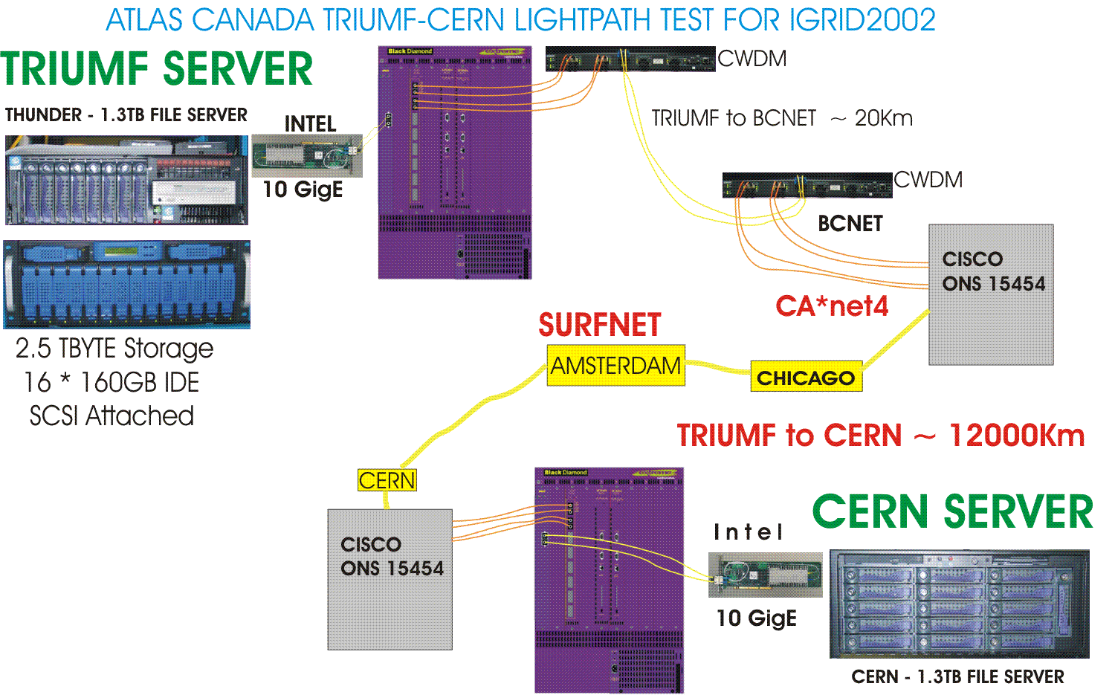
TRIUMF to CERN Topology

Slide 11
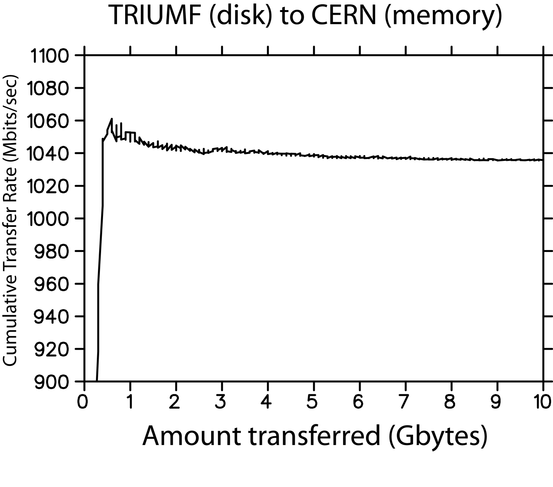
Exceeding 1Gbit/sec …
( using tsunami)

Slide 12
Lessons Learned - 1
10 GbE appears to be plug and play
channel bonding of two GbEs seems to work very well (on an unshared link!)
Linux software RAID faster than most conventional SCSI and IDE hardware RAID
more disk spindles is better
  distributed across multiple controllers and I/O bridges
the larger files the better for thruput
very lucky, no hardware failures (50 drives)

Slide 13
Lessons Learned - 2
unless programs are multi-threaded or the kernel permits process locking, dual CPUs will not give best performance
  single 2.8 GHz likely to outperform dual 2.0 GHz, for a single purpose machine like our fileserver
more memory is better
concatenating, compressing and deleting files takes longer than transferring
never quote numbers when asked :)

Slide 14
Yotta Yotta “Optic Boom”
Uses parallel TCP with data stripping
Each TCP channel assigned to a given e2e lightpath
Allows for consistent skew on data stripping
Allows for consistent throughput and coherence for geographic distributed SANs
Allows synchronization of data sets across multiple servers ultimately leading to “space” storage

Slide 15


OTTAWA
VANCOUVER
1 x GE loop-back
on OC-24
8 x GE @ OC-12 (622Mb/s)
CHICAGO
Sustained Throughput ~11.1 Gbps Ave. Utilization = 93%

Slide 16
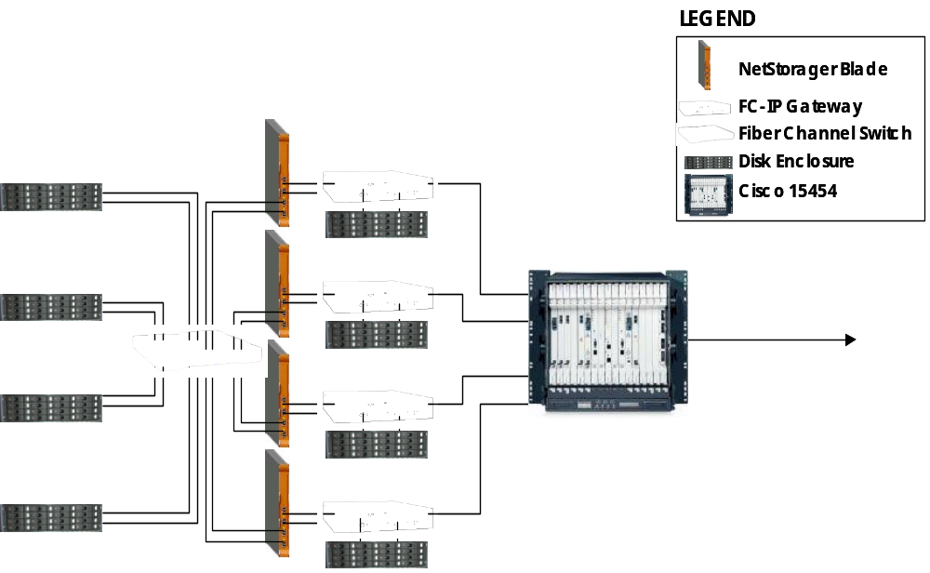
Local Configuration

Slide 17
What Next?
continue testing 10GbE
  try the next iteration of the Intel 10GbE cards in back to back mode
  bond multiple GbEs across CA*net 4
try aggregating multiple sources to fill a 10 Gbps pipe across CA*net 4
setup a multiple GbE testbed across CA*net 4 and beyond
drive much more than 1 Gbps from a single host

Slide 18
Further Investigations
Linux TCP/IP Network Stack Performance
  Efficient copy routines (zero copy, copy routines, read copy update)
Stream Control Transmission Protocol
Scheduled Transfer Protocol
  OS bypass and zero copy
  RDMA over IP
Web 100, Net 100, DRS

