Slide 1
A Note on the Stochastic Bias of Some Increase-Decrease Congestion Controls: HighSpeed TCP Case Study
M. Vojnović, J.-Y. Le Boudec, D. Towsley, V. Misra
EPFL, EPFL, UMASS, Columbia U
PFLDNet 2003, CERN, Geneve, Switzerland, Feb 2-3, 2003.

Slide 2
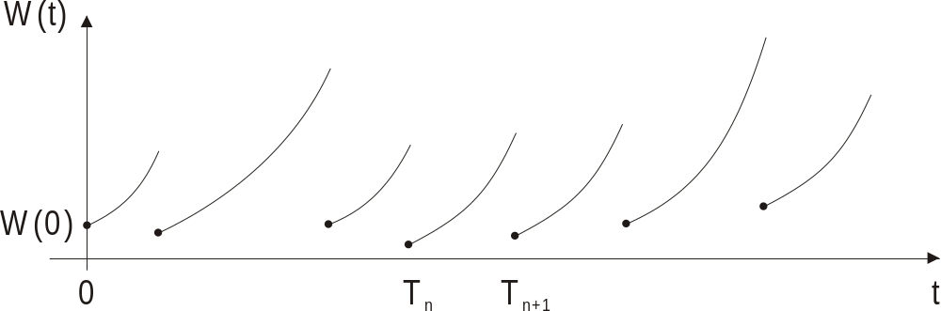
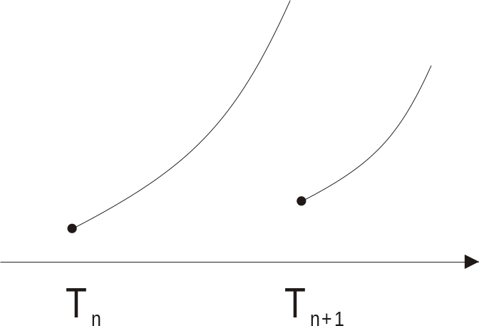
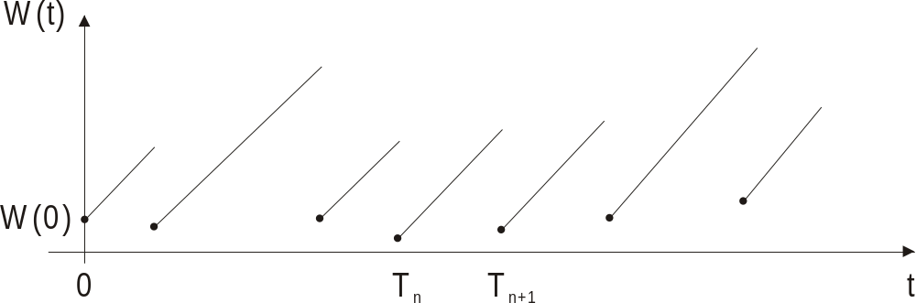
Idealized Fluid Increase-Decrease
W(T_{n+1}-)
Rate of
increase
a(W(t))
Jump to W(T_{n+1})=b(W(T_{n+1}-))
t
Many window and rate controls are increase decrease controls
Rate of
increase,
a(w)=α
In particular,
AIMD:
w
Jump to,
b(w) = β w

Slide 3
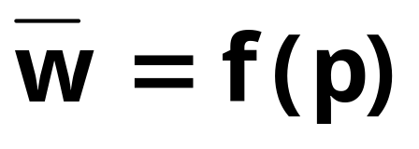
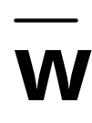

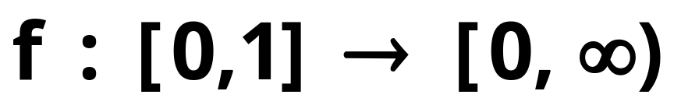
Direct Problem
Problem:
given: w->a(w) and w->b(w)
process of inter-loss times S
find:
is time-average window
is loss event rate
is a “loss-throughput
formula”; a “response function”

Slide 4
Inverse Problem
Problem:
given:
process of inter-loss times S
find: w->a(w) and w->b(w)
“Goal is to design an increase-decrease control, i.e., to find a() and b(), to target a given response function p->f(p)”

Slide 5
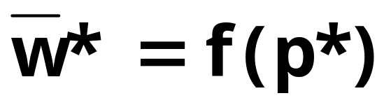
A Design Method
Method: given p->f(p), find a() and b() s.t. for some reference inter-loss times S*
Note: In many works, S* is taken to be a sequence of fixed, equal, inter-loss times, we call “deterministic constant inter-loss times”.

Slide 6
Design Method (Cont’d)
Q1: Is there S* that would be invariant, or at least, it would be found to hold almost in many cases in some parts of the Internet?
Q2: Is there some preferred choice of S*?
Q2bis: Why one S* would be preferred over some other?

Slide 7
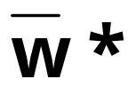
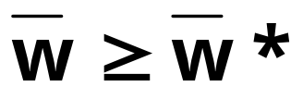
Problem that we Study
Problem: Identify increase-decrease controls, which under S* attain time-average window , and under some other S,
Note: for the given set of increase-decrease controls, S* is extremal over the set of inter-loss times S.
It is a worst-case!

Slide 8
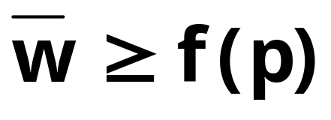
Problem that we Study (Cont’d)
Assume we designed an increase-decrease control, i.e. found a() and b(), such that under S*:
Problem (cont’d): Find conditions under which for any inter-loss times in S,

Slide 9
Rest of the Talk
We assume, S* = deterministic constant inter-loss times
Result I - S* is worst-case for AIMD over the entire set S of inter-loss times with the same mean as in S*
Result II - S* is (almost) worst case for a wider set of increase-decrease controls (defined later) over the set S of i.i.d. random inter-loss times with the same mean as in S*. Moreover, the time-average window is (almost) lower bounded by its target response function.
Application of Result II to HighSpeed TCP
Concluding Remarks

Slide 10
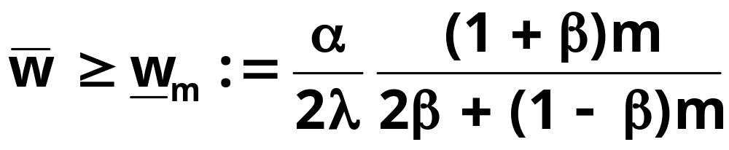
Result I: S* is worst-case for AIMD
Consider an AIMD control with α>0, 0<β<1, initial window size w₀>=0.
Result Ia: for any m, w₀, λ,
This is a lower bound that holds for any sequence of inter-loss times of length m with mean 1/λ.

Slide 11
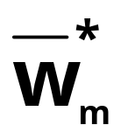
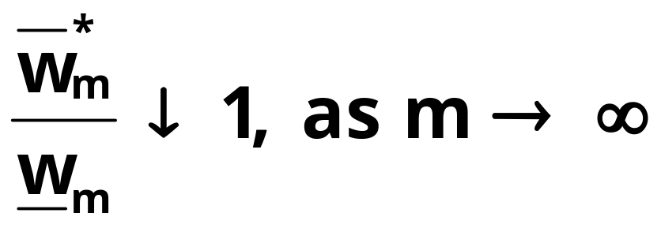
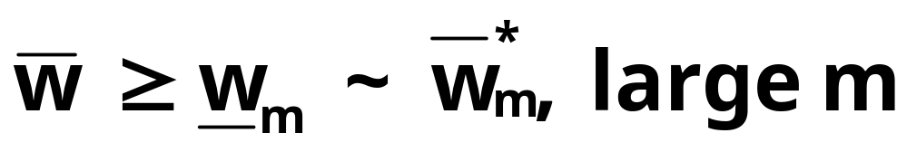
Result I: (Cont’d)
= time-average window attained with inter-loss times fixed to 1/λ
Result Ib: for any w₀, λ,
Putting together:

Slide 12
Result I: (Cont’d)
Remark 1: In long-run, determinism minimizes time-average window. It is a worst-case!
Remark 2: In fact, the worst-case extremal property for AIMD can be concluded from a result by Altman, Avrachenkov, Barakat (Sigcomm 2000) over the set S of stationary ergodic inter-loss times.

Slide 13

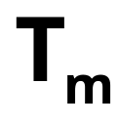
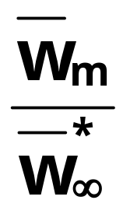
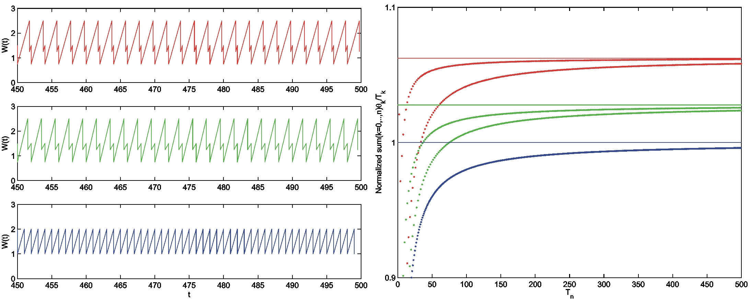
An Illustrative Example:
Period-Two Loss Events
Consider sequence of inter-loss times, 2η/λ, 2(1-η)/λ, 2η/λ, 2(1-η)/λ, …, for some 0<=η<=1.
= time-average window at the m-th loss event
= time instant of the m-th loss event
η=1/8
η=1/8
η=1/4
η=1/4
η=1/2
η=1/2

Slide 14
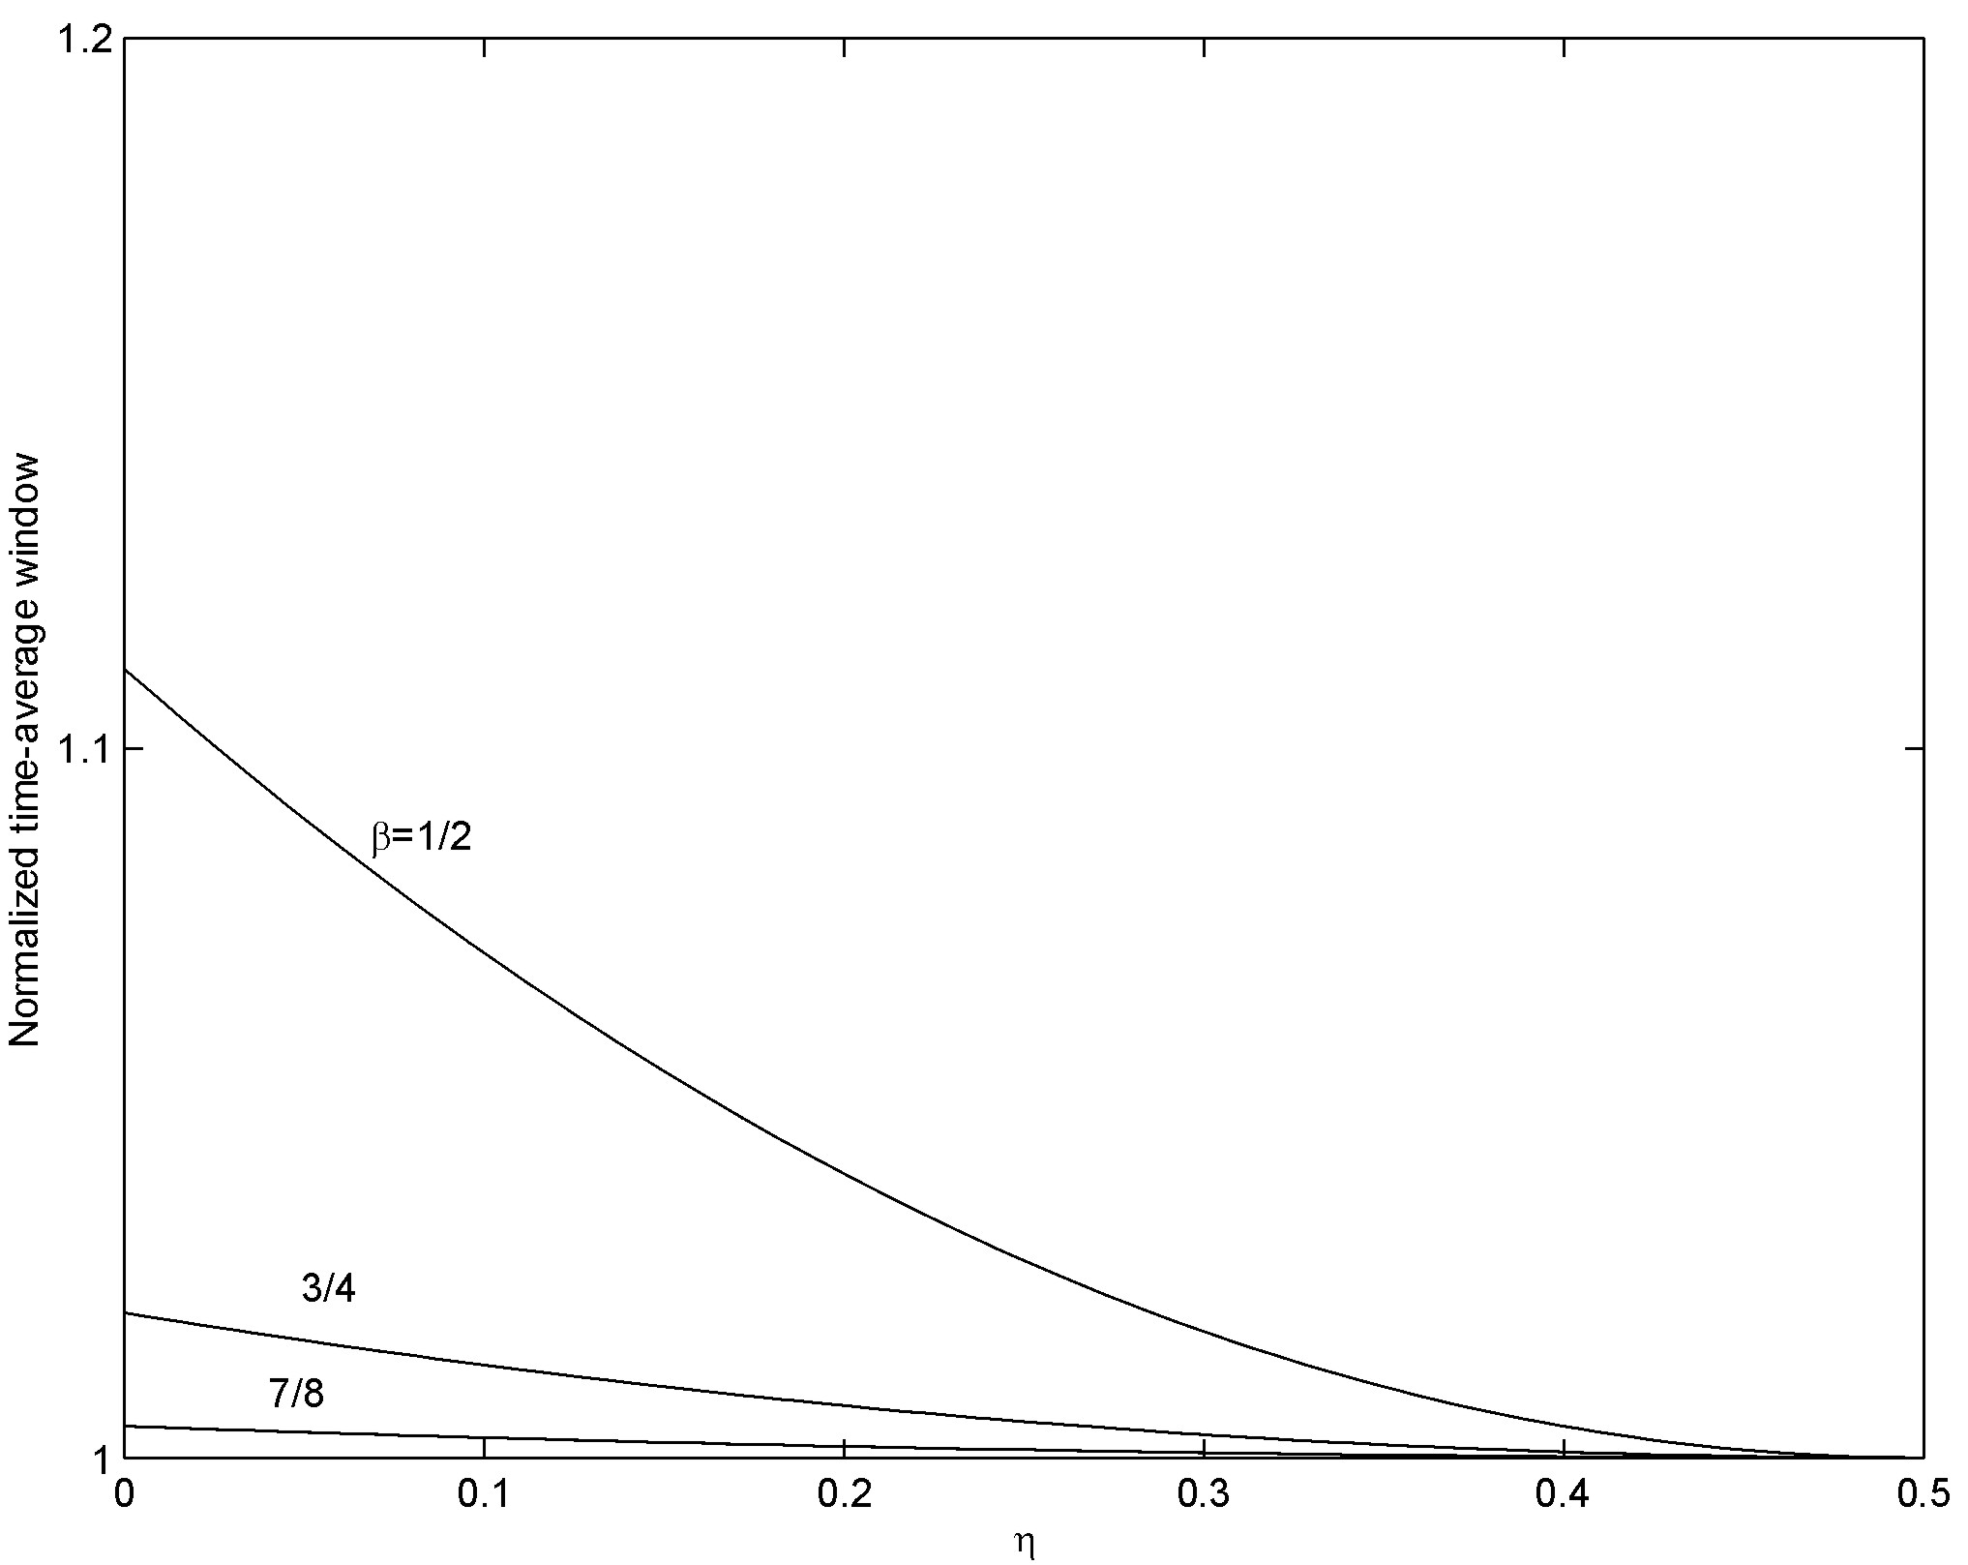
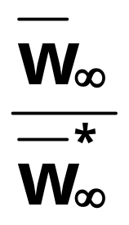
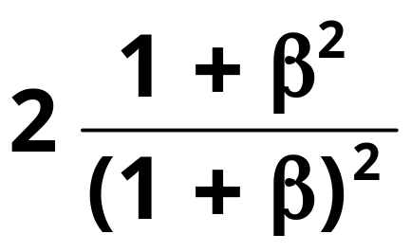
An Illustrative Example: Period-Two Loss Events (Cont’d)
At most:
deterministic
constant
inter-loss
times
η

Slide 15
Result II: Worst-Case of the Determinism for Increase-Decrease Controls other than AIMD
Def. set C_{ε} of increase-decrease controls:
A1): x->φ⁻¹(b(φ(x))) is increasing convex
x -> φ(x) : 1/a(x) is the first derivative of φ(x)
A2): there exists a convex function
x->ψ(x) s.t., for some ε>=0,
ψ(x) <=φ⁻¹(x)<=(1+ ε) ψ(x), all x>=0
Note 1: A2) is a relaxation of: x->a(x) non-decreasing
Note 2: the set C_{ε} encompasses HighSpeed TCP

Slide 16
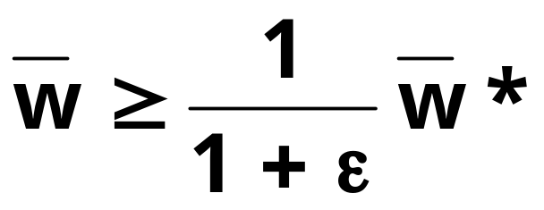


Result II: (Cont’d)
Result IIa: For any increase-decrease control in C_{ε}, it holds
where is the time-average window attained with any i.i.d. random inter-loss times with mean 1/λ, and is the time-average window under S*.
Note: for all incdec controls in C₀, S* is worst-case over the set of i.i.d. random inter-loss times.

Slide 17
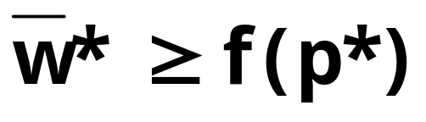
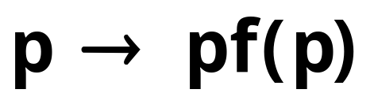
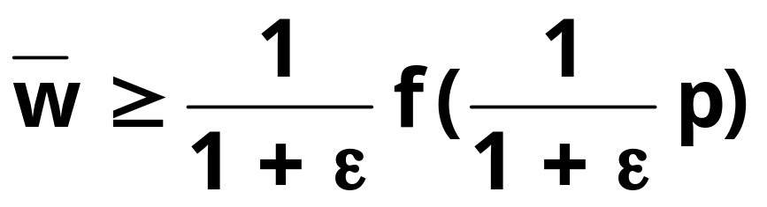
Result II: (Cont’d, Cont’d)
Result IIb: If , and is non-decreasing. Then, for all increase-decrease controls in C_{ε}, and any i.i.d. random inter-loss times, it holds
The result tells us: if ε=0, then
is never smaller than f(p).
If ε>0, but small, the statement holds almost.

Slide 18
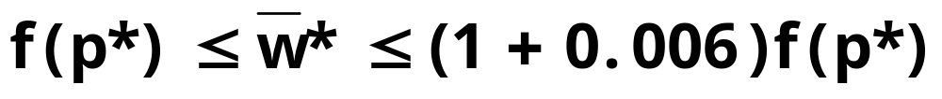
Application to HighSpeed TCP
Consider idealized, stochastic fluid, version of HighSpeed TCP [Floyd’02], then, Result II holds with 0<ε<0.0012.
Remark:
the design method in HighSpeed TCP
[Floyd’02] can be seen as approximately solving the inverse problem.
Under S*:

Slide 19
Concluding Remarks
We showed that deterministic constant inter-loss times is extremal, a worst-case, for some increase-decrease controls.
With objective to design a friendly increase-decrease control to another control, is it viable to use as a reference, deterministic constant inter-loss times, given that for some controls this reference is a worst-case ?

Slide 20
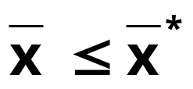
Concluding Remarks
Extremal of Determinism in
Internet Congestion Controls
Batch loss events. With loss events that arrive in batches, and batch sizes independent of the point process of arrivals, the window is minimal with batch sizes fixed to their mean, a determinism.
Equation-Based Rate Control. It follows from V. and Le Boudec (ITC-17 2001, Sigcomm 2002) that under some conditions, the steady-state send rate of equation-based rate control satisfies .
Note that the last inequality means:
Determinism is a best-case!

