Slide 1
Panel: Is IP Routing Dead?
-- Linda Winkler, Argonne Natl Lab
-- Bill St Arnaud, CANARIE
Guy Almes <almes@internet2.edu>
PFLDnet Workshop – Geneva
3 February 2003
Notes:
This is a general overview presentation about Internet2. Internet2 is a consortium, led by US universities, which is recreating the partnership among academia, industry and government that fostered today’s Internet in its infancy.

Slide 2
Overview
Structuring the Problem:
  IP Routers vs (say) Ethernet Switches
  Statistical multiplexing / packet switching
  vs dedicated / circuit switching
Consequences
Presenters
Discussion

Slide 3
Structuring the Problem: routers vs switches
Differences
  Need to do IP routing on each packet
  Burdened by traditional expectations of routers
Similarities
  Statistical multiplexing issues
  Need for large buffers per output port
  Need to support large MTUs as speeds increase
  Extreme statement:
  “A switch is just a router that doesn't decrement the TTL”

Slide 4
Structuring the Problem:
Packet vs circuit switching
Key question
  Can TCP (or something like it) make effective use of high-speed wide-area networks?
  Multiple dimensions:
    utilization
    fairness
    robustness
  This is a key issue!

Slide 5
Consequences I
For the end user, success would mean:
  Make complete use of high-speed bottleneck links in wide-area networks
  Make success robust with respect to circumstances
  Maybe work toward 'predictable' performance
  (but no claim to 'guaranteed' performance)

Slide 6
Consequences II
Technical implications for the network:
  Transport advances combine with MTU improvement
  Transport advances may reduce pressure on buffer memory per output port
  Can fairness be achieved?
  Should wide-area links grow to 40 Gb/s?
  Can improvements be made even for small flows?
  Good news: several different project report very large fraction of 1 Gb/s!
  Current FTPs limited by disk speeds!

Slide 7
Consequences III
Economic implications:
  The university / laboratory community has decades of experience in building, managing, and using such nets
  This community knows how to share the costs of such nets
  We have a tradition of networks that serve high-end users benefiting early academic adopters and then benefiting the broader internet community
  Thus, there are huge issues at stake for our community

Slide 8
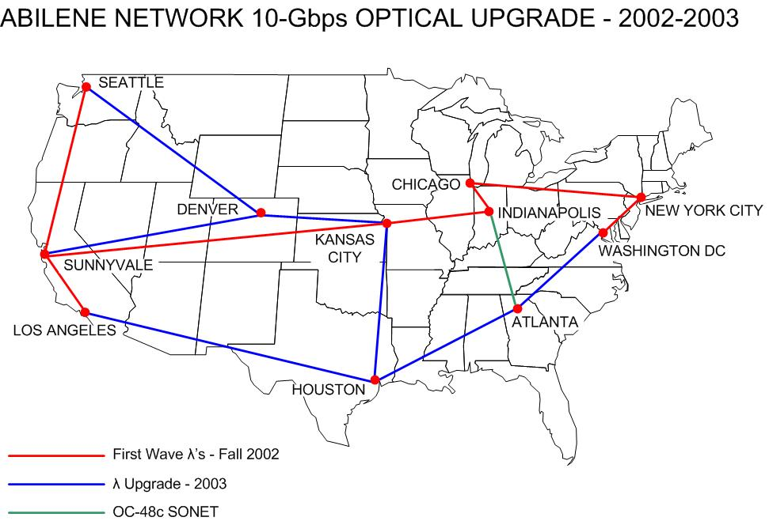

Slide 9
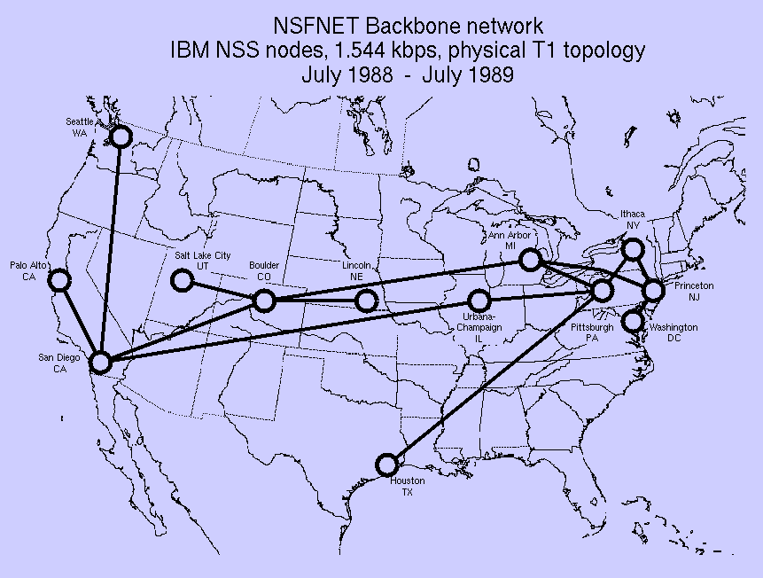

Slide 10
