Slide 1
TCP transfers over high latency/bandwidth networks
&
Grid DT
Measurements session
PFLDnet February 3- 4, 2003
CERN, Geneva, Switzerland
Sylvain Ravot
sylvain@hep.caltech.edu

Slide 2
Context
High Energy Physics (HEP)
  LHC model shows data at the experiment will be stored at the rate of 100 – 1500 Mbytes/sec throughout the year.
  Many Petabytes per year of stored and processed binary data will be accessed and processed repeatedly by the worldwide collaborations.
New backbone capacities advancing rapidly to 10 Gbps range
TCP limitation
  Additive increase and multiplicative policy
Grid DT
  Practical approach
  Transatlantic testbed
    Datatag project : 2.5 Gb/s between CERN and Chicago
    Level3 loan : 10 Gb/s between Chicago and Sunnyvale (SLAC & Caltech collaboration)
    Powerful End-hosts
  Single stream
  Fairness
    Different RTT
    Different MTU

Slide 3
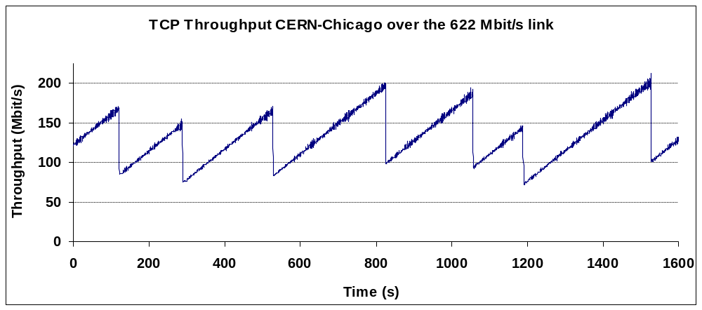
Time to recover from a single loss
6 min
TCP reactivity
    Time to increase the throughput by 120 Mbit/s is larger than 6 min for a connection between Chicago and CERN.
A single loss is disastrous
    A TCP connection reduces its bandwidth use by half after a loss is detected (Multiplicative decrease)
    A TCP connection increases slowly its bandwidth use (Additive increase)
    TCP throughput is much more sensitive to packet loss in WANs than in LANs

Slide 4
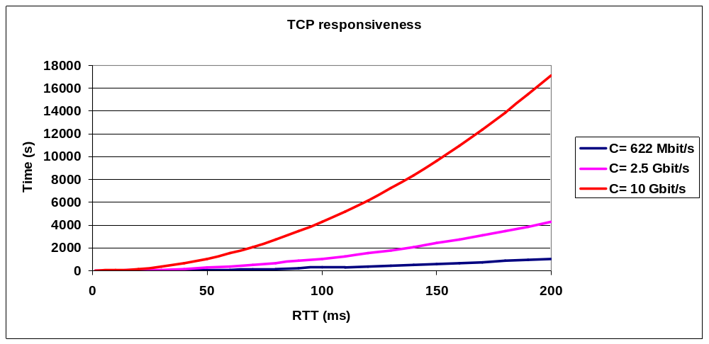
Responsiveness (I)
The responsiveness ρ measures how quickly we go back to using the network link at full capacity after experiencing a loss if we assume that the congestion window size is equal the Bandwidth Delay product when the packet is lost.
2
C : Capacity of the link
ρ =
C . RTT
2 . MSS

Slide 5
Responsiveness (II)
Case | C | RTT (ms) | MSS (Byte) | Responsiveness
Typical LAN in 1988 | 10 Mb/s | [ 2 ; 20 ] | 1460 | [ 1.7 ms ; 171 ms ]
Typical LAN today | 1 Gb/s | 2 (worst case) | 1460 | 96 ms
Futur LAN | 10 Gb/s | 2 (worst case) | 1460 | 1.7s
WAN Geneva <-> Sunnyvale | 1 Gb/s | 120 | 1460 | 10 min
WAN Geneva <-> Sunnyvale | 1 Gb/s | 180 | 1460 | 23 min
WAN Geneva <-> Tokyo | 1 Gb/s | 300 | 1460 | 1 h 04 min
WAN Geneva <-> Sunnyvale | 2.5 Gb/s | 180 | 1460 | 58 min
Futur WAN CERN <-> Starlight | 10 Gb/s | 120 | 1460 | 1 h 32 min
Futur WAN link CERN <-> Starlight | 10 Gb/s | 120 | 8960 (Jumbo Frame) | 15 min
The Linux kernel 2.4.x implement delayed acknowledgment. Due to delayed acknowledgments, the responsiveness is multiplied by two. Therefore, values above have to be multiplied by two!

Slide 6
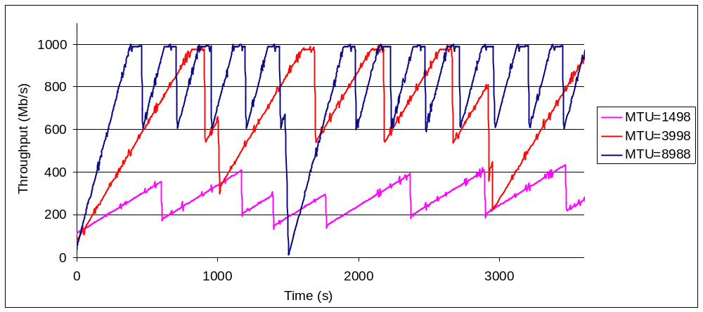
Effect of the MTU on the responsiveness
Effect of the MTU on a transfer between CERN and Starlight (RTT=117 ms, bandwidth=1 Gb/s)
Larger MTUs improve the TCP responsiveness because you increase your cwnd by one MSS each RTT.
Couldn’t reach wire-speed with standard MTU
  Larger MTU reduces overhead per frames (save CPU cycles, reduce the number of packets)

Slide 7
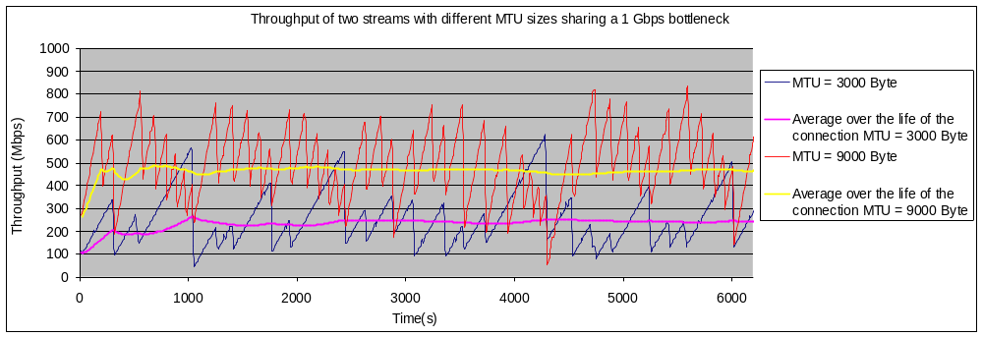
MTU and Fairness
CERN (GVA)
Starlight (Chi)
Host #1
1 GE
1 GE
Host #1
GbE Switch
1 GE
R
POS 2.5 Gbps
R
Host #2
1 GE
Host #2
Bottleneck
Two TCP streams share a 1 Gb/s bottleneck
RTT=117 ms
MTU = 3000 Bytes ; Avg. throughput over a period of 7000s = 243 Mb/s
MTU = 9000 Bytes; Avg. throughput over a period of 7000s = 464 Mb/s
Link utilization : 70,7 %

Slide 8
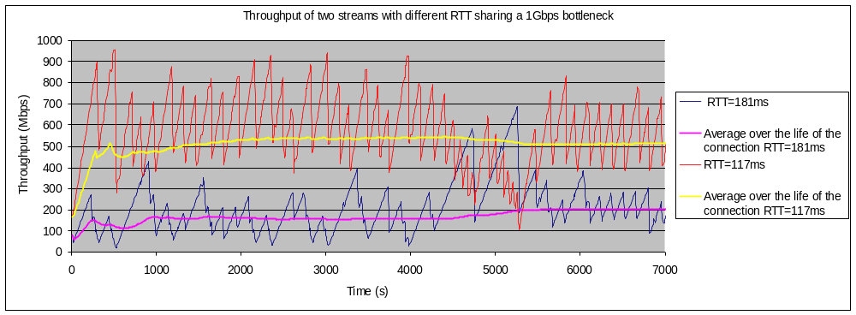
RTT and Fairness
CERN (GVA)
Starlight (Chi)
Sunnyvale
Host #1
1 GE
10GE
GbE Switch
1 GE
R
POS 2.5 Gb/s
R
R
POS 10 Gb/s
R
Host #2
Host #2
1 GE
1 GE
Bottleneck
Host #1
Two TCP streams share a 1 Gb/s bottleneck
CERN <-> Sunnyvale RTT=181ms ; Avg. throughput over a period of 7000s = 202Mb/s
CERN <-> Starlight RTT=117ms; Avg. throughput over a period of 7000s = 514Mb/s
MTU = 9000 bytes
Link utilization = 71,6 %

Slide 9
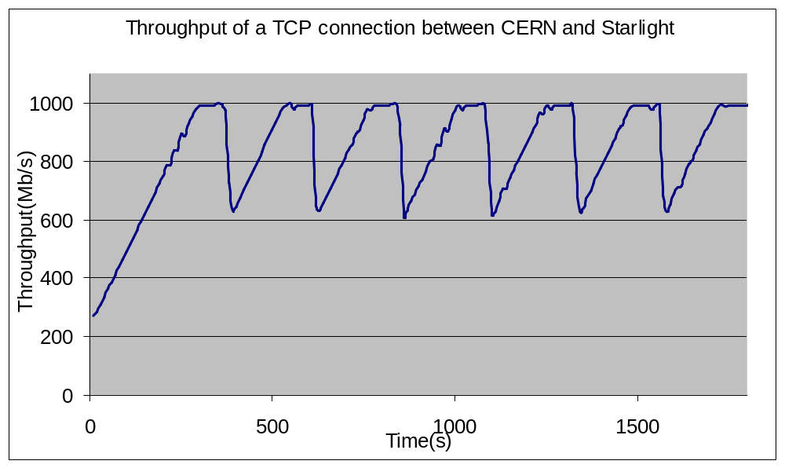
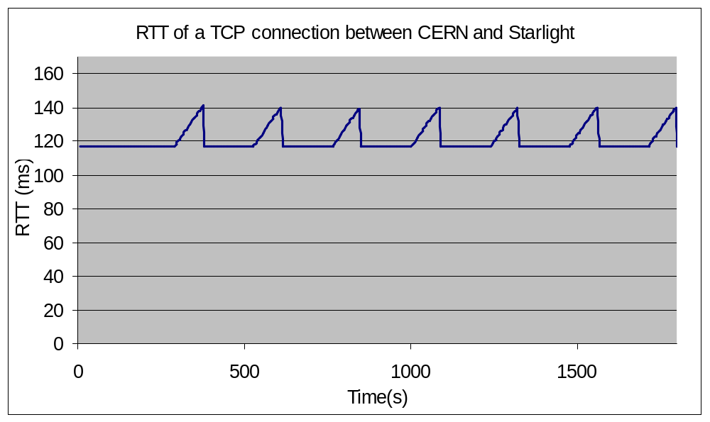
Effect of buffering on End-hosts
Setup
  RTT = 117 ms
  Jumbo Frames
  Transmit queue of the network device = 100 packets (i.e 900 kBytes)
Area #1
  Cwnd < BDP =>
  Throughput < Bandwidth
  RTT constant
  Throughput = Cwnd / RTT
Area #2
  Cwnd > BDP =>
  Throughput = Bandwidth
  RTT increase (proportional to Cwnd)
Link utilization larger than 75%
CERN (GVA)
Starlight (Chi)
Host GVA
1 GE
R
POS 2.5 Gb/s
R
1 GE
Host CHI
Area #1
Area #2

Slide 10
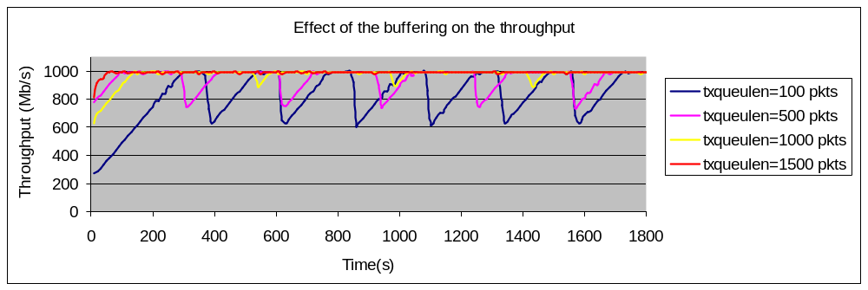
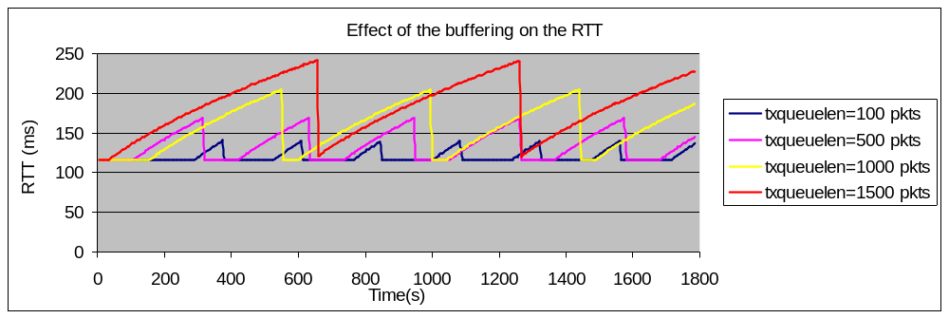
Buffering space on End-hosts
Txqueulen is the transmit queue of the network device
Link utilization near 100% if :
  No congestion into the network
  No transmission error
  Buffering space = Bandwidth delay product
  TCP buffers size = 2 * Bandwidth delay product
  => Congestion window size always larger than the bandwidth delay product

Slide 11
Linux Patch “GRID DT”
Parameter tuning
  New parameter to better start a TCP transfer
    Set the value of the initial SSTHRESH
Modifications of the TCP algorithms (RFC 2001)
  Modification of the well-know congestion avoidance algorithm
    During congestion avoidance, for every acknowledgement received, cwnd increases by
    A * (segment size) * (segment size) / cwnd.
    It’s equivalent to increase cwnd by A segments each RTT. M is called additive increment
  Modification of the slow start algorithm
    During slow start, for every acknowledgement received, cwnd increases by M segments. M is called multiplicative increment.
  Note: A=1 and M=1 in TCP RENO.
Smaller backoff
  Reduce the strong penalty imposed by a loss
Notes:
Single-stream with modified backoff policy + different increment allows us to simulate multi-streaming
Single stream implementation differs from multi-stream in some important ways:
- it is simpler (CPU utilization – try to quantify)
- startup and shutdown are faster (performance impact on short transfers– try to quantify)
- fewer keys to manage if it is secure.

Slide 12
Grid DT
    Only the sender’s TCP stack has to be modified
    Very simple modifications to the TCP/IP stack
    Alternative to Multi-streams TCP transfers
      Multi streams vs single stream
        it is simpler
        startup/shutdown are faster
        fewer keys to manage (if it is secure)
    Virtual increase of the MTU.
    Compensate the effect of delayed ack
    Can improve “fairness”
      between flows with different RTT
      between flows with different MTU

Slide 13



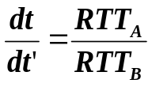
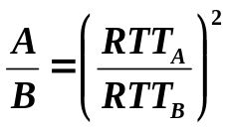
Effect of the RTT on the fairness
Objective: Improve fairness between two TCP streams with different RTT and same MTU
We can adapt the model proposed by Mat. Mathis by tacking into account a higher additive increment
Assumptions:
  Approximate the packet loss of probability p by assuming that each flow delivers 1/p consecutive packets followed by one drop.
  Under these assumptions, the congestion window of the flows oscillate with a period T0.
  If the receiver acknowledges every packet, then the congestion widow size opens by x (additive increment) packets each RTT.
W
Number of packets delivered by each stream in one period:
W/2
T0
2T0
(RTT)
Relation between t and t’:
CWND evolution under periodic loss
If we want each flow to deliver the same number of packets in one period:

Slide 14
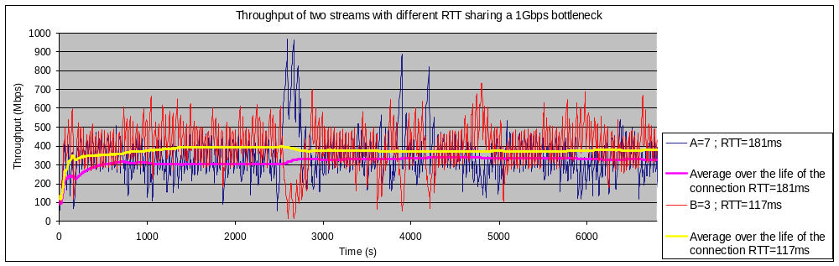


Effect of the RTT on the fairness
CERN (GVA)
Starlight (CHI)
Sunnyvale
Host #1
1 GE
10GE
GbE Switch
1 GE
R
POS 2.5 Gb/s
R
R
POS 10 Gb/s
R
Host #2
Host #2
1 GE
1 GE
Bottleneck
Host #1
TCP Reno performance (see slide #8):
  First stream GVA <-> Sunnyvale : RTT = 181 ms ; Avg. throughput over a period of 7000s = 202 Mb/s
  Second stream GVA<->CHI : RTT = 117 ms; Avg. throughput over a period of 7000s = 514 Mb/s
  Links utilization 71,6%
Grid DT tuning in order to improve fairness between two TCP streams with different RTT:
  First stream GVA <-> Sunnyvale : RTT = 181 ms, Additive increment = A = 7 ; Average throughput = 330 Mb/s
  Second stream GVA<->CHI : RTT = 117 ms, Additive increment = B = 3 ; Average throughput = 388 Mb/s
  Links utilization 71.8%

Slide 15
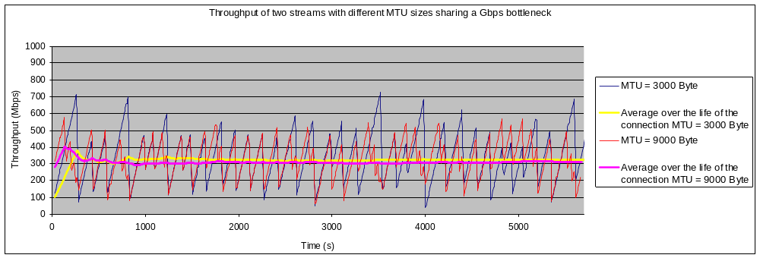
Effect of the MTU
CERN (GVA)
Starlight (Chi)
Host #1
1 GE
1 GE
Host #1
GbE Switch
1 GE
R
POS 2.5 Gbps
R
Host #2
1 GE
Host #2
Bottleneck
Two TCP streams share a 1 Gb/s bottleneck
RTT=117 ms
MTU = 3000 Bytes ; Additive increment = 3; Avg. throughput over a period of 6000s = 310 Mb/s
MTU = 9000 Bytes; Additive increment = 1; Avg. throughput over a period of 6000s = 325 Mb/s
Link utilization : 61,5 %

Slide 16
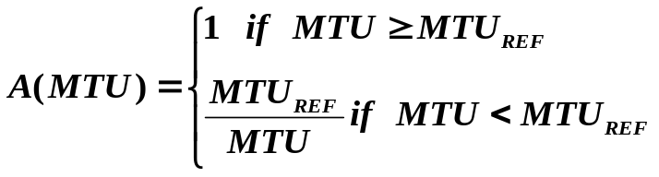
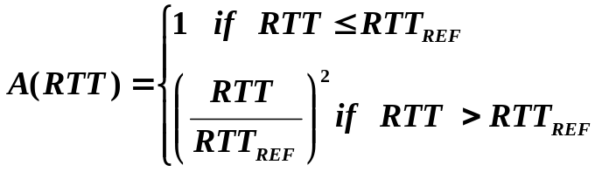

Next Work
Taking into account the value of the MTU in the evaluation of the additive increment:
  Define a reference:
  For example:
    Reference: MTU = 9000 bytes => Add. Increment = 1
    MTU = 1500 bytes => Add. Increment = 6
    MTU = 3000 Bytes => Add. Increment = 3
Taking into account the square of the RTT in the evaluation of the additive increment:
  Define a reference:
  For example:
    Reference: RTT=10 ms => Add. Increment = 1
    RTT=100ms => Add. Increment = 100
    RTT=200ms => Add. Increment = 400
Combining the two formulas above:
Periodic evaluation of the RTT and the MTU.
How to define the references?

Slide 17
Conclusion
To achieve high throughput over high latency/bandwidth network, we need to :
  Set the initial slow start threshold (ssthresh) to an appropriate value for the delay and bandwidth of the link.
  Avoid loss
    By limiting the max cwnd size
  Recover fast if loss occurs:
    Larger cwnd increment
    Smaller window reduction after a loss
    Larger packet size (Jumbo Frame)
      Is standard MTU the largest bottleneck?
How to define the fairness?
  Taking into account the MTU
  Taking into account the RTT

