Slide 1
Using NetLogger and Web100 for TCP analysis
Brian L. Tierney
Data Intensive Distributed Computing Group
Lawrence Berkeley National Laboratory

Slide 2
The Problem
The Problem:
  TCP throughput on very high-speed networks is often disappointing.
    Why is this? What is the cause?
    Using tuned TCP buffers, txqueuelen, and see no loss, but performance is still poor. Why!?
  Want to test a modification to TCP (eg.: HS-TCP, Fast TCP,etc)
    What are the effects of this modification?
The Solution
  Instrumented TCP and analysis tools

Slide 3
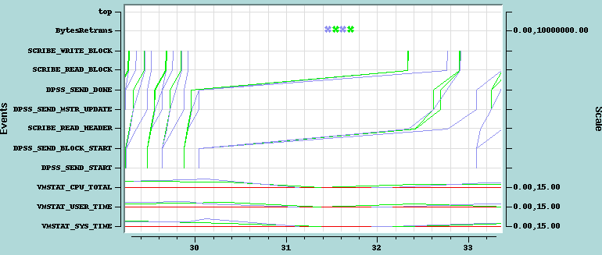
Web100 + NetLogger
Web100 (PSC + NCAR) provides
  Ability to instrument TCP stack in detail
NetLogger (LBNL) provides
  Ability to correlate data from varies sources based on time
  Easy way to collect data from multiple clients/servers reliably
  Visualization and analysis tools

Slide 4
Important Web100 Variables for understanding TCP
TCP throughput directly related to the Congestion Window size (CWND)
The following may restrict/reduce CWND
  CongestionSignals (includes Retransmits, FastRetransmits, & ECN)
  MaxRwinRcvd: receiver advertised maximum
  SendStall: Interface queue is full (txqueuelen)
  X_OtherReductionsCV: TCP Congestion Window Validation (RFC2861). Reduce CWND when the actual window is smaller than CWND for more than 1 RTT
  X_OtherReductionsCM: Linux “CWND Moderation” (explained below)
These variables indicate if the throughput is limited by the sender, the receiver, or the network
  SndLimTimeRwin
  SndLimTimeCwnd
  SndLimTimeSender

Slide 5
Net100 pyWAD
WAD = Work Around Daemon
  pyWAD: python version implemented by Jason Lee, LBNL
Originally conceived as a tuning daemon
  E.g: auto-tune TCP buffer size, etc.
  Can also be used for transparent instrumentation, and can generate derived events
    Sample Configuration file
      [monitor iperf_client]
      src_addr: 0.0.0.0 # all source addresses
      src_port: 0 # any source port
      dst_addr: 0.0.0.0 # any destination address
      dst_port: 5005 # all traffic on port 5555
      [NetLogger]
      web100.CongestionSignals: CongestionSignals
      web100.SendStall: SendStall
      web100.CurCwnd: CurCwnd
      web100.SmoothedRTT: SmoothedRTT
      web100.OtherReductions: OtherReductions
      AveBW1: (DataBytesOut*8)/(SndLimTimeRwin + SndLimTimeCwnd + SndLimTimeSender)
      [PyWAD]
      outputdest: file:///tmp/iperf.test.2.log
      polltime: 0.5

Slide 6
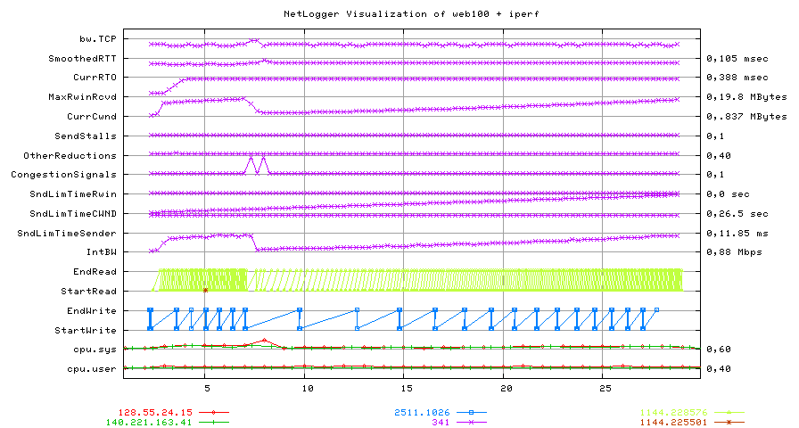
“Normal” Plot: Standard TCP

Slide 7
SC02 Test Environment
ANL test host
1.13 GHz
NIKHEF test host
2.4 GHz
LBL test host
1.4 GHz
900 Mbps
900 Mbps
780 Mbps
NERSC test host
2 x 1 Ghz
SC02 test host
2 x 1.4 GHz
580 Mbps
Network speed = Measured UDP throughput

Slide 8
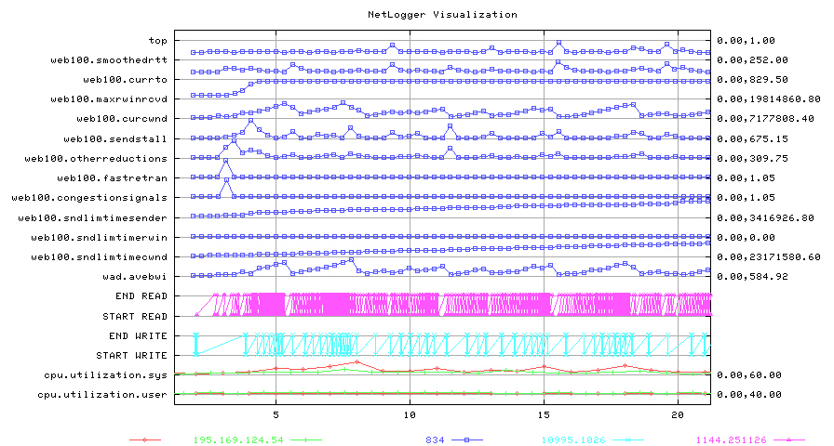
With Net100 Mods: HS-TCP + IFQ
Amsterdam to SC02

Slide 9
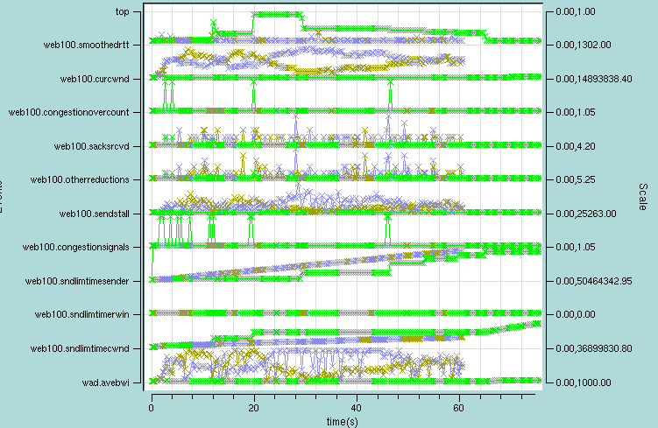
Uneven Parallel Streams
Amsterdam to LBNL
Note variation of smoothedRTT varies on slow stream

Slide 10
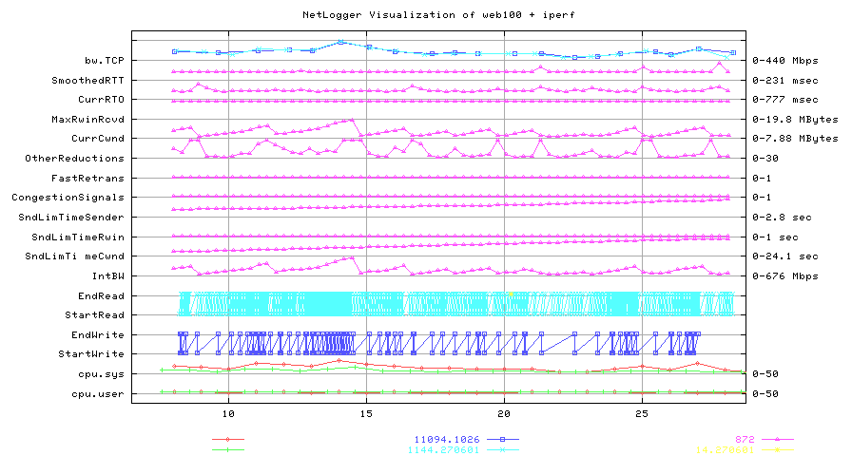
OtherReductions reduce CWND
Amsterdam to SC02
HS-TCP turned on

Slide 11
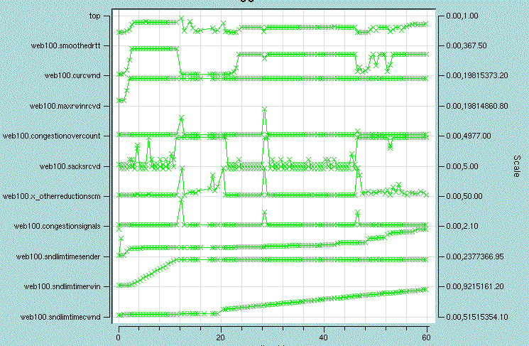
Coloration of Sack and OtherReductionsCM
CWND drops
SACKs
OtherReductionsCM

Slide 12
Linux OtherReductionsCM Code
/* CWND moderation, preventing bursts due to too big ACKs in dubious situations. */
static __inline__ void tcp_moderate_cwnd(struct tcp_opt *tp)
{ tp->snd_cwnd = min(tp->snd_cwnd,
tcp_packets_in_flight(tp)+tcp_max_burst(tp));
tp->snd_cwnd_stamp = tcp_time_stamp;
}
/* Slow start with delack produces 3 packets of burst */
static __inline__ __u32 tcp_max_burst(struct tcp_opt *tp)
{ return 3; }
/* This determines how many packets are "in the network" to the best of our knowledge. Read this equation as:
* "Packets sent once on transmission queue" MINUS
* "Packets left network, but not honestly ACKed yet" PLUS
* "Packets fast retransmitted" */
static __inline__ unsigned int tcp_packets_in_flight(struct tcp_opt *tp)
{ return tp->packets_out - tp->left_out + tp->retrans_out;
}

Slide 13
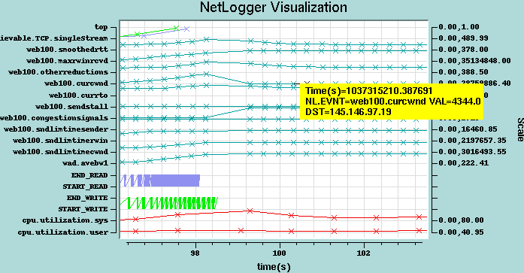
Linux TCP Bug
Path = Amsterdam to LBL
This happens when CWND gets too large

Slide 14
Conclusions and Recommendations
Web100 + NetLogger provide a very useful method for analyzing Linux TCP behavior
Parallel streams may be a bad idea with well tuned streams
Personal Recommendation:
  All Linux-based TCP testing be based on the Web100 kernel, and always run pyWAD to collect TCP instrumentation data during all tests
  This will can always help answer the question: “Why did that happen?”

Slide 15
For More Information
Web100: http://www.web100.org/
NetLogger: http://www-didc.lbl.gov/NetLogger/
pyWAD: http://www-didc.lbl.gov/net100/pyWAD.html
Email: BLTierney@LBL.GOV

Slide 16
Extra Slides

Slide 17
Summary Results
Things to note:
  TCP was typically 5 times slower than UDP
  Parallel streams VERY uneven on paths 1 and 2
  Parallel streams slower than single stream on path 1
  SendStalls were only seen on paths 1 and 2, so net100 IFQ setting will only effect these paths
  Floyd High-Speed TCP helped on paths 3 and 4
  Large standard deviation on all measurements

Slide 18
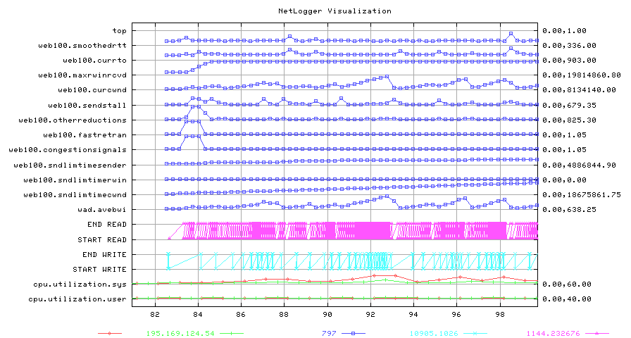
SendStalls Reducing CWND
Amsterdam to SC02; HS-TCP

Slide 19
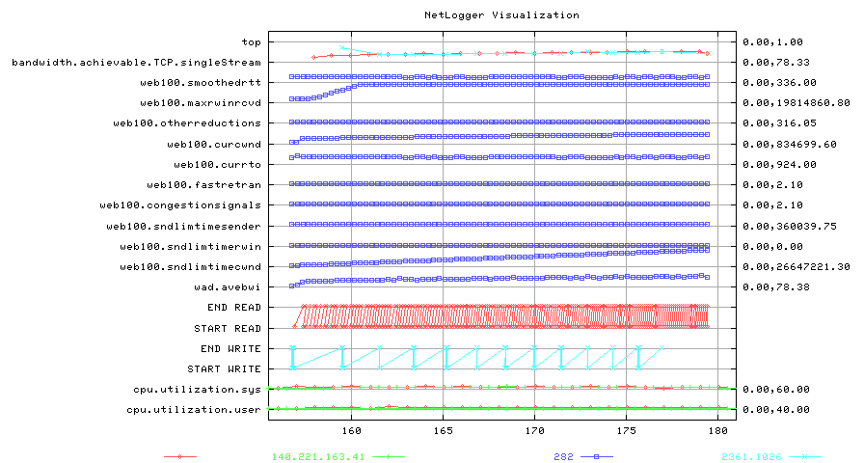
Bursty Sender
Oakland to SC02
Send bursts due to large txqueuelen on send host

Slide 20
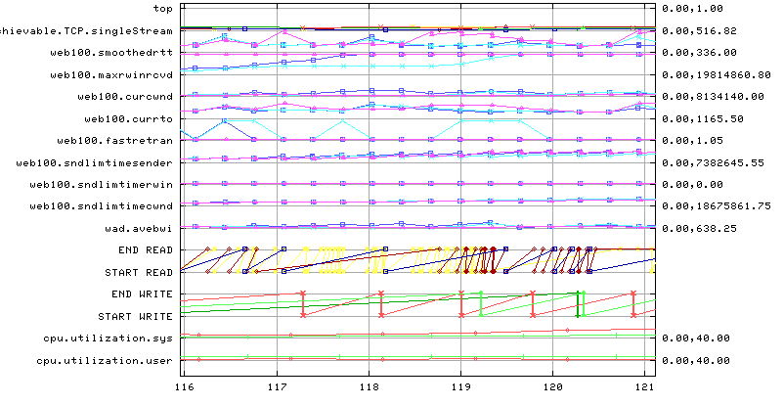
Uneven Parallel Streams
Amsterdam to SC02
Note variation of smoothedRTT varies on different streams

Slide 21
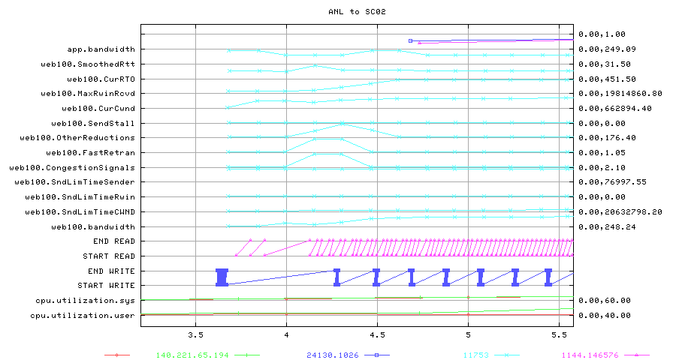
Zoom on Slow Start
ANL to SC02

Slide 22
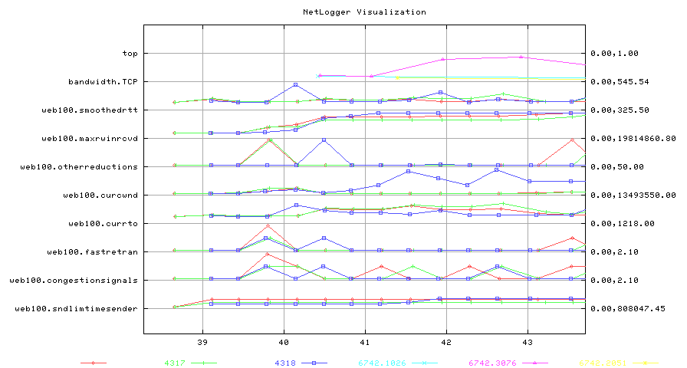
Zoom on Parallel Streams
LBL to SC02

