Slide 1
Debugging end-to-end performance in commodity operating system
Pavel Cimbál, CTU, xcimbal@quick.cz
Sven Ubik, CESNET, ubik@cesnet.cz

Slide 2
End-to-end performance
Protective QoS -> proactive QoS
Interaction of all computer system components
(applications, operating system, network adapter, network)
Decided to concentrate on E2E performance on Linux PCs
Need to increase TCP buffers, how much?
What „autoconfiguration“ do we need?

Slide 3
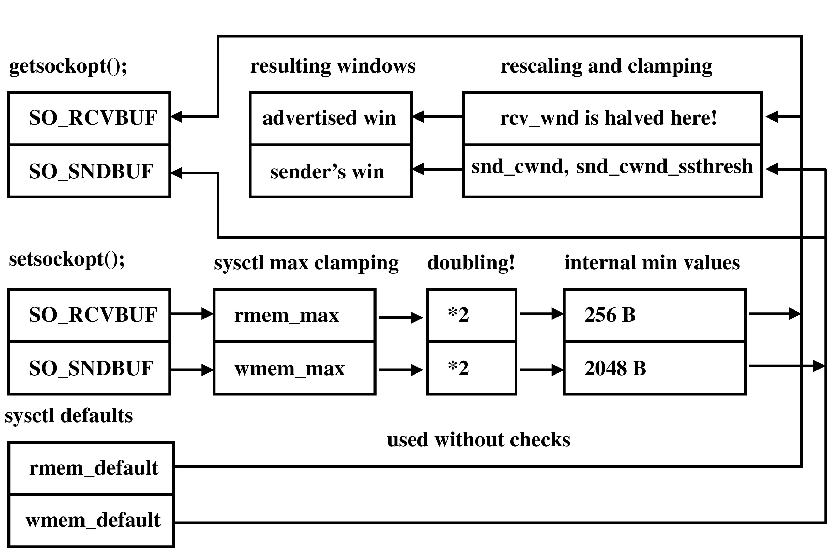
How big are my TCP windows?
Linux 2.2

Slide 4
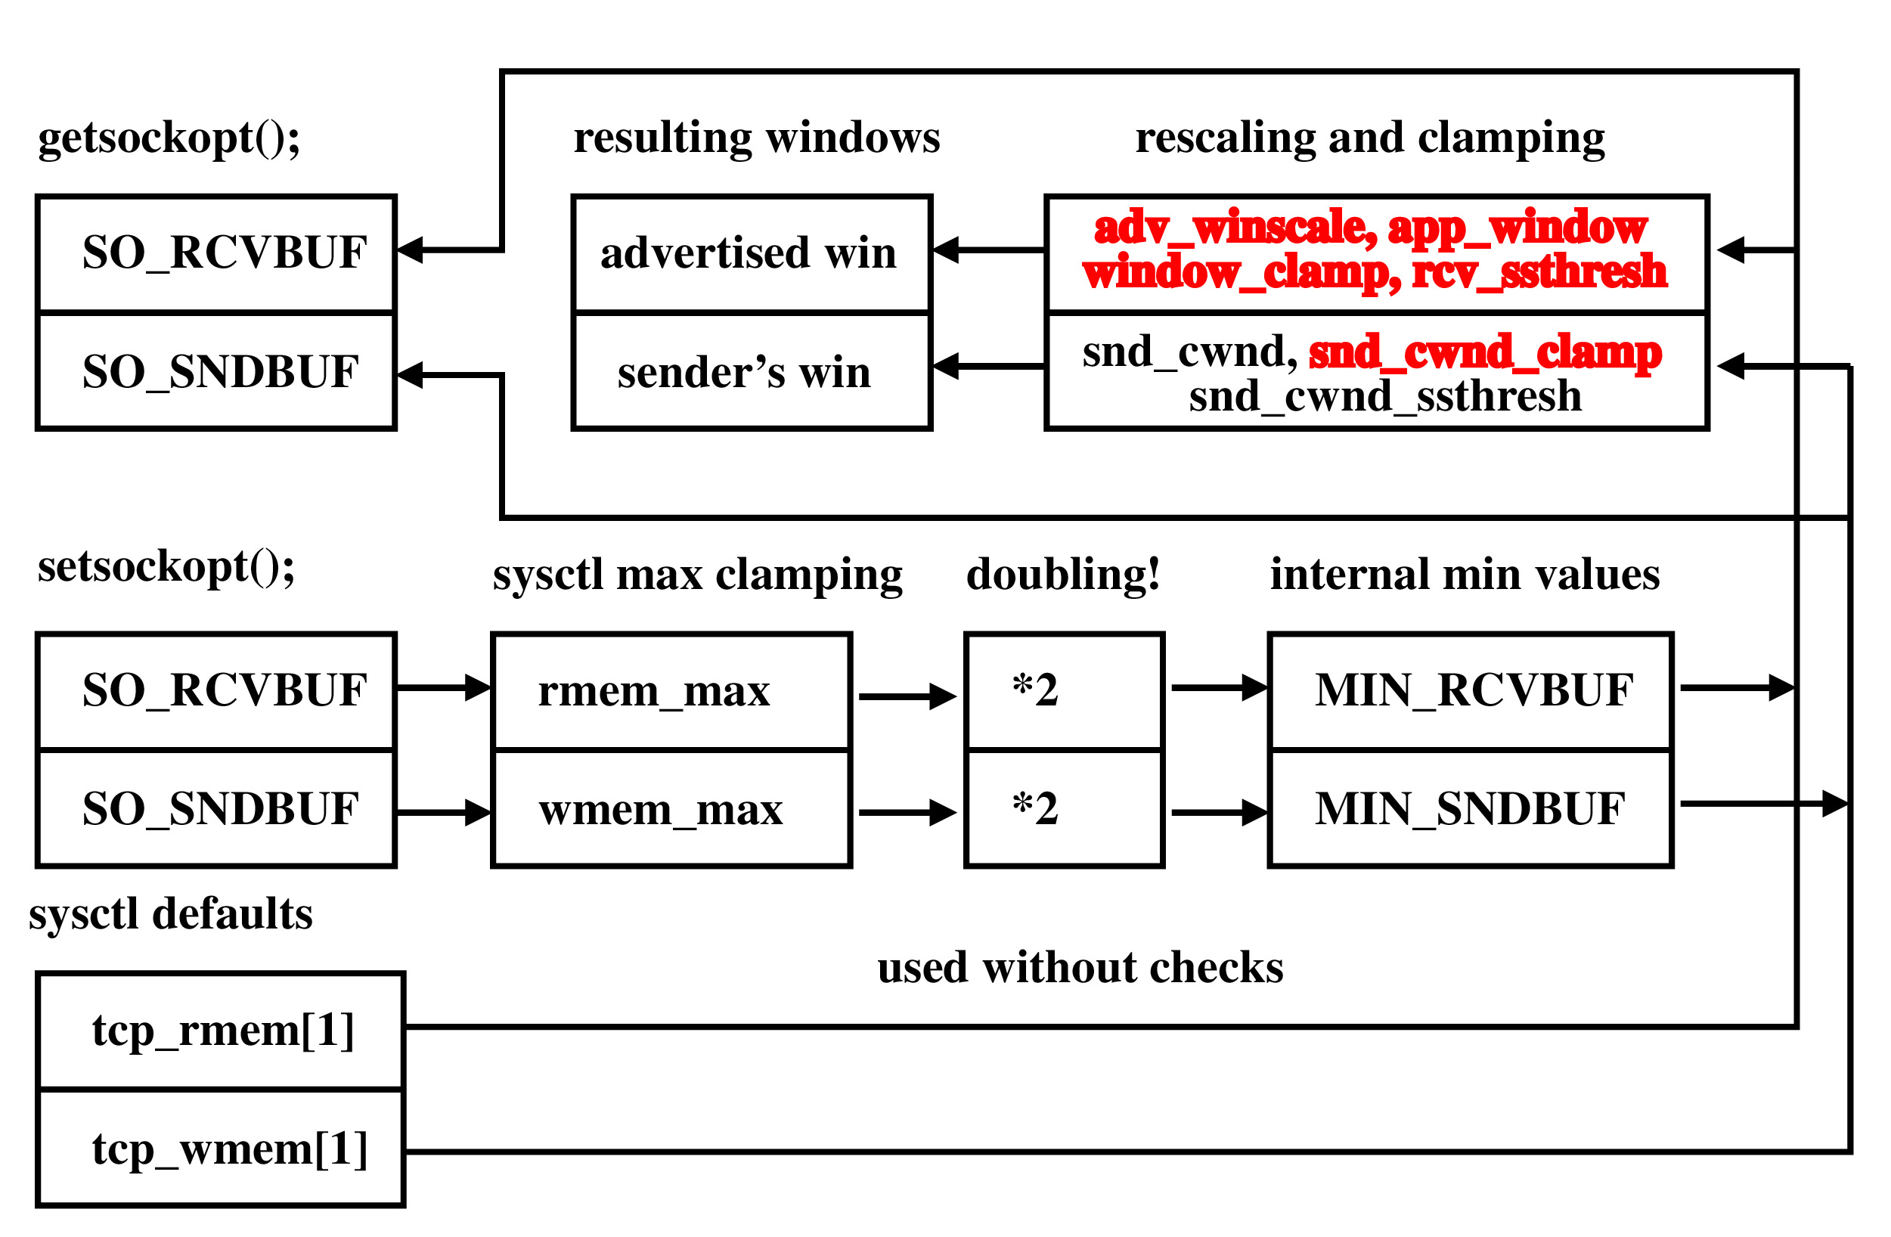
How big are my TCP windows?
Linux 2.4

Slide 5
Is the bigger the better?
rwnd<=pipe capacity - bw=rwnd/rtt
rwnd>pipe capacity - AIMD controlled, bw~(mss/rtt)*1/sqrt(p)
Linux is not RFC standard slow start + congestion avoidance,
includes a lot of modifications
Interaction with network adapter must be considered
TCP cache must be considered
Router queues must be considered

Slide 6
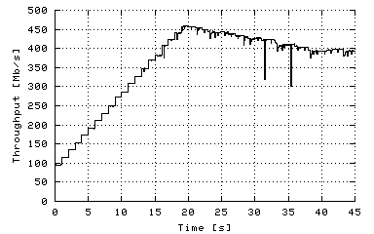
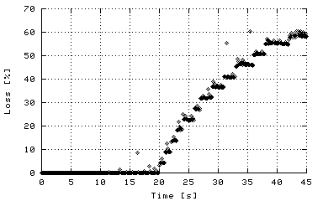
Testing environment
Cesnet (CZ) -> Uninett (NO)
12 hops, 1GE + OC-48, rtt=40 ms, wire pipe capacity<=5 MB
tcpdump on a mirrored port captures all headers for > 800 Mb/s
pathload: 149 measurements
- 40 too low (50-70 Mb/s)
- 10 too high (1000 Mb/s)
- 99 realistic (750-850 Mb/s),
but range sometimes
too wide (150 Mb/s)
iperf: 50 measurements
1 MB 135 Mb/s
2 MB 227 Mb/s
4 MB 107 Mb/s
8 MB 131 Mb/s
16 MB 127 Mb/s

Slide 7
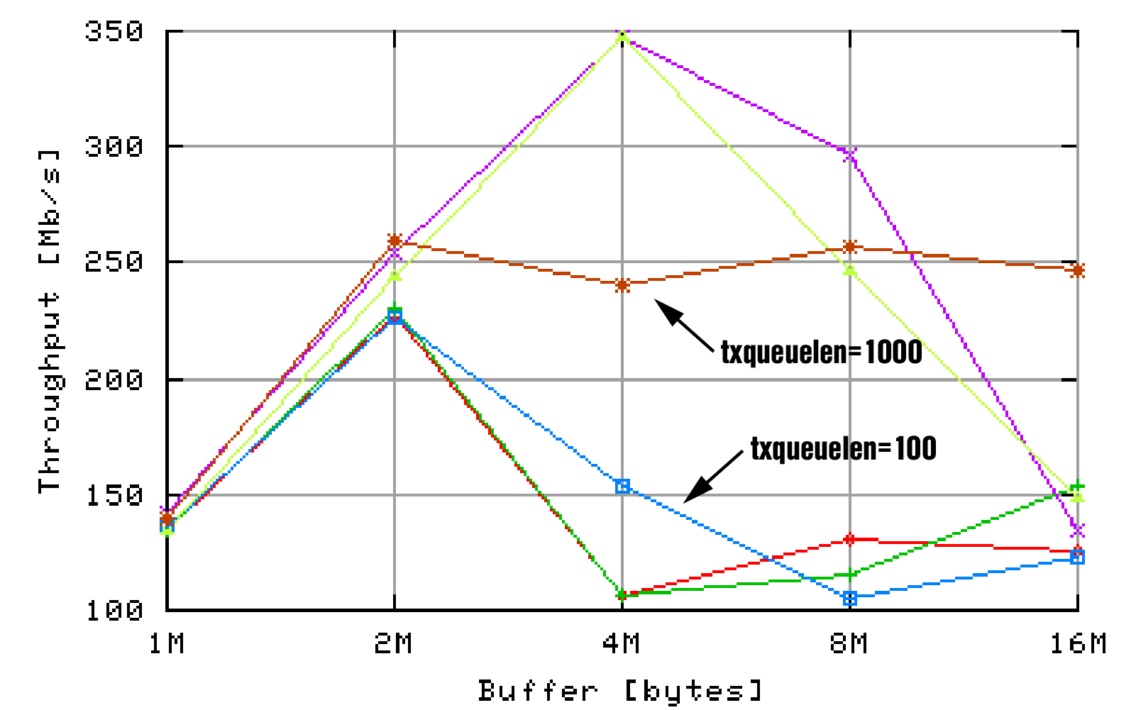
Gigabit interfaces and txqueuelen
ifconfig eth0 txqueuelen 1000

Slide 8
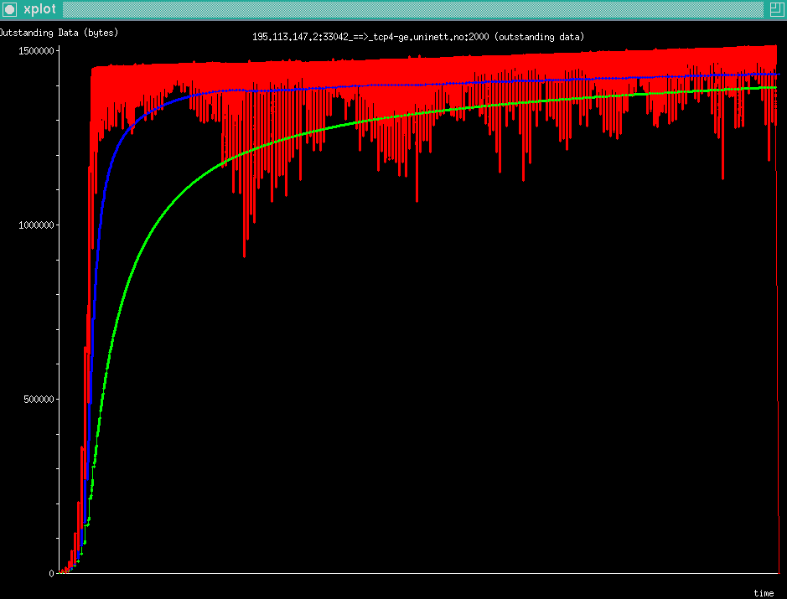
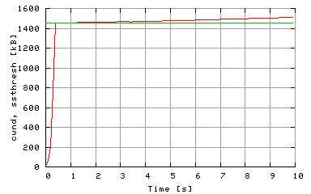
TCP cache
initial ssthresh locked at 1.45 MB
echo 1 > /proc/sys/net/ipv4/route/flush

Slide 9
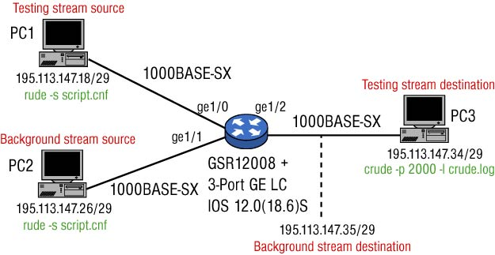
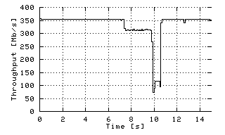
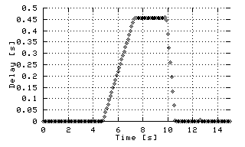
What is the right “pipe capacity”
Gigabit routers have very big buffers
150 Mb/s overload buffered for 2 s => buffer=37.5 MB

Slide 10
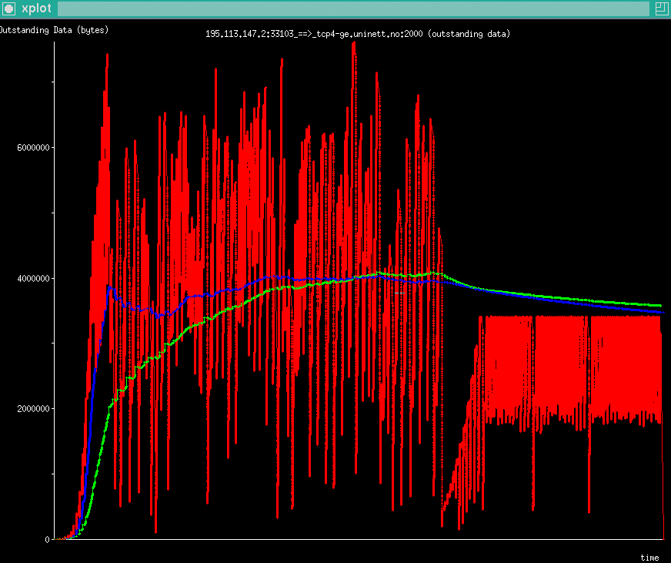
Using “buffered pipe” is not good
No increase in throughput over using „wire pipe“ in long term
Self-clocking adjusts sender to bottleneck speed, but does not
stop sender from accumulating data in queues
Filled-up queues are sensitive to losses caused by cross-traffic

Slide 11
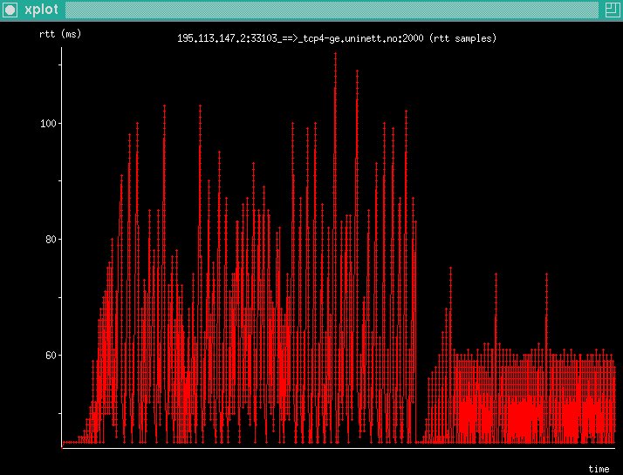
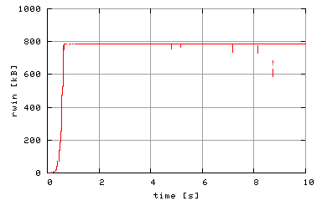
How to use not too much more than “wire pipe”
Can sender control filling
pipe by checking RTT ?
Can receiver better
moderate its advertised
window?

Slide 12
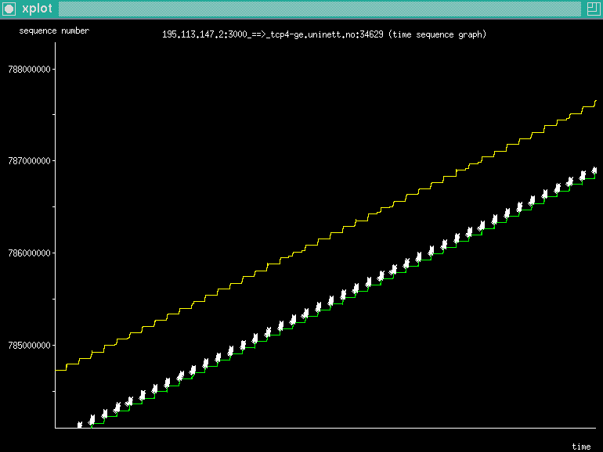
scp
Cesnet -> Uninett, 1.5 MB window, 10.4 Mb/s, 9% load CPU

Slide 13
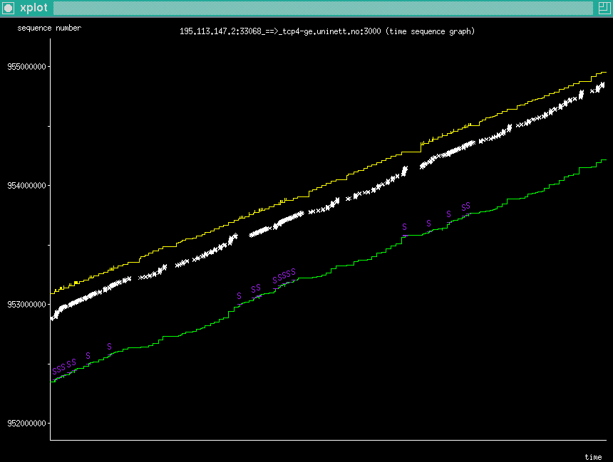
scp, cont.
Patched scp, with increased CHAN_SES_WINDOW_DEFAULT:
set to 20, rwnd=1.5 MB 48 Mb/s, 45% CPU load
set to 40, rwnd=1.5 MB 88 Mb/s, 85% CPU load

Slide 14
PERT
Performance Enhancement and Response Team
TF-NGN initiative (TERENA, DANTE, so far 6 NRENs)
Comparable to CERT
A support structure for users to help solve performance
issues when using applications over a computer network
- hierarchical structure
- accepting and resolving performance cases
- knowledge dissemination
- measurement and monitoring infrastructure
Relations with other organizations
Pilot project in 2003

Slide 15
Conclusion
Configuration and interaction of existing components
(application, TCP buffers, OS, network adapter, router buffers)
may have greater influence on E2E performance than new
congestion control algorithms
Use „wire pipe“ rather than „buffered pipe“
Autoconfiguration should not just save memory and set
buffers „large enough“, but also „small enough“
PERT pilot project started

