Slide 1

Presentation by ANML
January 2003
Tsunami File Transfer Protocol

Slide 2
Overview
Motivation: Why create Tsunami?
Description: What is Tsunami?
Performance: How well does it work?
Behavior: How does Tsunami work?
Tuning: How can it run faster?
Future work: Where is Tsunami going?

Slide 3
Motivation (1)
Basic assumption of TCP:
  Packet loss is due to network congestion
TCP thus reacts to packet loss with exponential backoff
After backoff, transmission speed grows only linearly

Slide 4
Motivation (2)
What about high-speed research networks?
  Packet loss is usually not due to congestion
  Loss comes from equipment, cabling, etc.
  This loss cannot necessarily be avoided
TCP will collapse even though plenty of capacity is still available

Slide 5
Motivation (3)
Proposed solutions to the TCP problem:
  Multiple concurrent TCP streams
  Modifications to TCP parameters
  Large packets
  Very large packets

Slide 6
Motivation (4)
We can treat file transmission as a special problem domain
  We know transmission size in advance
  We have random access to data
  We can have “holes” in the incoming data
We do need reliability, but we don’t need a stream!

Slide 7
Description
Tsunami is a file transfer protocol
  Standard client/server architecture
  TCP control stream and UDP data stream
  Portable, user-space application
  Exponential in both backoff and regrowth
  Does not collapse transmission rate under low levels of packet loss

Slide 8
Performance (1)
Prototype was used for GTRN network test in May 2002
  Results: over 800Mbps without disk access
Newer version used between TRIUMF and CERN in Fall 2002
  Results: between 600Mbps and 1Gbps with disk access

Slide 9
Performance (2)
Performance on fast commodity hardware (Intel/Linux) without special OS tuning is about 400 - 450Mbps
Key to performance is a well-tuned disk subsystem and a fast disk controller
We are using 3ware IDE RAID controllers with 4 - 6 drives per controller

Slide 10
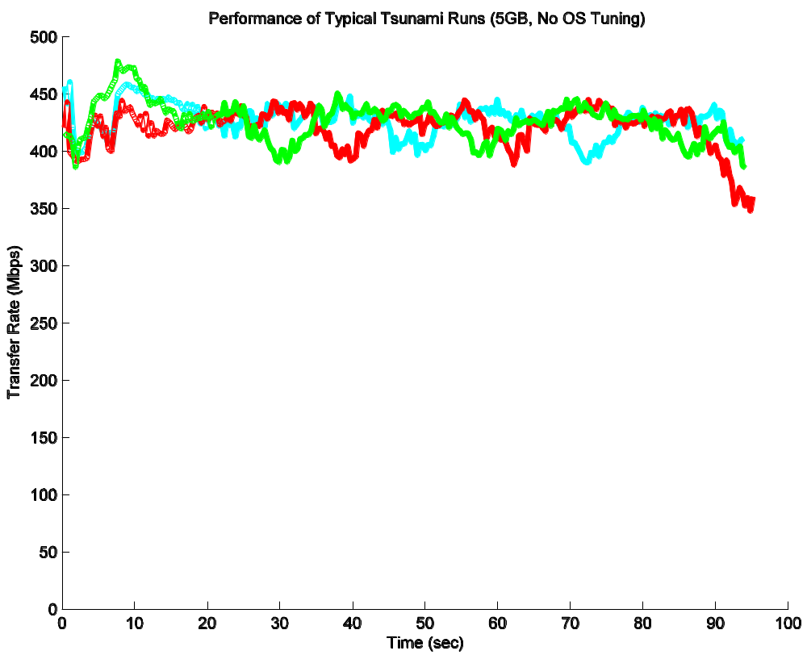
Performance (3)

Slide 11
Behavior (1)
Overview of protocol
  Client requests file over TCP control stream
  Client and server negotiate parameters over TCP control stream
  Server sends data blocks to client using UDP
  Client sends retransmission requests to server using TCP control stream

Slide 12
Behavior (2)
Client architecture
  Two threads: network and disk
  Puts indices of “missing” blocks into retransmission queue
  Contents of retransmission queue are periodically sent to server along with error rate information
  Error rate is used for backoff and regrowth

Slide 13
Behavior (3)
Server architecture
  Single thread per client
  Polls control connection for retransmission requests before sending new blocks
  Adjusts inter-packet delay (IPD) based on reported error statistics
  At end of file, repeats final block until client sends completion message

Slide 14
Behavior (4)
Rate control through IPD
  Each transfer has a target data rate
  Server adjusts delay between blocks based on error rate reported by client
  Both backoff and regrowth are exponential

Slide 15
Tuning (1)
Many parameters can be adjusted
  Block size
  Speedup and slowdown factors
  Error threshold
  Maximum retransmission queue
  Target transfer rate
  Retransmission request interval
  …and others…

Slide 16
Tuning (2)
The parameter space is very large
We’re still learning how to tune Tsunami
The next few slides show the effects of some of these parameters

Slide 17
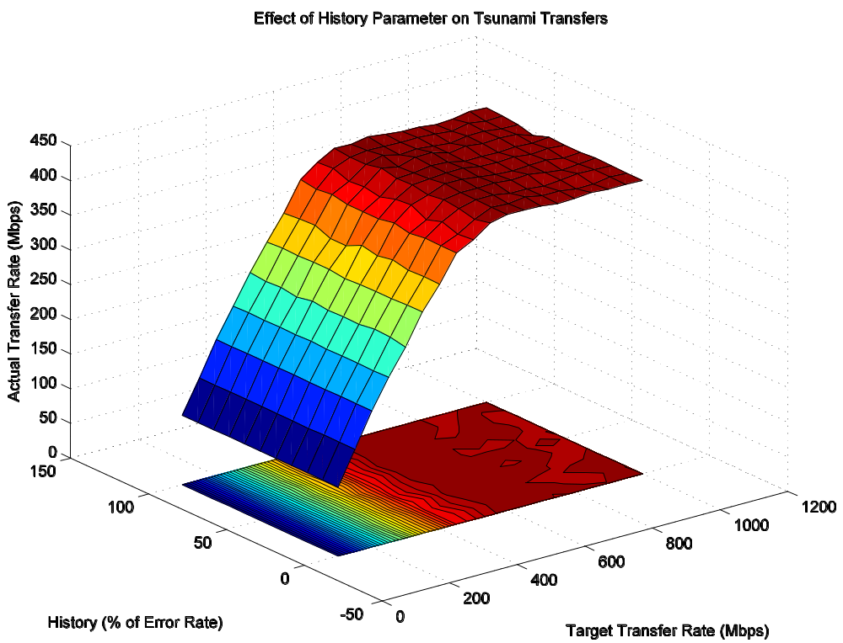
Tuning (3)

Slide 18
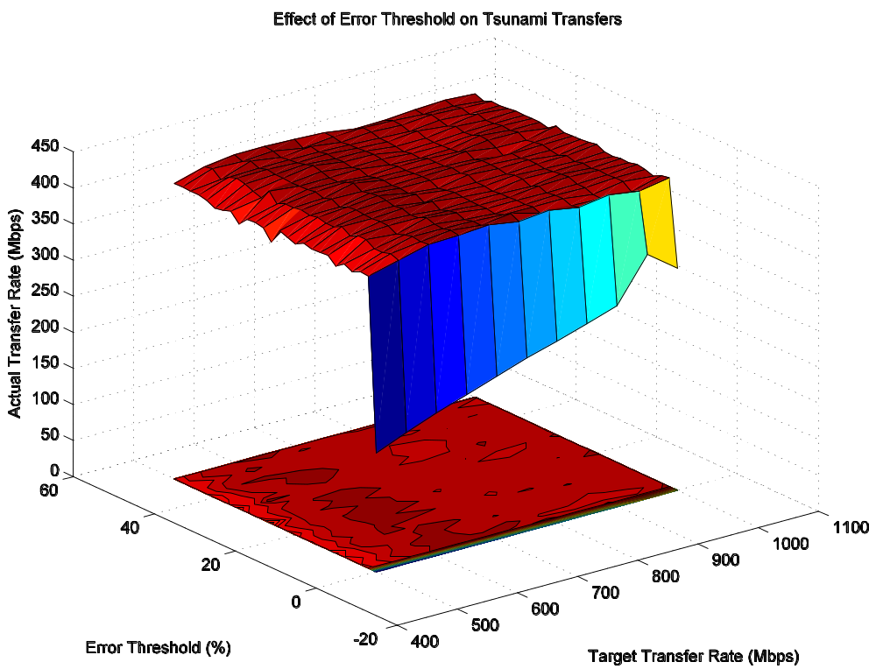
Tuning (4)

Slide 19
Future Work
Library version of the Tsunami protocol
Integration of Tsunami into GLOBUS Toolkit
Lots and lots of parameter tuning
Maybe…
  Graphical user interface?
  Linux kernel module implementation?

