Slide 1
Collective Certificate Management
Robin Berguerand

Slide 2

Introduction
Certificate Authority
Issues Example

Slide 3
Goal and Motivation
Desentralised Infrastrucure
Automatic and Free Certificate
Compatibility
Framework

Slide 4
Bulding Blocks
Let’s Encrypt
Cothority
SkipChain
Cisc

Slide 5

Let’s Encrypt
Free
ACME
Domain Validation

Slide 6
Cothority
Desentralised protocol
Conodes
Applications

Slide 7
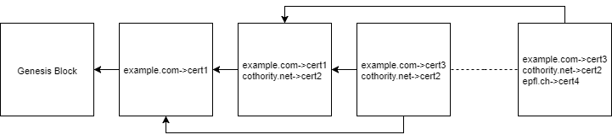
SkipChain And Cisc
Conode maintain
SkipBlock
Voting Process

Slide 8
The Project
Addition to Cisc
  Manage Certificate
  Voting

Slide 9
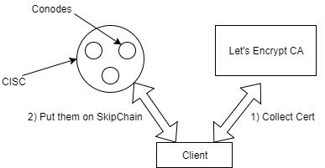
Request Certificate
Challenge from Let’s Encrypt
Verification
Proposal

Slide 10
Voting
Verification
Comparaison
Decision

Slide 11
Other Additions
Renew Certificate
Retrive Certificate
Revoque Certificate
List Certificate

Slide 12
Limitation in Implementation
Number of device
Voting problems
Signature Verification

Slide 13
Results
Right Verification
Difficult to Hack
..

Slide 14
Futur Works
Connection
Warning
Automaticity

