Slide 1
Know Thy Neighbour: Approximate Proof-of-Location
Sabrina Kall
EPF Lausanne, Switzerland
June 5, 2019

Slide 2
Abstract
Coffee shop scenario

Slide 3
Introduction
What we are going to do

Slide 4
Models and Methods
Part 1 : Exchanging latencies
Part 2 : Detecting malicious nodes

Slide 5
Part 1 : Exchanging latencies

Slide 6
Attacks to avoid
Outside node tampering with the latency
Malicious node misleading honest node about its latency

Slide 7
5-way messaging protocol

Slide 8
Present messaging system

Slide 9
Unhandled cases
Malicious node delays its messages to make itself seem further away
Malicious node m asks other malicious node c to create its latencies, making m look like it’s in a different place.

Slide 10
When this is not a problem
When the malicious nodes stay consistent.
  If Alice wants everyone to think she is 5ms further away than she is, and never changes her lie
When the malicious nodes move out
  If all the malicious nodes move themselves away to form their own cluster, away from the honest nodes

Slide 11
When this is a really big problem
When malicious nodes coordinate to attack a single honest node
When a malicious node n registers as being in 2 or more positions at the same time
  n will effectively count as 2 (or more) nodes, and will have twice the powers

Slide 12
Worst Case Scenario
N/3 malicious nodes pretend to be in multiple places at once
  > With enough clones, they can take over the network

Slide 13
Part 2 : Detecting malicious nodes
Blacklisting Algorithm :
  Basic idea : if a node’s latencies don’t make sense, ignore it
  Caveat : the algorithm must balcklist the same nodes no matter which node runs it

Slide 14
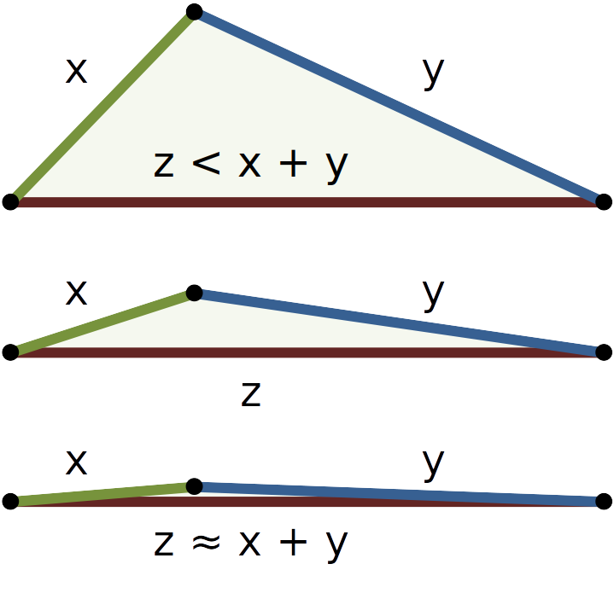
The Basics : Triangle Inequality

Slide 15
How to use it
We create triangles from all known triples of nodes connected by latencies
For each triangle, check if inequality holds
If not, one (or several) nodes in the triangle must be malicious. But which ?
  > Give each node a strike

Slide 16
Blacklisting
Once we have collected all the strikes :
  Remove the ones with more than θ strikes
    What is θ ?
    θ is at least the maximum number of strikes an honest node can get
    when N/3 liars target victim v :
    θ = number of liars * number of nodes, not including v
    θ = (N/3)* (N – 1)

Slide 17
Blacklisting with Triangle Inequality
Pros :
  We don’t blacklist honest nodes
Cons :
  We end up not blacklisting very many malicious nodes

Slide 18
Enhancement : Strike Patterns
The behavior of the malicious nodes dictates the distribution of the strikes
What if we could recognize liars from these patterns ?

Slide 19
Example
We want to find out if node n is honest
We compute the strikes for all the nodes using only triangles which n is part of

Slide 20
Case n honest
If the second node s in the triangle is honest, it will only receive strikes if the third node is a liar
This happens at most N/3 times, once for each liar
s receives at most N/3 strikes
There exist at least (2N/3) – 1 honest nodes

Slide 21
Case n honest
Ergo : n honest => we can find at least 2N/3 – 1 nodes with ≤ N/3 strikes
If we cannot find these nodes : n is malicious

Slide 22
Strike Pattern Analysis
Pros :
  Finds more malicious nodes than basic triangle inquality
Cons :
  More expensive per node than triangle inequality
  Still doesn’t catch all malicious nodes

Slide 23
Fooling Strike Patterns
A malicious node can escape detection by
  making its lies more realistic
  lying to fewer nodes
AKA : behaving better!

Slide 24
In Practice
Graphs

Slide 25
Variables
How many malicious nodes ?
How big the difference between real and crafted latencies ?
How are the victims distributed ?

