Slide 1
Virgo 3.5.0 Release Review
Planned Review Date: 6-13 June 2012
Communication Channel: Virgo forum
Glyn Normington (Project Lead)

Slide 2
Introduction
Virgo Version 3.5 is the second major functional enhancement release since the contribution.
Release contents
  Tomcat based web servers for enterprise Java applications
  Jetty based web server for enterprise Java applications
  Kernel – base for web servers and other server types
  Nano – small/fast kernel subset
  Snaps framework for modular OSGi web applications
  Eclipse-based tooling
  Documentation

Slide 3
Features
The objectives of this release are integration with p2 and IDE tooling improvements.
Major features:
  p2 initial provisioning
  p2 provisioning of kernel region at runtime
  New Nano offerings - the smallest one - Nano - serves as an enhanced OSGi container with various serviceability features and hot-deployment for your everyday bundles. The other flavor - Virgo Nano Full - is a more complete, yet very small web-server with embedded Tomcat, p2 provisioning and various serviceability features. Virgo Nano Full comes bundled with Gemini Web and is therefore capable of handling web applications (WARs and Web Application Bundles). Each Nano distribution runs in a single region.
  Launch Virgo using Equinox launcher and align folder structure with Eclipse
  Major IDE tooling rework and alignment with Libra tooling
  Use Gemini Blueprint instead of Spring DM 1.2.1
  Allow already installed artefacts to be referenced from plans which therefore form a DAG rather than a tree
  Align shell authentication with that of web admin console
  Various dependency upgrades and diagnostic improvements

Slide 4
Non-Code Aspects
User documentation:
  User Guide
  Programmer Guide
  Snaps User Guide
  Tooling Guide
  3.0.x to 3.5 migration notes
  A Guide to the GreenPages Sample
I18n enabled, English resource files only

Slide 5
APIs
The APIs in this release meet Eclipse Quality standards
Migration from Virgo 3.0 is straightforward and documented

Slide 6
Architectural Issues
None

Slide 7
Tool Usability
Major rework of Virgo tooling for its initial release
  Removal of Spring IDE dependency
  Alignment with Libra
  Many functional and usability improvements
  Many bug fixes

Slide 8
Incubation Content
Virgo 3.5 includes bundles from Equinox bundles project that are in incubation
  Region digraph (moved from Virgo)
  Console supportability (integrates Apache Felix Gogo)
Rationale for inclusion
  Region digraph is stable and mature
  New console no longer depends on OSGi Alliance standard being finalised
The download page will note the incubation content to avoid misleading anyone

Slide 9
End-of-Life
No issues

Slide 10
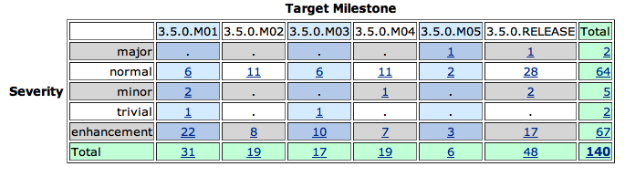
Bugzilla
Fixed

Slide 11
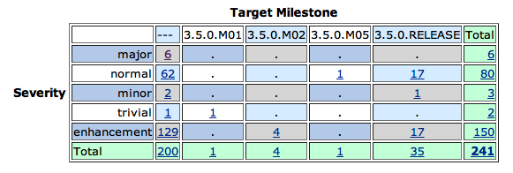
Bugzilla
Not fixed

Slide 12
Standards
Virgo requires Sun Java 6
Virgo supports OSGi v4.3
The Gemini Web container provides support for Web Bundles as defined by OSGi Enterprise Spec v4.2
Tomcat 7 and Jetty 8 provides underlying servlet 3.0 support
Kernel uses OSGi standard framework hooks
Virgo supports the OSGi Blueprint service, OSGi Declarative Services, and OSGi JMX Management

Slide 13
UI Usability
Admin Console
  no usability issues raised by users
Shell
  no usability issues raised by users

Slide 14
Schedule
Virgo 3.5 planned to participate in the Eclipse Juno release train

Slide 15
Communities
Bugzilla in active use by users and contributors
Virgo forum and virgo-dev similarly active
Weekly Virgo community call
Blogs
Twitter is used for propagating news updates
Committers have demo'd Virgo at EclipseCon and elsewhere
Presentations at EclipseCon and OSGi conferences
Interaction with Gemini, Equinox, Jetty, and p2 projects
Notes:
http://www.readtfb.net/tag/virgo/
http://maniagnosis.crsr.net/2010/06/requiescat-in-pace-springsource-dm.html
http://www.redmonk.com/cote/2010/01/13/virgo/

Slide 16
IP Log
The Eclipse IP policies and procedures have been followed
Submitted IP Log for freezing and approval on 29 May 2012:
  http://www.eclipse.org/projects/ip_log.php?projectid=rt.virgo

