Slide 1
Eclipse Virgo
Glyn Normington

Slide 2
Agenda
What is Virgo?
Using Virgo
How can I get involved?

Slide 3
What is Virgo?
“Dynamic Enterprise Application Platform”
Based on SpringSource dm Server 2.0
  Not to be confused with Spring DM
Objectives:
  Better OSGi platform
  Migration of Java EE apps
  Modular and extensible
Notes:
Associated Eclipse tooling:
Plugin Development Environment
Web Tools Platform

Slide 4
Problems Virgo Solves
Groups bundles into manageable units
  Scoping, atomicity
Enables existing open source libraries
  TCCL, LTW, implicit package use
Provisions from repositories
Extensive diagnostics
  resolution failure, deadlock, delayed services

Slide 5
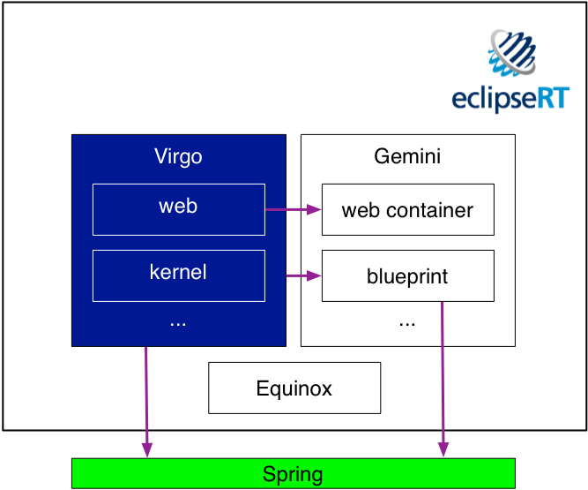
Virgo and EclipseRT
Notes:
Server runtime for EclipseRT
Kernel for application deployment and management

Slide 6
Using Virgo

Slide 7
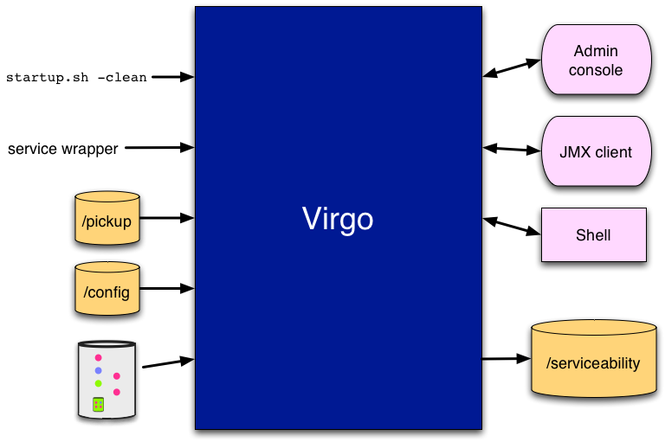
Virgo Externals
Notes:
Compare Equinox shell
/pickup deployed and started
Interesting events
Method entry/exit (via aspect)
Asserts
Unchecked exceptions (via aspect)
Deadlocks
Resolution failures - N.B. RFD
JMX dump request
Event log messages: Component, number, severity. I18N
Log messages: Global and per-application logging
Dumps: Resolver state, thread stacks, heap, in-memory log, ...

Slide 8
Application Types
Web apps
OSGi apps
New servers/containers

Slide 9
Getting Involved

Slide 10
Work Areas
Developer docs & wiki
Baseline release
Jetty adapter
Regions and nested frameworks
p2 integration
More server types
  Integration, batch, ECF, ...
Notes:
Tooling -> WTP, PDE

Slide 11
Roles
Casual user: kick the tires
  make comments
Expert user: build applications
  file bugs and feature requests
Contributor
  contribute tests, patches
Committer
  implement features, fix bugs, improvements
  support the community
  mentor contributors

Slide 12
Committer Skills
Clean architecture
Clean code
Unit and integration testing
Concurrency
(Deep) OSGi
git, ant, ivy, etc.

Slide 13

Further Information
Virgo Community Launch BoF
  Today 7.15pm in Tasman
http://www.eclipse.org/virgo
  Join us in the forum and dev list
#VirgoRT
http://www.springsource.org/dmserver
  Download dm Server 2.0 and try it out

