Slide 1
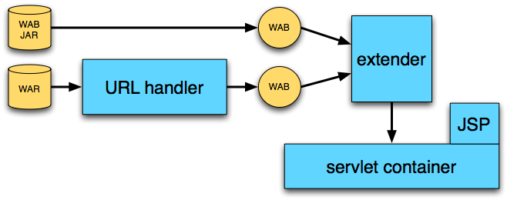
Gemini Web Container
Reference implementation for OSGi RFC 66
  Based on servlet 2.5, JSP 2.1
  Depends on Apache Tomcat, Jasper
Used by Eclipse Virgo & others
Developed by VMware (SpringSource)

Slide 2
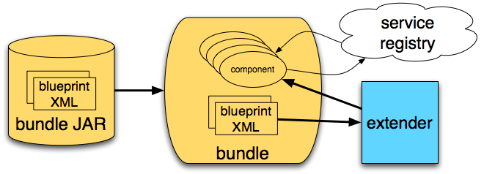
Gemini Blueprint Service
Reference implementation for OSGi RFC 124
  Based on Spring DM project
  Depends on Spring framework
Used by Eclipse Virgo & others
Developed by VMware (SpringSource) & Oracle/BEA

