Slide 1
Gemini Web
Graduation & 1.1.0 Release Review
Planned Review Date: 20 October 2010
Communication Channel: Gemini forum
Glyn Normington (Subproject Lead)

Slide 2
Introduction
Gemini Web is a mature project derived from SpringSource OSGi Web Container v1.0.0 which is the Reference Implementation of the OSGi Web Applications specification
Major use case: web container for Virgo web server
Release contents:
  Web container runtime
  Unit and integration tests
Gemini Web is an active project, ready for graduation
  Committers: 3 (SpringSource/VMware)
  Non-committer code contributors: 2

Slide 3
Features
The objective of this release is migration of community and applications from SpringSource OSGi Web Container 1.0.0.
Gemini Web specific features:
  Rebase on Tomcat 6.0.29
  Context configuration extension (bug 312752)
  Restructure Tomcat bundles to enable clustering to work (bug 322983)
  Resource extraction fix (bug 307393)
  Redirection fix (bug 308985)
  Test and build improvements

Slide 4
Features (continued)
Features inherited from SpringSource OSGi Web Container:
  OSGi Web Bundle support via extender
  WAR files can be installed by URL
    Properties can be overridden by URL parameters
  Based on Tomcat 6.0.x embedded servlet container
    Standard Tomcat container configuration

Slide 5
Non-Code Aspects
User documentation:
  OSGi Enterprise Specification
  Basic usage instructions on the Gemini Web wiki
  Further information in Virgo User Guide
I18n not relevant as there are no end user oriented messages
See Virgo samples/tutorial as Virgo is the main way Gemini Web is made available to users in addition to its use as a spec implementation

Slide 6
APIs
The project provides no APIs

Slide 7
Architectural Issues
None

Slide 8
Tool Usability
No tools provided

Slide 9
End-of-Life
Not applicable

Slide 10
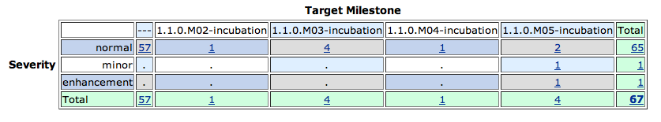
Bugzilla
Fixed
  50 of these are CQ tracking bugs

Slide 11
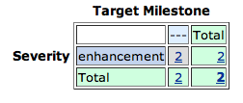
Bugzilla
Not fixed – both P3

Slide 12
Standards
Gemini Web Container requires Java 6 or later
Supports Web Bundles as defined by OSGi Enterprise Spec v4.2
Tomcat 6.0.x provides underlying servlet 2.5 support

Slide 13
UI Usability
There is no UI

Slide 14
Schedule
No schedule slippage
Regular milestones produced

Slide 15
Communities
Bugzilla in active use by users and contributors
Gemini forum and gemini-dev less active
Blogs
  SpringSource blog covers Gemini Web milestones
Twitter is used for propagating news updates
Interaction with Virgo project
  Gemini Web is regarded as a sister project of Virgo
Notes:
http://www.readtfb.net/tag/virgo/
http://maniagnosis.crsr.net/2010/06/requiescat-in-pace-springsource-dm.html
http://www.redmonk.com/cote/2010/01/13/virgo/

Slide 16
IP Log
Eclipse IP policies and procedures have been followed
IP Log
  http://www.eclipse.org/projects/ip_log.php?projectid=rt.gemini.web
  IP log finalised and sent to legal for review on 24 September 2010

Slide 17
Graduation
Gemini Web must exit incubation to release 1.1.0
The OSGi Web Container project came with a stable codebase, a diverse set of users, and an open development process
The codebase is stable and demonstrable
  See Virgo webinar
The community is small but active
The project is open and transparent
The team is adhering to the Eclipse development process and IP policy and relates well to other RT projects. The project lead is an active member of the RT PMC

Slide 18
Credits and Kudos
Non-commiter code contributors:
  Violeta Georgieva – SAP << multiple valuable contributions
  David Savage - Paremus

